Slide 1


Overview of MEGA: Mobile 3D Engine for Game API
Hoon-Young Cho
Senior researcher, ETRI

Slide 2
Content
Background - Mobile 3D Standard Forum
MEGA Overview
WIPI and MEGA
MEGA Code Example
Summary and Demo

Slide 3
Background
Market situation
  Demand for mobile 3D content is rapidly increasing
  Various platforms and development environments blocks interoperability of 3D content
  Need standardization on mobile 3D content and platforms
ETRI (Electronics and Telecommunications Research Institute)
  Non-profit government-funded research organization established in 1976
  Developed information technologies such as TDX-Exchange, High Density Semiconductor Microchips, Mini-Super Computer (TiCOM), and Digital Mobile Telecommunication System (CDMA)
M3DSF (Mobile 3D Standardization Forum)
  Established in Apr. 2004 by Digital Content Research Division of ETRI
  One of 33 IT standardization organizations supported by Korea government
  Goal: Standardize mobile 3D technology

Slide 4
M3DSF - Members
Members
About 50 companies including SK Telecom, KTF, LG Telecom,
Samsung electronics, LG electronics
Mobile network operators
  KTF, LG Telecom, SK Telecom
Phone Manufacturer
  Samsung, LG, SKTT, VK, ...
Content Provider
  Gavaplus, Buruxo, ThinMedia, ...
Platform Manufacturer
  Sinjisoft, AromaSoft, XCE, …
H/W Solution provider
  Cetecom, Chips&Soft Convergence, Innosign, NexusChips, …
S/W Solution Provider
  Gomid, Reigncom, Reakosys, Wow4M, FatHammer, Seasoft, Emersys, …
University & Research Institute
  KAIST, ETRI, SAIT, Hanyang Univ., Aju Univ., Hongik Univ., …

Slide 5
M3DSF - Organizational Structure
President
(Reigncom inc. CEO)
Office
ETRI
3D Engine WG
3D Sound WG
Application
Layer WG
Gomid inc.
Emersys inc.
Reakosys inc.
Mobile
Contents WG
Information and
Strategy WG
Wibro Application
WG
Wow4m inc.
Samsung
Reigncom inc.

Slide 6
M3DSF - Activities
MPEG standardization work (Oct. 2004 ~ Dec. 2005)
  3D compression profile
  Proposed file formats for 3D compression to MPEG4-3DGC (MPEG-SNHC)
  Adopted as MPEG standards
    Core 3D Compression profile
    MPEG-4 Graphics stream
    3D Compression profile descriptor
Current work
  Standardization of Mobile 3D Graphics API
    Higher level than OpenGL ES
  Standardization of Mobile 3D Sound API for 3D Game
    Higher level API than OpenSL ES
  Standardization of Mobile 3D Engine for Game API (MEGA 1.0)

Slide 7
MEGA - Overview
High Level 3D Game API
  Conceptually similar to
    Open Inventor, Open Scene Graph, Qualcomm Game SDK
    C++ version of JSR-184
Purpose
  Obtain platform independency
    API layer between game applications and pre-existing game engines
  3D game content can be
    Easily migrated between different target devices
    Easily integrated with existing game engine
  Major target devices
    Mobile phone, PDA, portable game console with 3D capacity
Current status
  MEGA 1.0 is at finalizing stage with minor changes undergoing
  Expected to be adopted as a M3DSF standard by June, 2006

Slide 8
MEGA - Scope
  Vertex / UV Animation / Multi-texture
  Bone-based Skinning Animation
  OpenGL ES based engine
  - Fog
  - Particle
  - Billboard
Rendering
Engine
Animation
Engine
MEGA
Networking based on
- Wireless LAN (802.11b)
- TCP/IP
- Winsock non-blocking
  3D Sound effects for game
  - Sound positioning
  - Sound field control
Network
Engine
Sound
Engine

Slide 9
MEGA - Architecture
MEGA 1.0
MEGA 1.1 (next)
3D Game APP
3D Game APP
Transform
API
Rendering
API
Animation
API
Rendering
API
Animation
API
Sound
API
Networking
API
Any 3D Game Engine
Any 3D Game Engine
OpenGL ES 1.0 or 1.1
OpenGL ES
OpenSL ES
OSAL
Graphic HW
Graphic HW

Slide 10
MEGA - 3D Data Compression
MPEG-3DGC
  MPEG 3D Graphics Compression (3DGC)
  Subgroup of the Moving Picture Experts Group (MPEG)
  http://www.mpeg-3dgc.org
  Standard technologies for coding of 3D geometry and animation data
3D Compression Profile
  Compression of 3D geometry and animation data using
    3DMC (3D mesh compression)
    Interpolation Compression
    WSS (wavelet subdivision surface)
    BBA (bone-based animation)
MEGA’s choice for 3D data compression !

Slide 11
WIPI and MEGA
WIPI
  Each of cellular operators in Korea had different proprietary application platforms
  Developed by KWISF (Korea Wireless Internet Standardization Forum) of which over 30 major players in Korean Mobile market are members
  Feb. ’02, first version (v1.0) of WIPI specification released
  Feb. ’04, WIPI 2.0 released
  Korea MIC (Ministry of Information and Communication) mandated WIPI for all handset shipments in Korea from Apr. 1st, 2005
  http://www.wipi.or.kr
Why MEGA wants to join in WIPI platform?
  WIPI is planning to add 3D graphics functionality
  Low level API
    OpenGL ES is a good candidate
  MEGA as a high level API
    Easy programming model
    Fast development of game applications

Slide 12
WIPI System Architecture + MEGA
Update or
add API
dynamically
WAM
(WIPI APP. &
API Manager)
WIPI Applications
Binary runtime
environment
3D Games
Music Box
Flash Player
Video Player
Games
. . .
LBS
IM
MEGA
Dynamic
Linking
Library
Clet APIs
MSP (Jlet)
MIDP (Midlet)
MSF / CLDC
WIPI Run-time Engine
API sets for
Application
Developers
Co-exist
with J2ME
HAL (Handset Adaptation Layer)
Maintain
independency
onto underlying
OS and hardware
Handset Hardware & Native System Software

Slide 13
WIPI Roadmap & MEGA
WIPI 2.0 Spec.
Base Platform
MIDP 2.0
DLL
Math
Media
VGI
SMS
Generic I/O
Phone Book
Terminal
Resource
WIPI Next
Base Platform &
App. Middleware
3D Graphic
DMB
Location
WIPI on Open OS
MMS
SIP
Web Service
Bluetooth
DRM
Voice Recognition
2004
2005
2006
Optional platform specification development
DMB
spec.
3D Graphic/
3D Game
spec.
Solution
spec.
MEGA is expected
to fill this part !!

Slide 14
MEGA - Game Client Structure
: data
: external editor
: by game programmer
: Mega Engine part
: IO
Game Client
Graphic Data
User Input
Game Logic
Touch pad/
Button
Game Situation/
Game Object
Exporter Plug-in
Animation
Engine
Rendering
Engine
Special Effects
Editor
Special Effects
Module
Video Output
UI Module
Sound Editor
Sound Data
Sound Engine
Sound Output
Game Network Events
Client Network Engine

Slide 15
MEGA - Game Flow
Initialize
    Engine init
    Loading of model data
      Geometry, animation
      Scene composition
Event loop
    User/network event
    Game logic
    State update (animation)
    Render
End

Slide 16
Example Code (1)
Geometric data loading
Load
Geometric data
g_sky = g_GameEngine.LoadGeo("sky1.GE5");
CDCMeshInstBase *sInst = g_sky->GetMeshInstance(0);
CDCMesh *dMesh = (CDCMesh *) (sInst->m_pMesh);
g_skyTrans.AssignMatrix(dMesh->m_mat);
g_skyTransInv.Inverse(g_skyTrans);
g_GameEngine.LoadGeo("sky2.GE5");
g_GameEngine.LoadGeo("sky3.GE5");
Access geometric
object instance
Access mesh data
Assign matrix
Inverse matrix
for object rotation

Slide 17
Example Code (2)
Animation loading
Load
Graphic data
CRcGameInst inst;
inst = g_GameEngine.LoadGeo("sophe.GE5");
inst->LoadAe5("sophe_low_Idle_1.AE5");
inst->LoadAe5("sophe_low_Idle_2.AE5");
inst->LoadAe5("sophe_low_Idle_3.AE5");
inst->LoadAe5("sophe_low_run_sword_1.AE5");
inst->LoadAe5("sophe_low_run_sword_2.AE5");
Load
Animation data

Slide 18
Example Code (3)
Animation state change
Retrieve
current animation
int current_anim_id = Inst->GetCurAnim();
Inst->ChangeAnim (current_anim_id + 1);
Inst->m_mat.SetTranslateFixed(x,y,z);
RcVectorf tr(0, -10, 0); // Delta value
Inst->m_mat.SetTranslateAdd(tr); // Move
Inst->m_mat.RotateYAndPostMul(20); // Rotation
Change to
another animation
Positioning

Slide 19
Example Code (4)
Rendering
//Animation update and sorting
g_GameEngine.UpdateAnimation();
// Render scene
g_GameEngine.Render();

Slide 20
MEGA - Roadmap
1.1 + Physics, Script and AI
1.0 + 3D Sound,
Networking APIs
Rendering,
Animation
MEGA 2.0
MEGA 1.1
MEGA 1.0
2006. 2Q
2006. 4Q
2007. 4Q

Slide 21

Summary
MEGA
  A platform-independent mobile 3D game engine
  Minimize APIs while maximizing the implementation of game applications
  Expected to be 3D game spec of WIPI next standard
  Will expand to include Networking and 3D sound functionalities
WIPI + MEGA is finding a way to contribute to
Questions on MEGA or anything in this material
  Send e-mail to: hycho@etri.re.kr or ryusw@etri.re.kr

Slide 22
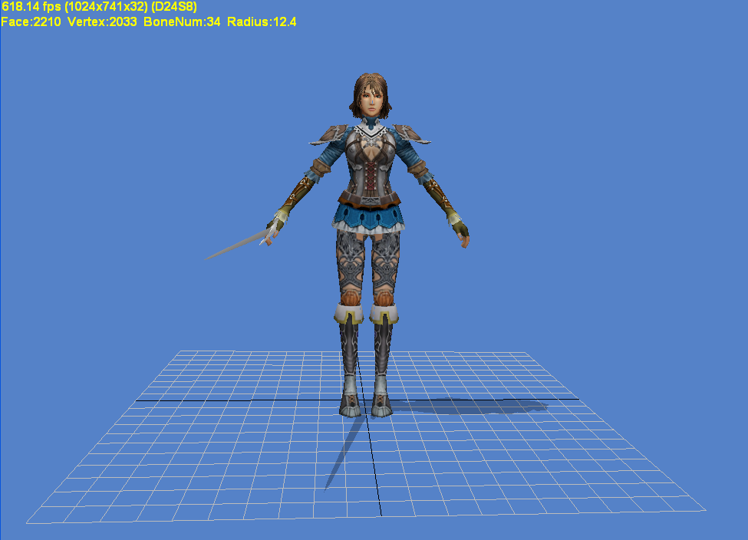
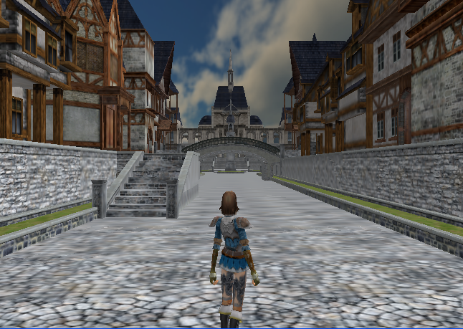
MEGA demo – PC emulation
Sample demo application built on MEGA 1.0

Slide 23
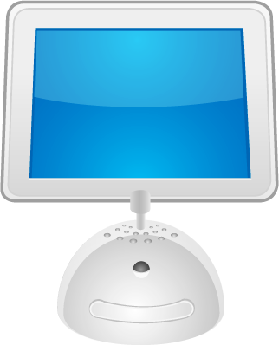
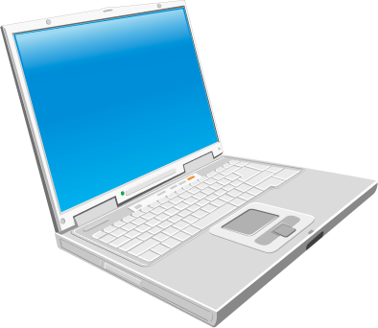
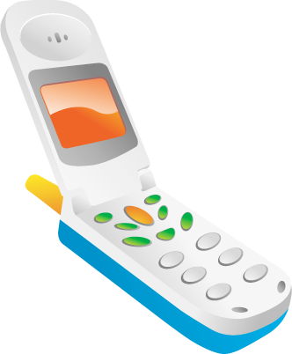

VENUS Demo
Combat Zone
  Runs on Cross-platform online environment
  VENUS (Virtual Environment Network User Simulation)
    Multiple players connect to a server to play with other virtual users
Cross-platform
online
environment
Virtual user
simulation
Combat Zone
implemented on
WIPI platform
Server
VENUS Studio
Phone
PDA
PC

Slide 24
Thank you !

