Slide 1

A Business Perspective
Steve Gleitsmann
President, Emdigo Inc.

Slide 2

Outline
COLLADA offers great functional benefits to content developers, tools providers and hardware companies alike
COLLADA also offers great financial benefits
This presentation will explore the value of COLLADA from a business and financial perspective

Slide 3


About Emdigo
Emdigo Overview
  Mobile software and technology company – established in 2004
  Offices in Silicon Valley, Tokyo and Beijing
  Total staff of ~20, most in engineering and production
Our Background
  Unique experience in building “industrial strength” middleware
  Intrinsic Alchemy middleware – valuable lessons learned
Our Business
  We develop 3D graphics based mobile lifestyle content (eye-candy for kids)
  We develop & license infrastructure technology to enable the rapid creation of this content
Emdigo is Khronos Contributor Member
  Using COLLADA and OpenGL ES as fundamental components to its business

Slide 4
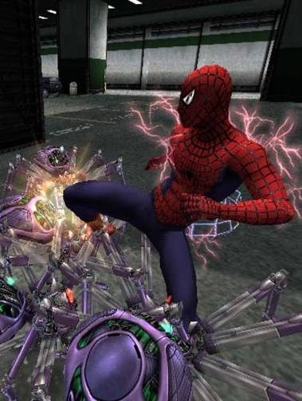

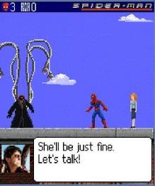
Mobile Content Revolution
First seen on supercomputers… … then on workstations … then on game consoles … and soon on your mobile phone!
As device capabilities grow, so does the complexity of content production
Graphics content is getting much more appealing, much more realistic and much more expensive to develop.
Consumer expectations are growing…
Mobile games prices are not…
Spider-Man 2
Activision
Spider-Man 2 3D: NY Subway
Sony Pictures
“Borrowed” from OpenKode Presentation:
More complex scenes
High-res rigs & textures
Demanding animations
You name it…
Spider-Man 2: The Hero Returns
Sony Pictures
2D
3D Software
3D with HW Acceleration

Slide 5
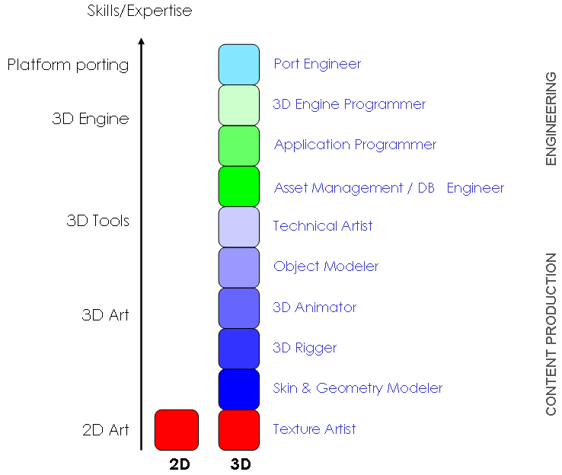
Mobile Content Revolution
Overview: Basic skills for the creation of advanced 3D content
  Skills to build “simple” 3D personalization content same as for “complex” 3D games
  Typical mobile content may not quite be there today, but let me predict…

Slide 6
Emdigo and COLLADA
COLLADA gives us scalable graphics content from many sources
  Don’t like to re-invent the wheel all over again, no more exporter implementations please…
  Supports the leading tools that are relevant to our business/industry
COLLADA can expand to include our vocabulary
  Ensures inclusion of features relevant to our business
    Provided by other industry participants
    Provided by Emdigo
COLLADA lets us focus on building our sustainable advantage
  Consumers pay for content, not for our effort to create it
  COLLADA provides a solid foundation for scalable content acquisition
COLLADA has become a fundamental
component of our content strategy

Slide 7
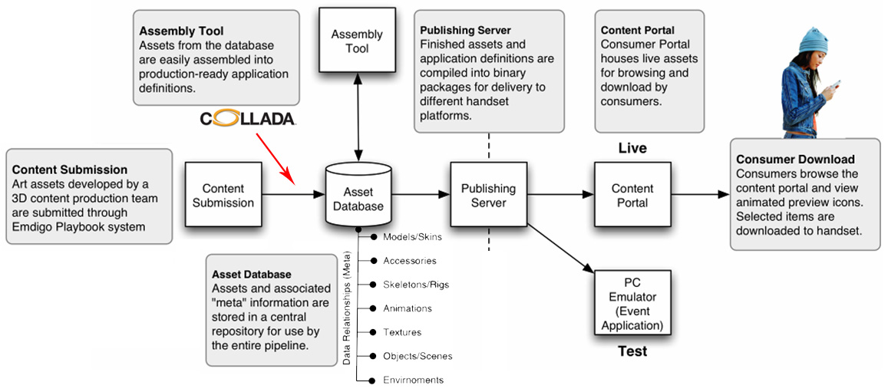
How we are using COLLADA
COLLADA allows integration of more tools better/easier/faster
  Tools providers are directly enabled to implement features on the DCC level
  We can focus on the essentials: creating better products for consumers faster

Slide 8
COLLADA makes a difference
A Life without COLLADA…
  Been there, done that… at Intrinsic Graphics
  Created Intrinsic Alchemy – leading middleware for console games & handheld
Developed and maintained exporters for all leading DCC tools
  One full-time engineer for each primary DCC tool exporter path
  One full time engineer for the secondary DCC tool exporter integrations
  One full-time engineer for 3rd party tool integration infrastructure
Integrated with many of the other leading middleware vendors
    Approx 1/3 engineering for integration/maintenance of each partner technology
Spent many men-months in tools-related business development
  Forged relationships with all leading DCC tool vendors
  Integrated technology with many of the leading middleware companies
  Developed relationships with all relevant hardware platform providers
Nine women can’t make a baby in one month…
  Spent a total of 2 years of development to get to a stabile DCC tool export path…
  …followed by our continuing effort to stay on top of industry changes.

Slide 9

COLLADA makes a difference
Back of the envelope calculation:
Intrinsic Graphics spent more than $2 million in non essential development costs on its DCC export path over 4 years…
  Equals to 349,384 bottles of beer in a Tokyo bar…
This does not include expenses for travel, entertainment , equipment or any administrative overhead…
This does not include the effort/expense of our partners
Position | ~Salary* (p.a.) | 1st Year | 2nd Year | 3rd Year | 4th Year
Engineering Manager | $125,000 | 0.2 | 0.17 | 0.15 | 0.12
Senior Engineer | $125,000 | 2 | 1.5 | 1 | 0.8
Staff Engineer | $95,000 | 1 | 1.5 | 1.5 | 1.5
Junior Engineer | $75,000 | 1 | 1 | 1 | 1
Biz Dev Mgr. (tech/non-tech) | $125,000 | 0.5 | 0.5 | 0.4 | 0.3
Net Salary Expenses |  | $507,500 | $488,750 | $411,250 | $370,000
Benefits, Insurance & Taxes | ~20% | $101,500.0 | $97,750.0 | $82,250.0 | $74,000.0
Total Staff Expenses |  | $609,000.0 | $586,500.0 | $493,500.0 | $444,000.0
* Based on common Silicon Valley rates |  |  |  |  | $2,133,000

Slide 10

COLLADA – Benefits
Tangible benefits
  Improved cash-flow (unless of course you are rich and $2 mio don’t matter)
  Future Value of savings over a period of 4 years:
    If invested at typical fixed interest savings rate: ~2.34 million*
    If invested in stock market (at average return):~2.72 million*
Intangible benefits:
  Less re-training staff artists / engineers results in increased productivity
  Better content faster due to earlier content path maturity
  Access to greater talent pool with directly applicable experience
  Easier to collaborate with other tools & technology vendors
  Easier asset exchange between platforms (i.e. console to mobile)
  …
  …
  …
*based on $45 average monthly deposits, tax not considered

Slide 11

Conclusion
Emdigo is using COLLADA because:
COLLADA makes great technical sense
COLLADA makes great business sense
COLLADA is the right thing for our industry

Slide 12

Thanks for not leaving early…
Any Questions?
Visit us at www.emdigo.com for more information
or email me directly at sg1@emdigo.com

