Slide 1

COLLADA 1.4 advanced features and Maya
Christian Laforte
President, Feeling Software

Slide 2
Feeling Software
Feeling Software delivers affordable 3D graphics software
consulting and contract development.
We specialize in 3D DCC tools and COLLADA:
  ColladaMaya: COLLADA translator for Maya
  ColladaMax: COLLADA translator for 3DSMax
  Nima: PhysX and COLLADA Physics for Maya
  Feeling Viewer: COLLADA 1.4 reference viewer
  Integration of COLLADA in commercial game engines and pipelines,
  e.g. Unreal Engine 3.
  FCollada: Feeling’s COLLADA scene graph and import/export library
Our tools are used by dozens of game and film studios and
by thousands of artists and developers.
Recent clients include: Autodesk/Alias, AGEIA, Electronic Arts, Epic Games, Scaleform, Sony Computer Entertainment

Slide 3
Outline
COLLADA 1.4 introduced two major new features.
COLLADA Physics = Rigid dynamics
COLLADA FX = Advanced shading effects
This presentation will show how each feature is integrated in Maya and how it can be exported in a game engine

Slide 4
Outline
COLLADA 1.4 introduced two major new features.
COLLADA Physics = Rigid dynamics
COLLADA FX = Advanced shading effects
This presentation will show how each feature is integrated in Maya and how it can be exported in a game engine

Slide 5
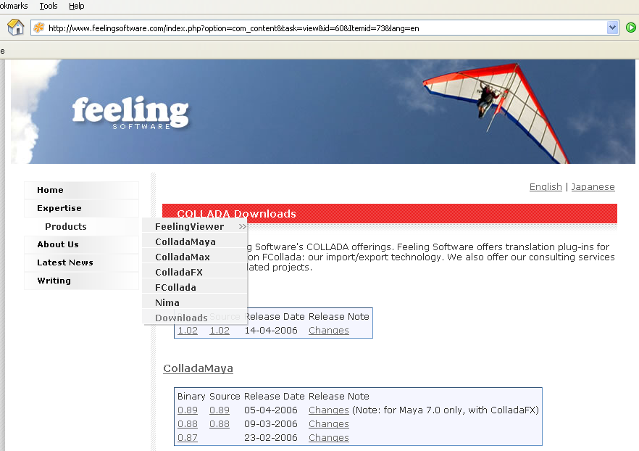
Free downloads
ColladaMaya and Nima support Maya 6.5 and 7.0
Plug-ins and source code: http://www.feelingsoftware.com/

Slide 6
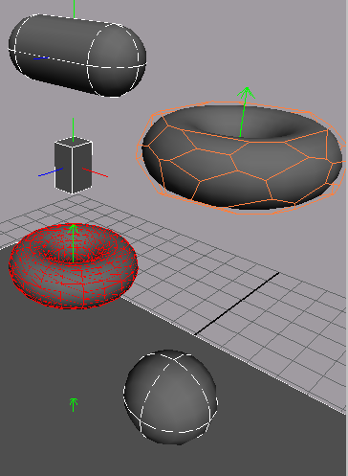
Rigid bodies
Group of shapes that can collide realistically with other rigid bodies
Rigid = doesn’t deform
Can be dynamic (animated by physics simulation) or kinematic (animated by artist)
Shapes can be analytical (e.g. capsule, sphere, box) or meshes (convex or not)
Demonstrate

Slide 7
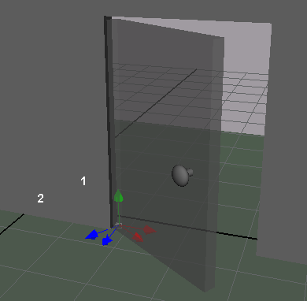
Rigid constraints
Specify how two rigid bodies can move relative to each other
6 degrees of freedom:
translation and rotation, each along X, Y, Z
For example, a rigid constraint can attach a door to a wall, by only allowing rotation along Y axis

Slide 8
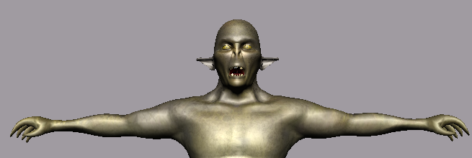
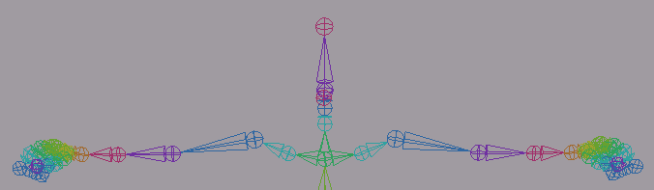
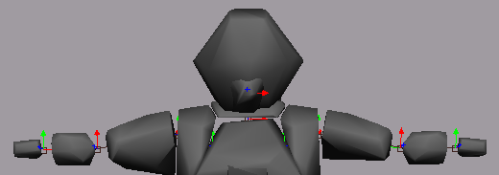
Ragdolls
Animate skinned characters in a physically realistic way
Nima has scripts to help authoring ragdolls
COLLADA Physics can represent ragdolls through a group of rigid bodies and constraints
Demonstrate

Slide 9
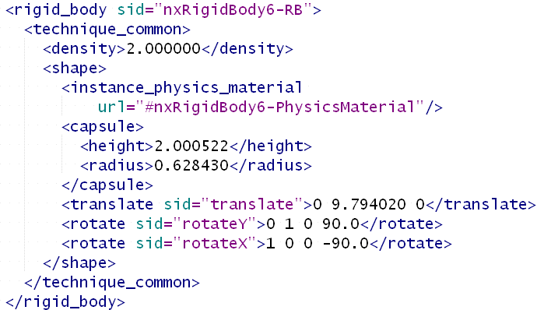
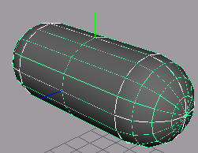
Export using ColladaMaya
Notes:
A rigid body can be dynamic, meaning that it is entirely simulated by the physics engine. Or it can be static, i.e. it affects the simulation but is not affected by it. The position and orientation of a static rigid body can be animated. The <dynamic> flag itself can be animated, e.g. to have a keyframed character transform into a ragdoll.

Slide 10
Feeling Viewer
Commercial COLLADA playback engine
Free executable for Windows to promote adoption of COLLADA.
COLLADA 1.4 beta version will be available on Feeling web site soon
Supports:
  Collada 1.4 (in progress) and 1.3
  Windows, PS3, Mac, Linux.
  Physics using Ageia PhysX
Physics demonstration

Slide 11
COLLADA FX
Enables advanced shading effects in COLLADA
Why COLLADA FX?
  Data-driven: Easy to author and modify
  Allow artists to use non-standard styles
  Open format, with contributions from HW vendors, DCCs, application and game developers
  Designed for cross-platform, cross-API
Notes:
I’ll go briefly over this, since Rémi touched this subject already.
NOT proprietary
Contributions from DCC vendors: Autodesk, Softimage, and Feeling Software, which contributes COLLADA open-source translators for Maya and Max. No longer need to write complicated exporters to access all the information stored in the DCC.
Somewhat complex specification -> although there is more and more documentation coming up, and there are free, open-source ways to simplify the import through the COLLADA DOM and Feeling Software’s FCollada.

Slide 12
COLLADA FX profiles
Supported:
  Common
  Cg
  OpenGL Shading Language
  OpenGL ES 1.x
In progress:
  OpenGL ES 2.0
  Microsoft .FX and HLSL

Slide 13
COMMON Profile
Shading models supported: Lambert, Phong, Blinn
Supported by Maya, 3DSMax, Softimage XSI, etc.
Encapsulates values and declarations for
platform-independent fixed-function shader
Often a good target for very limited platforms
(e.g. older mobile phones)
Notes:
1. The <profile_COMMON> elements encapsulate all the values and declarations for a platform independent
fixed-function shader, and is required to be supported by all platforms. <profile_COMMON>effects are
designed to be used as the reliable fall-back when no other profile is recognized by the current effects
runtime.
2. For a DCC to be considered compliant, it must have some support for the common profile.

Slide 14
Cg profile
Best profile for Playstation 3, useful for PC and other targets
Supported by Maya, XSI and partially by 3DSMax.
Notes:
1. The <profile_COMMON> elements encapsulate all the values and declarations for a platform independent
fixed-function shader, and is required to be supported by all platforms. <profile_COMMON>effects are
designed to be used as the reliable fall-back when no other profile is recognized by the current effects
runtime.
2. For a DCC to be considered compliant, it must have some support for the common profile.

Slide 15
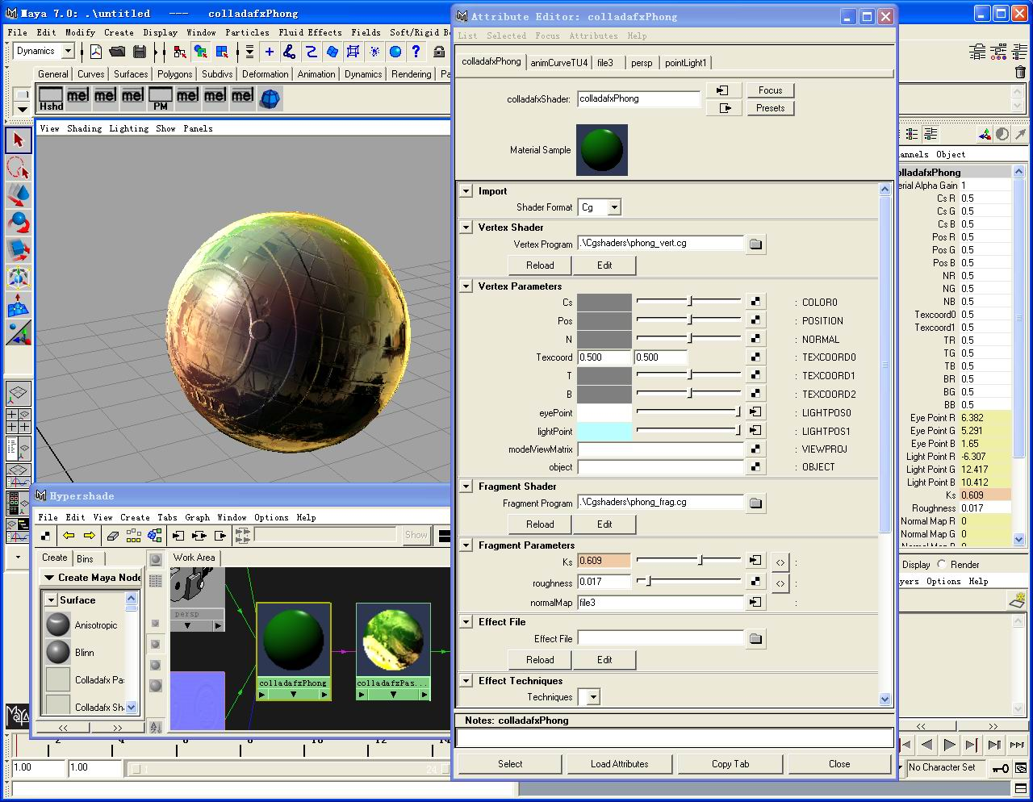
COLLADA FX support in ColladaMaya
Support interactive editing of parameters and in-viewport visualization
Demonstrate
Notes:
1. The <profile_COMMON> elements encapsulate all the values and declarations for a platform independent
fixed-function shader, and is required to be supported by all platforms. <profile_COMMON>effects are
designed to be used as the reliable fall-back when no other profile is recognized by the current effects
runtime.
2. For a DCC to be considered compliant, it must have some support for the common profile.

Slide 16
Conclusion
COLLADA Physics and FX can add a lot of richness
to your 3D titles
If you’re doing any serious 3D graphics development,
you need to know about COLLADA
Feeling Software offers free tools with source code to take advantage of these amazing technologies.
Notes:
1. The <profile_COMMON> elements encapsulate all the values and declarations for a platform independent
fixed-function shader, and is required to be supported by all platforms. <profile_COMMON>effects are
designed to be used as the reliable fall-back when no other profile is recognized by the current effects
runtime.
2. For a DCC to be considered compliant, it must have some support for the common profile.

Slide 17
Thanks
For COLLADA Physics:
  AGEIA for sponsoring Nima
  Stan Melax (Ageia)
  Gabor Nagy (SCEA)
For COLLADA FX:
  Daniel Horowitz, NVIDIA (present chair)
  Robin Green, SCEA (chair for 1.4)
Feeling Software COLLADA team:
  Guillaume Laforte
  Zhang Jian
  Antoine Azar
  Alfred Leung
  Misako Matsumoto
  John Raho
Notes:
No longer need to write complicated exporters to access all the information stored in the DCC.

Slide 18
Questions?
claforte@feelingsoftware.com
http://www.feelingsoftware.com
  Free tools include ColladaMaya, Nima, Feeling Viewer, ColladaFX plug-in for Maya, including Japanese documentation.
http://www.ageia.com (PhysX SDK)

