Slide 1
Streaming Media Portability
April 2006

Slide 2
Media Portability Problem
Media infrastructure portability is a multi-level industry problem
  Media infrastructure is time-consuming and expensive to develop, integrate and program
Media applications are not portable as proprietary hardware-centric libraries are needed to access media acceleration
Media Applications
Use media networks to deliver a compelling user experience
Application programmers need a cross-platform portable API for controlling high-level media operations
Difficult to flexibly integrate diverse, multi-vendor media components into complete media processing solutions
Media Graphs
Media components connected to process media in real-time
System integrators need cross-vendor standard for media component integration with sophisticated data routing and robust synchronization
Software components are not portable across processors - exacerbated by proliferation of media standards and increasing silicon complexity
Media Components
Inputs, video codecs, image and sound libraries, outputs etc.
Software component & silicon vendors need to a reliable way to accelerate diverse codecs on diverse silicon
Media Infrastructure Stack
Hardware and software to deliver rich
media processing solutions

Slide 3
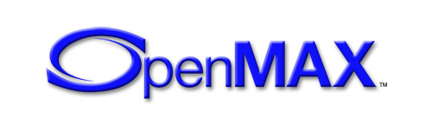
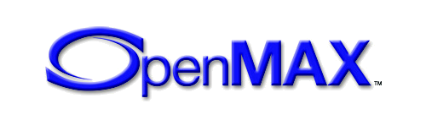
OpenMAX - Three Layer Solution
AL
More media applications available on more platforms
for more end-user value!
”Application Layer”
Media Application Portability
Applications programmed using cross-vendor interfaces
Portable and powerful media processing graphs can flexibly leverage available platform media components
IL
Media Infrastructure Portability
Open, royalty-free standard
“Integration Layer”
Media Graph Portability
Integrate media networks using standard interconnect protocols
Component vendors can ship more advanced functionality across more processors. Media silicon vendors reduce costs and time to market
DL
“Development Layer”
Media Component Portability
Develop portable media components using low-level media APIs
OpenMAX defines three holistically designed media open standards to provide complete media infrastructure portability

Slide 4
OpenMAX-based Media Stack
Application
Media applications can be written portably, independent of the underlying media platform
AL
“Application Layer”
Defines high-level playback and recording interface API
Platform Media Framework
Media components can be integrated into flexible media graphs for advanced streaming media processing
“Integration Layer”
Defines media component interfaces
IL
Audio Components e.g. MP3
Video Components e.g. H.264
Image Components e.g. JPEG
Media components can be written using primitives for portability across diverse parallel and serial silicon architectures
“Development Layer”
Defines media primitives and concurrency constructs
DL
Media Engines - CPUs, DSP, Hardware Accelerators etc.
OpenMAX layers can be implemented together or independently from the other layers

Slide 5

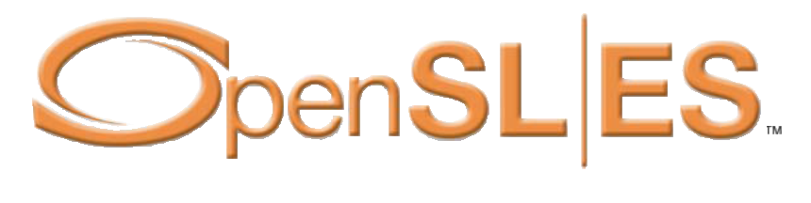
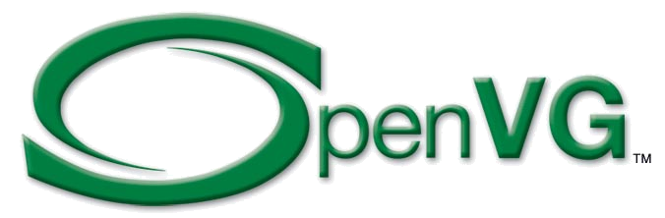
Complete Khronos Media Stack
The Khronos API family provides a complete ROYALTY-FREE, cross-platform media acceleration platform
Applications or middleware libraries (JSR 184 engines, Flash players, media players etc.)
AL
Playback and recording interfaces
Platform Media
Frameworks
3D
Small footprint 3D for embedded systems
Vector 2D
Low-level vector
acceleration API
SOUND
Low-level gaming audio
acceleration API
IL
Component interfaces for codec integration
EGL
Image Libraries, Video Codecs,
Sound Libraries
Abstracted Access to OS Resources
Fast mixed mode 2D/3D rendering
DL
Accelerated media
primitives for codec
development
Media Engines – CPUs, DSP, Hardware Accelerators etc.
Khronos defines low-level, FOUNDATION-level APIs.
“Close to the hardware” abstraction provides portability AND flexibility

Slide 6
OpenMAX Working Group Structure
Steering Group sets overall direction and coordinates multiple domain-focused Technical Sub-Groups
OpenMAX
Steering Group
Shiv Ramamurthi
TI
AL
Jim van Welzen
NVIDIA
IL
Leo Estevez
TI
Video DL
Doina Petrescu
Motorola
Still Image DL
Hedley Francis
ARM
Speech/Audio DL
Omry Paiss
Intel
Component network integration with Symbian MDF, GStreamer, DirectShow, MMAPI media frameworks
JPEG encode and decode, Color space conversion, packing/unpacking, De-blocking / de-ringing, Camera processing, Simple rotation and scaling
High-level Recording and playback API for application developers
MPEG-4 / H.263
(encode & decode)
H.264 (encode & decode)
MP3 and AAC, AMR-WB and AMR-NB for Mobile Phones, Portable Media Players and MP3 Players
Technical Sub-Groups (TSG) and Chairs as of February 2006

Slide 7
OpenMAX Summary
Three layer standard for media infrastructure portability
  Media component Development, Integration and Application programmability
Created with strong industry consensus and participation
  ARM, ATI, Beatnik, Broadcom, Emuzed, Fraunhofer, Freescale, Infineon, Intel, Motorola,
  Nokia, NVIDIA, Philips, SKY MobileMedia, Samsung, Sasken, Siemens,
  STMicroelectronics, Symbian, Texas Instruments
Specification is open and royalty-free using Khronos IP framework
  Delivered with sample implementations and conformance tests
Available on wide variety of architectures and operating systems
  To enable true streaming media portability
OpenMAX IL 1.1 specification public release
OpenMAX IL 1.0 Specification and Conformance Process Released
OpenMAX IL 1.0 Sample Implementation Released
4Q05
1Q06
2Q06
3Q06
4Q06
OpenMAX DL 1.0 Specification Released
OpenMAX AL 1.0 Specification
Target Release Date
Notes:
OpenMAX Working Group established within Khronos
Public announcement to invite industry participation

Slide 8
Integration Layer

Slide 9
OpenMAX IL - Integration Level
Defines component interfaces to construct portable media graphs
  OpenMAX IL graphs are consistent across systems
Abstracts hardware architecture
  Processor specific code is encapsulated within components
  Intelligently built components maximize system utilization
Reusable integration with major media frameworks
  Provides a uniform interface for framework integration across many architectures
  Designed to sit below major frameworks - e.g. Symbian MDF, GStreamer, DirectShow, MMAPI
  Defines a low level initialization and communication protocol
Extensible
  API extensions can be used to expose non standard features with only minor tweaks
Media graph use cases can be reused
  Use cases can be debugged in parallel on different projects and then shared
Enables Performance Comparisons and Optimization
  Common API allows benchmarking of different architectures, implementations and frameworks
  Performance differences can be used by vendors to find areas for further optimization

Slide 10
OpenMAX IL Example Graph
Standardized component interfaces enable flexible media graphs
Includes multi-stream synchronization
OpenMAX IL Component Interfaces
Enables components to be flexibly connected in any graph topology
*.mp4 / *.3gp
File Reader
AAC Audio
Audio
Decoder
Audio
Renderer
Speakers
Clock
for AV Sync
File
Time
Data
Video
Decoder
Video
Scheduler
Video
Renderer
Display
MPEG4/
H.264 Video
Decompressed
Video
Example: MPEG-4 video synchronized with AAC audio decode

Slide 11
OpenMAX IL Deliverables
OpenMAX IL 1.0 specification
  Publicly released
Conformance Tests
  Component based with two profiles
    Base Profile - to test the component’s basic operation
    Interop Profile - to test the component’s interoperable behavior with a test component
  Conformance tests will be validated on independently developed sample implementations
Whitepapers available now!
  Examples of how to implement Microsoft DirectShow, Symbian MMF, and GStreamer
Linux sample implementation (coded by TI)
  Video - H.263
  Audio - Narrow Band AMR
  Image - Baseline JPEG
Bellagio OSS implementation (coded by ST)
  ALSA and MP3 components (based on ffmepeg)
  Available on Sourceforge

Slide 12
OpenMAX Architecture & Features
Objectives & Profiles
System Architecture
Component Architecture
Component Registration
Component States
In-Context/Out-Context Behavior
Buffer Allocation & Sharing
Port Reconnection
Buffer Queue Flush
Buffer Marking
Buffer Payload
Buffer Flags
Synchronization
Rate Control
Resource Management
Future Features

Slide 13
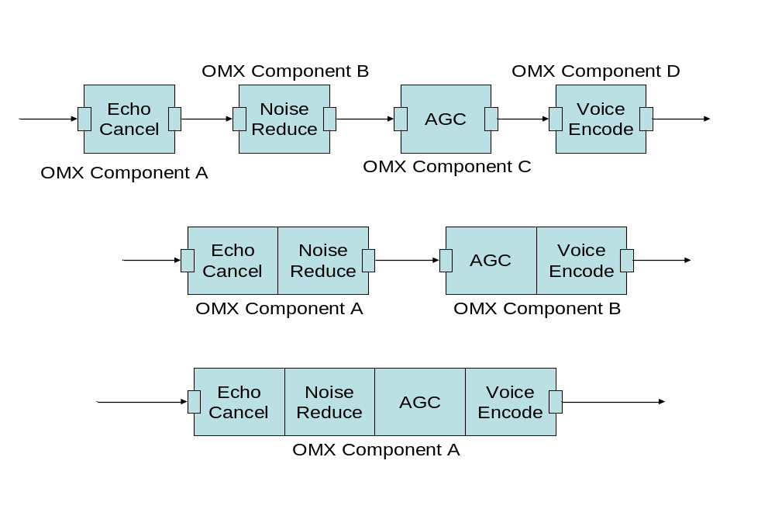
Objectives & Profiles
Media Engine Plugability – Base Profile
Media Engine Interoperability – Interop Profile

Slide 14
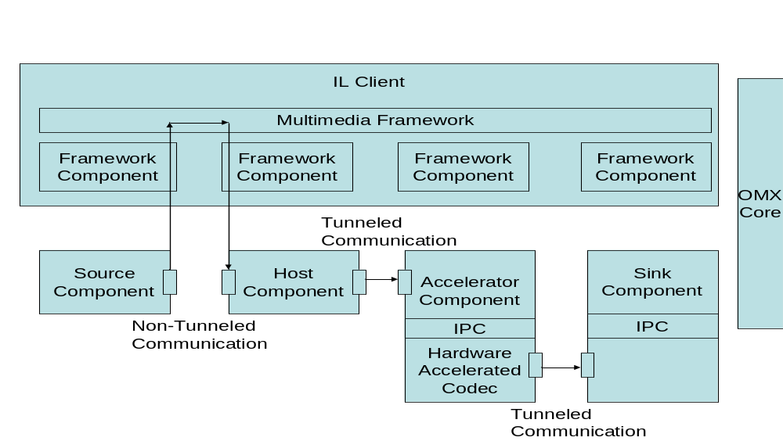
System Architecture
OMX components behave deterministically
  Whether they are loosely or tightly accelerated
Interop profile components are guaranteed to interoperate
  Via a specified interop protocol

Slide 15
Component Architecture
Component Registration is specified for low level operating systems
  May not have a defined mechanism for discovery
  Statically linked components use OpenMAX mechanisms
  Dynamically linked components may be registered and loaded with system mechanisms
Standard configuration structures are assigned to individual ports
  Ensuring component interoperability and may be expanded with proprietary configurations
IL Client
Component
Or other
Handle
Parameter/
Configuration
component
Configuration
Structures
SET/GET
Port
Commands
Callbacks
Port A
Port
And Calls
Input
Command
Callbacks
Queue
Port B
And Calls
Port A Buffer
Output
Header
Port B Buffer
Pointer
Header
Queue
Pointer
IL Client
Component Event
Buffer Sent
Queue
Event
Handler
Handler

Slide 16
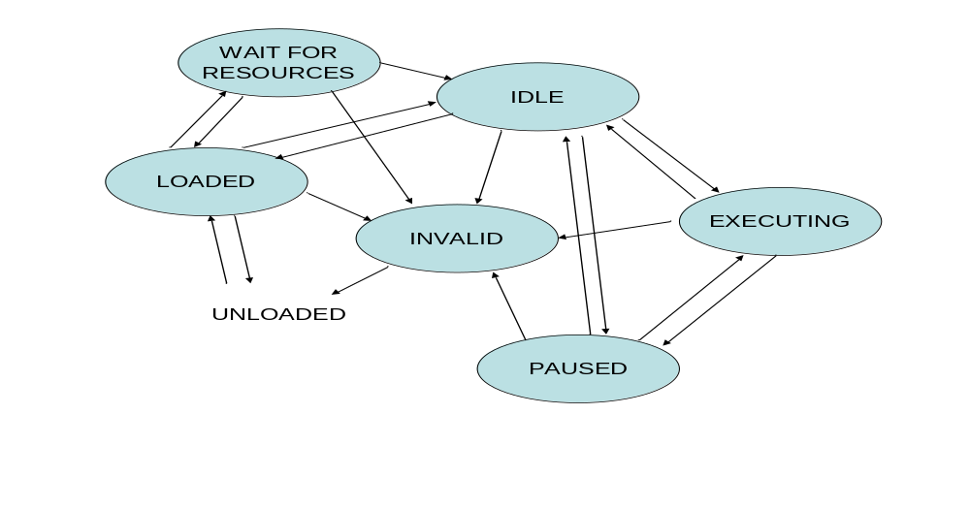
Component States
Resource allocation takes place between Loaded and Idle
  With possible resource management pending in Wait For Resources
The invalid state is entered only upon internal detection of a problem

Slide 17
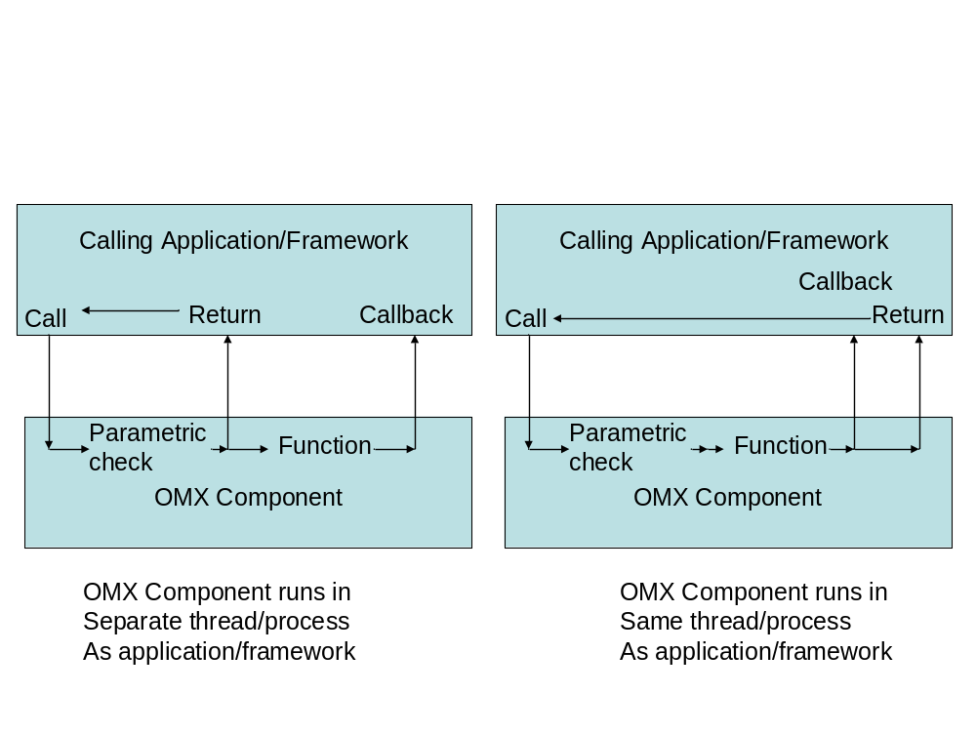
In/Out-Context Behavior

Slide 18
Buffer Allocation & Sharing
A component must enable the IL client or the component to allocate buffers
Buffer sharing between components is enabled but not required
Input to supplier output(s)
Output to supplier input
No sharing to multiple inputs
No sharing to non-suppliers
Possible sharing relationships

Slide 19
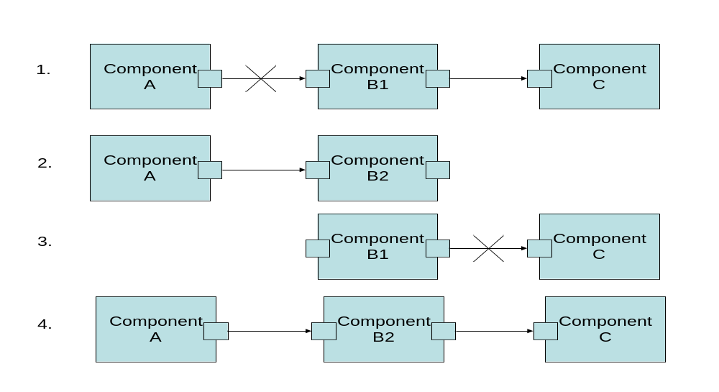
Port Reconnection
The state of a component may be maintained as executing while the state of one of its ports is disabled and reconnected
  Enables components such as mixers to dynamically vary their memory footprints

Slide 20
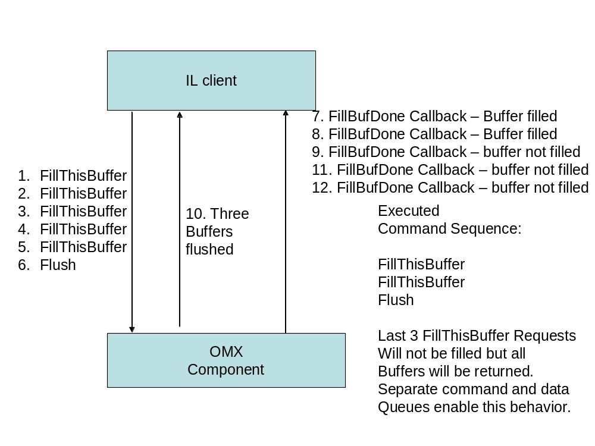
Buffer Queue Flush
The buffer queue of a component may be flushed with anticipated behavior

Slide 21
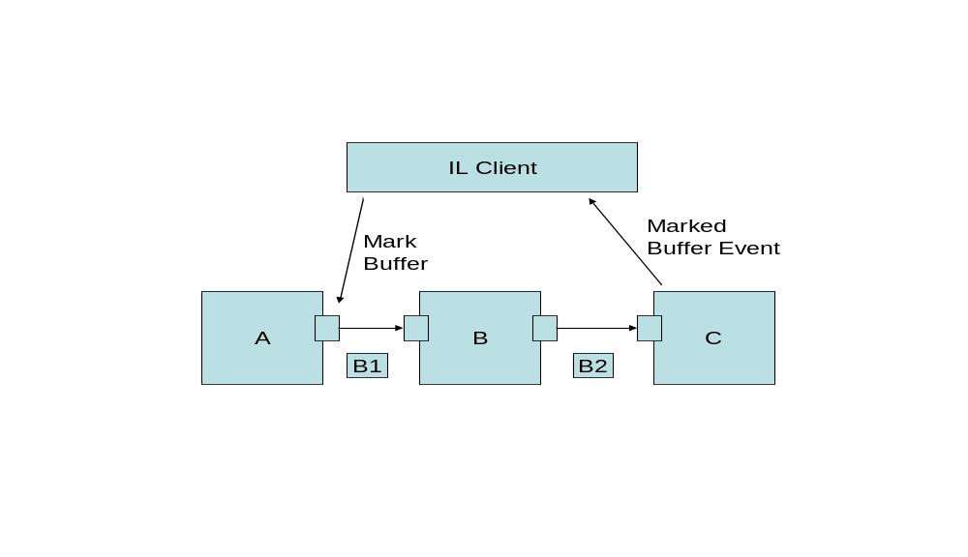
Buffer Marking
Buffers can be marked to generate events
  As they propagate through a chain

Slide 22
Buffer Payload
Components must handle variations in buffer payload with repack logic
  Each buffer may contain partial, complete, or multiple frames
Standard buffer flags such as EOS and EOF are defined
  To enable event generation as data propagates through a chain of components
Components may generate events and clear these flags upon detection
  Additional flags may be defined
buffer n
buffer 4
buffer 3
buffer 2
buffer 1
fn
f5
f4
f3
f2
f1

Slide 23
Synchronization
Synchronization is defined for interop profile components
  Via a clock component and time ports
Audio
Decoder
time
Clock
Component
File
Reader/
Demux
data
data
Audio
Renderer
time
Video
Decoder
Video
Renderer
time
data
data

Slide 24
Rate Control
The clock component implements all rate control
  By exposing a set of configs for controlling its media clock
IL client may change the scale factor of the media clock
  Effectively changing the rate and direction that the media clock advances
  To implement play, fast forward, rewind, pause, and slow motion trick modes
This is specific to interop profile

Slide 25
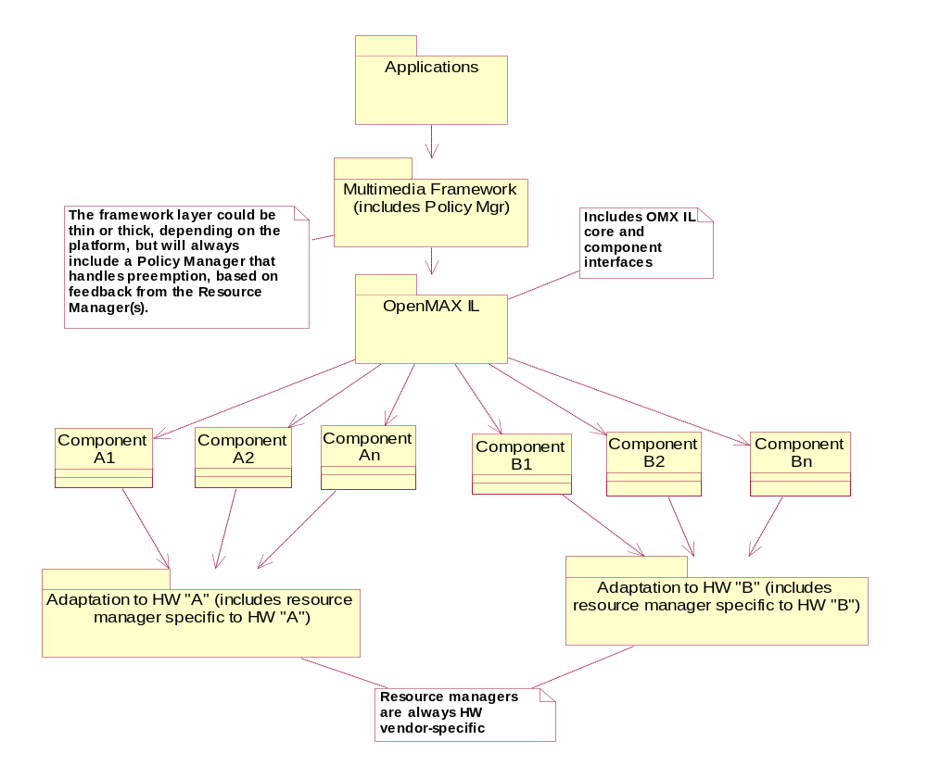
Resource Management
Resource Management is defined from a behavioral perspective
  With standard metrics to come in 2.0

Slide 26
Tentative OpenMAX IL Roadmap
Standard Components
  Set of group defined components
OS Services
  File I/O, Network I/O, Scheduling, Memory Management
Security
  DRM, Platform
Power Management
  Metrics, Hooks
Resource Management
  Metrics, Hooks
OpenMAX IL 1.0 specification public release
Final Input for OpenMAX IL 1.1 Received
OpenMAX IL 1.1 specification public release
1Q06
2Q06
3Q06
4Q06

Slide 27
Development Layer

Slide 28
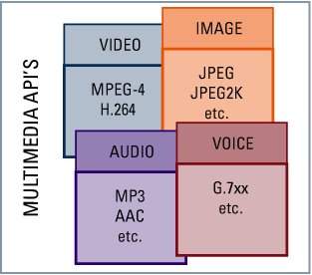
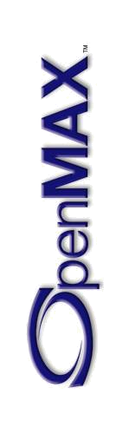
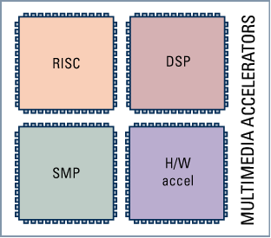
OpenMAX DL – Low-Level Media API
OpenMAX DL is a library of key static primitive functions
  Designed to cover 80% of the processing required in a multimedia codec
Abstracts the ISA from the multimedia codec
  Enables faster codec development time and faster porting of existing codecs
Enables third party codec vendors to sell processor-agnostic codecs
  Multi-core architectures (i.e. ARM + DSP) gain greater code reuse between cores
Combinatorial
Problem
An increasing number of multimedia API codecs for video, audio, graphics and images
A wide range of media acceleration silicon using many diverse architectures
Silicon vendors supply optimized OpenMAX DL library for rapid porting of codecs across multiple accelerators

Slide 29
OpenMAX DL Domains
Video Domain
  MPEG-4 SP/H.263 BL (encode and decode)
  H.264 (encode and decode)
Image Codec Domain
  JPEG (encode and decode)
Image Processing Domain
  Color space conversion
  Pixel packing/unpacking
  De-blocking / de-ringing
  Rotation, scaling, compositing, etc.
Multimedia Audio Domain
  MP3
  AAC
Signal Processing Domain
  FIR
  IIR
  FFT
  Dot Product

Slide 30
OpenMAX – Asynchronous DL (aDL)
API to group or chain multiple DL primitives together
  To form a single executing block
Enables vendors to accelerate key groups of primitives through:
  Specialized hardware
  Co-processors
  Hand-coded ISA optimizations
Enables a standard migration path between platforms
  With pure software and tightly coupled hardware
OpenMAX iDL
  Achieves same effect as OpenMAX aDL using OpenMAX IL constructs
Notes:
The group loooked at MM codecs w/ the 80/20 rule in mind. This rule states that 80% of the processing happens in 20% of the code. The DL targets the APIs that represent these processing intensive functions in the MM codec to focus the porting effort to areas that will make the most performance difference.
As the DL is targeting functions that most heavily exploit the ISA, the library gives ISA portability across processor families.
As the optimized sections are already provided, codec authors can concentrate on the codec algorithm itself with less concern for low-level optimization. The result is faster codec development.
As most of the performance bottlenecks are handled in the DL eliminating &| concentrating much of the codec porting effort.
Multiple DL libs could be available for a single platform allowing codecs to move between cores on that platform.

Slide 31
OpenMAX DL Video Domain
Computationally intensive “hotspots” for video applications
  Basic video processing building blocks
Typical devices
  Digital still cameras, PDAs, Mobile Phones, Portable Media Players, Set-top-boxes, PCs, etc.
Example video primitive functions in OpenMAX DL 1.0
  8x8 Add, Sub and 16X16 Add, Sub
  8x8 DCT+Q+Scan and 8x8 IDCT+Q+InvScan
  MPEG-4 Variable Length Decode
Merged functions for improved performance on some architectures
  Motion Estimation, Motion Compensation, Deblocking
Video codecs covered by OpenMAX DL 1.0
  MPEG-4 SP/H.263 BL (encode & decode)
  H.264 (encode and decode)
Can use aDL and iDL for video processing
  OpenMAX DL 1.1 will publish standard DL chains for aDL wrappers

Slide 32
OpenMAX DL Image Domain
Computationally intensive “hotspots” for imaging applications
  Basic image processing building blocks
Typical devices
  Digital still cameras, PDAs, Mobile Phones, Set-top-boxes, PCs, Printers etc.
Example image primitive functions in OpenMAX DL 1.0
  JPEG - encode and decode, 8x8 DCT and 8x8 IDCT, Quantization
  Merged DCT & quantization functions, Huffman encoding and decoding
  Image Processing - color space conversion and packing/unpacking
  De-blocking / de-ringing filtering, Filtering, Moments, Block copy, rotation, mirroring and scaling
OpenMAX DL 1.1 will widen image functionality
  JPEG2000
  Image Blending
  Raw Camera data processing etc…

Slide 33
OpenMAX DL Speech / Audio Domain
Computationally intensive “hotspots” for audio applications
  Speech codecs are not supported since the standards are bit-exact
  Other speech applications are supported indirectly with some signal processing APIs
Typical devices
  PDAs, Mobile Phones, Portable Media Players etc.
Example speech / audio primitive functions in OpenMAX DL 1.0
  Audio API - Unpacking of headers and bit-streams, Huffman decode, IMDCT and MDCT Polyphase filter, TNS and PNS processing
  Signal Processing API - FFT and IFFT, FIR, IIR and Median filters, Dot product,
  Block exponent (finding minimal sign bits in array elements)
Example uses
  MP3 decoder, including low frequencies extensions, MPEG4-AAC decoder (LC/L TP profiles), Signal processing (FFT, digital filters, some math )
OpenMAX DL 1.1 will widen functionality
  Audio encoders
  EAAC, EAAC+
  LMS filters
  Voice Recognition front-end …

Slide 34
Application Layer

Slide 35
OpenMAX AL - Application Level
Enabling application developers to easily leverage OpenMax acceleration
  A simple high-level interface for common multimedia playback and capture use cases
Typical applications are found in:
  Mobile Phones
  Mobile Music/Video Players
  PDAs
  Digital still cameras
  Digital Media Adapters
  STBs, PCs, etc…

Slide 36
OpenMAX AL 1.0 – Scope
Standard use cases
  Playback: play a video file, play a music file, display an image file
  Recording: record a video file, record an audio file, capture an image file
Operational controls
  Playback: play, pause, stop, FF, RW
  Recording: record, stop
Configuration control
  Audio output: volume, channels, etc
  Video output: video window position, size, etc
Metadata controls
  Extract metadata from a playing stream
  Insert metadata into a recording stream

Slide 37
OpenMAX AL - Milestones
OpenMAX AL Taskforce formed in November 2005
  Membership included: ATI, Beatnik, Freescale, Nokia, NVIDIA, Symbian, SkyMobile Media, TI
  Scoped intended functionality and investigated alternative solutions
  Recommended formation of an OpenMax AL working group
OpenMAX AL Working Group formed in December 2005
  Call for widened working group participation
  Official scope/requirements definition at face to face meeting in January 2006
OpenMAX AL Working Group
Established
Targeting Specification
lock down
Targeting Specification
Ratification
and completion of
Conformance Tests
Publicly Release OpenMAX AL 1.0
Initial implementations available
1Q06
2Q06
3Q06
4Q06

