Slide 1


Optimizing OpenGL ES Applications
Kristof Beets
3rd Party Relations Manager - Imagination Technologies
kristof.beets@imgtec.com

Slide 2
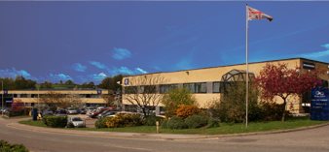




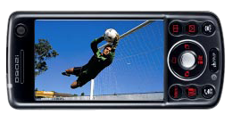
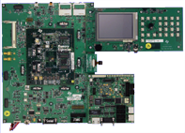

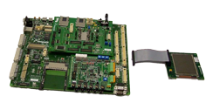

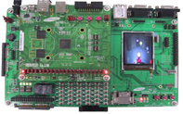


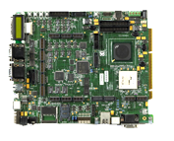








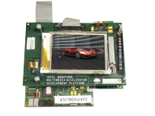

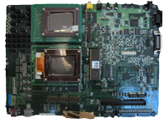



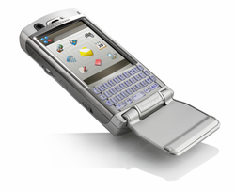


Imagination: World Leader in SoC IP Cores
Products
  Silicon and software IP for multimedia and communication
Customers
  Global semiconductor, fast-moving
  fabless businesses and system companies
People
  >300 with over 75% highly skilled engineers
PowerVR MBX de facto standard for Mobile 3D Graphics
  In use by 6 of the top 10 semi-conductor companies
  Several products already in the market and many more coming soon…

Slide 3
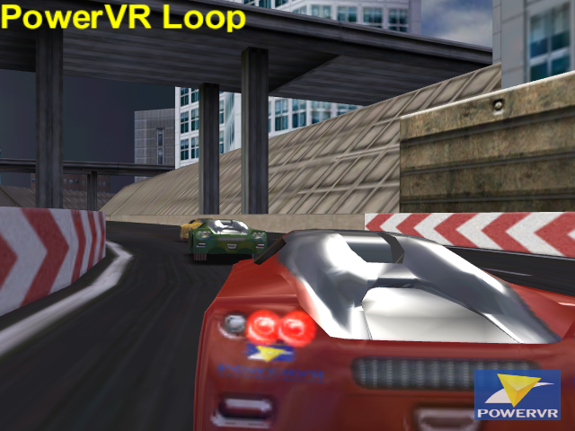
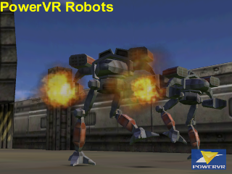
PowerVR MBX Family
OpenGL ES 1.x Compliant
Family Members
  PowerVR MBX
  PowerVR MBX Lite
High Quality, High Performance Texture Filtering
  Bi-Linear Filtering with MIP-Mapping at Full Speed
PowerVR Texture Compression: 2bpp and 4bpp
  Allows higher quality, higher resolution textures
  for same bandwidth and storage cost
High Quality, High Performance Anti-Aliasing
Internal True Color
DOT3 Per-pixel Lighting
Optional PowerVR VGP
  Dedicated programmable Vertex Processing Unit
  Allows high polygon throughput
  Advanced features: Skinning, Curved Surfaces, Lighting

Slide 4
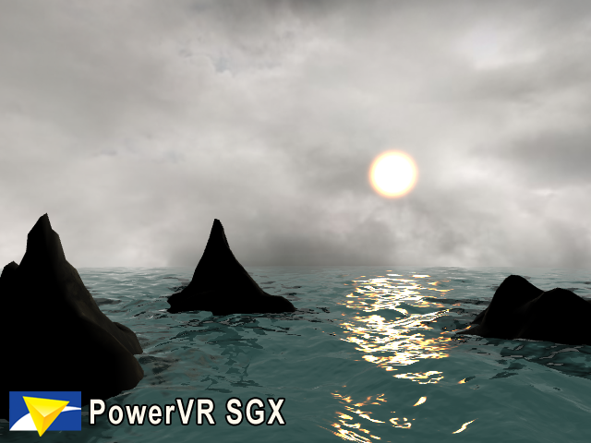
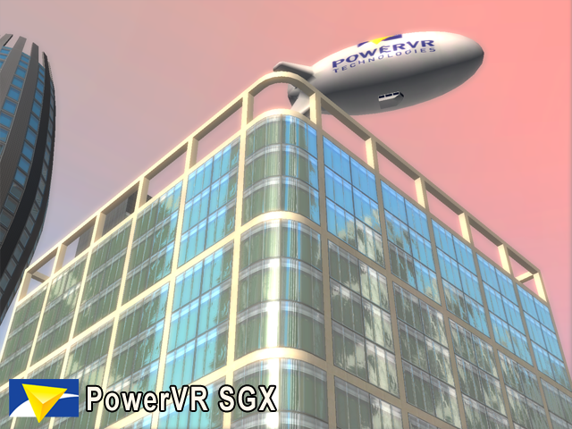
PowerVR SGX Family
OpenGL ES 2.x
Wireless SGX Family Members
  SGX510, SGX520, SGX530
    sizes ranging from less than 2mm² to 8mm² in a 90nm process.
Universal Scalable Shader Engine™ (USSE)
  Scalable multi-threaded processing engine
  Vertex, Pixel, Video, Imaging, Physics, etc. Processing
  Single Compiler
Advanced Geometry and Pixel Processing
  Procedural Geometry, Higher Order Surfaces, etc.
  Advanced Vertex Shaders
  Advanced Pixel Shaders such as Parallax bump mapping
  Advanced Shadow Techniques
    Stencil Shadows, Shadow maps, etc.
Programmable Anti-Aliasing
On-chip Multiple Render Targets (MRTs)
IEEE 32 Bit Floating Point Internal Accuracy
Much more…

Slide 5
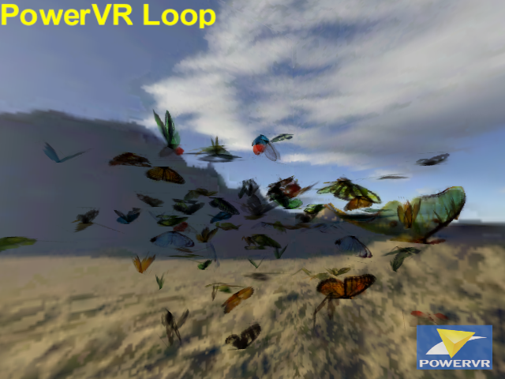
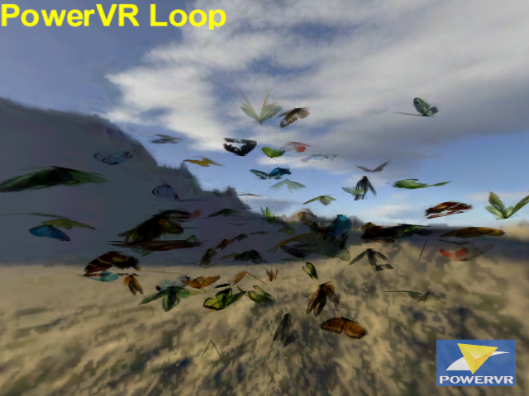
PowerVR Butterflies Demo
Demo shows a high number of butterflies in a dynamic flock
  Demo originally used for Arcade Hardware
  Illustrates Alpha Blending Capability
  Illustrates High Number of Textures and Texture Compression
Performance for "flocking algorithm only" :
Fully Floating Point Algorithm (Without FPU) 72 FPS
Fully Fixed Point Algorithm 304 FPS
Fully Fixed Point Algorithm with ASM Optimizations 373 FPS
Fully Floating Point Algorithm (With FPU) 415 FPS
Optimised Algorithm Fully Floating Point (With FPU) 1000+ FPS

Slide 6
Butterflies Demo : Lessons Learned
Floating point on non-floating point device is SLOW
  about 6x slower in this case
Only use Float on non-float device when ABSOLUTELY required !
  Non performance critical situations e.g. offline calculations
  Fixed Point accuracy insufficient
Use ASM Optimised Fixed Point where required
  Only most critical ops need ASM tweaking
Use Float if device supports Floating Point
  E.g. Floating Point Unit has faster divide op than the Fixed Point Core
But do your own benchmarking
  Not all algorithms and platforms are equal...
Using a smart efficient optimised algorithm benefits all cases...
  Essential for high performance on Mobile HW !

Slide 7
Reducing Graphics API CPU Load
Every API call introduces overhead which costs valuable CPU cycles
  Aim to minimize the number of API calls
  Matrix Ops and Draw Calls can be expensive
How to reduce the number of API calls ?
  Batching (grouping) allows reduction of the number of API Calls
  Different Texture can break up DrawCalls
    Consider using a Texture Atlas / Texture Page
      One large texture containing several “sub-textures”
      This makes it possible to draw multiple objects in a single draw call
For optimal geometry throughput use “Sorted Indexed Triangles”
  Sorting improves memory access patterns
  Sorting makes optimal use of caches
  Ideally use “strip ordered” indexed triangles
  PowerVR SDK contains Optimised Geometry Exporter and Geometry Optimisation Lib
  Ideally use Multi_Draw_Arrays Extension
    Submit multiple strips in a single draw call – minimal API overhead

Slide 8
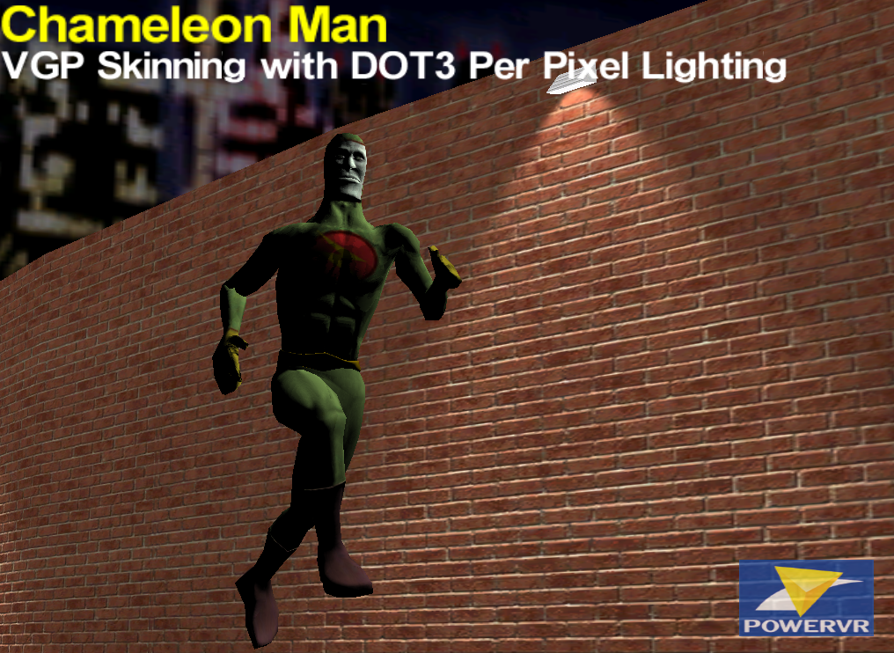


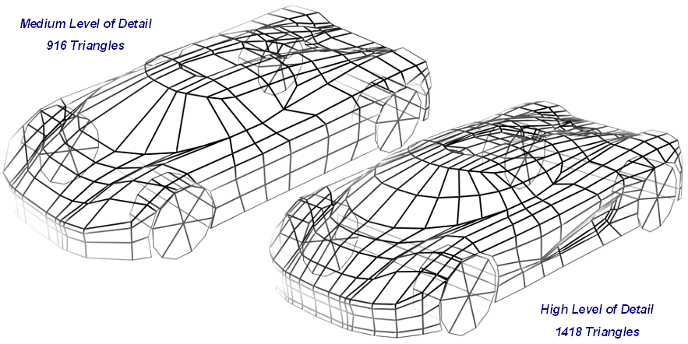
Further Polygon Submission Optimisations
Interleave the per vertex data elements (Position, Normal, Color, Etc.)
  Keep data that belongs together close together in memory !
Simplify the geometry complexity
  Use a polygon reduction algorithm
  Use DOT3 lighting or textures to represent fine detail
Reduce the size of vertex components
  Use smaller formats whenever possible
  E.g. Use byte instead of float
Don’t store “constants” per vertex
  Use Diffuse, Specular, Factor, etc. Colours
  Make sure to disable client states that are not required
    glEnableClientState / glDisableClientState
  Use Vertex Shader constants if available
Consider using Level Of Detail (LOD)
  Don’t use 1000’s of polygons for an object 10’s of pixels on screen
DOT3
No DOT3

Slide 9
Draw Order / Sorting
No need to sort objects front to back
  Likely to bottleneck on the CPU due to increase in number of state changes (API overhead)
  PowerVR Hardware handles HSR efficiently irrespective of depth render order.
Do use High-level Render State Batching
  Draw all opaque objects first
    Group by number of Texture Layers
      E.g. First all Dual Textured Objects and then all Single Textured Objects
  Draw all Alpha Blended and Alpha Tested Objects Last
Use High-Level Geometry Culling
  Do not submit the whole world geometry every frame
  Use Fog to hide sudden pop-in effect

Slide 10
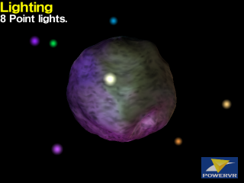
Let there be Light…
OpenGL Lighting is quite complex and can thus be CPU & VGP heavy
  OpenGL implementations need to be conformant…so no shortcuts can be taken!
Use the simplest light type that works for your application
    E.g. parallel lights are cheaper than spot lights
Use the fewest number of lights that work for your application
Pre-compute lighting whenever you can
  Static models with static lights
  Pre-compute offline and store in color array or textures
Only enable lighting when needed
  E.g. On moving objects, or if the light properties are changing
  Consider caching lighting if an object stays static for long times
    Calculate once use many
Could implement your own lighting algorithm
  Implement exactly the algorithm you need and want
  Use custom IMG Vertex Program (VGP Lighting) or custom code (CPU Lighting)
  Can take shortcuts and use hacks... as long as it does the job!
  Do verify that it’s faster and/or better looking than default OpenGL Lighting…
Consider pixel lighting
  Light maps (as used by most PC Games instead of Vertex Lighting)
  DOT3 Per Pixel Lighting

Slide 11
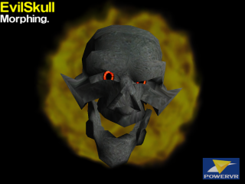
Texturing
Use Compressed Textures whenever possible !
  Various formats depending on hardware (DXT, PVRTC, ETC, …)
  PVRTC2 = 2bpp & PVRTC4 = 4bpp
    less bandwidth, less storage, smaller distribution size of the application
  Don't use palletised textures
    Less quality and less performance then PVRTC2/4
Alternatively use 16bpp Texture Formats
  32bpp is “usually” overkill on a 16bpp LCD
Remember special types
    Luminance I8 and Luminance_Alpha IA88 can be useful
Always use MIPMapping
  Ideally use: LINEAR_MIPMAP_NEAREST
  Only use Trilinear when needed
Use sensible Texture Sizes
  No 1024x1024 Textures for objects that cover a quarter of a QVGA screen
  Do use large compressed textures for Texture Pages/Atlas, even 2048x2048
Load all Textures up front
  Before rendering create and load all textures
  Consider Warm-up phase which touches all textures once
  Avoid mid action texture create and uploads and/or changes

Slide 12
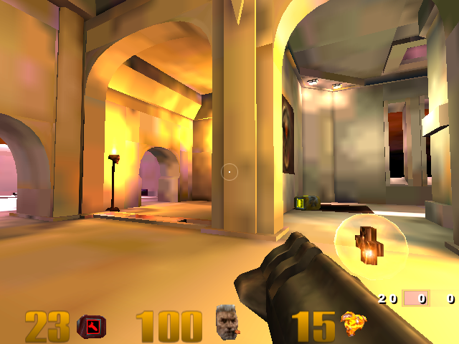
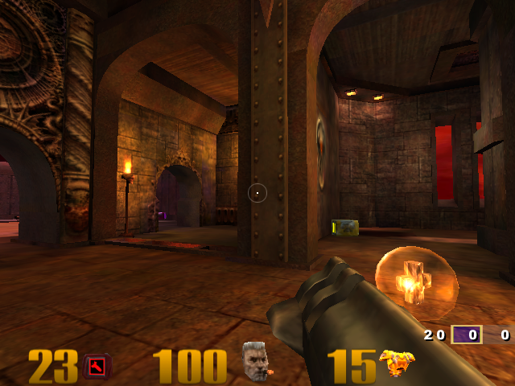
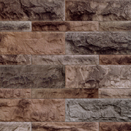


Multi-texture vs Multi-pass
Use Multi-Texturing over Multi-Pass!
  Saves draw calls
    Considerably reduces vertex processing work
  Saves render states changes
    Reduces driver overhead and thus CPU Load
  Avoids potential “Z fighting” issues
    Subsequent passes with e.g. lighting disabled
    can yield different depth values
Quake 3 : Light Maps Only


2 Quads
1 Texture Each
Multi-Pass
1 Quad
2 Textures in 1 go
Multi-Texture
Quake 3 : Light Maps + Base Map
Drawn with a single geometry pass
Possible through Multi-Texturing

Slide 13
Maintain CPU and GPU Parallelism
Normally CPU and 2D/3D Graphics Core work in Parallel…
… but some ops can break this parallelism!
Do NOT attempt to access the color buffer directly
  CPU will stall until HW completes the render
  And the GPU stalls while the CPU does its work
  Results in lost CPU and GPU performance
  Avoid glReadPixels() glCopyTexImage2D() glCopyTexSubImage2D()
Find workarounds to avoid accessing the color buffer directly
  E.g. use ray casting algorithm for a lens flare effect instead of glReadPixels()

Slide 14
Java 3D Graphics
M3G (JSR-184) layered on top of OpenGL-ES functionality
  OpenGL ES performance recommendations remain valid:
    Minimise API calls - especially geometry draw calls
    Use Optimised Triangle Strips
      Make sure your M3G Exporter tool does a good job…
    Batching
      E.g. use “Group” object to bundle meshes
    Always flag opaque objects as opaque
    Avoid Mid-scene texture uploads/changes
    Etc.
JAVA makes it easy to mix MIDP 2D and JSR184 based 3D
  Do NOT mix 2D and 3D operations within the same frame
    Majority of current implementations use CPU for 2D and GPU for 3D
    E.g. No MIDP Text Drawing, No Filled Rectangles, etc. within 3D Frame
  Future JAVA implementations will solve this performance issue

Slide 15
Join the “PowerVR Insider” Program
PowerVR Technical Support & Co-Marketing Programme
  Direct Technical Support through email, phone & on-site
    Assure Optimal Compatibility
    Highest Possible Performance
    Leading Image Quality
    Extensive Support for Key Partners
      Including Middleware Vendors, JAVA VM & JSR Vendors, Benchmarks, Launch Titles
    Free SDKs including sample code, documentation and extensive toolset
  Joint Marketing Activities
    Press Releases, Joint Event Participation, Website presence, etc.
PowerVR Insider brings the whole ecosystem around 3D Graphics together
  From Software Developers to Mobile Phone OEMs
  Provide introductions between PowerVR Insiders
  Assure co-operation between PowerVR Insiders
To join send email to: insider@powervr.com

Slide 16
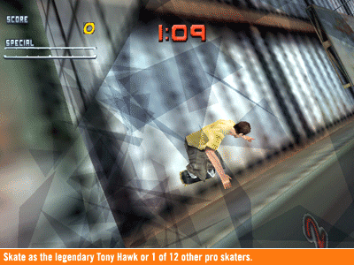
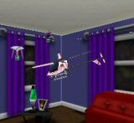
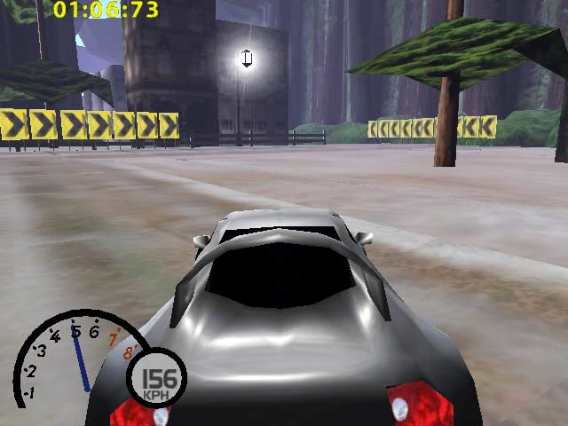
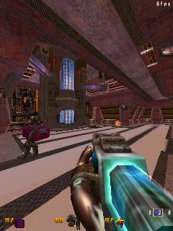
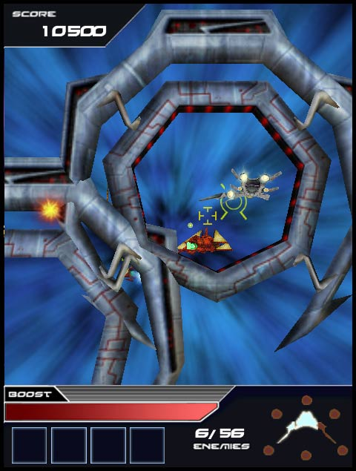
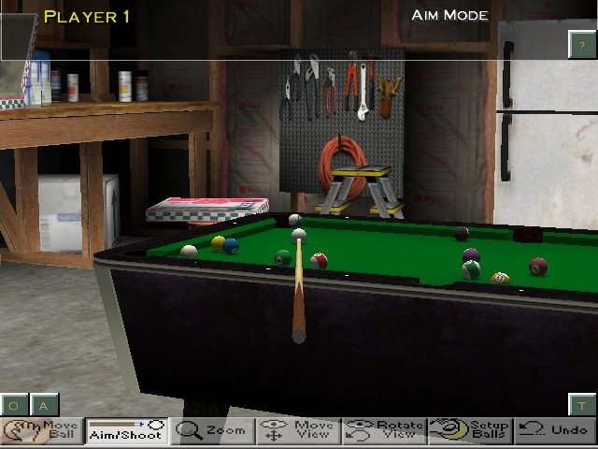
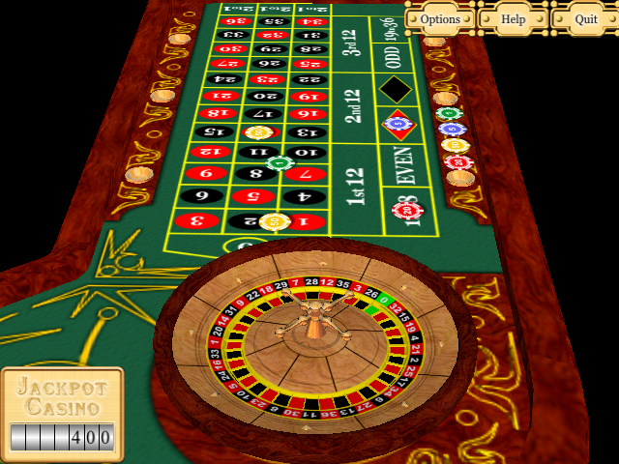
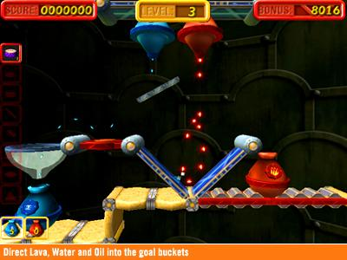
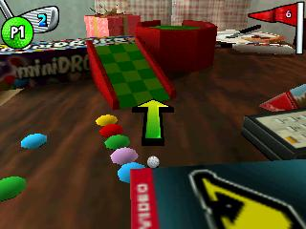
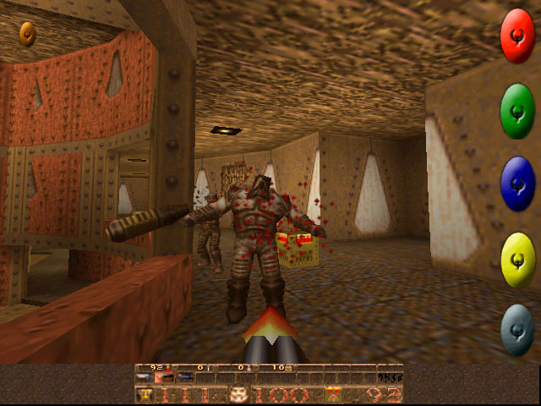
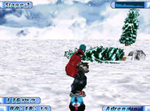
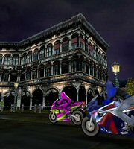
PowerVR MBX Content
Selection of available content
3D Golf
3DMarkMobile06
Bling My Ride
Chopper Fight
Cube Engine
Enigmo
Everybody's Golf Mobile 2
GeoRallyEx
Interstellar Flames
Jackpot Casino
Kastor Platform
Onimusha: Curtain of Darkness
Quake III CE
Quake Mobile + Expansion Packs
Ridge Racer Mobile
Scaleform VGx
And more than 73 native 3D-Game Titles on SKTelecom GXG Services
Middleware + All available content
Synergenix Mophun
EA/Criterion Renderware
TAO Intent Game Player
Speed
Sphere
SSX III
Stuntcar Extreme
The Lost Sister
Tin Star
Tony Hawk Pro Skater
Tony Hawk's Pro Skater 2
ToyGolf
Vijay Singh Pro Golf 2005
Virtual Pool Mobile
VIVID UI
VIVID Message
Xmen Legends
Yeti3D Engine

Slide 17
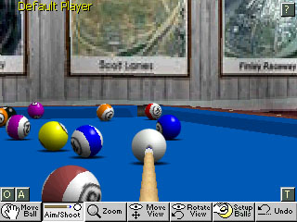
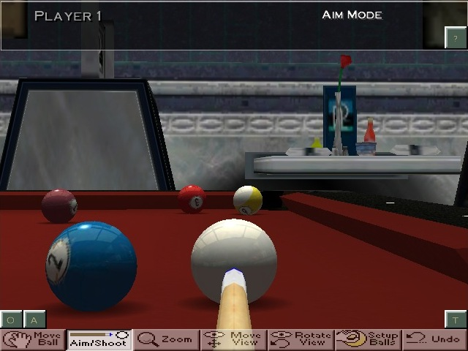

Example: Virtual Pool Mobile by Celeris
High Quality Texture Filtering
&
Increased Texture resolution
High-detail 3D Polygonal Background
Software Version
Reflection Mapping
Increased Performance
Higher Screen Resolution
&
Increased Polygon Counts
OpenGL-ES PowerVR MBX Hardware Accelerated Version
Alpha-Blended Menu

Slide 18
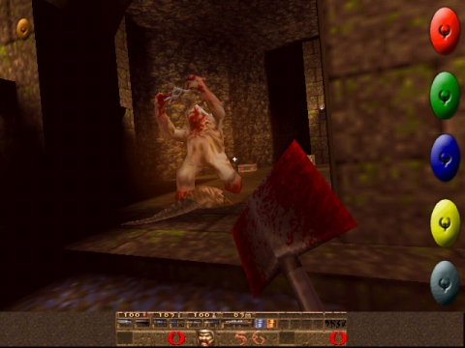
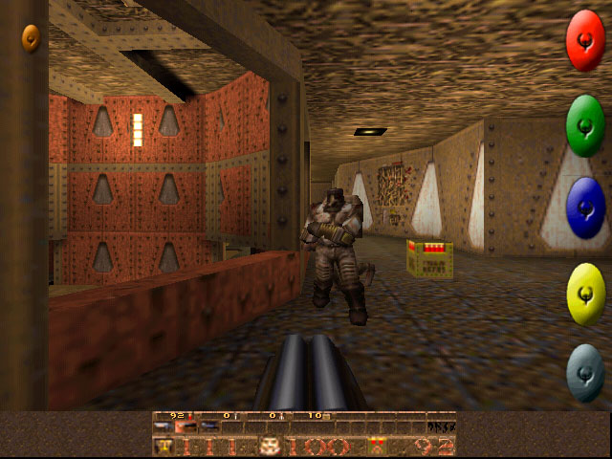
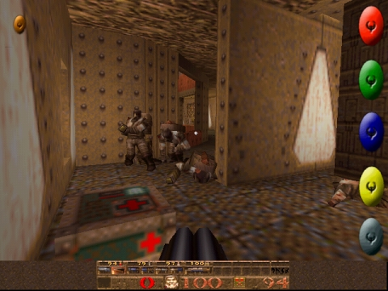

Example: Quake Mobile by Pulse Interactive
Quake III Arena also already available…

Slide 19

Any Questions?

