Slide 1
Mobile Developer Forum
Tokyo, April 2006

Slide 2
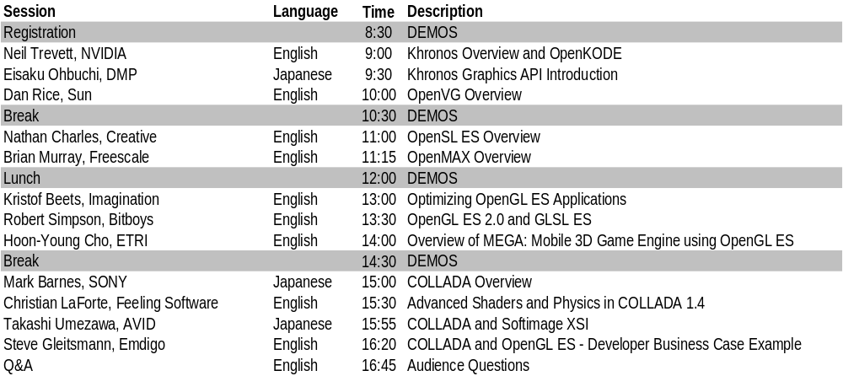
Welcome!
Today will give you the latest information on embedded media standards
  A day of technical content – marketing free!
Khronos standards being used in many embedded markets
  Mobile, console, automotive, consumer electronics
Demos during the day – at back of room
All today’s slides are at www.khronos.org

Slide 3
Khronos Overview and OpenKODE
Neil Trevett
Vice President Embedded Content, NVIDIA
President, Khronos

Slide 4
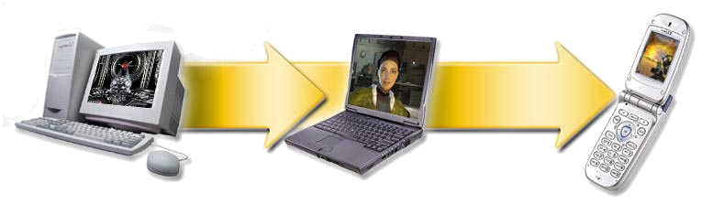
Mobile Convergence
Handsets are becoming the predominant personal computing platform
  Sophisticated media processing will be central to this revolution
50% of phones will have multimedia hardware acceleration by 2008
  Source - Jon Peddie & Associates
Significant opportunity for games developers
  Handhelds are the largest market for a manufactured device – ever – period
100Ms / year
10Ms / year
100Ks / year
80’s
Workstations
90’s
PCs
00’s
Handhelds
Notes:
Made text bigger – too hard to see from back of room

Slide 5

Media APIs Enable Market Growth
An API is a contract between hardware and software worlds
  Enabling both - everyone wins
ISVs see reduced variability across multiple platforms
  More software can reach market faster at a better level of functionality and quality
Hardware vendors can accelerate many applications
  Adding value to their platform
Hardware Provider
Software Developer
Hardware Provider
Software Developer
Hardware Provider
Software Developer
Hardware Provider
Software Developer
Hardware Provider
Software Developer
Khronos develops “Foundation-Level” APIs
As close-to-the-metal” as possible while providing portable access to hardware acceleration. Great performance.
Good foundation for higher-level engines and middleware

Slide 6

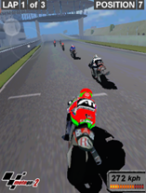
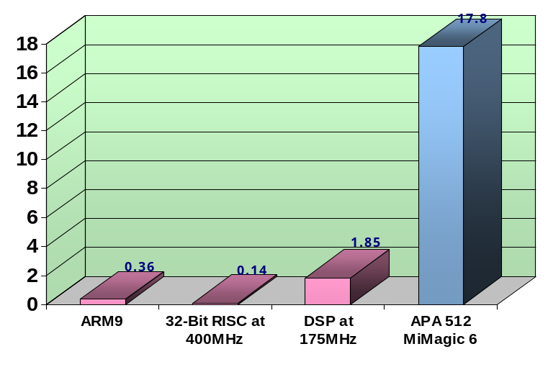
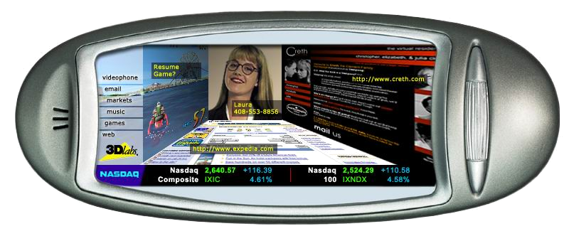
APIs Enable Mobile Acceleration
Faster Performance at Higher Quality
Hardware delivers at least 10 times the performance of software – even on low-cost systems with low-end CPUs
POWER EFFICIENCY
Less Power
Hardware accelerators exploit parallelism in a media pipeline to give a x10 increase in power efficiency over software
State of the art user interfaces
Smaller screens need more advanced graphics processing per pixel

Slide 7

Creating Open API Standards
Open Membership
Any company is welcome
Funded by membership dues - $5K / year
Open Standards
Publicly available on web-site
Royalty-free
Open Standard Platform for Embedded Rich Media Acceleration
Cross Platform
Enabling diverse handheld and
embedded markets
Promoting Ecosystem
Conformance tests, tools,
developer materials and outreach
Khronos has a PROVEN reputation for the TIMELY creation of HIGH-QUALITY, ROYALTY-FREE standards

Slide 8















































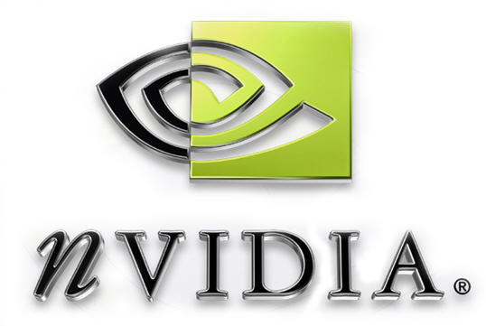







































Over 100 companies creating media authoring and acceleration standards

Slide 9


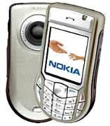
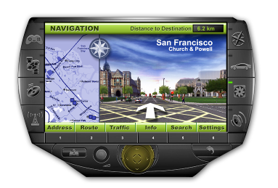
How Does Khronos Make Money?
It doesn’t!
Khronos is purely a non-profit organization
  Funded by member dues – to cover costs
Our members make money by selling PRODUCTS enabled by standards
  NOT trying to charge for the standard itself
$
An open, royalty free API standard creates much larger market opportunities
$
Selling an API would generate relatively small amounts of revenue
Our members cooperate to create standards – and compete in the marketplace with products that use Khronos standards

Slide 10




Khronos API Stack
Khronos is developing APIs from processing ALL media types on embedded platforms
Applications or middleware libraries (JSR 184 engines, Flash players, media players etc.)
Abstracted component controls
AL
Media
Frameworks
3D
Small footprint 3D for embedded systems
Vector 2D
Low-level vector
acceleration API
SOUND
Advanced Interactive Audio
Component interfaces for codec integration
IL
EGL
Image Libraries, Video Codecs,
Sound Libraries
Abstracted Access to OS Resources
Fast mixed mode 2D/3D rendering
Accelerated media
primitives for codec
development
DL
Media Engines – CPUs, DSP, Hardware Accelerators etc.
Khronos defines low-level, FOUNDATION-level APIs.
“Close to the hardware” abstraction provides portability AND flexibility

Slide 11

Adoption of Khronos APIs
We Are Here
- OpenGL ES is widespread
- OpenVG is in rapid adoption
- OpenMAX is being implemented
- OpenSL ES is being designed
Market adoption in media-accelerated handsets
100%
Widespread, cross-platform availability
Rapid adoption when silicon ships
Silicon Designs in progress
Mid-2004
OpenGL ES 1.1
Spec release
Mid-2005
OpenVG 1.0
Spec release
Beginning-2006
OpenMax IL 1.0
Spec release
End-2006
OpenSL ES 1.0
Spec release
Time

Slide 12

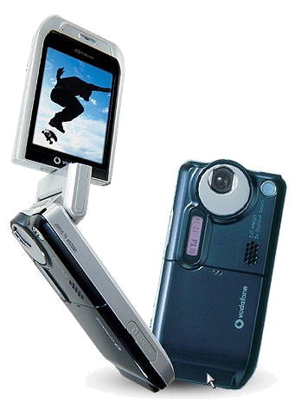


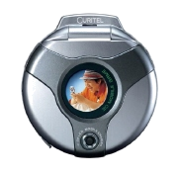

Cross Platform Tools and APIs
OpenGL ES will be available for Playstation 3
  Sony made public announcement at GDC in San Francisco in March 2005
COLLADA authoring file format now a Khronos Standard
  Originally created for Playstation 3 by Sony
Powerful portability for console and handset titles
  Previous generation console games can be deployed on 100s of millions of cell phones
Application
portability across a wide range of platforms

Slide 13



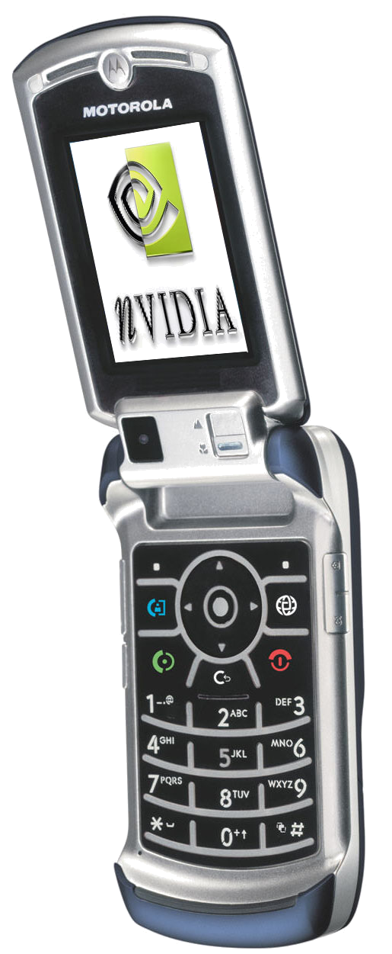


Mobile Media Ecosystem
Synergistic Development of authoring and acceleration standards under one body. Third party tools and debuggers. gDEBugger ES announced at GDC 2006
Market demand for mobile media
Great 3D
Applications
Industry
Cooperation
Tools
Khronos drives OpenGL ES roadmap to meet market needs
Open API Standards
Benchmarks
Conformance Tests
High-quality platforms
Futuremark
3DMarkMobile06
& JBenchmark 3D. Soon see consumer benchmark interest as on the PC?
All Khronos APIs are accompanied by rigorous Conformance Tests to ensure reliable operation

Slide 14
Industry Standard Embedded 3D

Slide 15


OpenGL ES API Standard
Small-footprint subset of OpenGL
  Created with the blessing and cooperation of the OpenGL ARB
Powerful, low-level API with full functionality for 3D games
  Available on all key platforms
Fully extensible
  Enables vendor differentiation and exploration of new functionality
Feedback and Ratification
ARB
Embedded
Focus
Workstation
Focus
Eliminate Redundancy
Strong functionality in a small footprint e.g. <100KB software engines
Eliminate Workstation Functionality

Slide 16







OpenGL ES – Central to Mobile 3D
JSR 239
Defining official Java Bindings to OpenGL ES
Java
Applications
C/C++ Applications
Usable directly by applications
Scenegraph APIs
M3G (JSR 184)
Games
Engines
Middleware
Libraries
Usable by higher-level graphics libraries
Hardware
OpenGL ES
Engines
Software
OpenGL ES Engines
“Close to the hardware” API provides portability AND flexibility
Brings advanced 2D/3D graphics to a wide range of OS platforms

Slide 17

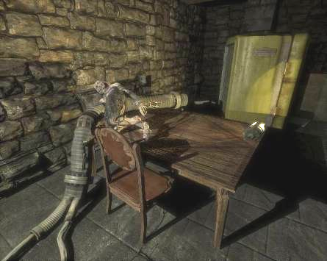
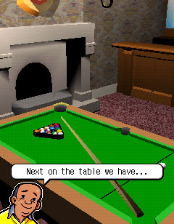
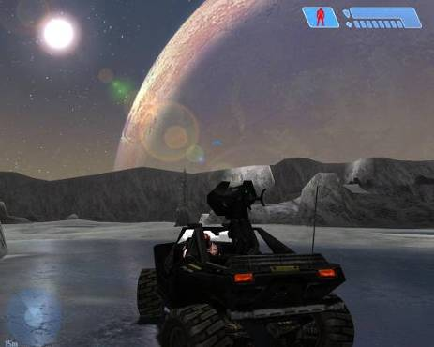
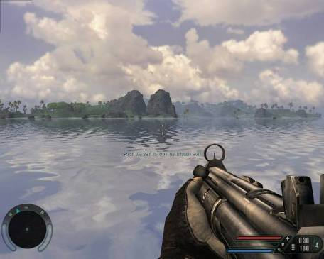
Shaders: Next Generation Mobile 3D
Graphics industry is in the middle of a programmable revolution
  Shader programs running on the GPU are enabling amazing new visual effects
Graphics APIs will need to support shading languages
  Enabling new visual effects to be created by developers
3D Tomorrow
- Shader Programmability
Doom 3’s Zombies
Unreal’s Rocks
3D Today
Fixed Functionality
Halo’s Ice
Far Cry’s Water

Slide 18
OpenGL ES Roadmap
Stability and reducing fragmentation is currently the key concern
  More important than new functionality in the current phase of market development
  Industry is still absorbing and implementing current OpenGL ES specifications
OpenGL ES 2.0 Provisional specification finalized
OpenGL ES 2.1
Absorbs proven extensions
WHEN NEEDED
OpenGL ES 2.2
New functionality to meet PROVEN market needs
OpenGL ES extensibility enables new functionality to be explored before adoption into the core specification
OpenGL ES 2.1 accelerated products begin to ship
OpenGL ES 2.0 accelerated products begin to ship
OpenGL ES 1.1 with hardware acceleration – “Sweet Spot”
OpenGL ES 1.1 will continue to be used in low-cost devices.
1.X specification will absorb proven extensions if needed
Shipping Products
2006
To Meet Market Needs

Slide 19
Khronos Open Development Environment

Slide 20
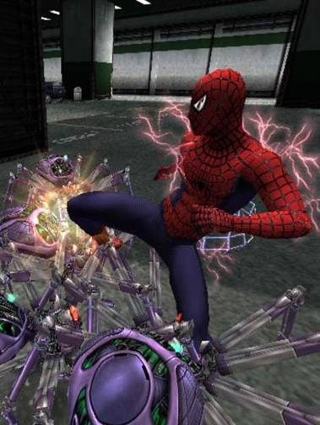
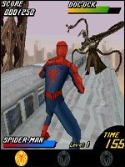

Good Titles Gaining Attention
Users place a premium on compelling media-enabled handsets
  Smooth 3D gaming functionality, MP3 audio and TV in the palm of your hand
  3D benchmarks to enable consumer comparisons now appearing
Users pay more for premium 3D gaming content
  50-100% price increase for 3D games over 2D games is common
  3D UI/Avatar/messaging applications will enable new levels of personalization
Multi-user content encourages higher network usage
  OTA provisioning 3D applications and levels
  Real-time, multi-player networking
BUT – compelling media applications not happening fast enough.
Systemic industry issues threaten to stall mobile media
Spider-Man 2
Activision
Spider-Man 2 3D: NY Subway
Sony Pictures
Spider-Man 2: The Hero Returns
Sony Pictures
2D
3D Software
3D with HW Acceleration

Slide 21

Barriers to Great Mobile Content
Barrier #1 - Platform Variability
  Each phone supports different selection of APIs
  Available APIs do not work reliably - needs workarounds
  Need to port to and support 100s of platform variants
  “Native Content Platform”
  1. A cross-platform set of native APIs for media application development
  2. Ability to provision, install and run native applications across diverse platforms
Titles are failing to meet customer expectations
and cost more to port than to develop
Price per title is being held artificially low
  Difficult for ISVs to get return on investment
  Holding back development of innovative content
Barrier #2 - Performance
  Java is architected for safety not speed
  Most handsets have no way to deploy a C native title
  The capability of OpenGL ES silicon not unleashed
“Khronos Open
Development Environment”

Slide 22

Building Application Source Portability
Platforms can select the Khronos media APIs needed for their target applications
Platform Tools
Native Provisioning Guidelines
  Using existing provisioning
  infrastructure
3D
2D Vector
Enhanced conformance tests
  Including trans-API tests
System Abstraction APIs
Portable access to operating system resources - input, files, memory, display resources etc..
Interfaces to platform capabilities
  E.g. Java, Brew, OMA for provisioning, billing etc. C binding to CHAPI - JSR 248
Audio
Streaming Media
Platform capability profiling tool - similar to WinSAT
  Query functions and measure key throughputs
  Avoid “lowest common denominator syndrome”

Slide 23
Embedded OpenGL ES Software
JAR
File
Java OTA Provisioning
OpenGL ES library enables embedded native titles with no change to other handset software
Phone Applications
Java
Games
Java Virtual Machine
User Interface
Embedded OpenGL ES Games and Utilities
JSR 184
Other JSRs
OpenGL ES
Phone Operating System
Java Infrastructure
Applications
Drivers

Slide 24
Complete Native Platform
JAR
File
Java OTA Provisioning
Design guidelines on how to use existing Java, Brew, OMA provisioning infrastructure with dynamic download of needed libraries
CHAPI-based launcher
Accelerated UI and players
Java Virtual Machine
Phone Applications
Native Installer
Java
Games
User Interface
Flash/SVG Players
Native applications and Utilities
JSR 184
JSR 239
Other JSRs
OpenKODE
OpenGL ES, OpenVG, OpenMAX OpenSL ES & OS Abstraction APIs for application portability
Phone Operating System
Java Infrastructure
OpenKODE accelerates user interface, native applications, content players and JSRs
Applications
Drivers

Slide 25
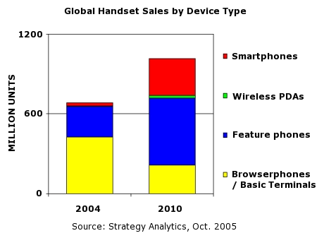
Need for Native Deployability
OpenKODE needs to be available on maximum number of OS
  For widest application portability
Smartphone OS are able to download and link native applications
  Windows Mobile, Symbian, Linux
But >80% of the handheld market today uses feature phone OS
  Many RTOS do not have the in-built capability to link and load a native application
OpenKODE design will not preclude deployment on RTOS
  Including guidelines for OTA provisioning
OpenKODE needs to enable smart phones AND feature phones with the identical native media platform

Slide 26
OpenKODE Milestones
40 companies participating in OpenKODE working group
  ARM, Ericsson, Freescale, Ideaworks 3D, Intel, Monotype, Nokia, NVIDIA, SUN, Tao, TI
Aiming for OpenKODE 1.0 release in 2006
  Keeping things as simple possible for first release while delivering significant benefit
OpenKODE is NOT:
  An operating system, DRM scheme, provisioning scheme or a carrier certification process
  Maximize leverage of existing mobile infrastructure
Working for industry adoption on many platforms
  Java, Symbian, WIPI, Linux, Windows, Brew, Nucleus
  Simple build out of existing OpenGL ES/OpenVG adoption
Call for participation and contributions
First
F2F meeting
Scope Agreed
First public deliverables
1Q06
2Q06
3Q06
4Q06
1Q07

Slide 27

OpenKODE Bottom Line
Silicon vendors expose media acceleration through reliable APIs
  With full native performance
  Building out from current OpenGL ES and OpenVG APIs
Carriers and OEMs have deployment control
  Can simply specify “OpenKODE Compliance”
  Can use existing provisioning and billing infrastructure
  Can use existing DRM and signature checking
  Implement own certification programs
ISVs gain a wider market footprint
  ISVs use C and spend time developing not porting
  Native applications run 3-5 times faster than Java
  OpenKODE applications can ship on wide range of phones
More compelling 3D content – faster to market

Slide 28
Why Use Khronos Standards?
Khronos is creating a complete, coherent media acceleration platform
  To reduce development and deployment costs and increase market opportunity
“Foundation Level” APIs
  Close to the silicon – fundamental, flexible functionality needed on every platform
Designed by industry experts
  The industry leaders in media silicon, platforms and software are all Khronos members
Flexible, fast-track roadmap evolution
  Effective and streamlined process – specification updates every 12 months if needed
Royalty-free
  Khronos is committed to generating market opportunities for its members and the industry
Any company is welcome to join Khronos!
  Only $5,000 / year membership fees

