Slide 1

COLLADA Overview
Mark Barnes
COLLADA Project Lead
Sony Computer Entertainment

Slide 2
COLLADA History
COLLADA was announced at SIGGRAPH 2004
and has become a Khronos standard
Since then we have
  Formed the COLLADA work groups
  Released the 1.4.0 specification
  Been adopted by thousands of users (about 15% of the market)

Slide 3
What is COLLADA?
COLLADA is a database schema for 3D assets
  COLLADA is an interchange format.
  COLLADA is an intermediate format.
  COLLADA is not a delivery format.
COLLADA is a lossless format.
  COLLADA enables interoperability between DCC tools.
  COLLADA can be a source format that retains all information.
    Even multiple versions of the same asset.
COLLADA is a comprehensive format.
  COLLADA can encode visual scenes and physics scenes.
  COLLADA can contain libraries of assets.
  COLLADA can contain many types of objects.
  COLLADA is not a scene graph.

Slide 4
What is COLLADA?
COLLADA is an open format
  COLLADA is a fully documented, open standard built using standard tools: UTF8, XML, URLs, Base64, XML Schema, etc.
  COLLADA is not a proprietary format.
COLLADA is an open standard
  COLLADA is a standard technology of The Khronos Group industry consortium.
COLLADA seeks to liberate your 3D assets
  COLLADA is an open, archive-grade format that retains meta information.
  When your DCC tool upgrades, you keep your assets.

Slide 5
COLLADA is your data in motion
COLLADA is designed to transport your content between applications
  It is the glue that binds together your DCC and 3D processing tools into a production pipeline
  It allows applications to talk with each other using the same language
  It opens up new opportunities for developers and tool makers to build on each other's strengths without reinventing the wheel

Slide 6
Structure of a COLLADA document
Every COLLADA document is expressed in XML, with
<?xml version="1.0" encoding="UTF-8"?>
<COLLADA>
<asset> ... </asset>
<library_geometries>
<geometry id=“Teapot”>
...
</geometry>
</library_geometries>
<library_visual_scenes>
<visual_scene id=“World">
<node>
<instance_geometry url="#Teapot"/>
</node>
</visual_scene>
</library_visual_scenes>
<scene>
<instance_visual_scene url="#World"/>
</scene>
</COLLADA>
a header,
a set of libraries,
and a scene.

Slide 7
COLLADA Documents
We call them "documents" not "files"
  XML can be more than just files on a file system.
  XML may be the formatted result of a SQL database query.
  XML may come from an HTTP request sent to a remote server.
  XML might be a temporary output fragment from a DCC tool.
  XML could be a small subset of a large source control system, selected by "assets most recently altered by David".
Using XML to represent structured data enables 3D tools to use the full arsenal of modern database tools

Slide 8
Libraries
Libraries hold and organize many types of objects
COLLADA documents are modular containers of information
<library_animations> <library_cameras> <library_effects> <library_controllers> <library_geometries> | <library_lights> <library_materials> <library_nodes> <library_rigid_bodies> <library_physics_models>

Slide 9
Assets
Every COLLADA document is an asset and can be managed using the meta-information
<?xml version="1.0" encoding="UTF-8"?>
<COLLADA>
<asset>
<contributor>
<author>John Doe</author>
<authoring_tool>Maya Collada exporter v0.7.4</authoring_tool>
</contributor>
<created>2004-12-20T03:14:58Z</created>
<modified>2004-12-20T22:10:18Z</modified>
<revision>12.3.257</revision>
<up_axis>Y_UP</up_axis>
</asset>
<library_geometries>
<geometry id="3f454bb2" name="Teapot>">
...
</geometry>
</library_geometries>
</COLLADA>

Slide 10
Assets
Every COLLADA document also contains assets that can be managed individually
<?xml version="1.0" encoding="UTF-8"?>
<COLLADA>
<asset> ... </asset>
<library_geometries>
<geometry id="3f454bb2" name="Teapot>">
<asset>
<contributor>
<author>Jane Doe</author>
<authoring_tool>XSI COLLADA exporter v5.1</authoring_tool>
</contributor>
<created>2005-01-13T18:33:17Z</created>
<modified>2005-01-13T18:33:17Z</modified>
<revision>1.04</revision>
</asset>
</geometry>
</library_geometries>
</COLLADA>

Slide 11
Models and Geometry
Geometry contain multiple streams of data at each vertex, indexed from raw arrays of values
<source id="revolve_Pos">
<float_array count="1824">
6.44546 2.22100 0.04451 8.94581 ...
</float_array>
</source>
<vertices id="revolve-Vtx">
<input semantic="POSITION" source="#revolve-Pos"/>
</vertices>
<polygons count="720" material="Default">
<input semantic="VERTEX" source="#revolve-Vtx" offset="0"/>
<input semantic="NORMAL" source="#revolve-0-Normal" offset="1"/>
<input semantic="TEXCOORD" source="#revolve-0-TexCoord0" offset="2"/>
<input semantic="TEXCOORD" source="#revolve-0-TexCoord1" offset="3"/>
<input semantic="TANGENT" source="#revolve-0-Tangent" offset="5"/>
<p>0 0 0 0 0 0 31 1 1 1 1 1 32 2 2 2 2 2 1 3 3 3 3 3</p>
...
</polygons>

Slide 12
Scene Descriptions
Each COLLADA <visual_scene> describes a hierarchy or scene graph of objects in the same space
<visual_scene id=“World">
<node id="Camera">
<lookat> ... </lookat>
<instance_camera url="#camera"/>
</node>
<node id="Light" name="Main_Light">
<translate>-5.0 10.0 4.0</translate>
<rotate>0 0 1 0</rotate>
<instance_light url="#Lt-Light"/>
<node id="Teapot">
<instance_node url="#teapot-lod-02"/>
</node>
</node>
</visual_scene>

Slide 13
Animations and Skinning
Animations can be controlled by curves or key frames
  Each <animation> contains one or more <source> arrays of values.
  <sampler> objects take these <source> arrays and either indexes or interpolates them into output variables.
  Finally, <channel> binds these outputs to values in the scene,
  e.g. "elbow/rotation.ANGLE"
COLLADA supports skinned animations
  One skeleton can animate many meshes.
  Meshes are bound to a default pose by an arbitrary array of weights and an array of inverse bind matrices.

Slide 14
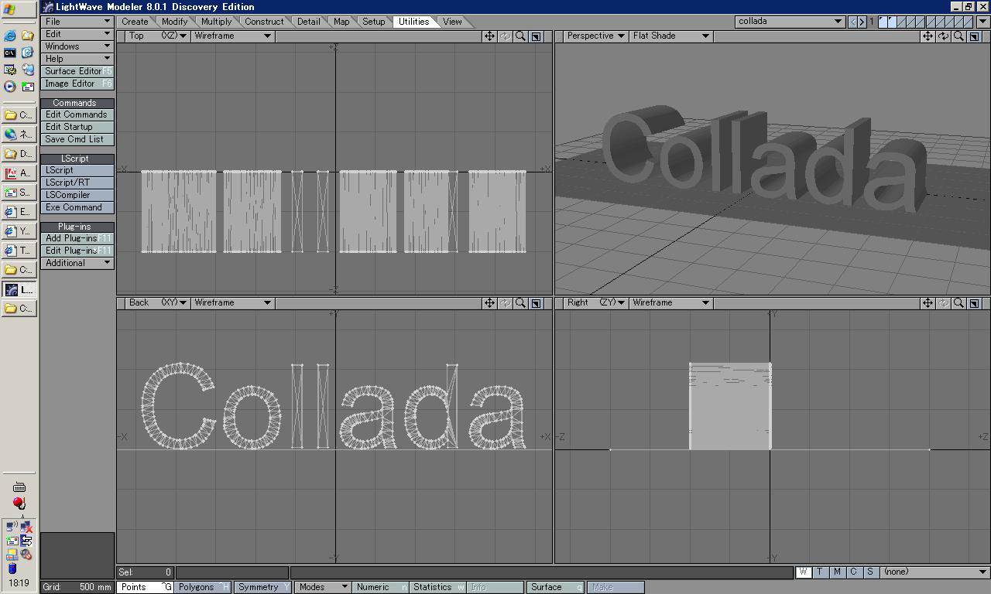
COLLADA in Lightwave™

Slide 15
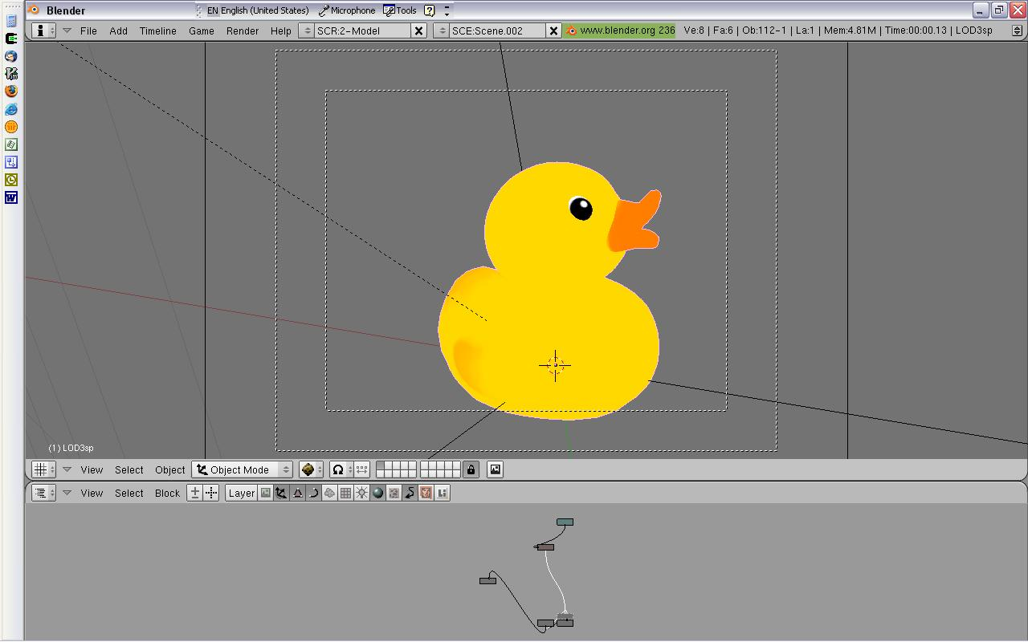
COLLADA in Blender™

Slide 16
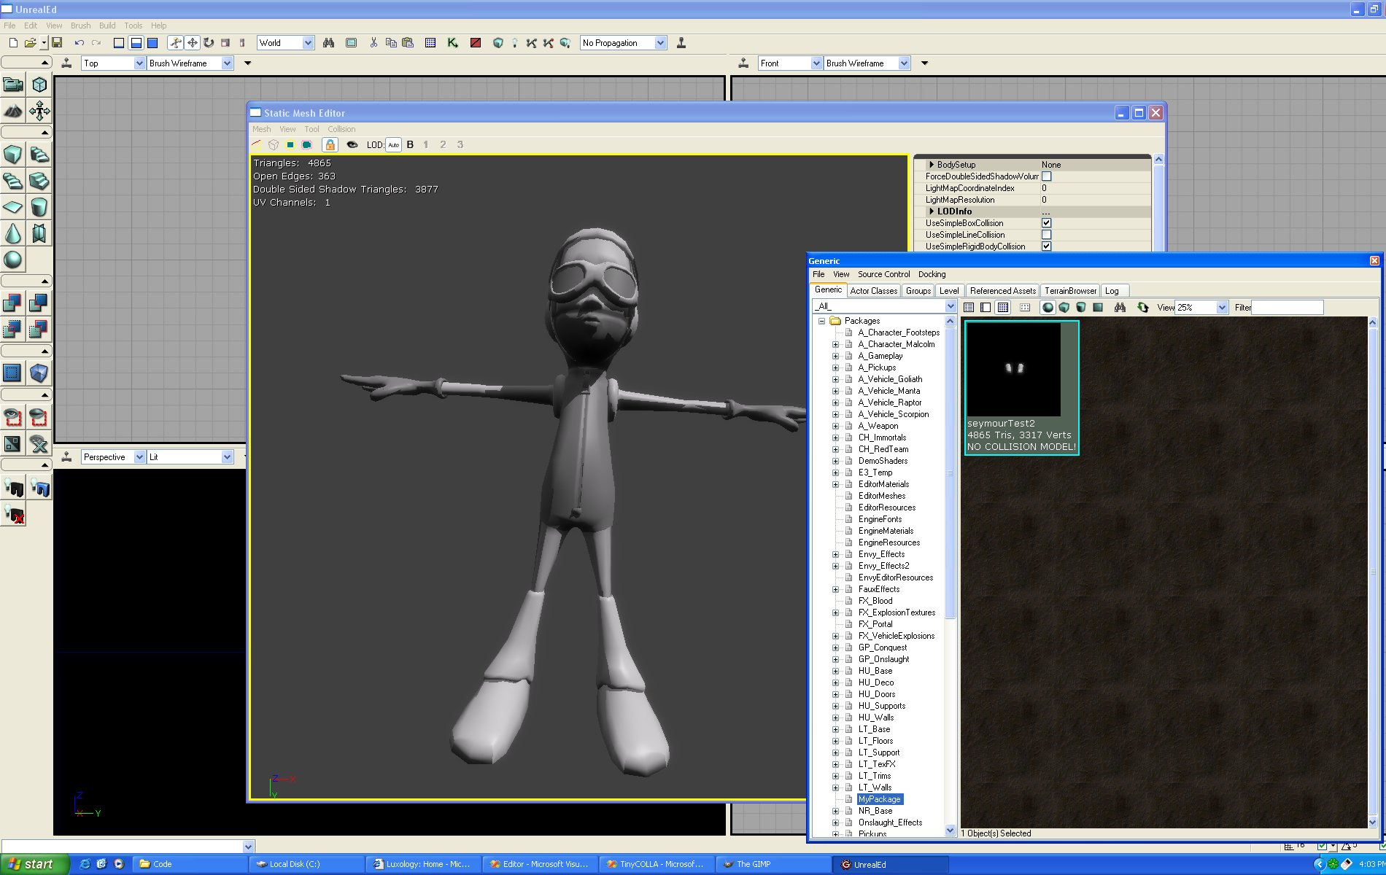
COLLADA in Unreal Engine™

Slide 17
What’s in COLLADA 1.4?
COLLADA FX
COLLADA Physics
Conformance and
Standardization
Reconfigurable
Production Pipelines

Slide 18
What are Shader Effects?
Shaders are programs that run on a GPU and produce graphical effects
Shader Effects additionally describe the environment that a shader is designed to run within:
  Set render states (culling, blending, depth tests, etc.)
  Which shader to use in which pipeline stage.
  Which parameters are automatically set by the runtime.
  Which parameters are tweakable by users.
  How many passes are required to finish the effect.
  Which textures are used during which pass.

Slide 19
The Shader Effects Problem
Each platform has its own proprietary file format (or none at all) that expresses multi-pass shader effects.
If you are designing a multi-platform game, you have a real resource management problem.
Cg
CgFX effect format
HLSL
.FX effect format
GLSL
No effect format yet
OpenGL|ES
No standard effect format

Slide 20
COLLADA FX
COLLADA FX is designed to:
  Allow interchange of complex, multi-pass shader effects.
  Encapsulate multiple descriptions of an effect.
    E.g. levels of detail, daytime/nighttime versions, etc.
  Encode shaders for multiple platforms in one file.
    e.g. CG and GLSL versions of your effect in one document.
  Supports both fixed-function and programmable-pipeline effects in the same format.

Slide 21
COLLADA FX
Additional features:
  COLLADA FX can be coded as stand-alone COLLADA documents.
    Each document can contain all the elements of an effect inline.
  COLLADA FX supports advanced shader language techniques.
    Use Interface objects and declare Unsized Arrays.
    Multiple Render Targets and off-screen buffers.
  Share simple parameters across all platforms
    Control multiple platforms or techniques with a single parameter.
  Share source code between multiple techniques.
  All elements can be annotated with meta-information

Slide 22
How COLLADA FX works
COLLADA FX does not attempt to create a single set of render states or an intermediate shader language
  Platform specific elements allow access to the full set of data types and render states for that platform
  COLLADA FX assumes the use of a Run-time API that holds state
  COLLADA FX does not require that a run-time supports a scripting interpreter
<effect id="MossyRockEffect">
<profile_GLSL id=“GLSL_medium_LOD”>
...
</profile_GLSL>
<profile_CG id="CG_with_lighting">
...
</profile_CG>
</effect>

Slide 23
Techniques and Passes
COLLADA FX files are structured into techniques and passes.
<effect id="Level3-spaceship-damaged ">
<profile_GLSL id="high-LOD-shadows">
<technique sid=“Multipass1”>
<code> ... </code>
<pass sid="shadow-pass">
...
</pass>
<pass sid="specular-reflection">
...
</pass>
</technique>
</profile_GLSL>
</effect>

Slide 24
Passes
Each pass sets render states and declares as many programmable pipeline stages as your platform supports
Uniform shader inputs can be bound to variables or literal values
Profiles without programmable shaders can only set render states
Render states can be set by literal values or by reading a parameter
<pass sid="pass0">
<shader stage="VERTEX">
<compiler_target>vs_2_x</compiler_target>
<name>vertex_function</name>
</shader>
<depth_test_enable> TRUE </depth_test_enable>
<depth_func> LEQUAL </depth_func>
<cull_face> BACK </cull_face>
<shader stage="FRAGMENT">
<compiler_target>ps_2_x</compiler_target>
<name>pixel_function</name>
<bind symbol="damage">
<param ref="damage_amount"/>
</bind>
</shader>
</pass>

Slide 25
Parameters
<effect id="ThinFilm2">
<profile_CG>
<include sid=“thin1” url="#thinfilm_code"/>
<technique sid=“Thin1”>
<annotate name="UIName">
<string>Light Pos 1</string>
</annotate>
<annotate name="Object">
<string>PointLight</string>
</annotate>
<annotate name="Space">
<string>World</string>
</annotate>
<setparam ref="LightPosP1">
<float3> 10.0 10.0 10.0 </float3>
</setparam>
...
Parameters declared within source code can be given values using <setparam>
Parameters can have multiple annotations. COLLADA FX does not interpret these annotations in any way
Parameters can be created from data types defined in source code using <newparam>

Slide 26
Render to Texture
COLLADA FX supports Multiple Render Targets using indexed output <surface> objects that can persist between passes in an effect.
<pass sid="pass0">
<color_target index="0"> color_surface </color_target>
<color_target index="1"> normal_surface </color_target>
<depth_target> depth_stencil_surface </depth_target>
<stencil_target> depth_stencil_surface </stencil_target>
<clear_color index="0"> 0 0 0 </clear_color>
<clear_color index="1"> 0 0 0 </clear_color>
<clear_depth> 1.0 </clear_depth>
<clear_stencil> 128 </clear_stencil>
<draw>SCENE</draw>
...
</pass>

Slide 27
Advanced Shaders
Cg style variable-length arrays and interface objects are supported by COLLADA FX
  Structures and Interfaces are instanced as parameters of type <usertype>
  Structures can be initialized by leaf-node order or by element name.
  Array types can be given a size at creation time or by setting the array length using <setparam>.
  After creation and setting up, these dynamically created parameters can be bound to uniform inputs, as usual, using <bind>.

Slide 28
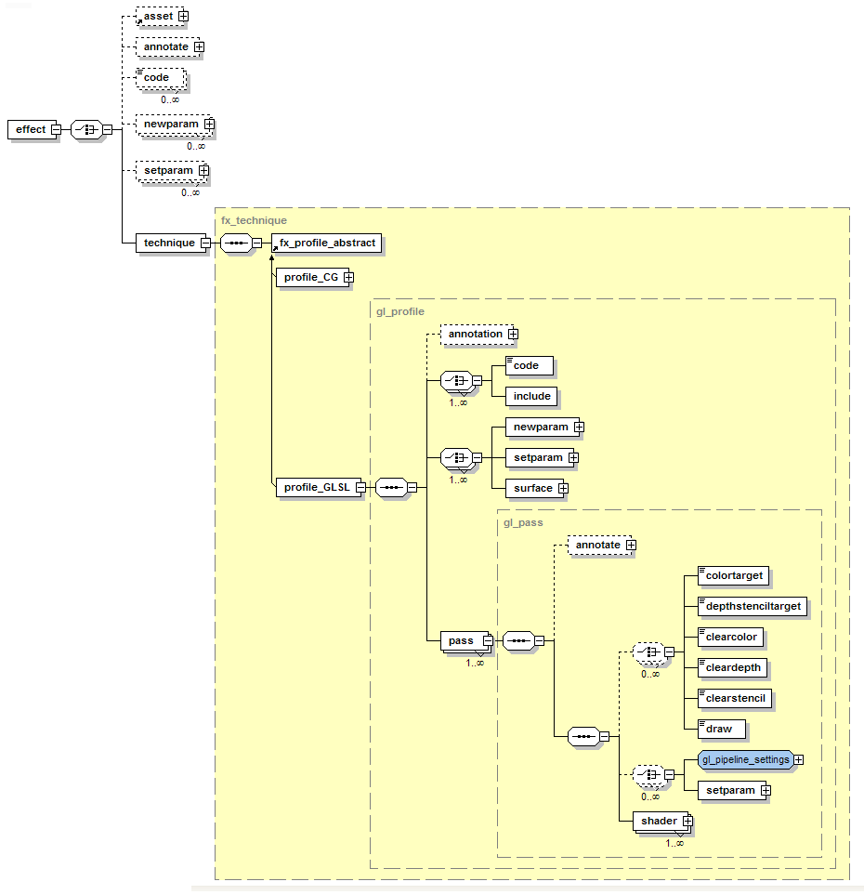
The COLLADA FX Schema
The schema is designed to be flexible and expressive – with clear ways to declare and implement effects.
There are clear, one-to-one mappings between a validating XML document and a sequence of calls in a each shader runtime.

Slide 29
Physical Simulation File Formats
Until now, no standard format existed for physical properties and physically simulated animation
  Every 3D API has their own file format
  Every 3D API has to provide their own export plugin for each DCC platform
There is no standard way to interchange the same physics settings across different physics engines
In many cases it is even impossible to author physical simulations without direct programming

Slide 30
COLLADA Physics
An API independent description of basic rigid body and articulated models
  Center of mass, initial velocity, moment of inertia, coefficient of friction, damping,
  coefficient of gravity, etc.
Declaration of simplified geometric or convex collision bounds for rigid bodies
Declare constrained joints and degrees-of-freedom and for compound models
Scene partitioning with static, dynamic and nonparticipating geometry

Slide 31
How COLLADA Physics Works
Properties are described as libraries of physical materials that can be applied to geometries
<library_physics_materials>
<physics_material id="WoodPhysMtl">
<technique_common>
<dynamic_friction sid=“X”> 0.12 </dynamic_friction>
<restitution> 0.05 </restitution>
<static_friction sid=“Y”> 0.23 </static_friction>
</technique_common>
</physics_material>
...
</library_physics_materials>

Slide 32
How COLLADA Physics Works
Physics Models are described by rigid bodies and constraints
<library_physics_models>
<physics_model id=“Model1”>
<rigid_body sid="Hammer_Rigid_Body">
</rigid_body>
<rigid_constraint sid=“Rigid_Hinge_Constraint">
</rigid_constraint>
</physics_model>
<physics_model id=“Model2”>
...
</physics_model>
</library_physics_models>

Slide 33
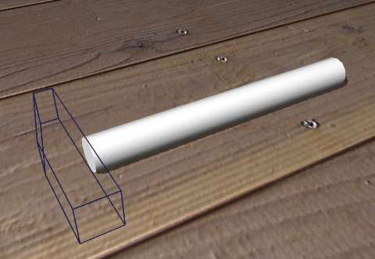
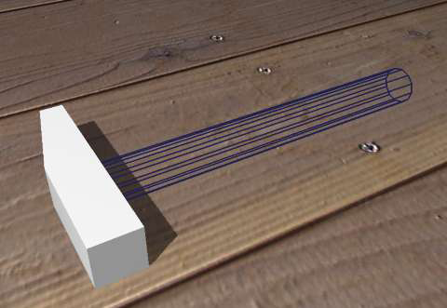
How COLLADA Physics works
Rigid Bodies are created from analytical shapes or convex hulls,
combined with physical materials
<rigid_body sid="Hammer_Rigid_Body">
<technique_common>
<mass> 1.25 </mass>
<shape>
<mass> 0.25 </mass>
<instance_physics_material url="#WoodPhysMtl"/>
<instance_geometry url="#hammerHandleForPhysics"/>
</shape>
<shape>
<mass> 1.0 </mass>
<instance_physics_material url="#SteelPhysMtl"/>
<instance_geometry url="#hammerHeadForPhysics"/>
<translate> 0.0 8.0 0.0 </translate>
</shape>
</technique_common>
</rigid_body>

Slide 34
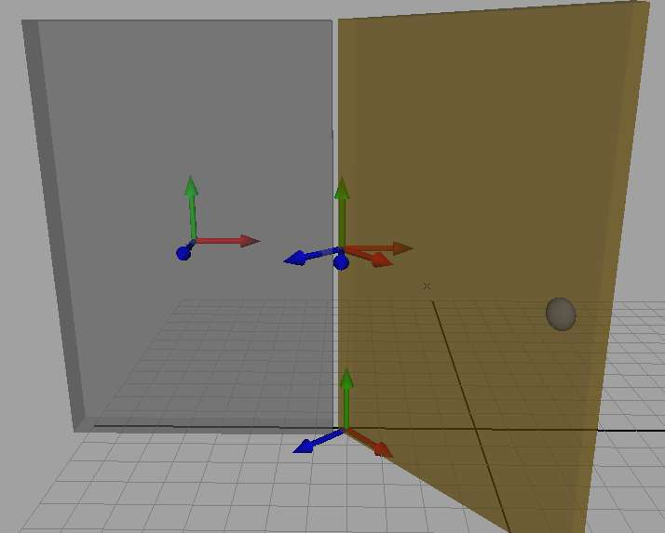
How COLLADA Physics works
Joint constraints can be applied to compound objects
<rigid_constraint id="rigidHingeConstraint">
<ref_attachment rigid_body="#wallRigidBody">
<translate sid="translate">5 0 0</translate>
</ref_attachment>
<attachment rigid_body="#doorRigidBody">
<translate sid="translate">0 8 0</translate>
<rotate sid="rotateX">0 1 0 -45.0</rotate>
</attachment>
<limits>
<swing_cone_and_twist>
<min>0 -90 0</min>
<max>0 +90 0</max>
</swing_cone_and_twist>
</limits>
</rigid_constraint>

Slide 35
Conformance Framework
COLLADA is a standard of The Khronos Group
  As part of the standardization effort, Khronos is creating a conformance test suite
In order to rely on a DCC plug-in, we need a lot of test cases to verify that the correct behaviour is observed.
  For example, COLLADA exporters must obey import and export rules
    If it's imported it must be exported, even if it's not recognized.
    Unrecognised data does not get transformed or discarded.
We want to help users and developers to have reliable, production ready exporters and importers for all DCC applications
To reach this goal:
  Khronos Adopters will use the conformance test suite to qualify their products against hundreds of test cases.
  Passing the conformance test earns Adopters the use of the COLLADA logo on their products.
  Customers can purchase tools with the COLLADA logo.

Slide 36
The COLLADA Conformance Suite
Currently over 500 feature tests and growing.
The COLLADA Conformance Test is available to Khronos Adopters for a fee
  To register as a Khronos Adopter visit http://www.khronos.org/members/join
200 Maya tests
150 XSI tests
150 3DS Max tests
30 XML parsing tests

Slide 37

COLLADA and The Khronos Group
Khronos is an independent organization with a strong representation in the 3D world, home to OpenGL ES, OpenML and other standards
COLLADA continues to develop under a strong Intellectual Property framework encompassing all Khronos member companies.
  Sony Computer Entertainment is a Khronos Promoter, to more actively participate in the development of open standards.
  Other Khronos members actively supporting COLLADA include:
    NVIDIA, AVID/Softimage, Autodesk M&E, Feeling Software, Nokia, and Emdigo

Slide 38
Tools for Asset Wrangling
Our ultimate goal is to provide a framework that allows users to reconfigure their own production pipelines using standard tools, with COLLADA as the interchange format between them
Our toolset consists of:
      1. The COLLADA Digital Asset Schema
      2. <asset> elements and Multi-Representation
      3. Standards based XML technologies
      4. Commercial tools for authoring, versioning, and database management

Slide 39
Asset Management
Asset elements are meta-data used to describe the history, meaning and uses of an asset.
  Most objects in a COLLADA document can have asset meta-data.
  Assets can have multiple representations.
  <asset> elements enable tracking of asset creation and ownership over time and across databases.
<asset>
<contributor>
<author>Joe Schmoe</author>
<authoring_tool>Maya Collada exporter v0.7.4</authoring_tool>
</contributor>
<created>2004-12-20T22:10:18Z</created>
<keywords>Blink animation level_04</keywords>
<modified>2004-12-20T22:10:18Z</modified>
<revision>1.04</revision>
<unit name=“millimeter" meter="0.001"/>
<up_axis>Y_UP</up_axis>
</asset>

Slide 40
Towards a Makefile for 3D Assets
Asset elements can make pipeline processing more efficient:
  Parent-child relationships can be used to rebuild or re-export only those assets affected by an edit.
  <asset> elements can be used to guide automatic generation scripts by recording command lines, parameters, tools and settings.
  <asset> elements allow integration with Versioning Systems at a finer granularity, so assets no longer need to be fragmented into thousands of individual files.
  Asset management is an active area of research, join the COLLADA working group!

Slide 41
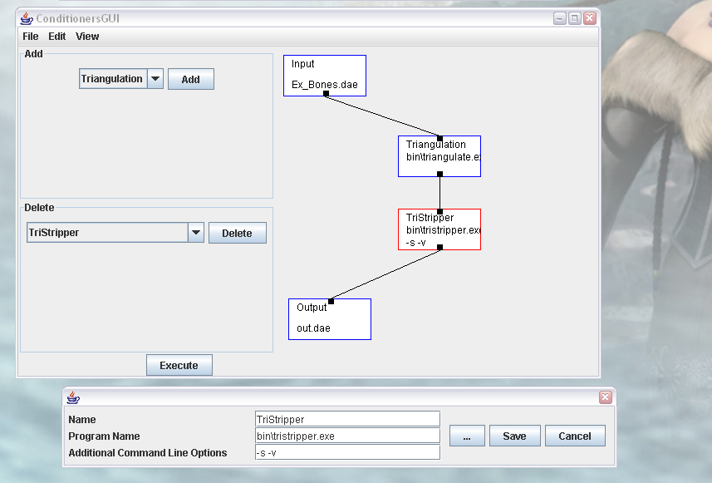
Pipeline Editors
Joining tools called “asset conditioners” together should be simple, like connecting nodes in a graph
Designing your data pipeline out of modular components enables experimentation and optimisation
Asset conditioners can be small efficient programs dedicated to a single task or algorithm
Java-based pipeline generator

Slide 42
Development Roadmap 2006
18 January March 24 April 1 June 1 August 1 September 23 October 1 November |  | COLLADA v1.4.0 specification released. COLLADA has strong presence at GDC. Khronos work group meets in Tokyo. COLLADA v1.4.1 schema patch release. COLLADA at SIGGRAPH. COLLADA at Eurographics. Khronos work group meets in London. COLLADA 1.4.2 schema patch release.

Slide 43
Summary
COLLADA is an open standard for the
interactive entertainment industry
Academic Researchers, please investigate COLLADA!
  Collaborative, many open source projects including:
    COLLADA plug-in for Maya - http://sourceforge.net/projects/colladamaya
    COLLADA DOM - http://sourceforge.net/projects/collada-dom
    COLLADA plug-in for Blender - http://sourceforge.net/projects/colladablender
    COLLADA plug-in for OpenSceneGraph - http://sourceforge.net/projects/osgdb-collada
  Make tools and extend the standard.
Read the documentation and visit the Khronos website at: http://khronos.org/collada
Join Khronos, join a working group and help define the standard.

