Slide 1
A Technical Introduction to OpenVG
  Daniel Rice
  Senior Staff Engineer
  Sun Microsystems, Inc.

Slide 2
OpenVG Timeline
OpenVG 1.0 was ratified in August, 2005
OpenVG 1.0.1 will be ratified in the next 2 months
  This specification contains clarifications only
OpenVG 1.0.1 Conformance Tests will be available in August
OpenVG 1.1 is being defined now
Possible 1.1 Features Include:
  Accelerated text
  Flash-compatible rendering
  Willing to consider other new features
Target date for 1.1 is Q1, 2007

Slide 3
The OpenVG Pipeline
OpenVG defines a hardware pipeline for paths and images
Path Definition & Setting of API Parameters
Stroking
  Line width, joins & caps, dashing, etc.
Transformation
  2x3 and 3x3 transformations
Rasterization
Clipping & Masking
  Scissoring rectangles, alpha mask
Paint Generation & Image Interpolation
  Flat color, gradient, or pattern paint
Blending & Antialiasing
  Multiple blend modes
Dithering
OpenVG also supports Image Filters
Path Definition &
Setting of API Parameters
Stroking
Transformation
Rasterization
Clipping and Masking
Paint Generation
Blending
Dithering

Slide 4
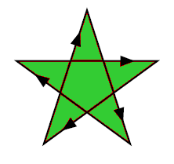
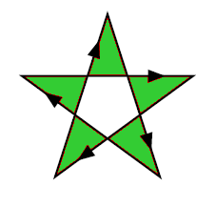
Path Definition
MOVE_TO, LINE_TO, QUAD_TO, CUBIC_TO, CLOSE_PATH
Elliptical Arcs
Absolute / Relative Coordinates
Smooth Curves
Path Interpolation
Path Queries:
  Bounding Boxes
  Transformed Bounding Boxes
  Point along path
  Tangent along path
Non-Zero and Even-Odd fill rules
(px, py)
(sx, sy)
LINE_TO
MOVE_TO
CUBIC_TO
(ox, oy)

Slide 5
Setting API Parameters
OpenVG follows the OpenGL model:
  vg{Get,Set}{f,i,fv,iv}
  vg{Get,Set}Parameter{f,i,fv,iv}
Settable parameters:
  VG_MATRIX_MODE, VG_FILL_RULE, VG_IMAGE_QUALITY, VG_RENDERING_QUALITY, VG_BLEND_MODE, VG_IMAGE_MODE, VG_SCISSOR_RECTS, VG_STROKE_LINE_WIDTH, VG_STROKE_CAP_STYLE, VG_STROKE_JOIN_STYLE, VG_STROKE_MITER_LIMIT, VG_STROKE_DASH_PATTERN, VG_STROKE_DASH_PHASE, VG_TILE_FILL_COLOR, VG_CLEAR_COLOR, VG_MASKING, VG_SCISSORING, VG_PIXEL_LAYOUT, VG_FILTER_FORMAT_LINEAR, VG_FILTER_FORMAT_PREMULTIPLIED, VG_FILTER_CHANNEL_MASK
Read-only values:
  VG_MAX_SCISSOR_RECTS, VG_MAX_DASH_COUNT, VG_MAX_KERNEL_SIZE, VG_MAX_SEPARABLE_KERNEL_SIZE, VG_MAX_COLOR_RAMP_STOPS, VG_MAX_IMAGE_WIDTH, VG_MAX_IMAGE_HEIGHT, VG_MAX_IMAGE_PIXELS, VG_MAX_IMAGE_BYTES, VG_MAX_FLOAT

Slide 6
Stroking
Stroking takes a path and defines an outline around it:
  Line Width
  End cap style (Butt, Round, or Square)
  Line join style (Bevel, Round, or Miter)
  Miter limit (to convert long miters to bevels)
  Dash array and offset
Miter Length
Dash array = { 10, 20, 30, 40} / Dash Phase = 35
25
10
30
10
30
10
30
...

Slide 7
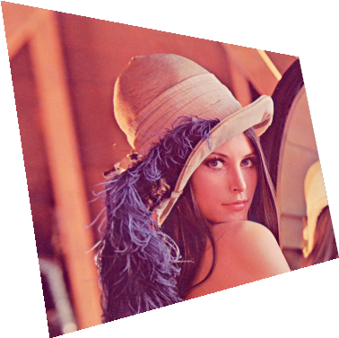
Transformations
Paths use 2x3 affine transformations
Images use 3x3 perspective transformations
Transformation functions are similar to OpenGL:
  vgLoadIdentity
  vgLoadMatrix
  vgGetMatrix
  vgMultMatrix
  vgScale
  vgRotate
  vgTranslate
  vgShear
$\left[\begin{matrix}1.080 & 0.101 & 0 \\ 0.209 & 0.691 & 0 \\ 1.28×{10}^{−3} & −1.19×{10}^{−3} & 1\end{matrix}\right]$

Slide 8
Rasterization (continued)
The goal of rasterization is to determine a filtered alpha value for each pixel, based on the geometry around that pixel
Filters may be up to 3 pixels in diameter
0
0
.1
.4
.5
.2
0
0
0
.3
.8
1
1
.9
.4
0
.4
.8
.9
1
1
1
1
.8
0
.6
.4
.3
.7
1
1
1
.3
0
0
0
.2
1
1
1
.5
0
0
0
.1
1
1
1
.5
0
0
0
.1
.9
1
.9
.2
0
0
0
0
.3
.5
.2
0

Slide 9
Scissoring
Only pixels inside a set of scissor rectangles are drawn
Scissoring is disabled by default
Display
Scissor Rectangles
Pixels drawn
Pixels not drawn

Slide 10



Masking
In addition to scissoring, a per-pixel mask may be applied
The mask has an alpha value at each pixel that is multiplied by the alpha from the rendering stage
May be used to “cut out” an area, create area transitions
Mask values may be modified using image data
  Fill, Clear, Set, Add, Subtract, Intersect
×
=
×
=

Slide 11
Masking (continued)
×
Alpha from Path Data
Mask Alpha
0
0
.1
.4
.5
.2
0
0
0
0
0
0
0
0
0
0
0
.3
.8
1
1
.9
.4
0
0
1
1
1
1
1
0
0
.4
.8
.9
1
1
1
1
.8
0
0
1
1
1
1
1
0
0
.6
.4
.3
.7
1
1
1
.3
×
0
1
1
1
1
1
1
1
0
0
0
.2
1
1
1
.5
0
0
0
1
1
1
1
1
0
0
0
.1
1
1
1
.5
0
0
0
0
0
1
0
0
0
0
0
.1
.9
1
.9
.2
0
0
0
0
0
.5
.5
.5
0
0
0
0
.3
.5
.2
0
0
0
0
0
0
.5
.5
.5

Slide 12
Masking (continued)
= Resulting Masked Alpha
0
0
0
0
0
0
0
0
0
.3
.8
1
1
.9
0
0
0
.8
.9
1
1
1
1
0
0
0
.4
.3
.7
1
1
1
.3
0
0
0
.2
1
1
1
.5
0
0
0
0
0
1
0
0
0
0
0
0
0
.5
.4
.1
0
0
0
0
0
.2
.1
0

Slide 13

Paint Generation
r
Paint is generated pixel-by-pixel and applied to geometry
The alpha from the previous stage (rendering + masking) is used to determine how much paint to apply
Separate paint objects for stroking, filling
Paint is transformed by an affine transform
Four types of paint are supported:
  Flat color paint
  Linear gradient paint: points (x1, y1) and (x2, y2), color ramp
  Radial gradient paint: center (x, y), focus (x, y), radius, color ramp
  Pattern paint based on an image, tiling mode
(x1, y1)
(cx, cy)
(x2, y2)

Slide 14
Blending
Combine masked alpha from path with paint alpha
Blend the result onto the drawing surface
Blending is a function of:
  The paint (R, G, B) color
  The masked alpha value (path alpha × mask alpha × paint alpha)
  The destination (R, G, B) color
  The destination alpha value (1 if no stored alpha)
There are 8 blending functions:
  Porter-Duff “source” mode (copy source to destination)
  Porter-Duff “source over destination”/ “destination over source”
  Porter-Duff “source in destination”/ “destination in source”
  Lighten (choose lighter of source and destination)
  Darken (choose darker of source and destination)
  Multiply (black source pixel forces black, white leaves unchanged)
  “Screen”(white source pixel forces white, black leaves unchanged)
  Additive (add pixel values, add alpha up to 1)

Slide 15




Dithering
As a final stage, the bit depth of pixels may be reduced using dithering
The details of dithering are platform-specific
8/8/8 RGB
+
Dither Values
8/8/8 RGB + Dither
Extract Upper Bits
5/6/5 RGB

Slide 16
Images
Images are defined using one of 13 pixel formats
  Linear or non-linear (sRGB) color spaces
  Linear or non-linear grayscale
  Pre-multiplied or non-premultiplied alpha
  8/8/8, 5/6/5, 5/5/5/1, 4/4/4/4 bit depths (< 8 non-linear color only)
  1-bit Black & White (e.g., for Fax applications)
Images may be stored in accelerated memory
Image filters may be applied:
  Color Matrix
  Convolve, Separable Convolve, Gaussian Blur
  Lookup, LookupSingle
Images may be drawn in perspective
Image may be used as a stencil to apply paint
  Very useful for drawing anti-aliased text
Image and paint colors may be multiplied together

Slide 17
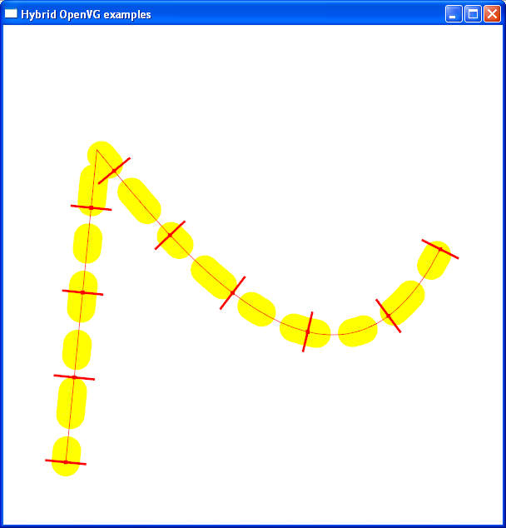
Demo - Stroking
VGfloat d[] = { 5, 15, 10, 15 };
vgSetfv(VG_DASH_PATTERN, 4, d);
LINE_TO
VGPath path = vgCreatePath(...);
cmd[0] = VG_MOVE_TO_ABS;
cmd[1] = VG_LINE_TO_ABS;
cmd[2] = VG_CUBIC_TO_ABS;
coord[0] = ...;
vgAppendPathData(...)
vgDrawPath(path, VG_STROKE_PATH);
CUBIC_TO
vgPointAlongPath
MOVE_TO

Slide 18
Creating a Path
  VGubyte * commands;
  VGfloat * coords;
  VGint numCmds, numCoords;
  // 0,0 is O.K. for numCommands, numCoords
  VGPath path = vgCreatePath(VG_PATH_FORMAT_STANDARD,
  VG_PATH_DATATYPE_F,
  1.0f, 0.0f, // scale,bias
  numCmds, numCoords, VG_PATH_CAPABILITY_ALL);
  commands[0] = VG_MOVE_TO_ABS;
  coords[0] = ...; coords[1] = ...; /* x,y */
  /* ... */
  vgAppendPathData(path, numCmds, commands, coords);

Slide 19
Creating Color Paint
VGfloat color[] = { 1.0f, 1.0f, 0.0f, 1.0f }; /* RGBA */
VGPaint colorPaint = vgCreatePaint();
/* Paint Type */
vgSetParameteri(paint,
VG_PAINT_TYPE, VG_PAINT_TYPE_COLOR);
/* Paint Color */
vgSetParameterfv(paint, VG_PAINT_COLOR, 4, color);

Slide 20
Setting Stroking Parameters
VGfloat lineWidth, miterLimit;
VGint capStyle, joinStyle;
VGfloat dashPattern[NUM_DASHES], dashPhase;
vgSetParameterf(VG_STROKE_LINE_WIDTH, lineWidth);
vgSetParameteri(VG_STROKE_CAP_STYLE, capStyle);
vgSetParameteri(VG_STROKE_JOIN_STYLE, joinStyle);
vgSetParameterf(VG_STROKE_MITER_LIMIT, miterLimit);
vgSetParameterfv(VG_STROKE_DASH_PATTERN,
NUM_DASHES, dashPattern);
vgSetParameterfv(VG_STROKE_DASH_PATTERN,
0, (VGfloat *) 0);
vgSetParameterf(VG_STROKE_DASH_PHASE, dashPhase);

Slide 21
Drawing the Path
VGPath path;
VGPaint fillPaint, strokePaint;
VGboolean doFill, doStroke;
if (doFill) {
vgSetPaint(fillPaint, VG_FILL_PATH);
}
if (doStroke) {
vgSetPaint(strokePaint, VG_STROKE_PATH);
}
if (doFill || doStroke) {
vgDrawPath(path, (doFill ? VG_FILL_PATH : 0) |
(doStroke ? VG_STROKE_PATH : 0));
}

Slide 22
Finding Points Along the Path
/* Determine # of path segments and path length */
VGint numSegments = vgGetParameteri(path,
VG_PATH_NUM_SEGMENTS);
VGfloat length = vgPathLength(path, 0, numSegments);
/* Get equally-spaced points and tangents */
for (i = 0; i < numTicks; i++) {
VGfloat x, y, tx, ty;
vgPointAlongPath(path, 0, numSegments,
i*length/numTicks,
&x, &y, &tx, &ty);
}
Tangent: draw line from (x, y) to (x + tx, y + ty)
Normal: draw line from (x, y) to (x + ty, y – tx)
N
T

Slide 23
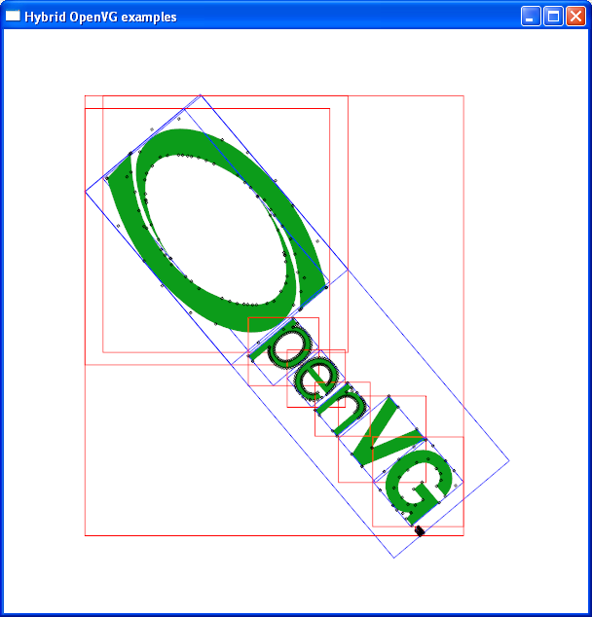
Demo – Bounding Boxes
Control Points
vgGetBounds(path)
vgGetTransformedBounds(path)
T

Slide 24
Bounding Boxes
VGPath path, bounds, t_bounds;
VGfloat x, y, width, height;
vgLoadMatrix(...); /* User transformation */
vgPathBounds(path, &x, &y, &width, &height);
vguRect(bounds, x, y, width, height); // bounds <- rect
vgDrawPath(path, VG_STROKE_PATH);
vgDrawPath(bounds, VG_STROKE_PATH);
vgPathTransformedBounds(path, &x, &y, &width, &height);
vguRect(t_bounds, x, y, width, height);
vgLoadIdentity(); // Draw bounds in device coordinates
vgDrawPath(t_bounds, VG_STROKE_PATH);

Slide 25
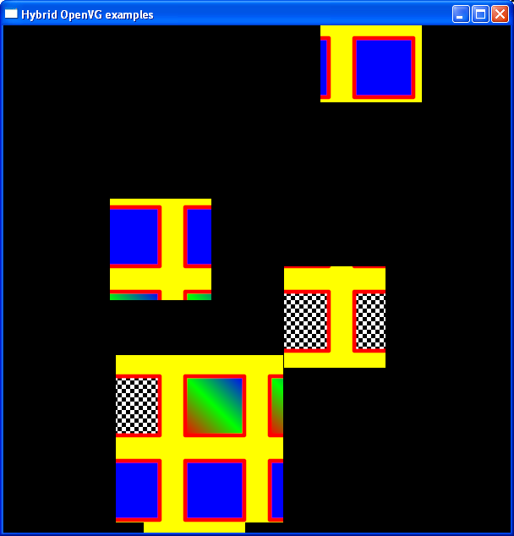
Demo - Scissoring

Slide 26
Enabling Scissoring
VGfloat rects[4*NUM_RECTS];
vgSeti(VG_SCISSORING, VG_TRUE);
rects[0] = x0;
rects[1] = y0;
rects[2] = width0;
rects[3] = height0;
...
vgSetiv(VG_SCISSOR_RECTS, 4*NUM_RECTS, rects);

Slide 27
Creating Linear Gradient Paint
VGfloat lgParams[4]; /* x0, y0, x1, y1 */
VGfloat stops[5*NUM_STOPS];
VGPaint lPaint = vgCreatePaint();
/* Paint Type */
vgSetParameteri(lPaint, VG_PAINT_TYPE,
VG_PAINT_TYPE_LINEAR_GRADIENT);
/* Gradient Parameters */
vgSetParameterfv(lPaint, VG_PAINT_LINEAR_GRADIENT,
4, lgParams);
/* Color Ramp */
vgSetParameterfv(lPaint, VG_PAINT_COLOR_RAMP_STOPS,
5*NUM_STOPS, stops);
vgSetParameteri(lPaint, VG_PAINT_COLOR_RAMP_SPREAD_MODE,
VG_SPREAD_MODE_PAD);

Slide 28
Creating Radial Gradient Paint
VGfloat rgParams[4]; /* cx, cy, fx, fy, r */
VGfloat stops[5*NUM_STOPS];
VGPaint rPaint = vgCreatePaint();
/* Paint Type */
vgSetParameteri(rPaint, VG_PAINT_TYPE,
VG_PAINT_TYPE_RADIAL_GRADIENT);
/* Gradient Parameters */
vgSetParameterfv(rPaint, VG_PAINT_RADIAL_GRADIENT,
4, rgParams);
/* Color Ramp is the same as for linear gradient */

Slide 29
Creating Pattern Paint
/* Create and fill pattern image */
VGint * data;
VGint w, h;
VGImage pattern = vgCreateImage(VG_sRGBX_8888, w, h,
VG_IMAGE_QUALITY_FASTER);
vgImageSubData(pattern, data, 4*w, /* stride */
VG_sRGBX_8888, 0, 0, w, h);
VGPaint pPaint = vgCreatePaint();
vgSetParameteri(pPaint, VG_PAINT_TYPE,
VG_PAINT_TYPE_PATTERN);
vgSetParameteri(pPaint, VG_PAINT_PATTERN_TILING_MODE,
VG_TILE_REPEAT);
vgPaintPattern(pPaint, pattern);

Slide 30
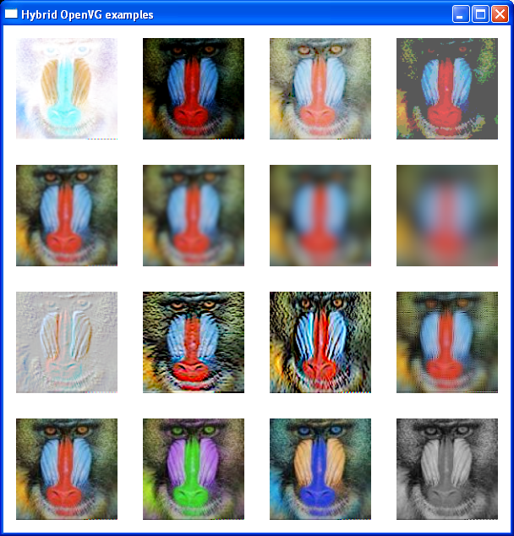
Demo – Image Filters
vgLookup: Invert, Darken, Lighten, “Posterize”
vgGaussianBlur: 1, 2, 5, 10
vgConvolve: Emboss, Edges, ?
vgColorMatrix: Original,
Swap RG, Swap RB, Gray

Slide 31
Using Image Filters
/* Lookup */
VGubyte r[256], g[256], b[256], a[256];
vgLookup(dst, src, r, g, b, a, VG_TRUE, VG_FALSE);
/* Gaussian Blur */
vgGaussianBlur(dst, src, radius, radius, VG_TILE_PAD);
/* Convolve */
VGshort kernel[9] = { 1, 1, 1, 1, 1, 1, 1, 1, 1 };
vgConvolve(dst, src, 3, 3, 1, 1,
kernel, 1.0f/9.0f, 0.0f, VG_TILE_PAD);
/* Color Matrix */
VGfloat cmatrix[20]; // r’ = ?r + ?g + ?b + ?a + ?
vgColorMatrix(dst, src, cmatrix);

Slide 32
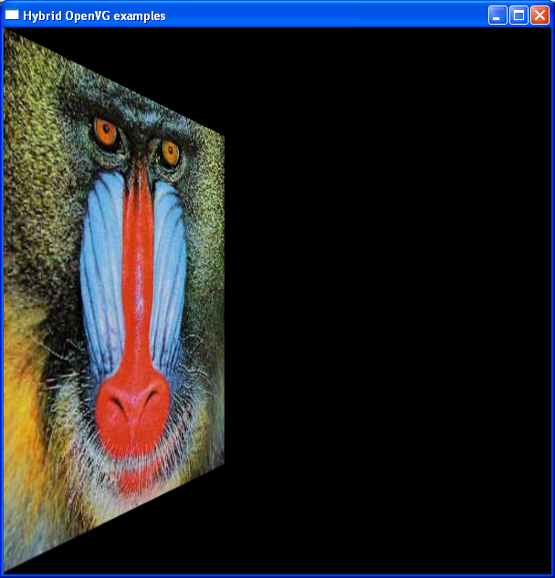
Demo – Image Warping
w
5
(x,h-y)
Define matrix such that:
(0,0) → (0,0)
(0,h) → (0, h)
(iw, 0) → (x, y)
(iw, ih) → (x, h - y)
Don’t forget to restore the matrix mode!
h
ih
iw
(x,y)

Slide 33
Warping Images
VGImage image;
VGfloat x, y, imW, imH, h;
VGfloat matrix[9];
// Derive projective matrix from corner points
vguWarpQuadToQuad(0, 0, imW, 0, imW, imH, 0, imH,
0, 0, x, y, x, h – y, 0, h,
matrix);
vgSeti(VG_MATRIX_MODE, VG_MATRIX_IMAGE_USER_TO_SURFACE);
vgLoadMatrix(matrix);
vgDrawImage(image);
/* Restore matrix mode */
vgSeti(VG_MATRIX_MODE, VG_MATRIX_PATH_USER_TO_SURFACE);

Slide 34
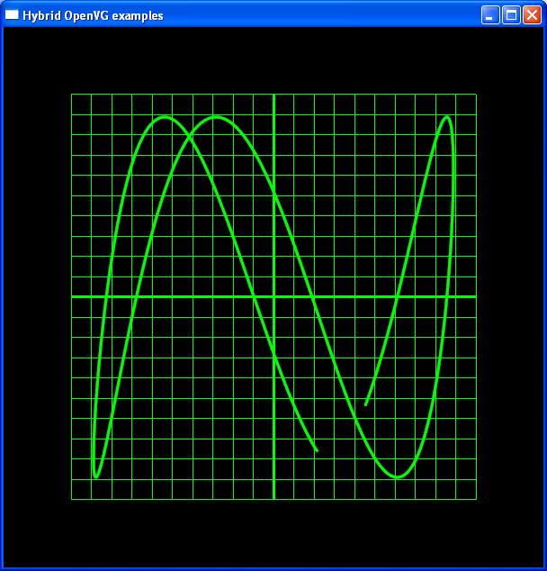
Demo – Oscilloscope
(x,h-y)
Draw background grid
Generate path from
(cos(a*t), sin(b*t))
Stroke path
Modify a, b interactively
ih
iw
(x,y)

Slide 35

Any Questions?

