Slide 1

Bitboys G12
SVG and OpenVG Vector Graphics Hardware Accelerator

Slide 2
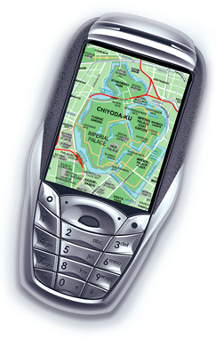
Bitboys G12
A tiny graphics processor for wireless and embedded devices
  Provided to silicon and handset vendors as a hardware IP core
Can be easily integrated into a wide range of devices
  Especially useful on lower-end mobile phones for creating
  slick user interfaces and speeding up application graphics
Accelerates rendering of vector graphics:
  Anti-aliased polygons, lines, curves and strokes
  Paint effects, such as color gradients and textures
  Text (also non-latin text rendering)
  Also supports 2D bitmap graphics acceleration
Supports OpenVG 1.0 and SVG Tiny 1.2
Easily 100x faster than software rendering

Slide 3
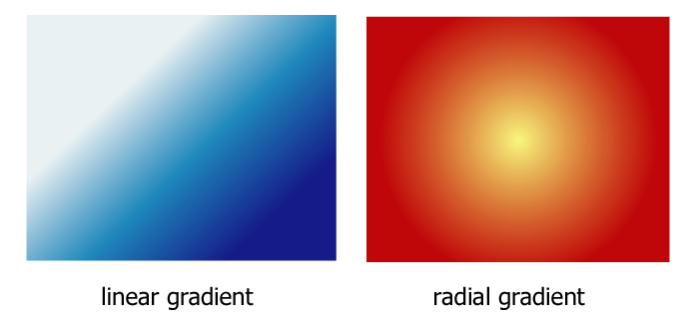
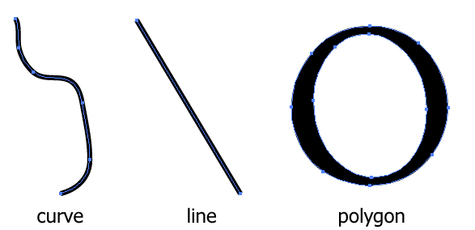
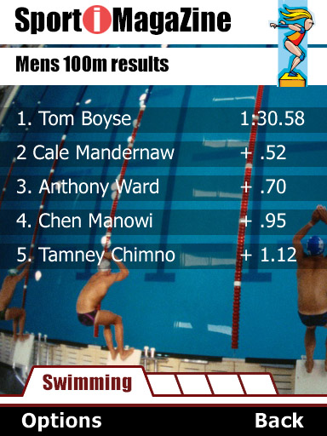
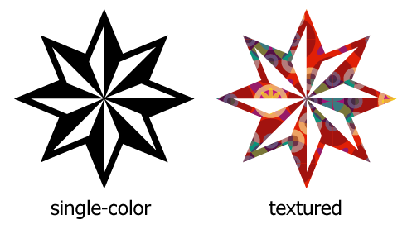


What is vector graphics?

Slide 4
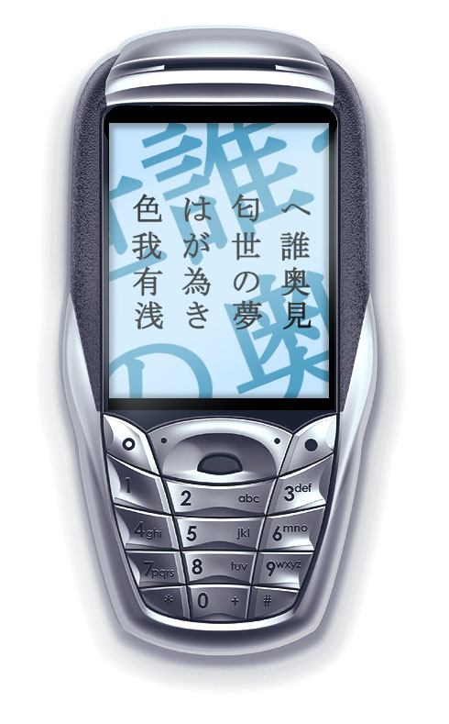
Vector graphics content on wireless devices
Slick user interfaces
  Scalable, animated, different aspect ratios, high quality rendering
Advertisements, animated and interactive
  Great value for mobile phone operators
High-quality scalable, rotating vector graphics maps
Cartoons and anime
  Stream large amounts of high-quality vector graphics
  format cartoons to user’s mobile phone
Greeting cards
  Easily beats SMS
Games and applications

