Slide 1

OpenVG Overview
Hwanyong Lee
Chief of Research Institutes, MTIS, KOREA

Slide 2
Developing Mobile Solution
  File systems for mobile phone
  Multi-media Solutions for mobile phone
  Mobile Phone UI
  Mobile Phone SI
Solutions based on Khronos Standard
  alexGL™ & alexVG™
    OpenVG 1.0 – for ARM & XScale Platform
      Linux & Window Platform
      SVGPlayer on OpenVG
      Today’s Demo is about alexVG™ for Win - PC Version OpenVG 1.0
    OpenGL ES 1.0, 1.1 – for ARM & XScale Platform

Slide 3
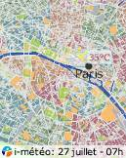
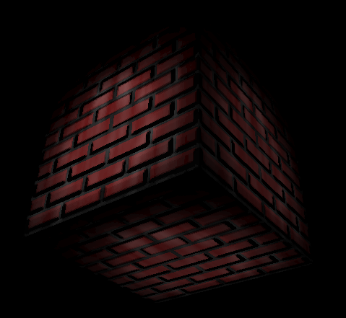

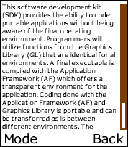
Strong Need for Vector Graphics
Many applications need low-level 2D vector graphics primitives
  Portable mapping and GPS applications
  Vector font
  Games
  Advanced user interfaces and screen savers
Many vector graphics formats in use
  Flash, SVG, PDF, Postscript, Vector fonts etc. etc.
Scalable graphics = Easier to port content

Slide 4

Why is New API Needed?
No existing API, including OpenGL ES, can cover all different requirements for handhelds
High-quality vector graphics
High performance
Low power consumption
Vector graphics acceleration brings high value to handheld devices
Code portability &
Seamless transition from SW implementation to HW implementation

Slide 5
OpenVG in a Nutshell
Open royalty-free standard
Low-level API for 2D vector graphics
  With a focus on enabling hardware acceleration
  Should also allow efficient SW implementations
OpenVG ACCELERATES existing formats
  NOT a competitor to existing formats
Applications
SVG, Flash, Font Package etc..
2D Hardware Acceleration

Slide 6
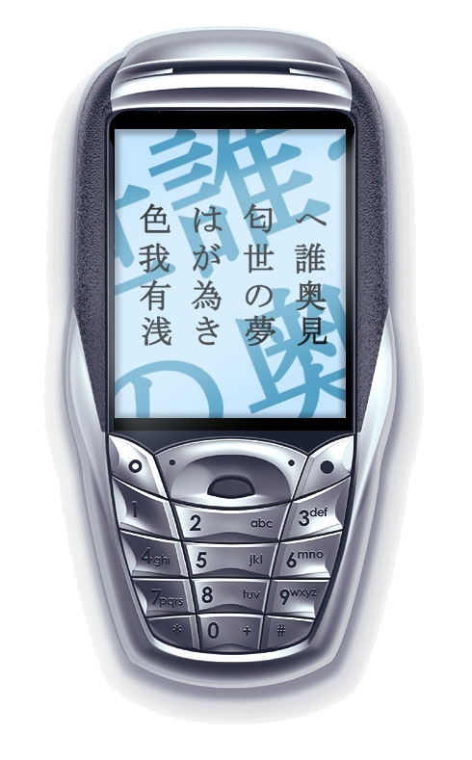
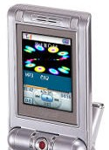
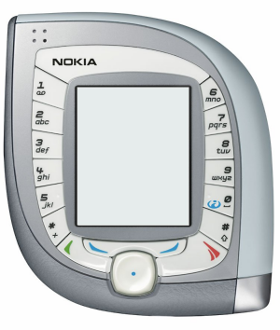
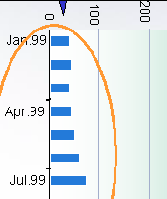

OpenVG Design Philosophy
Provide a low-level hardware acceleration abstraction layer
  Based on Bezier curves – not polygons
  Similar level to OpenGL ES for 3D graphics
Use OpenGL-style syntax where possible
  Make learning OpenVG as easy as possible for OpenGL developers
Allow flexibility in the way acceleration can be implemented
  Encourages healthy market competition between hardware vendors

Slide 7



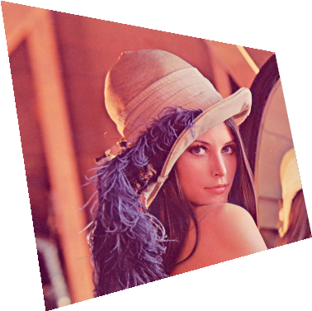


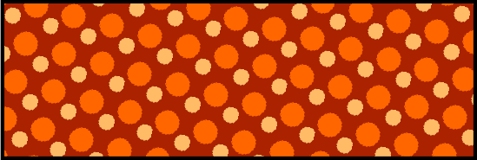
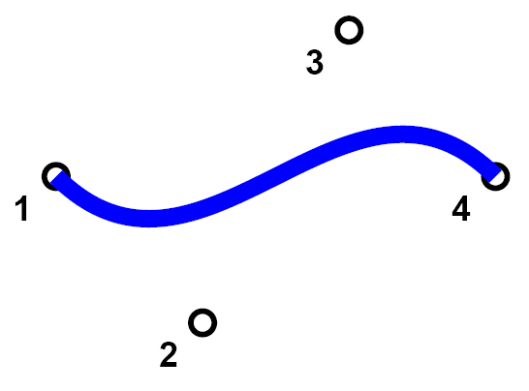


OpenVG Features
Core API
  Coordinate Systems and Transformations
  (Image drawing uses a 3x3 perspective
  transformation matrix)
  Viewport Clipping, Scissoring and Alpha Masking
  Paths - Line, Arc, Cubic Bezier, Quadratic Bezier,
  Stroked Path, Patter fill, gradation, Anti-aliasing, Path Interpolation
  Images
  Image Filters
  Paint (gradient and pattern)
  Blending
The VGU Utility Library
  Higher-level Geometric Primitives
  Image Warping

Slide 8










OpenVG Features : Stroke & Fill Sample

Slide 9
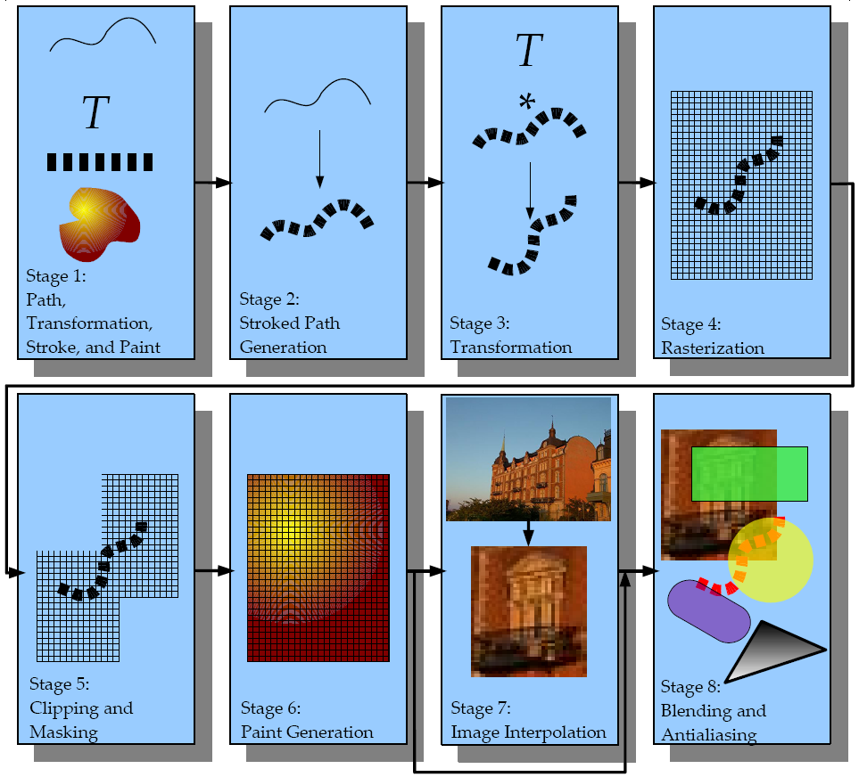
OpenVG Pipeline
AlexVG Pipeline
Definition of path, transformation, stroke and paint
Stroked path generation
Transformation
Rasterization
Clipping and Masking
Paint Generation
Image Interpolation
Blending

Slide 10

Use with other Khronos APIs
EGL– portable layer for graphics resource management
  Graphics context management
  Surface/buffer binding
  Rendering synchronization
The new EGL 1.2 supports OpenVG
Use cases of OpenVG + OpenGL ES
  OpenVG renders front/back ground of OpenGL ES application (surface sharing)
  OpenVG renders on OpenGL ES texture buffer
  OpenGL ES renders on OpenVG image buffer
EGL
Graphics context
Surface/buffer

Slide 11
OpenVG 1.0 Released!
http://www.khronos.org/openvg/
Available now
Specification
Header file
Past DevU presentations
Will be available soon
RI binary from Hybrid
Sample codes
OpenVG Adopter
Similar process as OpenGL ES is planned
Conformance test will be available in Q405

Slide 12
OpenVG Roadmap
Evolution continues!
Application using OpenVG
OpenVG Implementation
OpenVG 1.0 Spec.
OpenVG 1.0
Conformance Test
Device w/ OpenVG
Next OpenVG Preparation
2005 | 2006 | 2007

Slide 13
MTIS alexVG™ Demos

Slide 14

Any Questions?

