Slide 1

OpenVG Overview
Hwanyong Lee
Chief of Research Institutes, MTIS, KOREA

Slide 2
Developing Mobile Solution
  File systems for mobile phone
  Multi-media Solutions for mobile phone
  Mobile Phone UI / Mobile Phone SI
Solutions based on Khronos Standard (alexGL™ & alexVG™)
  alexVG™ : OpenVG 1.0 for PC, ARM, Xscale Platform
    Linux & Windows Platform
    SVGPlayer on alexVG™
    Today’s Demo is
      alexVG™ for Windows - PC Windows Platform
      alexVG™ for Xscale - PDA WinCE Platform (MMX Accelerated using Intel GPP)
  alexGL™ : OpenGL ES 1.1 for ARM, Xscale Platform
  MTIS is developing OpenVG Conformance Test Software

Slide 3
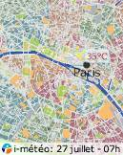
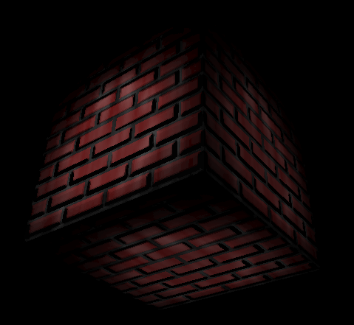
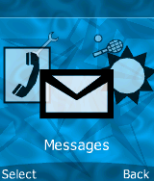
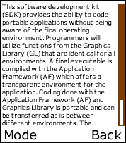
Strong Need for Vector Graphics
Many applications need low-level 2D vector graphics primitives
  Portable mapping and GPS applications
  Vector font
  Games
  Advanced user interfaces and screen savers
Many vector graphics formats in use
  Flash, SVG, PDF, Postscript, Vector fonts etc. etc.
Scalable graphics = Easier to port content

Slide 4

Why is New API Needed?
No existing API, including OpenGL ES, can cover all different requirements for handhelds
High-quality vector
graphics
High performance
Low power consumption
Vector graphics acceleration brings high value to handheld devices
Code portability &
Seamless transition from SW implementation to HW implementation

Slide 5
OpenVG in a Nutshell
Open royalty-free standard
Low-level API for 2D vector graphics
  With a focus on enabling hardware acceleration
  Should also allow efficient SW implementations
OpenVG ACCELERATES existing formats
  NOT a competitor to existing formats
Applications
SVG, Flash, Font Package etc..
2D Hardware Acceleration

Slide 6
OpenVG 1.0 Released!
http://www.khronos.org/openvg/
Available now
Specification
Header file
Past DevU presentations
RI binary from Hybrid
OpenVG Adopter
Similar process as OpenGL ES is planned
Conformance test will be available in 1H06

Slide 7

Use with other Khronos APIs
EGL– portable layer for graphics resource management
  Graphics context management
  Surface/buffer binding
  Rendering synchronization
The new EGL 1.2 supports OpenVG
Use cases of OpenVG + OpenGL ES
  OpenVG renders front/back ground of OpenGL ES application (surface sharing)
  OpenVG renders on OpenGL ES texture buffer
  OpenGL ES renders on OpenVG image buffer
EGL
Graphics context
Surface/buffer

Slide 8
OpenVG Roadmap
Evolution continues!
Application using OpenVG
Adoption by other standard
OpenVG Implementation
OpenVG 1.0 Spec.
OpenVG 1.0
Conformance Test
Device w/ OpenVG
OpenMAX mixed use cases
Font/text
Next OpenVG Preparation
2005 | 2006 | 2007

Slide 9
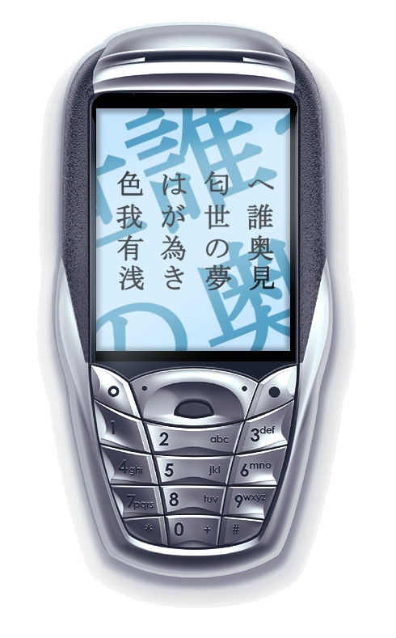
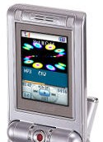
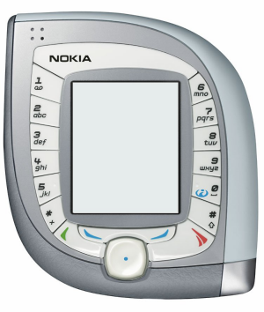
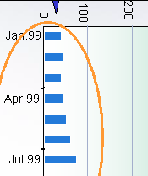
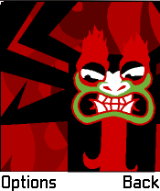
OpenVG Design Philosophy
Provide a low-level hardware acceleration abstraction layer
  Based on Bezier curves – not polygons
  Similar level to OpenGL ES for 3D graphics
Use OpenGL-style syntax where possible
  Make learning OpenVG as easy as possible for OpenGL developers
Allow flexibility in the way acceleration can be implemented
  Encourages healthy market competition between hardware vendors

Slide 10



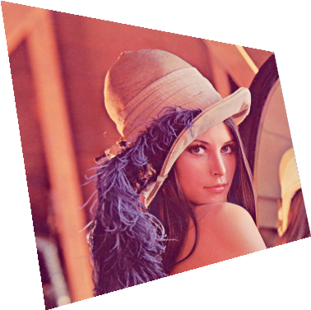


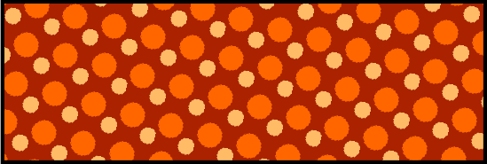
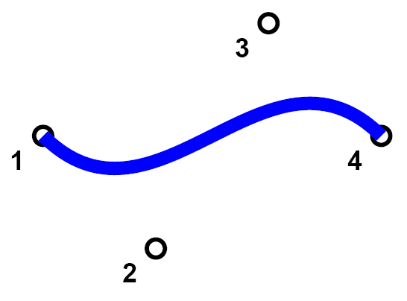

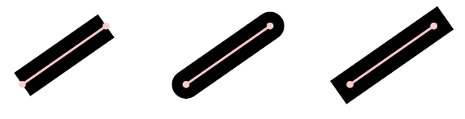
OpenVG Features
Core API
  Coordinate Systems and Transformations
  (Image drawing uses a 3x3 perspective
  transformation matrix)
  Viewport Clipping, Scissoring and Alpha Masking
  Paths - Line, Arc, Cubic Bezier, Quadratic Bezier,
  Stroked Path, Patter fill, gradation, Anti-aliasing, Path Interpolation
  Images
  Image Filters
  Paint (gradient and pattern)
  Blending
The VGU Utility Library
  Higher-level Geometric Primitives
  Image Warping

Slide 11
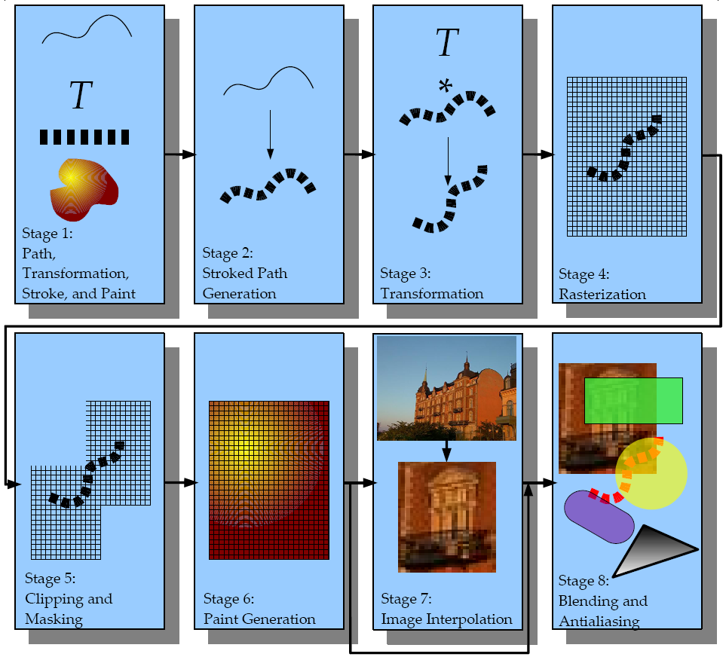
OpenVG Pipelines
Definition of path, transformation, stroke and paint
Stroked path generation
Transformation
Rasterization
Clipping and Masking
Paint Generation
Image Interpolation
Blending

Slide 12
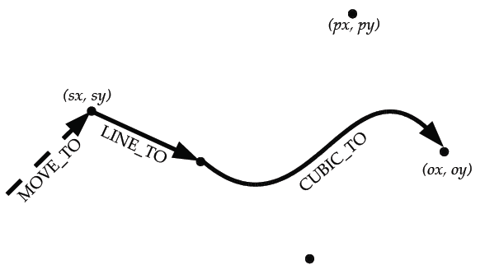
Stage1. Path Definition
MOVE_TO, LINE_TO, QUAD_TO, CUBIC_TO, CLOSE_PATH
Smooth Curves:
  SQUAD_TO, SCUBIC_TO
Elliptical Arcs:
  SCCWARC_TO, SCWARC_TO, LCCWARC_TO, LCWARC_TO
Absolute / Relative Coordinates
VGU Functions
  Line, Polygon, Rect, RoundRect, Ellipse, Arc
Path Interpolation
Path Queries:
  Bounding Boxes
  Transformed Bounding Boxes
  Point along path
  Tangent along path
Image
  a rectangle bounding the image

Slide 13
Stage1. Definition API Parameter (1/2)
OpenVG follows the OpenGL model:
  vg{Get,Set } {f,i,fv,iv} ; context parameter
  vg{Get,Set } Parameter{f,i,fv,iv} ; path, image, paint handle parameter
Settable parameters:
  VG_MATRIX_MODE, VG_FILL_RULE, VG_IMAGE_QUALITY,
  VG_RENDERING_QUALITY, VG_BLEND_MODE, VG_IMAGE_MODE,
  VG_SCISSOR_RECTS, VG_STROKE_LINE_WIDTH,
  VG_STROKE_CAP_STYLE, VG_STROKE_JOIN_STYLE,
  VG_STROKE_MITER_LIMIT, VG_STROKE_DASH_PATTERN,
  VG_STROKE_DASH_PHASE, VG_TILE_FILL_COLOR, VG_CLEAR_COLOR,
  VG_MASKING, VG_SCISSORING, VG_PIXEL_LAYOUT,
  VG_FILTER_FORMAT_LINEAR, VG_FILTER_FORMAT_PREMULTIPLIED,
  VG_FILTER_CHANNEL_MASK
Read-only values:
  VG_MAX_SCISSOR_RECTS, VG_MAX_DASH_COUNT,
  VG_MAX_KERNEL_SIZE, VG_MAX_SEPARABLE_KERNEL_SIZE,
  VG_MAX_COLOR_RAMP_STOPS, VG_MAX_IMAGE_WIDTH,
  VG_MAX_IMAGE_HEIGHT, VG_MAX_IMAGE_PIXELS,
  VG_MAX_IMAGE_BYTES, VG_MAX_FLOAT

Slide 14
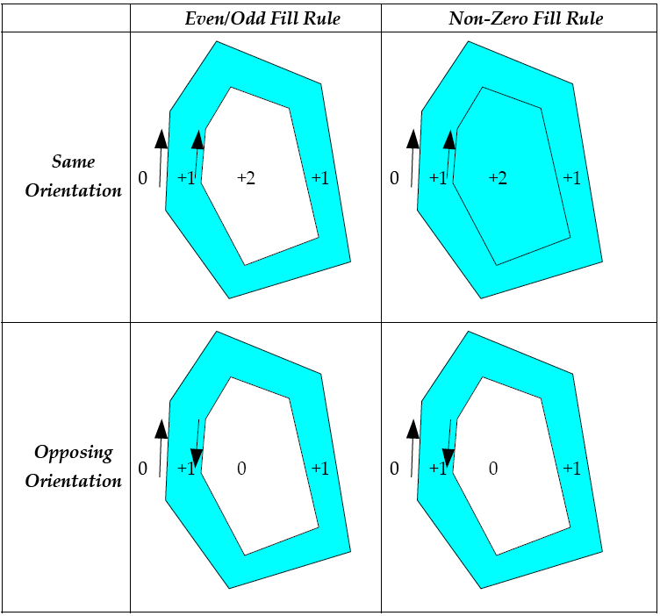
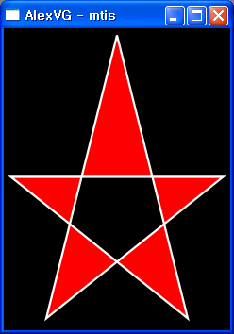
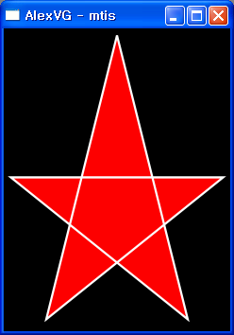
Stage1. Definition API Parameter (2/2)
Transform Matrix
  Transformation, Paint Generation, Image Interpolation
  VG_MATRIX_MODE:
    VG_MATRIX_PATH_USER_TO_SURFACE, VG_MATRIX_IMAGE_USER_TO_SURFACE
    VG_MATRIX_FILL_PAINT_TO_USER, VG_MATRIX_STROKE_PAINT_TO_USER
Fill Rules
  Rasterization
  VG_FILL_RULE:
    VG_EVEN_ODD
    VG_NON_ZERO
Even/Odd
Non-Zero

Slide 15
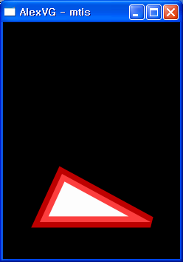
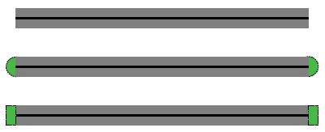
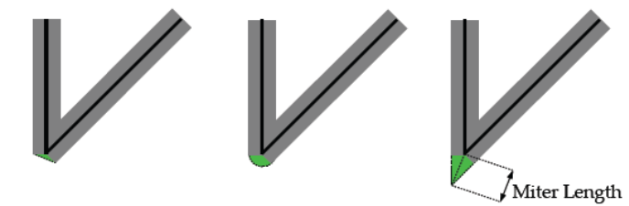
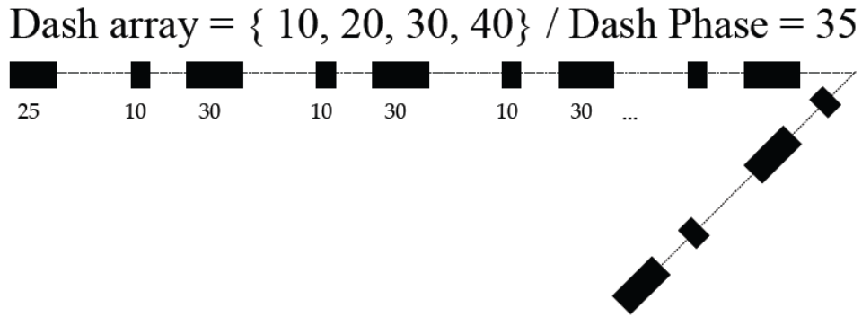
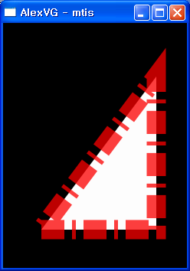
Stage2. Stroked Path Generation
Stroking takes a path and defines an outline around it based on:
  Line Width
  End cap style (Butt, Round, or Square)
  Line join style (Bevel, Round, or Miter)
  Miter limit (to convert long miters to bevels)
  Dash array and phase
Join & Miter Limit
Dash pattern & Phase

Slide 16
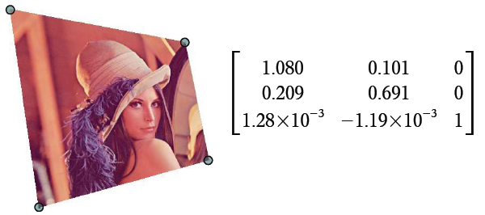
Stage3. Transformation
Paths use 2x3 affine transformations
Images use 3x3 perspective transformations
Transformation functions are similar to OpenGL:
  vgLoadIdentity
  vgLoadMatrix
  vgGetMatrix
  vgMultMatrix
  vgScale
  vgRotate
  vgTranslate
  vgShear
Image Warping
  vguComputeWarpQuadToSquare
  vguComputeWarpSquareToQuad
  vguComputeWarpQuadToQuad

Slide 17
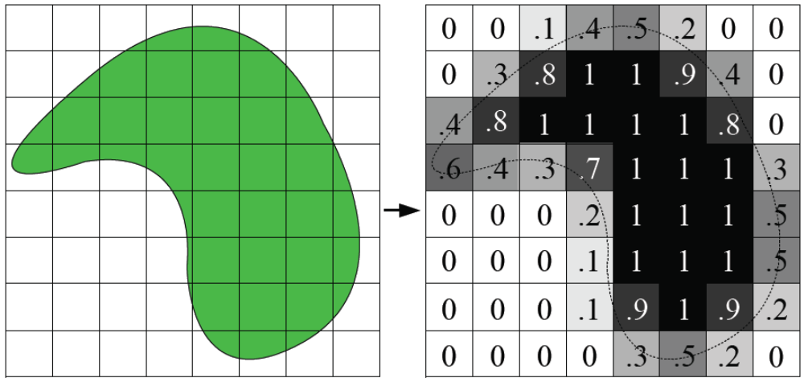
Stage4. Rasterization
The goal of rasterization is to determine a filtered alpha(coverage) value for each pixel, based on the geometry around that pixel

Slide 18
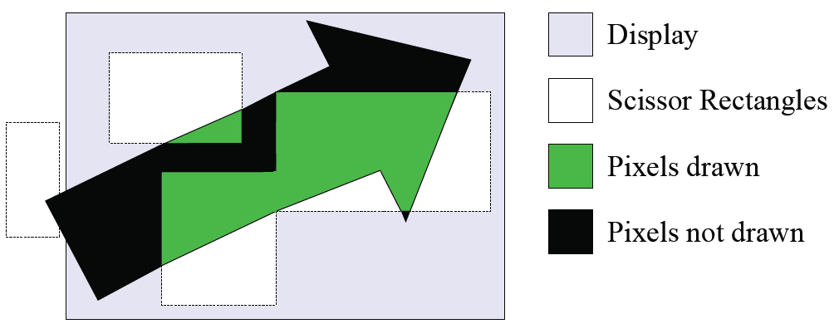
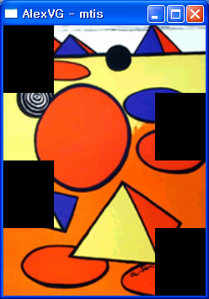
Stage5. Clipping & Scissoring
Only pixels inside a set of scissor rectangles are drawn
Scissoring is disabled by default
4 Scissoring rectangles

Slide 19

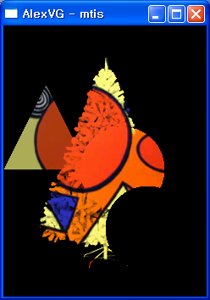
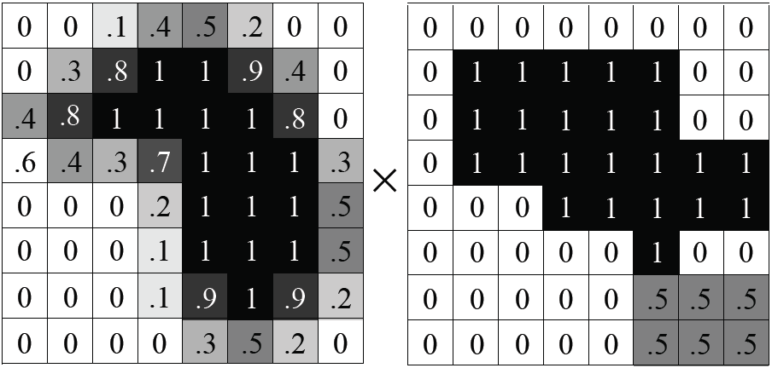
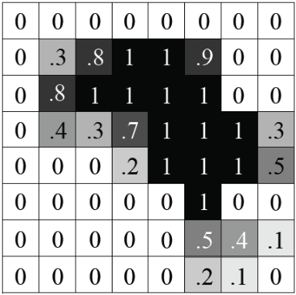

Stage5. Masking
In addition to scissoring, a per-pixel mask may be applied
The mask has an alpha value at each pixel that is multiplied by the alpha from the rendering stage
May be used to “cut out” an area, create a transition between areas
Mask values may be modified using image data
  vgMask : Fill, Clear, Set, Add, Subtract, Intersect
Multiple Masking Operation
Coverage Alpha (Stage 4)
Mask Alpha (Stage 1)
Result Alpha (Stage 5)

Slide 20

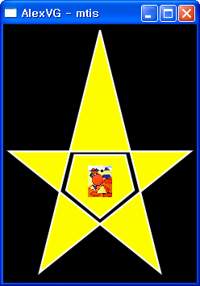
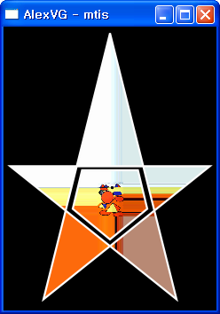
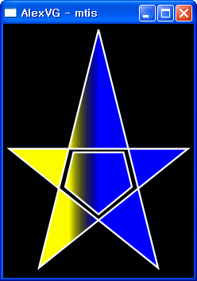
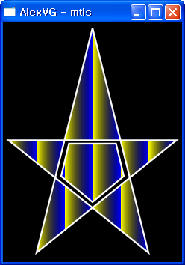
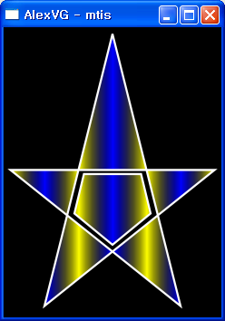
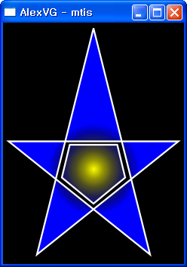
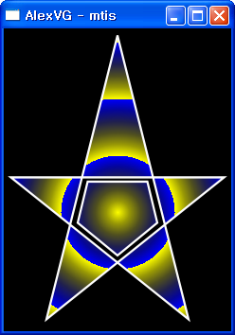
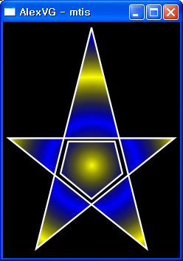
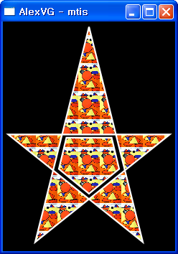
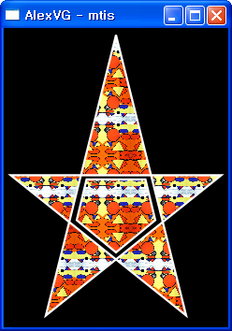
Stage 6. Paint Generation
Paint is generated pixel-by-pixel and applied on top of geometry
The alpha from the previous stage (rendering + masking) is
used to determine how much paint to apply
Separate paint objects for stroking, filling
Paint is transformed by an affine transform
Four types of paint are supported:
  Flat color paint
  Linear gradient paint: points (x1, y1) and (x2, y2), color ramp
  Radial gradient paint: center (x, y), focus (x, y), radius, color ramp
  Pattern paint based on an image, tiling mode
Flat Color Paint
Linear Gradient & Color Ramp Spread Mode
Radial Gradient & Color Ramp Spread Mode
Pattern Tiling Mode

Slide 21
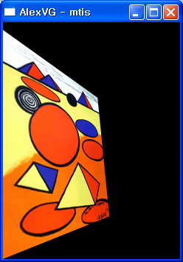
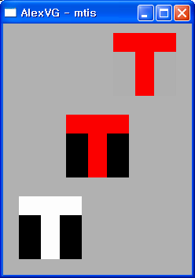
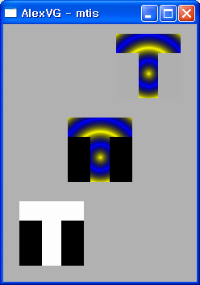
Stage 7. Image Interpolation
Image Color (R,G,B,A) is computed at each pixel
  using the inverse of the current image user-to-surface transformation
  The results are combined with the Paint Color (R,G,B,A) : Image Drawing Mode
    VG_DRAW_IMAGE_NORMAL
    VG_DRAW_IMAGE_MULTIPLY
    VG_DRAW_IMAGE_STENCIL : Very useful for drawing anti-aliased text
Stencil
Multiply
Normal
Perspective Transform
& Interpolation
Image Drawing Mode

Slide 22
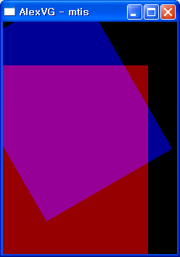
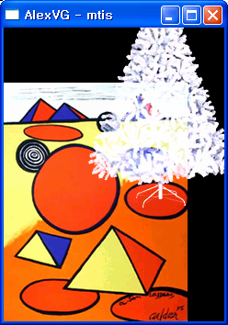
Stage 8. Blending
Combine masked alpha from path with paint alpha
Blend the result onto the drawing surface
Blending is a function of:
  The paint (R, G, B) color
  The masked alpha value (path alpha x mask alpha x paint alpha)
  The destination (R, G, B) color
  The destination alpha value (1.0f if no stored alpha)
There are 8 blending functions:
  Porter-Duff “source” mode (copy source to destination)
  Porter-Duff “source over destination”/ “destination over source”
  Porter-Duff “source in destination”/ “destination in source”
  Lighten (choose lighter of source and destination)
  Darken (choose darker of source and destination)
  Multiply (black source pixel forces black, white leaves unchanged)
  Screen (white source pixel forces white, black leaves unchanged)
  Additive (add pixel values, add alpha up to 1)
Blending Examples

Slide 23
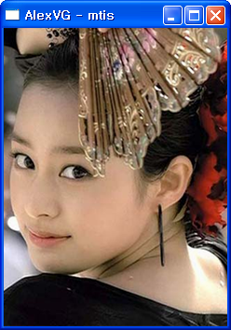
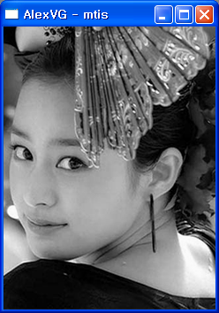
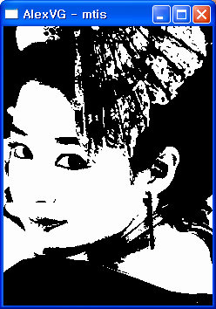
Images
Images are defined using one of 13 pixel formats
  Linear or non-linear (sRGB) color spaces
  Linear or non-linear grayscale
  Pre-multiplied or non-premultiplied alpha
  8/8/8, 5/6/5, 5/5/5/1, 4/4/4/4 bit depths (< 8 non-linear color only)
  1-bit Black & White (e.g., for Fax applications)
Images may be stored in accelerated memory
Images may be drawn in perspective
Image may be used as a stencil to apply paint
  Very useful for drawing anti-aliased text
Image and paint colors may be multiplied together
Image Format

Slide 24


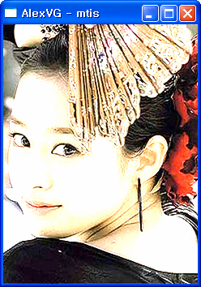
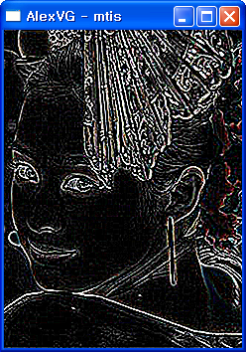









Image Filters
Image filters may be applied:
  Color Matrix
    RGB Swap, Gray Scale, ……
  Lookup, LookupSingle
    Invert, Darken, Lighten, Depth, ……
  Convolve, Separable Convolve, Gaussian Blur
    Emboss, Edge Detect, Sharp, Sobel, Smooth, ……
Gaussian Blur Examples
Color Matrix Examples
Lookup Table Examples
Convolve Examples

Slide 25










MTIS alexVG™ Demos

Slide 26

Any Questions?

