Slide 1
OpenVG Introduction
March 10, 2005
Koichi Mori
Nokia

Slide 2
Agenda
Motivation
  Background, Use cases, Problems to be solved
OpenVG in a Nutshell
  Milestones & Deliverables
OpenVG Technical Briefing
  API Design Philosophy
  OpenVG Rendering Pipeline and Feature Set

Slide 3
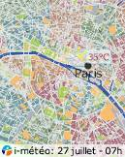
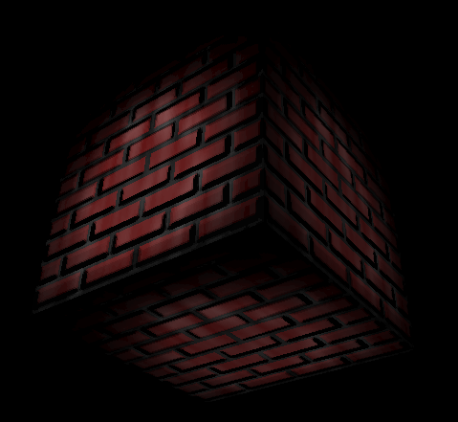
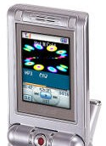
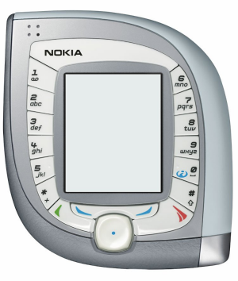
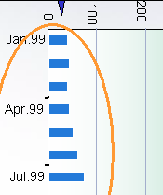
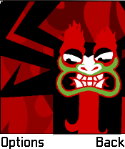

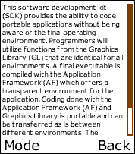
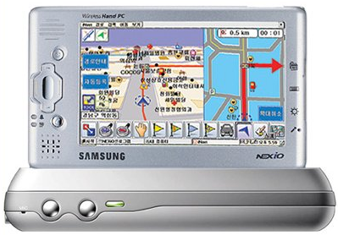
Strong Need for Vector Graphics
Many applications need low-level 2D vector graphics primitives
  Portable mapping and GPS applications, E-book readers and text packages
  Games
  Advanced user interfaces and screen savers, even GDIs
Many vector graphics formats in use
  Flash, SVG, PDF, Postscript, Vector fonts etc. etc.
Scalable graphics = Easier to port content

Slide 4

Why is New API Needed?
No existing API can cover all different requirements for handhelds
High-quality vector graphics rendering
Interactive performance
Low power consumption
Vector graphics acceleration brings high value to handheld devices
Code portability &
Seamless transition from SW implementation to HW implementation

Slide 5
OpenVG in a Nutshell
Open standard
Low-level API for 2D vector graphics
  With a focus on enabling hardware acceleration
  Should also allow efficient SW implementations
OpenVG ACCELERATES existing formats
  NOT a competitor to existing formats
Fast Track Development Schedule
Applications
SVG/Flash/
Font Package etc..
2D Hardware Acceleration
OpenVG working group started
1st OpenVG face-to-face meeting
Draft OpenVG1.0 specification completed
OpenVG 1.0 specification release
Samples and conformance tests
2Q04
3Q04
4Q04
1Q05
2Q05
3Q05

Slide 6
OpenVG Technical Briefing
Design Philosophy
Provide a low-level hardware acceleration abstraction layer
Allow flexibility in the way acceleration can be provided
Use OpenGL-style syntax where possible to make learning OpenVG as easy as possible for OpenGL developers
Reference Path and Image objects by opaque handles - enabling hardware vendors to use their own preferred representations

Slide 7
OpenVG Feature Set
Core API
  Coordinate Systems and Transformations
  (Image drawing uses a 3x3 perspective
  transformation matrix)
  Paths
  Images
  Image Filters
  Paint (gradient and pattern)
  Blending and Masking
The VGU Utility Library
  Higher-level Geometric Primitives
  Image Warping
OpenVG Pipeline
Definition of path, transformation, stroke and paint
Stroked path generation
Transformation
Rasterization
Clipping and Masking
Paint Generation
Blending
Dithering

Slide 8




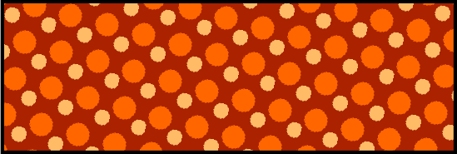

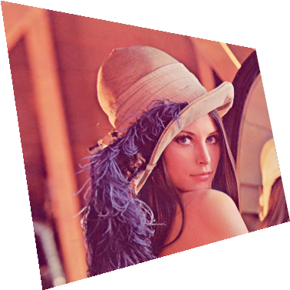

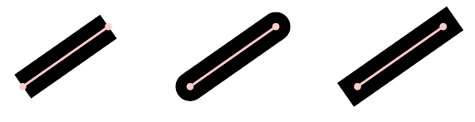
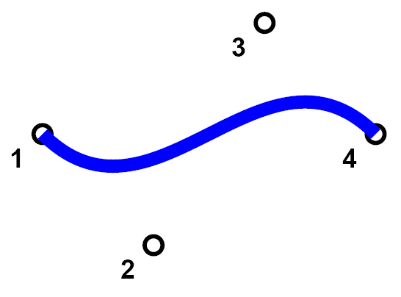


Paints
Mask
Image transformation
Stroke
Paths
Fill rule

Slide 9

Graphics Context and surface
OpenVG itself doesn’t have explicit graphics context
Highlight of extended features in EGL for OpenVG
  OpenVG graphics context creation and binding to rendering surface
  Share and synchronize rendering surface with OpenGL ES
  Share OpenVG objects among OpenVG graphics contexts
Backward compatibility for OpenGL ES 1.0/1.1
Will be ready with OpenVG
EGL
Native surface

Slide 10
Thank you, and See demos by members!

