Slide 1
Interpolation, Geometric Transform, and More on Motion Analysis
Based on ENEE631 Spring’04
Section 14
UMCP ENEE631 Slides (created by M.Wu © 2004)
Spring ’04 Instructor: Min Wu
ECE Department, Univ. of Maryland, College Park
www.ajconline.umd.edu (select ENEE631 S’04)
minwu@eng.umd.edu

Slide 2
Overview and Logistics
Last Time:
  Video coding beyond MPEG-1
    H.26x (conferencing),
    MPEG-2 (scalability, interlaced),
    MPEG-4 (object based)
  A side track: Image Interpolation
Today:
  A closer look at motion analysis: from 3-D scene to 2-D
UMCP ENEE631 Slides (created by M.Wu © 2004)

Slide 3
Overview and Logistics
Last Time: Motion analysis
  Estimating motion for each pixel from two pictures:
  Optical Flow Equation
  Global motion by camera’s movement
  General framework in estimating motion
Today:
  Continue on general framework for motion analysis
  Geometric transforms on images
UMCP ENEE631 Slides (created by M.Wu © 2004)

Slide 4
Preliminary (1) Interpolation
UMCP ENEE631 Slides (created by M.Wu © 2004)

Slide 5

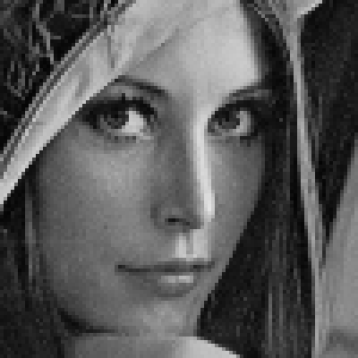

Examples of Image Interpolation
4x zoom (nearest neighbor)
4x zoom (bilinear)

Slide 6
Interpolation / Zooming
(p,q)
b
(p,q+1)
a
(p’,q’)
How to make up the new pixels?
Replication according to the nearest neighbor
  Simple but leaves zig-zag boundary
  (reflect spectrum artifacts; equiv. to interlace
  zero & LPF with a constant mask)
(p+1,q)
(p+1,q+1)
Bilinear interpolation
  Extend 1-D linear interpolation
f2
  Do two horizontal and one vertical 1-D interpolation
  F( p’, q’ ) = (1-a) [ (1-b) F(p, q) + b F(p, q+1) ] +
  a [ (1-b) F(p+1, q) + b F(p+1, q+1) ]
  For zoom in by 2 in each dimension
  F(p’, q’) = 0.5* [0.5 F(p,q) + 0.5 F(p,q+1)] + 0.5 *[0.5 F(p+1,q) + 0.5 F(p+1,q+1)]
f1
a
1-a

Slide 7
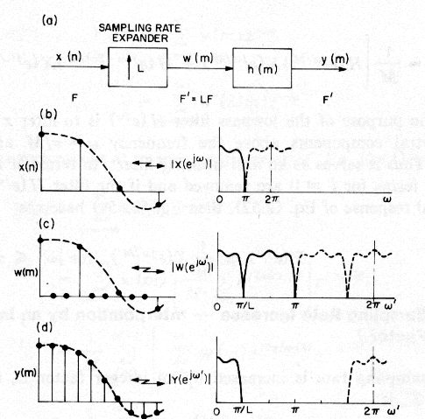
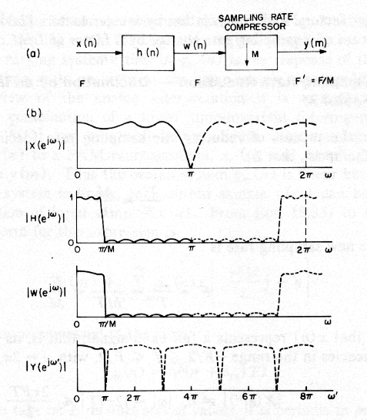
Review: 1-D Frequency-Domain Interpretation
From Crochiere-Rabiner “Multirate DSP” book Fig.2.15-16

Slide 8
Frequency-Domain Interpretation
Review multirate signal processing (ENEE624)
Upsampling
  Upsampling with zero interlacing ~ replicated spectrum
  LPF to filter out the spectra replicas in high-frequency part
  Ideal filter vs. practical filters
    nearest neighbor approach for 2x zoom use
    [think] what equiv. filters used for bilinear interpolation?
Downsampling
  Aliasing as spectra replicas becomes closer
  LPF to avoid aliasing
Sampling rate conversion with rational rate M / N
  Upsample with zero interlacing by M ➔ LPF ➔ Downsample
For Images: extend to the 2-D transform
1
1
1
1

Slide 9
More on Interpolation
Other filters
  Bi-cubic interpolation (3rd order polynomial)
Interpolation that avoids blurred edges and textures
  Sharpening
  Edge-preserving interpolation
    ( recent research papers in ICIP and Trans. on Image Proc. )
=> Will discuss more on 2-D sampling and frequency domain interpretations

Slide 10
Preliminary (2)
Geometrical Relations & Manipulations of Images
UMCP ENEE631 Slides (created by M.Wu © 2004)

Slide 11
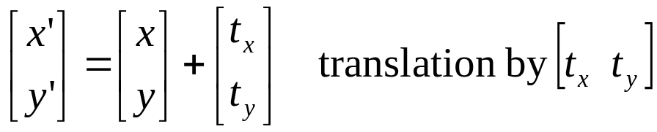
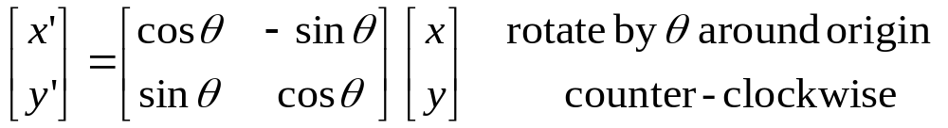
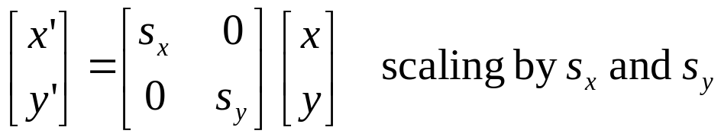
Rotation, Translation, and Scaling
(x’, y’)
R.S.T. of an image object
  Original pixel location (x,y) ➔ New location (x’,y’)
(x, y)
θ
UMCP ENEE631 Slides (created by M.Wu © 2001)
Preserve
length & angle
Uniform scaling Sx = Sy
(preserve angle and shape)
Differential scaling Sx ≠ Sy

Slide 12
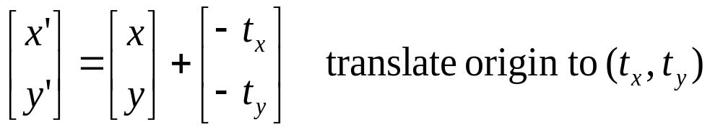
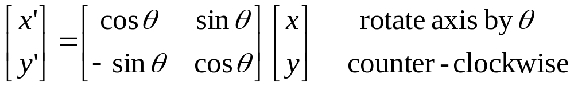
Rotation, Translation, and Scaling (cont’d)
Rotation and translation of image coordinates
  Note the connections with rotation and translation of image objects
UMCP ENEE631 Slides (created by M.Wu © 2001)
y
y’
x’
θ
x

Slide 13
Implementation Issues of Geometric Transform
Forward transform
  Index mapping from input to output image
    What if most values obtained for an output image are at fractional coordinate indices?
Reverse transform
  Map integer indices of output image to input image
    Get values of input image at fractional indices through interpolation
UMCP ENEE631 Slides (created by M.Wu © 2001)
(p,q)
b
(p,q+1)
a
(p’,q’)
(p+1,q)
(p+1,q+1)

Slide 14
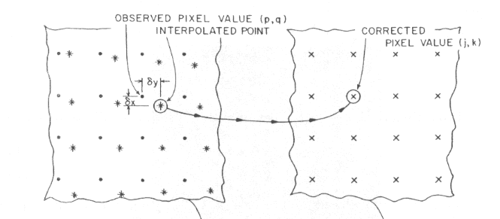
UMCP ENEE631 Slides (created by M.Wu © 2001)

Slide 15
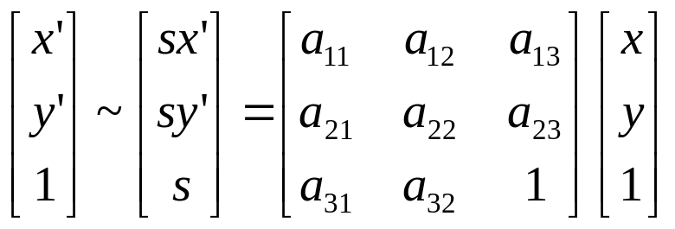
2-D Homogeneous Coordinate
Describe R.S.T. transform by P’ = M P + T
  Need calculating intermediate coordinate values for successive transf.
Homogeneous coordinate
  Allow R.S.T. represented by matrix multiplication operations
    successive transf. can be calculated by combining transf. matrices
  Cartesian point (x,y) ➔ Homogeneous representation ( s x’, s y’, s )
    represent same pixel location for all nonzero parameter s; often use s=1
The name: Equation f(x,y) = 0 becomes homogeneous equation in (s x’, s y’, s )
such that if the common factors in 3 parameters can be factored out
UMCP ENEE631 Slides (created by M.Wu © 2001/2004)

Slide 16
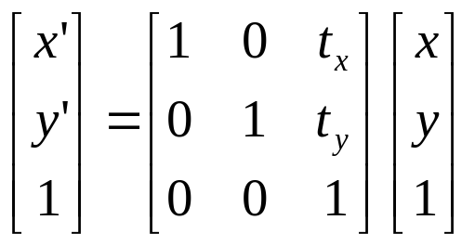
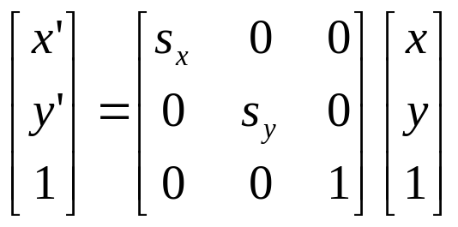
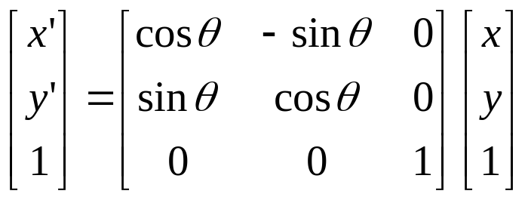
R.S.T. in Homogeneous Coordinates
UMCP ENEE631 Slides (created by M.Wu © 2001)
Successive R.S.T.
  Left multiply the basic transform matrices

Slide 17
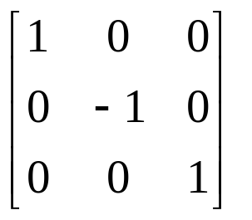
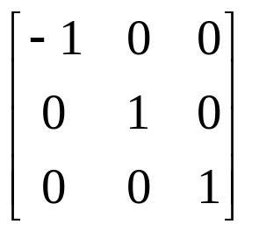
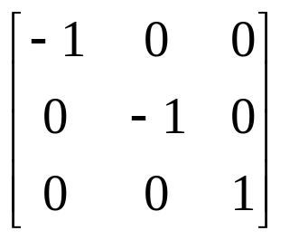
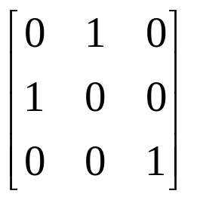
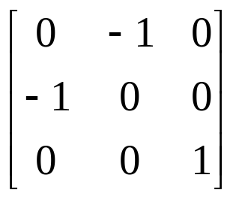
Reflection
Reflect about x-axis, y-axis, and origin
Reflect about y=x and y=-x
Reflect about a general line y=ax+b
  Combination of translate-rotate => reflect => inverse rotate-translate
UMCP ENEE631 Slides (created by M.Wu © 2001)
Notes:
[1] (x,y) => (x, -y); [2] (x,y) => (-x,y); [3] (x,y) => (-x,-y)
[4] (x,y) => (y, x); [5] (x,y) => (-y, -x)

Slide 18
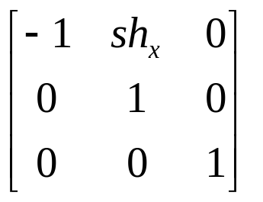
Shear
Shear ~ a transformation that distorts the shape
  Cause opposite layers of the object slide over each other
Shear relative to x-axis
Extend to shears relative to other reference lines
UMCP ENEE631 Slides (created by M.Wu © 2001)
y
y’
(1, 1)
sh_{x} =2
(2, 1)
(3, 1)
x
x’
(1, 0)

Slide 19
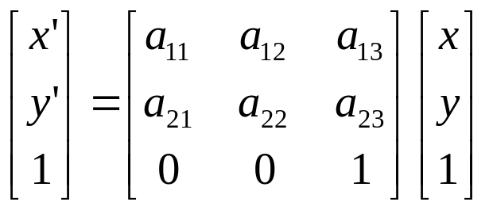
General Composite Transforms
Combined R.S.T.
  {a_{ij}} is determined by
  R.S.T. parameters
Rigid-body transform
  Only involve translations and rotations
  2x2 rotation submatrix is orthogonal
    row vectors are orthonormal
Extension to 3-D homogeneous coordinate
  ( sX, sY, sZ, s ) with 4x4 transformation matrices
UMCP ENEE631 Slides (created by M.Wu © 2001)

Slide 20
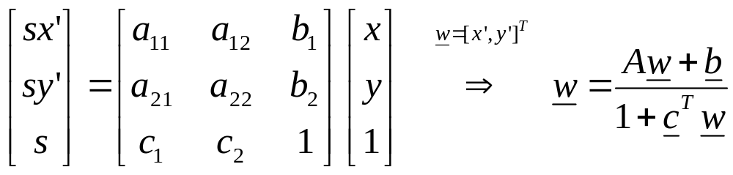
General Composite Transforms (cont’d)
Affine transforms ~ 6 parameters
  Can be expressed as composition of RST,
  reflection and shear
  Parallel lines are transformed as parallel lines
Projective transforms ~ 8 parameters
  Cover more general geometric transformations between 2 planes
  Two unique phenomena: chirping and converging effects
  Widely used in computer vision problems such as image mosaicing, and synthesized views
UMCP ENEE631 Slides (created by M.Wu © 2001)
Notes:
Projective transform: if we scale every element in the matrix by the same factor, the transform remains the same since we can cancel out the factor from homogeneous coordinate expression. Thus we can normalize one entry to be one, usually the matrix entry at (3,3), and specify the other eight parameters.

Slide 21
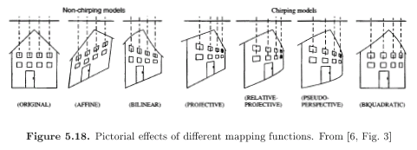
Effects of Various Geometric Mappings
UMCP ENEE631 Slides (created by M.Wu © 2004)
From Wang’s Book Preprint Fig.5.18

Slide 22
Higher-order Nonlinear Spatial Warping
Analogous to “rubber sheet stretching”
  Forward and reverse mapping of pixels’ coordinate indices
  (x, y) ⬄ (x’, y’)
Polynomial warping
  Extend affine transform to higher-order polynomial mapping
  2nd-order warping
    x’ = a₀ + a₁ x + a₂ y + a₃ x² + a₄ xy + a₅ y²
    y’ = b₀ + b₁ x + b₂ y + b₃ x² + b₄ xy + b₅ y²
Spatial distortion in imaging system (lens)
  Pincushion and Barrel distortion
UMCP ENEE631 Slides (created by M.Wu © 2001)

Slide 23
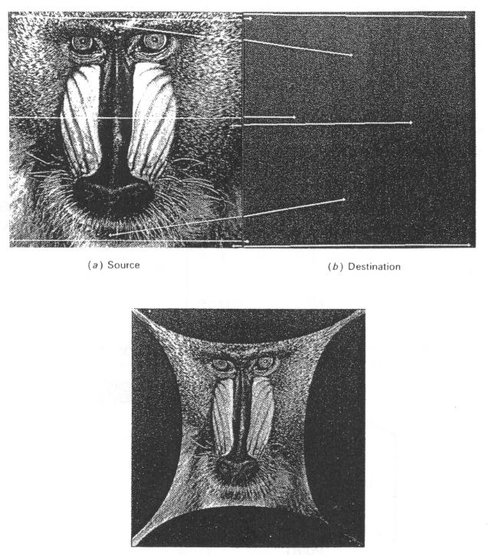
Example of 2nd-order Polynomial Spatial Warping
UMCP ENEE631 Slides (created by M.Wu © 2001)
From P. Ramadge’s PU EE488 F’00

Slide 24
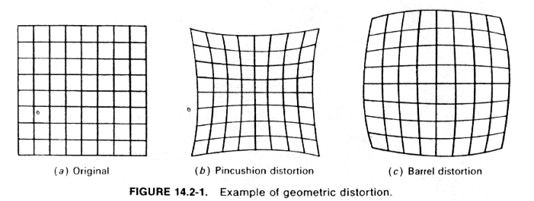
Illustration of Geometric Distortion
UMCP ENEE631 Slides (created by M.Wu © 2001)
From P. Ramadge’s PU EE488 F’00

Slide 25
Compensating Spatial Distortion in Imaging
Control points
  Coordinates before and after distortion are known
Fit into polynomial warping model
  Minimize the sum of squared error between a set of warped control points and the polynomial estimates
    x’ = [ x₁, x₂, …, x_{M} ], Z = [ 1, x₁, y₁, x₁², x₁y₁, y₁² ; 1, x₂, y₂, … ]
    E = ( x’ – Z a )^{T} ( x’ – Z a ) + ( y’ – Z b )^{T} ( y’ – Z b )
    ∂ E / ∂ a = 0 => x’ = Z a
  Least square estimates
    Solution expressed by generalized inverse
    a = Z^ x’ = (Z^{T} Z) ⁻¹ Z^{T} x’; b = Z^ y’
Higher-order approximation
  2nd order polynomial usually suffices for many applications
UMCP ENEE631 Slides (created by M.Wu © 2001)

Slide 26
Motion Analysis
UMCP ENEE631 Slides (created by M.Wu © 2004)

Slide 27
Review: Applications and Model of Motion
Why estimate motion?
  Help understanding the content of image sequence
  Help reduce temporal redundancy of video
    Predictively encode consecutive image frames
  Help stabilizing video by detecting and removing small, noisy global motions
  ……
Motion model used in hybrid video coding
  Block-based translation model
UMCP ENEE631 Slides (created by M.Wu © 2001/2004)

Slide 28
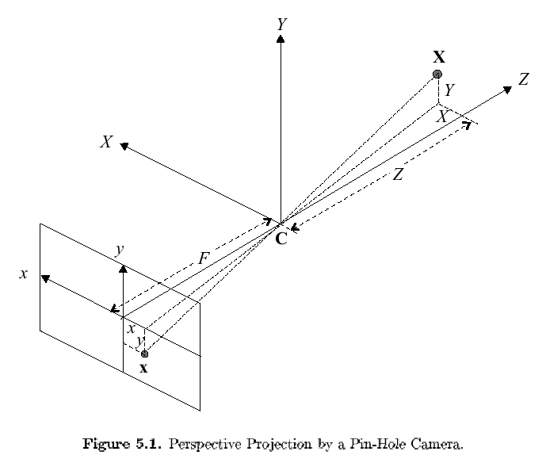
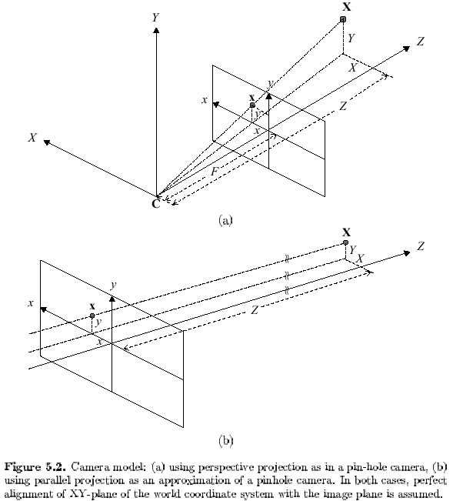
Pin-Hole Camera Model: 3D Scene to 2D Image
UMCP ENEE631 Slides (created by M.Wu © 2001)
“Place” image plane in the same side as object to avoid dealing with reverse imaging
C – Focal center; F – Focal length
Ray from X to C – line of sight for image point x
(many-to-one mapping)
Perspective projection: x = X⋅(F/Z), y = Y⋅(F/Z)
Object farther away is smaller (inverse relation between x, y & depth Z)
Figures from Wang’s Preprint Fig.5.1 & 5.2(a)

Slide 29
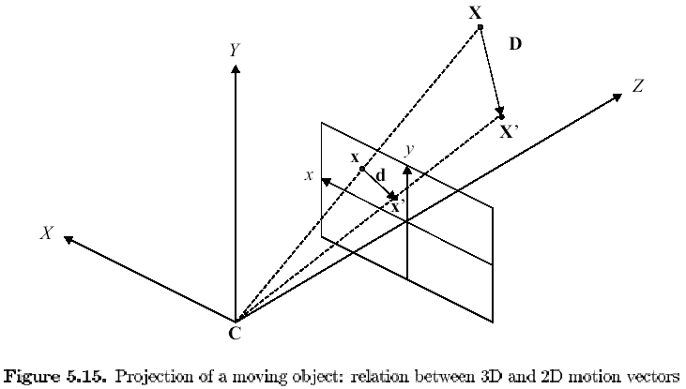
2-D Motion Models
From Wang’s Preprint Fig.5.15
3D Motion Vector D(X; t1, t2)
Mapping function w( ):
x’ = w(x) = x + d(x)
(projected)
2D Motion Vector d(x; t1, t2)
UMCP ENEE631 Slides (created by M.Wu © 2001)
Image plane
Motion vector (displacement vector)
Velocity vector (flow vector) ~ v = ∂d / ∂t
  For small time interval, motion is approx. constant ~ v = d / Δt
  Velocity vector is identical to motion vector for Δt = 1

Slide 30
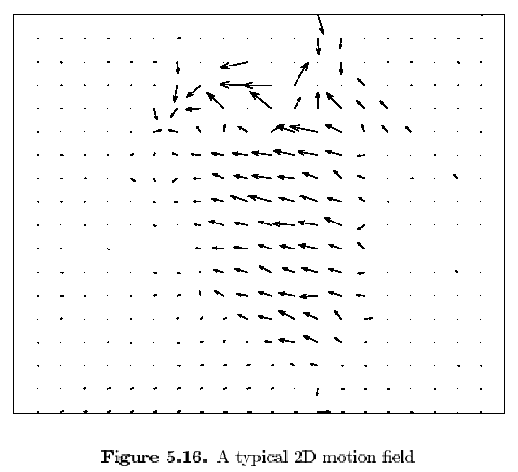
2-D Motion Field
From Wang’s Preprint Fig.5.16
Motion field
  {d ( x; t1, t2 )} for all image positions
Representing 2-D
discrete motion field
by vector graph
  Magnitude
  Direction
UMCP ENEE631 Slides (created by M.Wu © 2001)

Slide 31
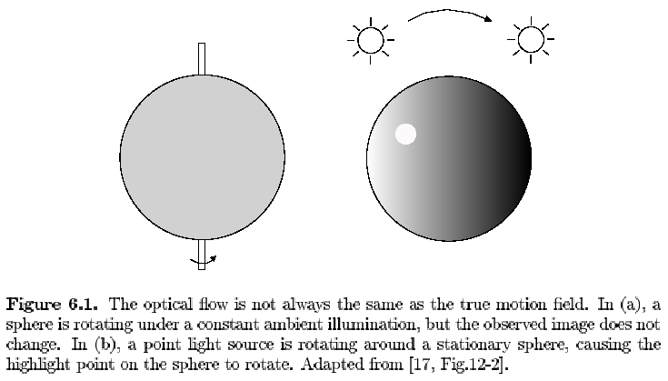
Can camera capture all motions?
From Wang’s Preprint Fig.6.1
“Optical flow”: Observed/Apparent 2-D motion
  May not be the same as the actual projected 2-D motion
  Based on color/luminance info. observed, we can only estimate optical flow instead of true motion
UMCP ENEE631 Slides (created by M.Wu © 2001)
Notes:
[All motion estimation algorithm are based on temporal changes in image intensities/colors;
observed 2-D motion based on intensity changes may not be the same as actual 2-D motions]
* Human eye perceives motion by identifying corresponding points at different time instants.
* The correspondence is usually determined by assuming the color/brightness of a point doesn’t change after the motion.

Slide 32
Determining Motion from Image Sequence
UMCP ENEE631 Slides (created by M.Wu © 2004)
  Can observe luminance variation within each picture and across pictures

Slide 33
Assumptions for Deriving Optical Flow Equation
Constant intensity assumption
  Luminance of a moving point (after projecting to 2-D) does not change
    f( x+d_{x}, y+d_{y}, t+d_{t} ) = f( x, y, t )
  True for invariant ambient illumination and diffuse-reflecting surface
    no moving shadows, no reflections due to glossy surface
  This assumption is widely used for its simplicity
    usually holds well for small time interval d_{t}
Apply Taylor expansion to f( x+d_{x}, y+d_{y}, t+d_{t} )
UMCP ENEE631 Slides (created by M.Wu © 2001)

Slide 34
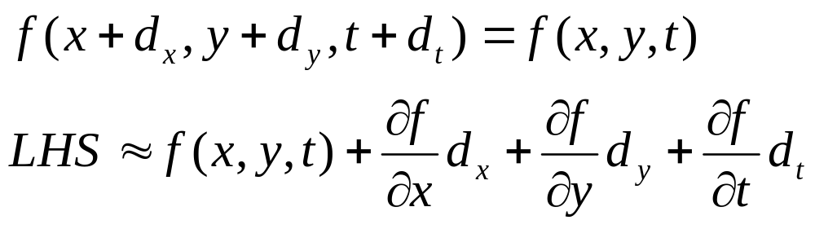
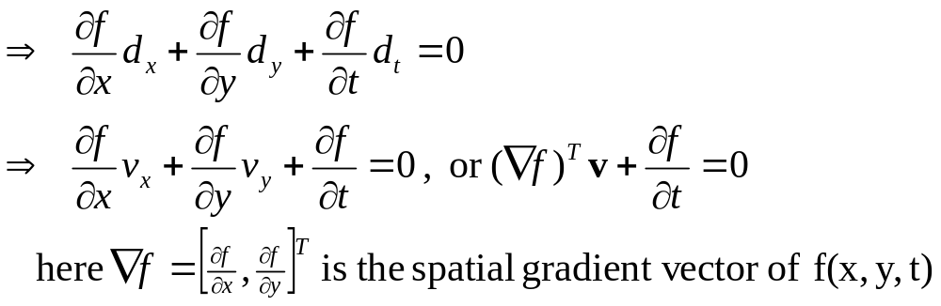
Optical Flow Equation (O.F.E.)
Const luminance assumpt.
1st order Taylor’s expansion
UMCP ENEE631 Slides (created by M.Wu © 2001/2004)
Notes:
This OFE is for each point (x,y)

Slide 35
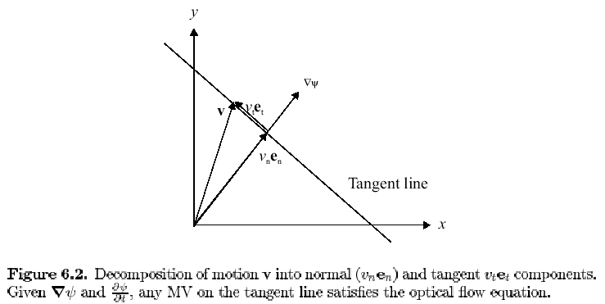
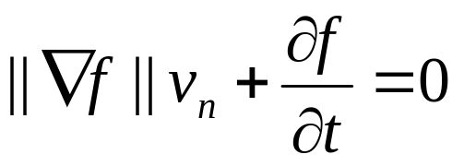
Alternative Representation of O.F.E.
Orthogonal decomposition of the flow vector v
  Projection along “normal direction” ~ v_{n}
    i.e., along image gradient ∇ f ’s direction
  Projection along tangent direction ~ v_{t}
    i.e., along orthogonal direction to image gradient ∇ f
O.F.E.
UMCP ENEE631 Slides (created by M.Wu © 2001)
Tangent direction
∇ f
Normal direction
From Wang’s
Preprint Fig.6.2

Slide 36
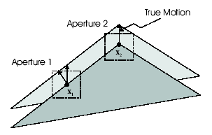
Ambiguity in Motion Estimation
One equation for 2 unknowns
  Tangent direction of motion vector is
  undetermined
  “Aperture problem”
    Aperture ~ small window over which to apply const. intensity assumpt.
    MV can be estimated only if aperture contains 2+ different gradient directions (e.g. the corner)
  Usually need additional constraints
    Spatial smoothness of motion field
Indeterminate motion vector over constant region (|| ∇f || = 0)
  Reliable motion estimation only for regions with brightness variations (e.g. edges or nonflat textures)
  Reflect the relation between temporal and spatial frequencies in freq. domain representation of video signal (Sec.2.3.2)
From Wang’s Preprint Fig.6.3
UMCP ENEE631 Slides (created by M.Wu © 2001)

Slide 37
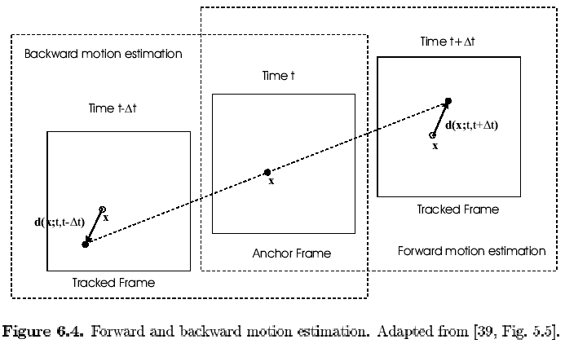
Forward and Backward Motion Estimation
UMCP ENEE631 Slides (created by M.Wu © 2001)
From Wang’s
Preprint Fig.6.4
  Current frame (anchor frame)
  Reference frame (target frame)

Slide 38
General Methodologies for Motion Estimation
Two categories: Feature vs. Intensity based estimation
Feature based
  Step-1 establish correspondences between feature pairs
  Step-2 estimate parameters of a chosen motion model by
  least-square fitting of the correspondences
  Good for global/camera motion describable by parametric models
    Common models: affine, projective, … (Wang Sec.5.5.2-5.5.4)
    Applications: Image mosaicing, synthesis of multiple-views
Intensity based
  Apply optical flow equation (or its variation) to local regions
  Good for non-simple motion and multiple objects
  Applications: video coding, motion prediction and filtering
UMCP ENEE631 Slides (created by M.Wu © 2001)

Slide 39
Key Issues for Motion Estimation
How to parameterize the underlying motion field?
What is the estimation criteria?
How to search for the optimal parameters?
UMCP ENEE631 Slides (created by M.Wu © 2001)

Slide 40
Motion Representations
Pixel-based representation
  Specify MV for each pixel
  Widely applicable at an expense of high computation complexity
  MVs may not be physically correct unless with additional constraints
    due to ambiguity problem; may impose smoothness on nearby MVs
Global motion representation
  Good if camera motion is the dominating motion
Region-based representation
  One set of motion parameters for each region
  Need to find and specify region segmentation
  Usually don’t know what pixels have similar motion
    Need iterative segmentation & estimation
UMCP ENEE631 Slides (created by M.Wu © 2001)

Slide 41
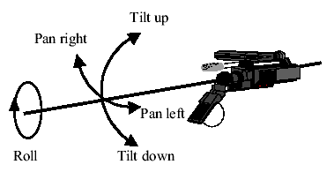
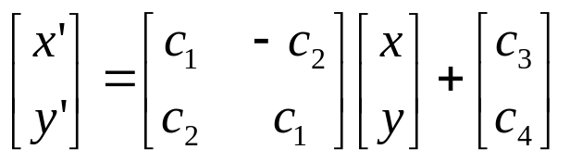
2-D Motion Models for Typical Camera Motions
Camera motions
  Track and Boom (horizontal/vertical translation within image plane)
  Pan and Tilt (rotation around Y and X axis, approx. no change in Z)
  Roll (rotation around depth axis Z)
  Zoom (change of focal length)
Determine new 3-D coordinate, then obtain 2-D image position by perspective projection
  Resulting a “Geometric mapping”:
    4-parameter mapping function
    representing any combinations of
    successive translation, pan, tilt, zoom, and rotation
  => 2-D motion for more general 3-D rigid motion (see Sec.5.5.3)
UMCP ENEE631 Slides (created by M.Wu © 2001)
From Wang’s Preprint Fig.5.4
Notes:
4-parameter geometric mapping doesn’t account for camera translation in Z axis, nor rotation around arbitrary axis

Slide 42
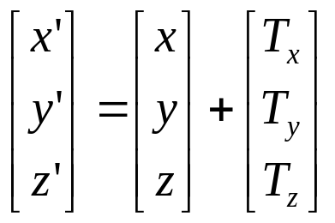
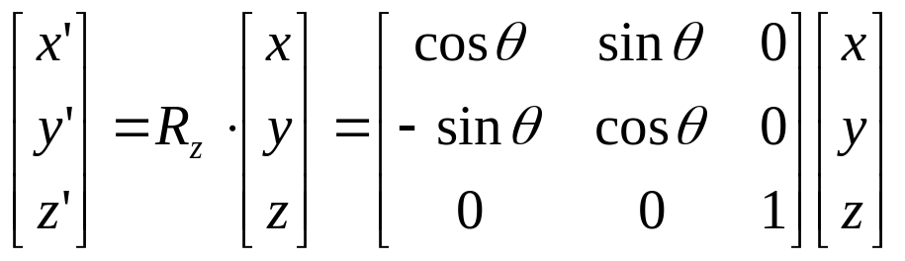
Global Motion: 3-D Translation & Rotation
3-D translation
3-D rotations (according to the order along X, Y, Z axis)
  Successive rotations can be represented by left-multiplying basic rotation matrices successively
  [R] = [Rz] * [Ry] * [Rx]
UMCP ENEE631 Slides (created by M.Wu © 2001)
y’
y
x’
θ
x
z

Slide 43
2-D Models Corresponding to 3-D Rigid Motion
General case: six-parameter 3-D motion per object point
  Map to 2-D via perspective transform: (scaling translation vector and object depth by same factor lead to same image)
  Mapping can change from point to point for arbitrary object surface
Projective transform
  8 parameters (can relate any two planes in 3-D space)
  Either no translation along Z, or any motion of a planar object
  Two unique phenomena: Chirping and converging/keystone effects
    Chirping: equal-distance objects become closer as being farther away
    Two parallel lines appear to move closer in distance
Approximation of projective mapping
  Affine motion (6 parameters): cannot capture converging & chirping
  Bilinear motion (8 parameters): capture converging but not chirping
[Readings: Wang’s book Sec. 5.5.3 & 5.5.4]
UMCP ENEE631 Slides (created by M.Wu © 2004)

Slide 44
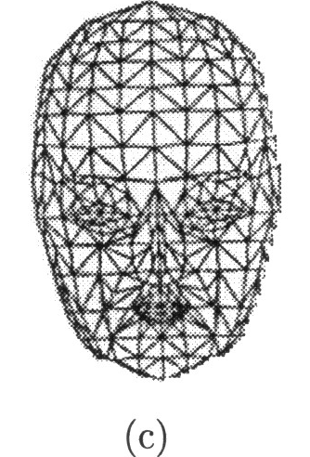
Motion Representation (cont’d)
Block-based representation
  Fixed partitioning into blocks and characterize each with simple model (e.g., translation model)
  [Pro] Good compromise between accuracy and complexity, and
  shown success in video coding
  [Con] False discontinuities of MVs between adjacent blocks
Mesh-based representation
  Partition image into polygons and specify MV
  for nodes
  MVs of interior are interpolated from node MV
  [Pro] Provide continuous motion everywhere
  [Con] Often fail to capture motion discontinuities
  at object boundaries
UMCP ENEE631 Slides (created by M.Wu © 2001/2004)
From R.Liu Seminar Course @ UMCP

Slide 45
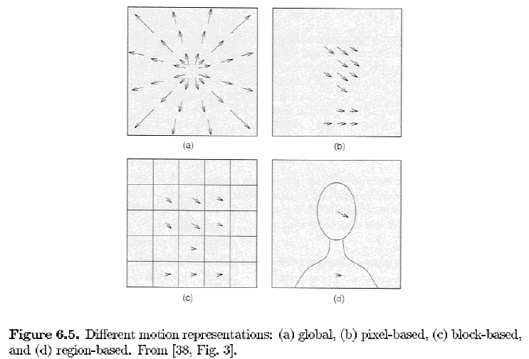
Motion Representation: Head-Shoulder Example
From Wang’s
Preprint Fig.6.6
UMCP ENEE631 Slides (created by M.Wu © 2001)

Slide 46
Motion Estimation Criteria
Criterion based on displaced frame difference
  E.g. in block matching approach
Criterion based on optical flow equations
Other criteria and considerations
  Smoothness constraints
  Bayesian criterion
UMCP ENEE631 Slides (created by M.Wu © 2001)

Slide 47
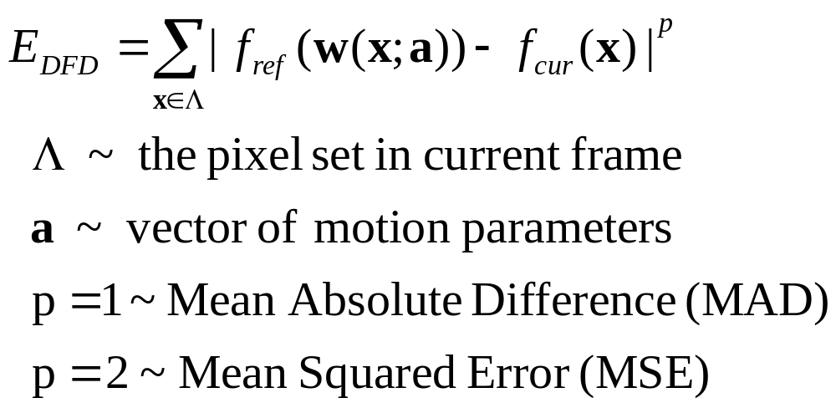
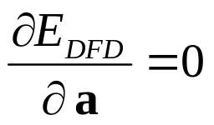
M.E. Criterion Based on Displaced Frame Diff.
Error of Displace Frame Difference (DFD)
Necessary condition for minimizing E_{DFD}
  For p=2, Gradient of E_{DFD} w.r.t. a is zero:
UMCP ENEE631 Slides (created by M.Wu © 2001)

Slide 48
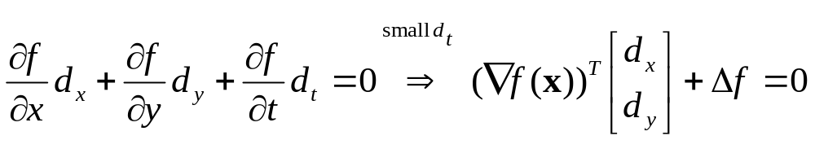
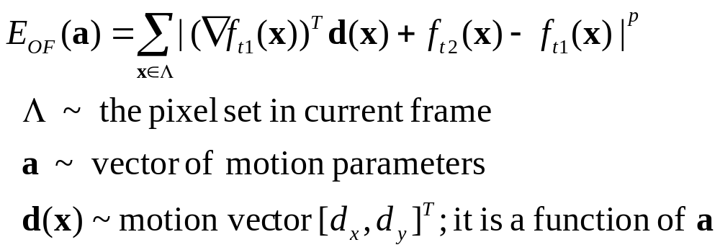
M.E. Criterion Based on Optical Flow Equation
Expect LHS of Optical Flow Equation to be zero
Try to minimize the “residue” of LHS
Set gradient to zero leads to least-square solutions for p=2
Pro: E_{OF} has unique minimum and are easily solvable if motion parameters are linearly related to MVs
Con: O.F.E. only valid for small motion or if we have a good initial estimate
UMCP ENEE631 Slides (created by M.Wu © 2001)
Notes:
Here we are minimizing a function that is a quadratic func of MVs => unique minimum
(unlike the DFD case – where we don’t have this quadratic relations wrt MV)

Slide 49
Commonly Used Optimization Methods
For minimizing the previously defined M.E. error function
Exhaustive search
  MAD often used for computational simplicity
  Guaranteed global optimality at expense of computation complexity
  Fast algorithms for sub-optimal solutions
Gradient-based search (Appendix B)
  MSE often used for mathematical tractability (differentiable)
  Iterative approach
    refine an estimate along negative gradient directions of objective func.
  Generally converge to local optimal
    require good initial estimate
  Estimation method of Gradient also affects accuracy and robustness
UMCP ENEE631 Slides (created by M.Wu © 2001)

Slide 50
Various Motion Estimation Approaches
Block-matching
  Correlation method (sec.6.4.5)
Deformable block-matching (sec.6.5)
  Use more block-based motion model than translational model
    e.g., affine/bilinear/projective mapping for each block (sec.5.5)
    square block in current frame match with non-square block in ref.
Mesh-based motion estimation (sec.6.6)
Pixel-based motion estimation (sec.6.3)
    Estimate one MV for every pixel
UMCP ENEE631 Slides (created by M.Wu © 2001)

Slide 51
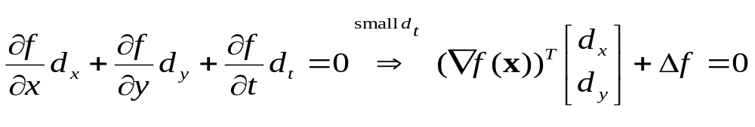
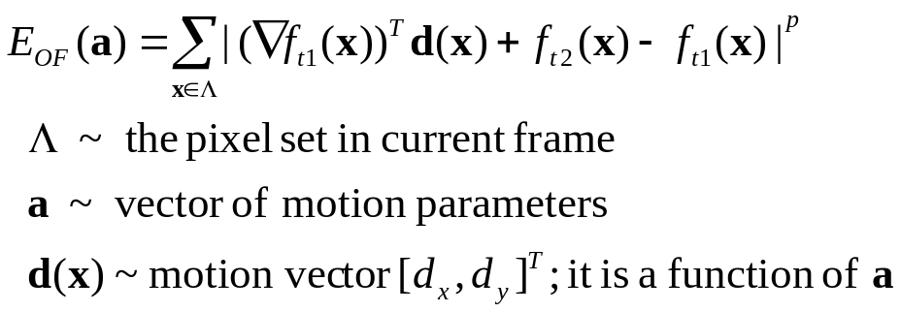
Pixel-Based Motion Estimation
Estimate motion vectors at each pixel
  Based on Optical Flow Equation
  Add smoothness constraints on motion field to avoid poor M.E.
  Gradient based search ~ e.g., steepest gradient descent (Appendix B)
Motion estimation criterion
  Expect LHS of O.F. equation to be zero
  Try to minimize the “residue” of LHS
  Smoothness constraints
    Add magnitude of spatial gradient of velocity vectors to objective func.
UMCP ENEE631 Slides (created by M.Wu © 2001)

Slide 53
Summary of Today’s Lecture
General framework for motion analysis
  Interpretation of optical flow equation
  Criteria of evaluating estimated motion; Optimization approaches
Geometric transforms on images
  Rotation/Scale/Translation; Homogeneous coordinates
  High-order mapping
Next Lecture:
  Sampling and resampling issues in 2-D and 3-D
Readings
  Wang’s book: Sec. 6.1 – 6.3
  “Computer Graphics” Chapter 5 (Hearn-Baker, Prentice-Hall, 2nd Ed);
  Gonzalez Sec. 5.11
UMCP ENEE631 Slides (created by M.Wu © 2004)

Slide 54
Summary of Today’s Lecture
Motion analysis
  Capture 3-D scene and motion in 2-D camera plane
  Optical flow and optical flow equation for describing small motion
  General approaches for estimating motion: Address 3 questions
Next Lecture:
  Wrap up motion analysis
  Sampling issues for image and video
Readings
  Wang’s book: Section 5.1, 5.3, 5.5, 5.6 (video modeling);
  6.1 – 6.3 (motion analysis)
UMCP ENEE631 Slides (created by M.Wu © 2004)

Slide 55
Further Exploration: Image Morphing
Image morphing paper by Beier-Neely (ACM SIGGRAPH’92)
UMCP ENEE631 Slides (created by M.Wu © 2001)

Slide 56
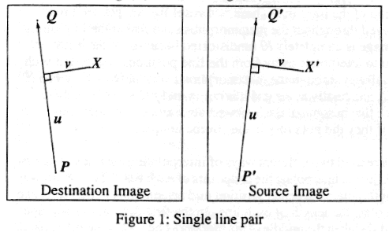
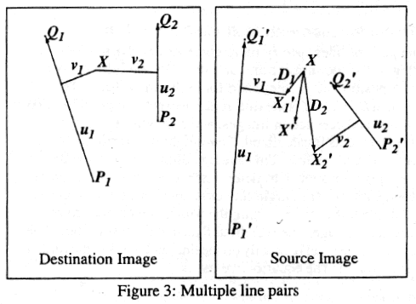
Warping Based on Feature Lines
Proposed by Beier-Neely (SIGGRAPH’92)
Controlling warping through
directed line pairs
  Points on a line in I₀ is mapped to corresponding line in I₁
  Other points are mapped by preserving certain relations w.r.t. the line
    u ∈[0,1] (portion), v (#pixels)
Transf. with multiple line pairs
  Estimate warping coordinate for each line
  Combine through weighed sum
    closer lines impose more influence
UMCP ENEE631 Slides (created by M.Wu © 2001)

Slide 57
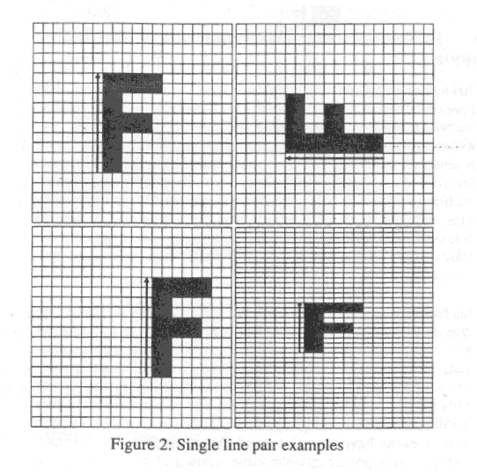

Examples of Feature Line-Based Warping
UMCP ENEE631 Slides (created by M.Wu © 2001)

Slide 58

Image Morphing (Metamorphosis)
Morph: gradually convert one image to another image
Pixel-wise dissolve
  I_{t} = (1-t) I₀ + t I₁
  Simple but intermediate frames may be blurred and have ghost-effect
    visual quality is not very good when played slowly
Feature-points based (mesh model)
  Require generate meshes and find correspondence
  Require same amount of feature points in I₀ and I₁
    Hard to morph between very different objects
Feature-based warping plus dissolve (Beier-Neely ’92)
  Interpolate line pairs for intermediate frames
  Warp both I₀ and I₁ toward the lines in I_{t}
  Generate final intermediate frames by dissolving two warped images
  Tradeoff between computation complexity and quality of visual effect
UMCP ENEE631 Slides (created by M.Wu © 2001)

