Slide 1
The ACME Lab
Totem and Précis Projects
Mark L. Chang
mchang@ee.washington.edu
February 26, 2002
ACME LAB

Slide 2
The ACME Lab
Adaptive Computing Machines and Emulators
Professor Scott Hauck
Eight graduate students
  Mark L. Chang
  Katherine Compton
  Kenneth Eguro
  Mark Holland
  Kimberly Motonaga
  Todd Owen
  Shawn Phillips
  Akshay Sharma
http://acme.ee.washington.edu

Slide 3
Current Research
FPGA-based Hyperspectral Image Compression
FPGA Configuration Management
ALICE - ACME Labs Instant Computer
Fast CAD
Totem: Reconfigurable Subsystems for System-on-a-Chip
Précis: Variable Precision Analysis
Notes:
TOTEM:
Development of domain-specific and domain-adaptive FPGA architectures, layout generation, and physical design tools for adding reconfigurable subsystems into future complex ASIC designs
PRECIS:
Techniques to automatically optimize the bitwidths of MATLAB specifications of future FPGA hardware designs
FPGA_based Hyperspectral Image Compression:
A NASA-sponsored investigation into spaceborne use of FPGAs. We are developing image compression algorithms to radically reduce the bandwidth requirements for downlinking NASA hyperspectral (multiple image bands, such as IR, UV, visible light) images
FPGA Configuration Management:
Exploration of methods to radically reduce the reconfiguration overhead in FPGA devices to enable efficient run-time-reconfiguration. We are also working on an configuration architecture layout to integrate these techniques into a complete chip design
ALICE – ACME Labs Instance Computer:
Development of an FPGA-based infrastructure and curriculum for computer architecture education
Fast CAD:
Development of fast placement & routing tools for logic emulation systems

Slide 4

Project Overview

Slide 5
Reconfigurable Computing
Specialized hardware is commonly used for compute-intensive applications
  Coprocessors (FPU, graphics, sound, …)
  Accelerator boards (FPGA boards, I/O cards, …)
FPGAs also perform well for many of these apps
Reconfigurable logic in System-On-A-Chip
RAM
FPGA
Custom
Logic
DSP
RAM
Custom Logic
CPU
DSP
CPU
Analog
FPGA

Slide 6
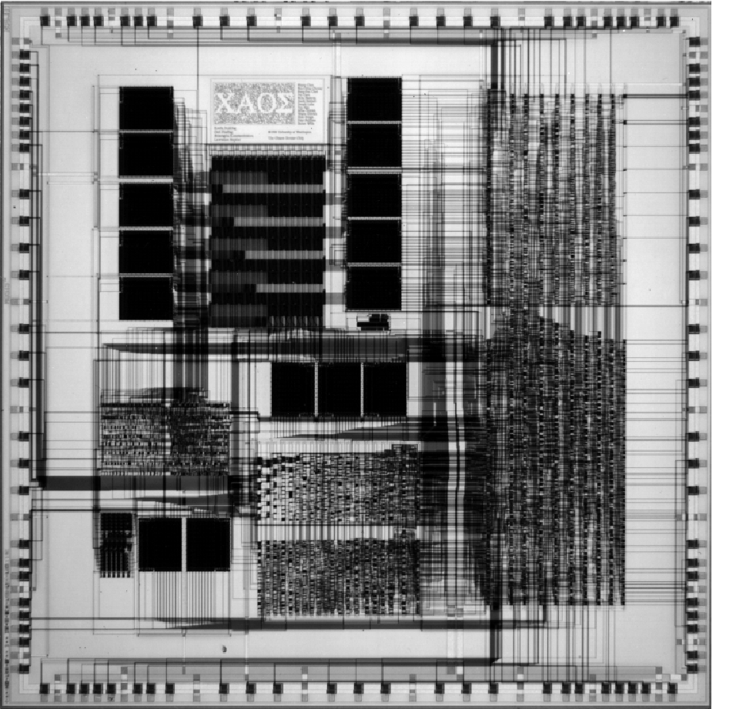
FPGA in System-on-a-Chip
Fast Time-To-Market
Post-Fabrication Customization
  Broaden application domain
  Run-time Reconfiguration
  Bug Fixes
  Upgrades
10x-100x Worse:
  Area
  Performance
  Power

Slide 7
Domain Specific FPGAs
Modify architecture to more efficiently support a range of known applications
  Higher performance
  Smaller area requirements
Creating architecture by hand for each domain?
  Time consuming!
  Makes SoC design too costly
Do it AUTOMATICALLY
  Would not add significantly to time of SOC design
  Fast time-to-market

Slide 8
Totem Goals
Totem Custom FPGA Generator
Speed of ASIC
Flexibility of FPGA
Specialized for application domains
  DSP, cryptography, scientific computing, etc.
Embedded in an SOC
  Instead of generic reconfigurable fabric
Quick automatic generation of custom reconfigurable architectures
Capacity: 150k gates
Global Signals: 7
Type: Datapath Control
Bus Width: 27 Rent Exponent: 0.7
Logic Block: 4-LUT/3-LUT mix
IP Blocks: 32Mult.cif
FFTcore.cif
Firewire.vhdl
Carry Chains
LUT RAM Mode
CAM
Set/Reset D-FF
Partial Reconfig.
OK
Cancel
Reset
Generating Architecture… Done.
Generating Layout… Done.
Generating CAD tools… Done.

Slide 9
Totem Design Flow
Domain description
Constraints
Shawn
VLSI Layout Generator
fab-ready layout
Architecture Generator
architecture description
P & R Tool Generator
Kati
custom P & R tools
Akshay

Slide 10
Architecture Generation
Application Set
Component Placement & Mapping of Apps
Routing Structure Generation
architecture description

Slide 11
Architecture Generation
Input several netlists for consideration
Use simulated annealing to place physical and logical components
Some components shared between netlists
Muxes added to handle different needs of the netlists (shown in green)
Some wires shared (black), others not
0
OUT
X
X
+
IN2
IN1
Notes:
Some components shared between netlists
Muxes added to handle different needs of the netlists (shown in green)
Some wires shared (black), others not

Slide 12
Routing Structure Generation
Need to make wires for the signals
  Share wires between netlists
  Have separate wires for each netlist
Compare several different algorithms
  Maximum wire sharing (left-edge)
    Loose approximation of “smallest” solution
  Greedy sharing
    Group wires together that share sources or destinations
  Clique partitioning sharing
IN1
0
OUT
X
X
+
IN2

Slide 13
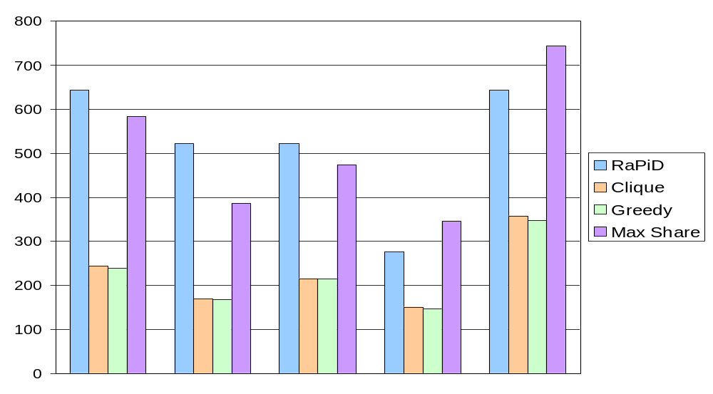
Area Results
Datapath Area in Mλ²
filter_img
filter_med
firsm
firsymeven
firsm
firsymeven
matmult
firsm
matmult
sort2
ALL

Slide 14
Automated VLSI Layout
With architecture description, we need to generate a layout automatically
Standard Cell
  Use standard cells to implement architecture description
  Use standard tools (Cadence) to perform physical design
Template Reduction
  Use standard component templates (macro-cells)
  Remove logic that isn’t needed to reduce area, perform compaction
Circuit Generator
  Create parameterized generators for main FPGA components
    LUTs, de/muxes, DFF, SRAM bits, etc.
  Create complete reconfigurable fabric by abutting generated components

Slide 15
Place and Route Tools
Goal is to efficiently map a logical netlist on a generated architecture
Placement Objective:
  Determine the position that each logic-element will occupy
  Ensure that the router is able to find enough routing resources
  Use simulated annealing
Router:
  Assigns a set of routing resources to each signal in the netlist
  Optimization goals are generally area, delay, or a combination of both
  Use PathFinder algorithm

Slide 16
Totem: The Future
Architecture Generation
  More flexible routing structures
  2D structures
Place and Route Tool Generation
  Pipelined routing
  2D architecture support
Automated VLSI Layout
  Template reduction
  Automatic circuit generator

Slide 17
Précis:
Design-Time Precision Analysis

Slide 18
Motivation
Mapping algorithms to FPGAs can be tough
Coping with precision is a key difficulty in mapping to hardware
  Too many bits == wasted resources
  Too few bits == incorrect results
Difficult for the non-hardware-savvy
Need tool to help designer optimize bit-widths
Still want to develop in a high-level description language
  MATLAB, C, C++, Java

Slide 19
Motivation
Few tools can automate HDL generation
  C-to-Verilog, C-to-VHDL
  MATCH (MATLAB to target code for embedded systems)
  Proprietary systems and languages…
Even fewer tools offer “Designer Aides”
  Floating-point to fixed-point translation
  Flexible resource utilization (e.g. memory vs. logic)
  Dealing with precision issues
Tool gap in design-time tools

Slide 20
Role of Précis in Tool Flow
Algorithm
Précis
Simulator
translation
HDL
Description
Compiler
+
Synthesizer
Place
&
Route
Bitstream

Slide 21
Précis Application
Supports MATLAB as an input language
Provides propagation engine for precision constraints
15..0
A
10..0
A
16..0
10..0
+
x
+
x
15..0
B
10..0
B
*
y
32..0
*
y
15..0
C
10..0
C
10..0
x = a + b
y = c + x

Slide 22
Simulation
Generates annotated MATLAB
User may specify precision constraints on any variable
Simulation demonstrates the effects of fixed-point operations which may result in rounding or truncation errors in the output
Matlab
Code
Précis
Annotated
Matlab
Matlab
Program
Output
Check for errors

Slide 23
Range Finding
Generates annotated MATLAB
Records ranges of variables for sample data sets
Results are reintegrated into Précis to allow for more investigation
Matlab
Code
Précis
Annotated
Matlab
Matlab
Program
Output
Variable
Stats

Slide 24
User Guidance
Want to guide a developer’s manual optimization
  Helpful for a novice designer
  Provides a starting point for hand-optimization
  Allows iterative optimization of the implementation
    Optimize until if fits and runs…
    Optimize further if we have time/money
We ask questions, developer answers
  What is the algorithm
  Known precision of variables
  Simulation and data gathering
Provide suggestions to the user

Slide 25
Slack Analysis
Propagation == upper bound
Range finding == lower bound
Difference == Slack
Try to identify nodes that have the greatest area impact on the final circuit implementation
Present these results as an ordered list of “moves” for the user to (optionally) make

Slide 26
Slack Analysis
For each node with slack, set precision to lower bound
  Propagate change through system
  Calculate the gain in area for this “move”
This creates a “tuning list” of variables to consider
Iteratively, the user can choose to make moves and recalculate what the next move should be

Slide 27
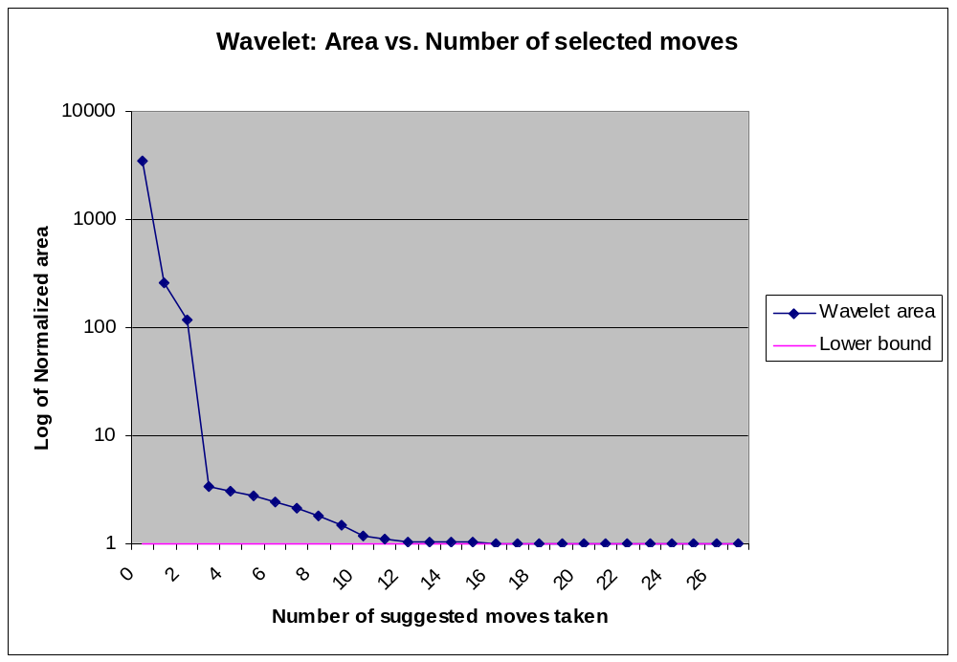
Benchmark: Wavelet Transform
27 variables selected for slack analysis
3 moves to within a factor of 3 of lower bound
11 moves to within 10% of lower bound
13 moves to within 3% of lower bound

Slide 28
Current Research
FPGA-based Hyperspectral Image Compression
FPGA Configuration Management
ALICE - ACME Labs Instant Computer
Fast CAD
Totem: Reconfigurable Subsystems for System-on-a-Chip
Précis: Variable Precision Analysis
Notes:
TOTEM:
Development of domain-specific and domain-adaptive FPGA architectures, layout generation, and physical design tools for adding reconfigurable subsystems into future complex ASIC designs
PRECIS:
Techniques to automatically optimize the bitwidths of MATLAB specifications of future FPGA hardware designs
FPGA_based Hyperspectral Image Compression:
A NASA-sponsored investigation into spaceborne use of FPGAs. We are developing image compression algorithms to radically reduce the bandwidth requirements for downlinking NASA hyperspectral (multiple image bands, such as IR, UV, visible light) images
FPGA Configuration Management:
Exploration of methods to radically reduce the reconfiguration overhead in FPGA devices to enable efficient run-time-reconfiguration. We are also working on an configuration architecture layout to integrate these techniques into a complete chip design
ALICE – ACME Labs Instance Computer:
Development of an FPGA-based infrastructure and curriculum for computer architecture education
Fast CAD:
Development of fast placement & routing tools for logic emulation systems

