Slide 1
Intel® OPEN SOURCE COMPUTER VISION LIBRARY

Slide 2
Goals
Develop a universal toolbox for research and development in the field of Computer Vision

Slide 3
We will talk about:
Victor Eruhimov:
Preliminary timing:
AC – 45 min
TC – 30 min
EU – 60 min
TR – 60 min
Algorithmic content
Technical content
Examples of usage
Trainings

Slide 4
OpenCV algorithms

Slide 5
OpenCV Functionality
(more than 350 algorithms)
Basic structures and operations
Image Analysis
Structural Analysis
Object Recognition
Motion Analysis and Object Tracking
3D Reconstruction

Slide 6
Basic Structures and Operations
Victor Eruhimov:
Multidimensional array operations include operations on images, matrices and histograms. In the future, when I talk about image operations, keep in mind that all operations are applicable to matrices and histograms as well. Dynamic structures operations concern all vector data storages. They will be discussed in detail in the Technical Section. Drawing primitives allows not only to draw primitives but to use the algorithms for pixel access. Utility functions, in particular, contain fast implementations of useful math functions.
Multidimensional array operations
Dynamic structures operations
Drawing primitives
Utility functions

Slide 7
Image Analysis
Thresholds
Statistics
Pyramids
Morphology
Distance transform
Flood fill
Feature detection
Contours retrieving

Slide 8
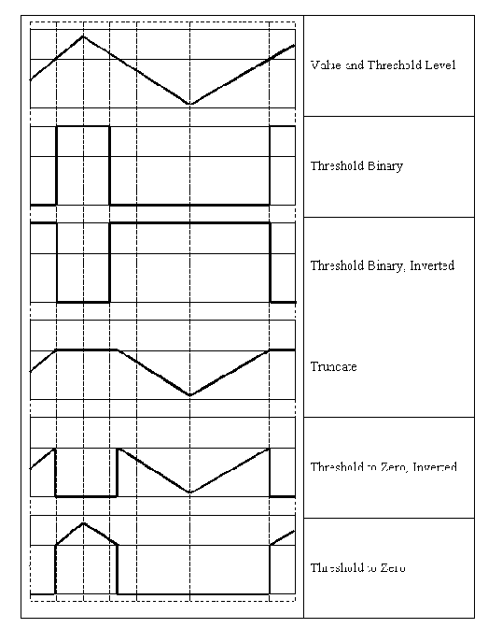
Image Thresholding
Fixed threshold;
Adaptive threshold;

Slide 9
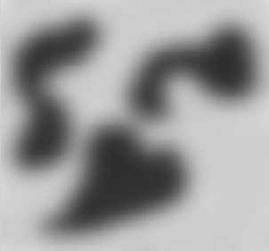
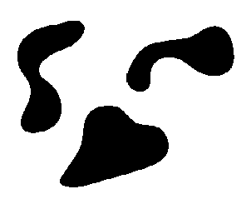
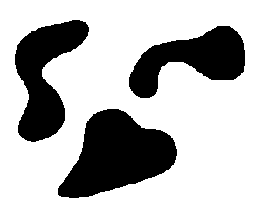
Image Thresholding Examples
Source picture
Fixed threshold
Adaptive threshold

Slide 10
Statistics
Victor Eruhimov:
In addition to simple norm calculation, there is a function that finds the norm of the difference between two images.
min, max, mean value, standard deviation over the image
Norms C, L1, L2
Multidimensional histograms
Spatial moments up to order 3 (central, normalized, Hu)

Slide 11
Multidimensional Histograms
Histogram operations : calculation, normalization, comparison, back project
Histograms types:
  Dense histograms
  Signatures (balanced tree)
EMD algorithm

Slide 12
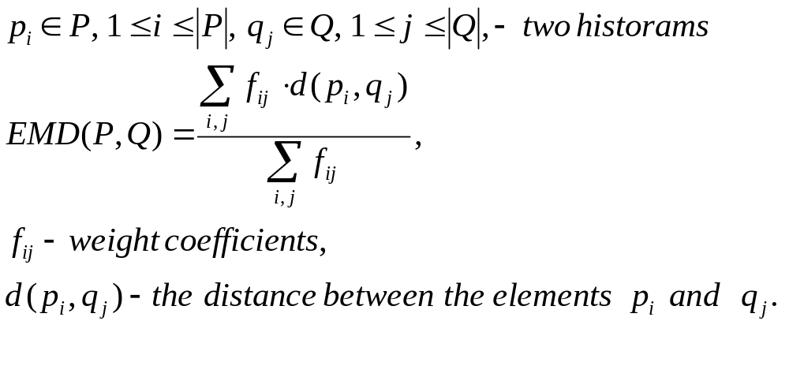
EMD – a method for the histograms comparison

Slide 13
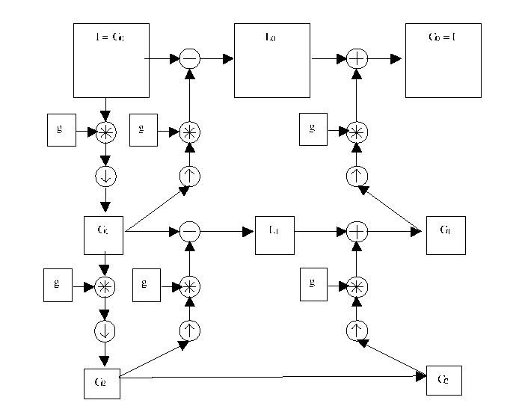
Image Pyramids
Gaussian and Laplacian pyramids
Image segmentation by pyramids
Notes:
Change the picture to something more clear!

Slide 14
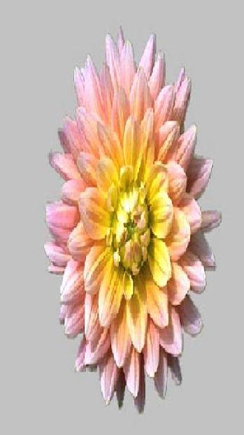
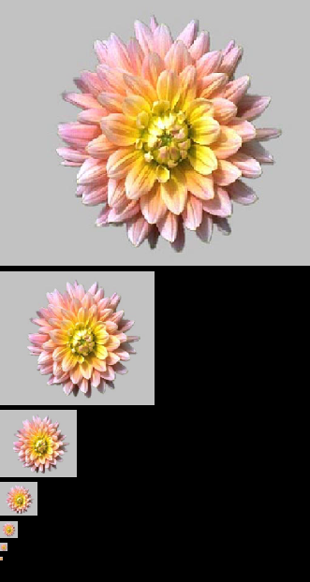
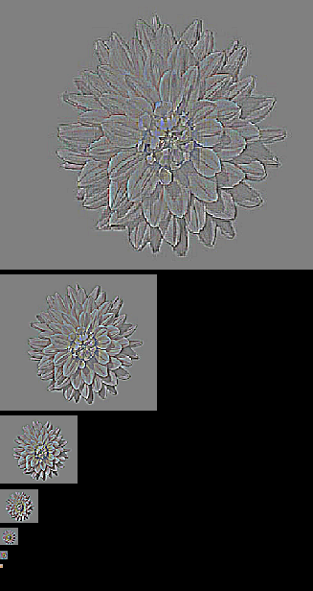
Image Pyramids
Gaussian and Laplacian

Slide 15
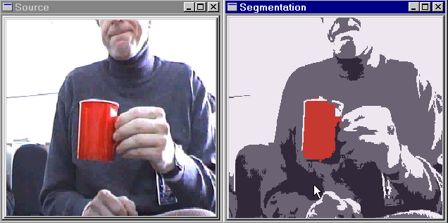
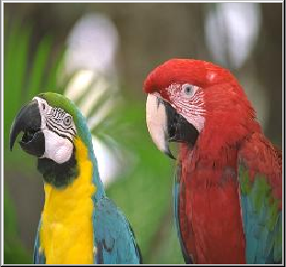
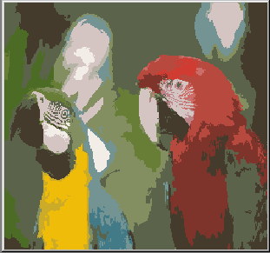
Pyramid-based color segmentation
On still pictures
And on movies

Slide 16
Morphological Operations
Two basic morphology operations using structuring element:
  erosion
  dilation
More complex morphology operations:
  opening
  closing
  morphological gradient
  top hat
  black hat

Slide 17
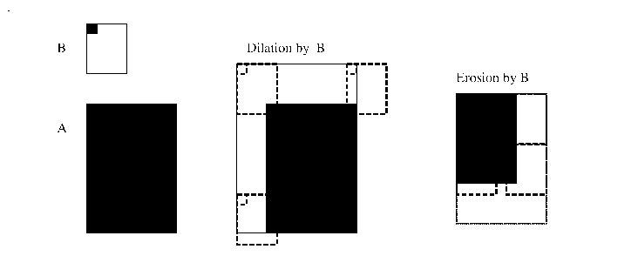
What is Structuring Element?
The rectangle mask with given position of a principal pixel:

Slide 18
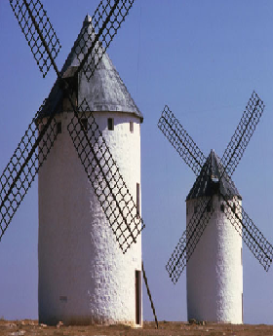
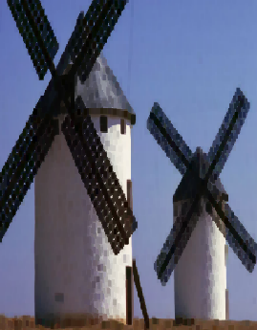
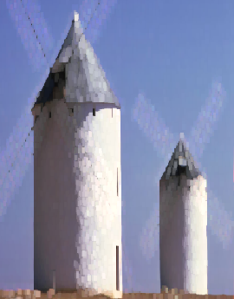
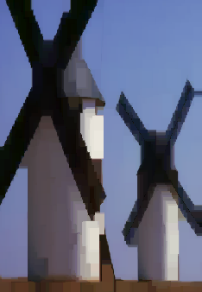
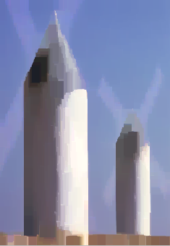
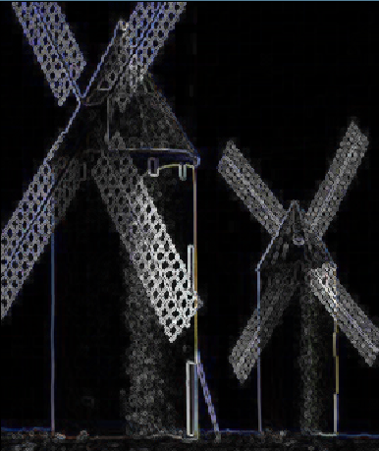
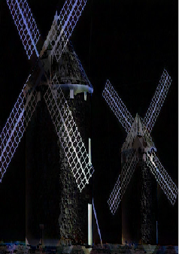
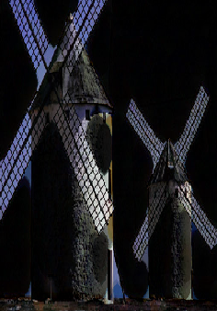
Morphological Operations Examples
Morphology - applying Min-Max. Filters and its combinations
Image I
Erosion IΘB
Dilatation I⊕B
Opening IoB= (IΘB)⊕B
Closing I•B= (I⊕B)ΘB
Grad(I)= (I⊕B)-(IΘB)
TopHat(I)= I - (IΘB)
BlackHat(I)= (I⊕B) - I

Slide 19
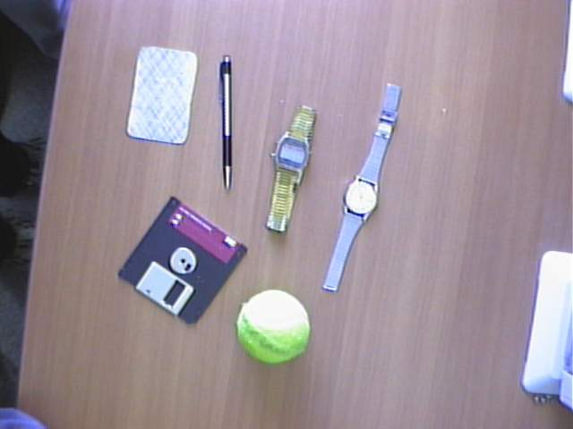
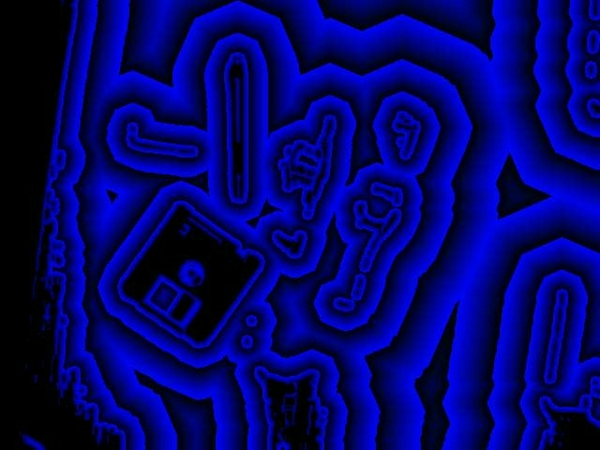
Distance Transform
Calculate the distance for all non-feature points to the closest feature point
Two-pass algorithm, 3x3 and 5x5 masks, various metrics predefined

Slide 20
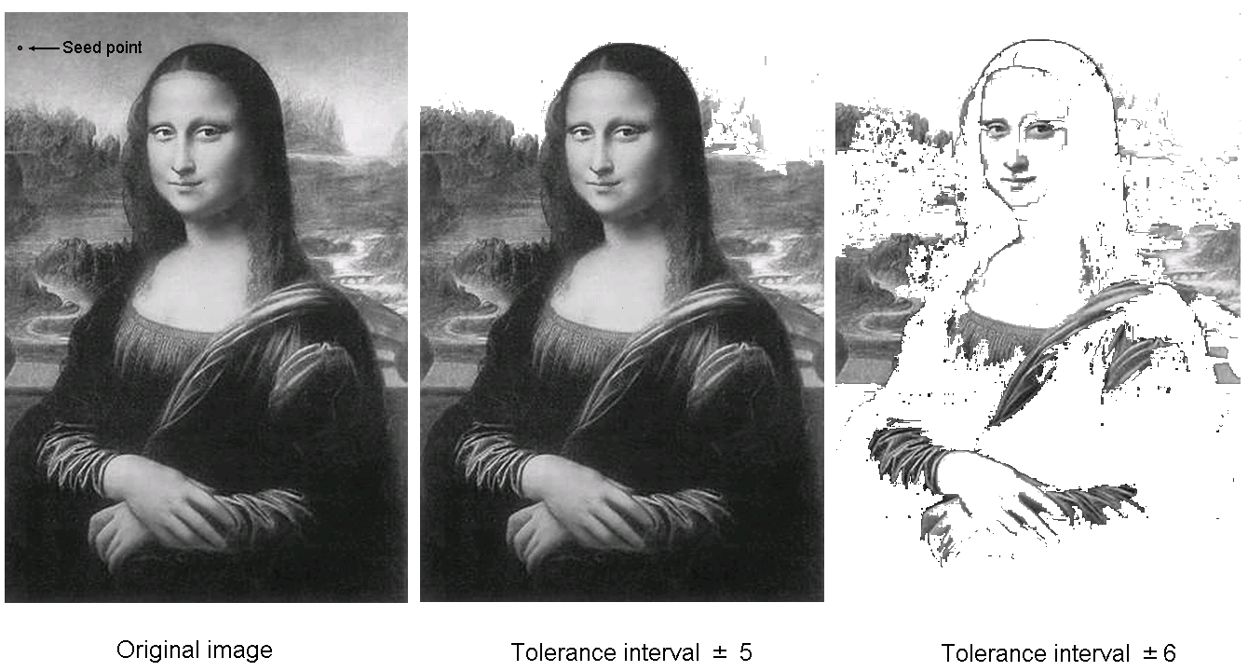
Flood Filling
Simple
Gradient

Slide 21
Feature Detection
Fixed filters (Sobel operator, Laplacian);
Optimal filter kernels with floating point coefficients (first, second derivatives, Laplacian)
Special feature detection (corners)
Canny operator
Hough transform (find lines and line segments)
Gradient runs

Slide 22
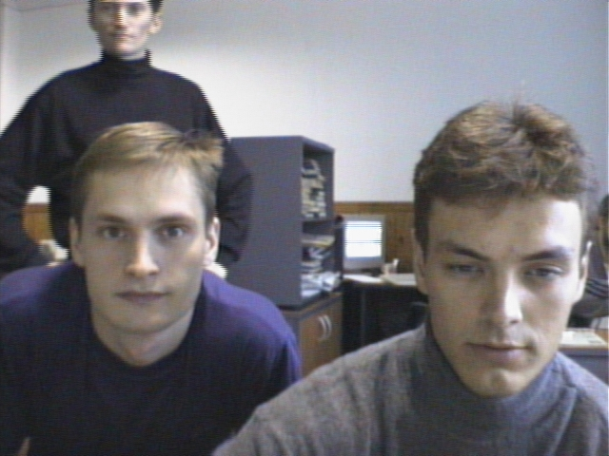
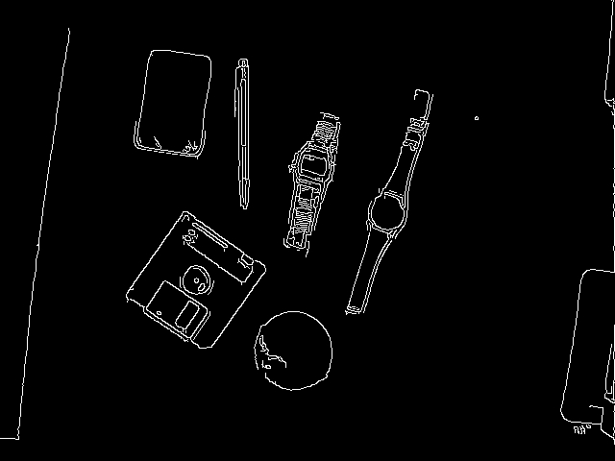
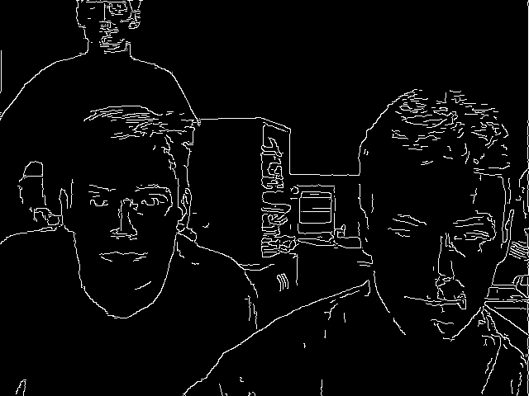
Canny Edge Detector

Slide 23
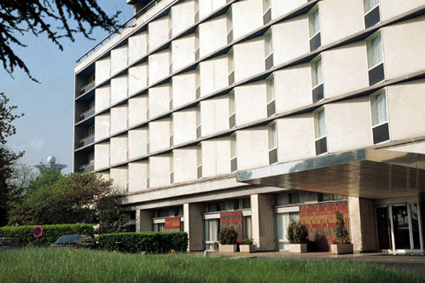
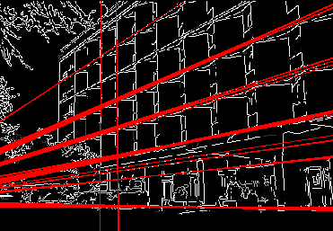
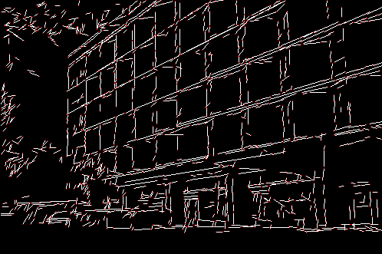
Hough Transform
Detects lines in a binary image
Probabilistic Hough Transform
Standard Hough Transform

Slide 24
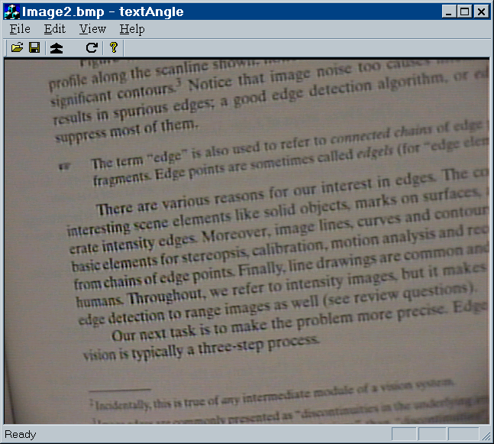
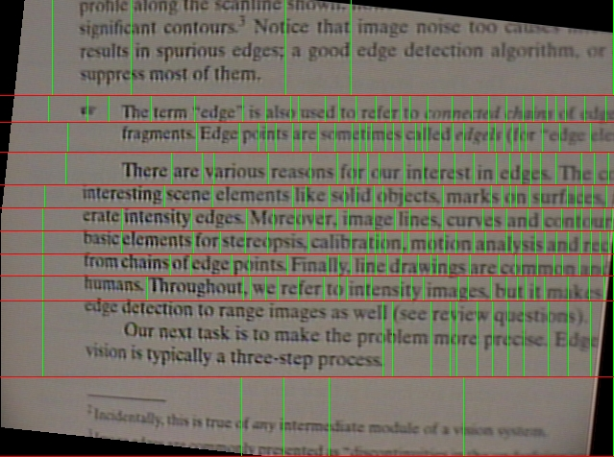
Another Sample of the Hough Transform Using
Source picture
Result

Slide 25
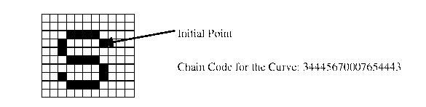
Contour Retrieving
The contour representation:
  Chain code (Freeman code)
  Polygonal representation
Initial Point
Chain code for the curve: 34445670007654443
Contour representation

Slide 26
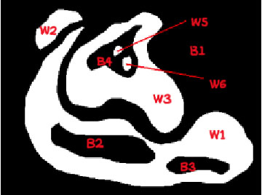
Hierarchical representation of contours
Image Boundary
(W1)
(W2)
(W3)
(B2)
(B3)
(B4)
(W5)
(W6)
Notes:
Get the english picture!

Slide 27


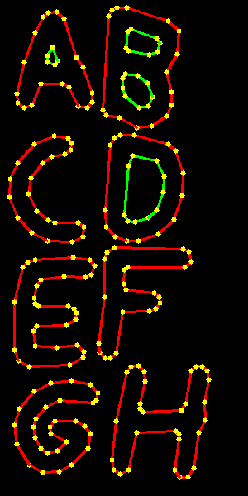
Contours Examples
Source Picture
(300x600 = 180000 pts total)
Retrieved Contours
(<1800 pts total)
After Approximation
(<180 pts total)
And it is rather fast: ~70 FPS for 640x480 on complex scenes

Slide 28
OpenCV Functionality
Basic structures and operations
Image Analysis
Structural Analysis
Object Recognition
Motion Analysis and Object Tracking
3D Reconstruction

Slide 29
Structural Analysis
Contours processing
  Approximation
  Hierarchical representation
  Shape characteristics
  Matching
Geometry
  Contour properties
  Fitting with primitives
  PGH

Slide 30
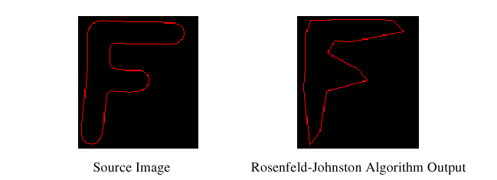
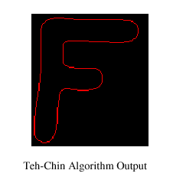
Contour Processing
Approximation:
  RLE algorithm (chain code)
  Teh-Chin approximation (polygonal)
  Douglas-Peucker approximation (polygonal);
Contour moments (central and normalized up to order 3)
Hierarchical representation of contours
Matching of contours

Slide 31
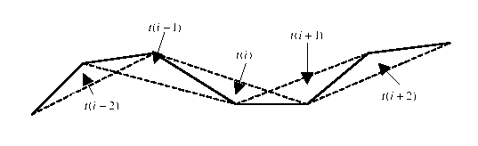
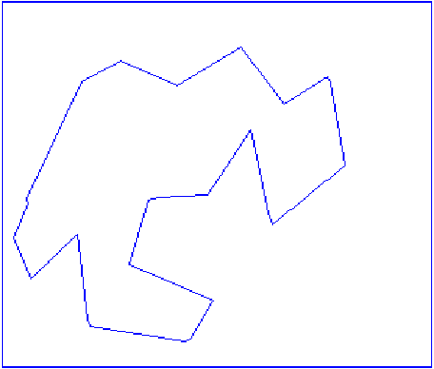
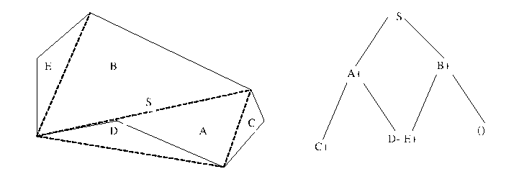
Hierarchical Representation of Contours
A contour is represented with a binary tree
Given the binary tree, the contour can be retrieved with arbitrary precision
The binary tree is quasi invariant to translations, rotations and scaling

Slide 32
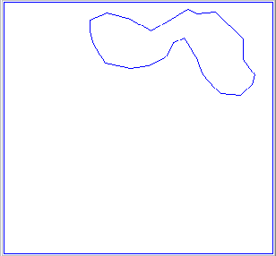
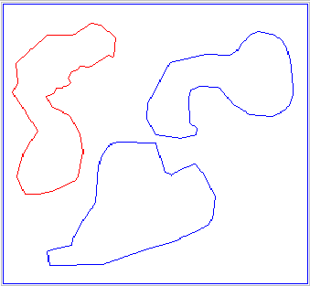

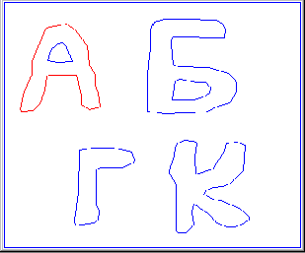
Contours matching
Matching based on hierarchical representation of contours

Slide 33
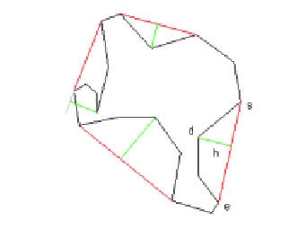
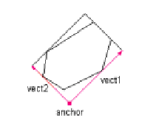
Geometry
Properties of contours: (perimeter, area, convex hull, convexity defects, rectangle of minimum area)
Fitting: (2D line, 3D line, circle, ellipse)
Pair-wise geometrical histogram

Slide 34

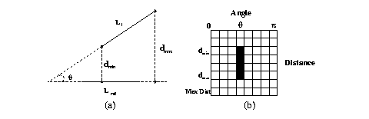
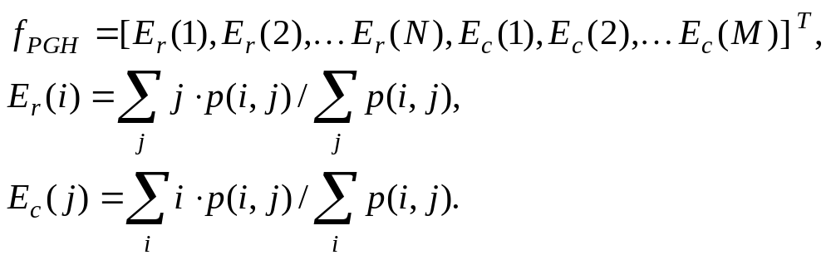
Pair-wise geometrical histogram (PGH)

Slide 35
OpenCV Functionality
Basic structures and operations
Image Analysis
Structural Analysis
Object Recognition
Motion Analysis and Object Tracking
3D Reconstruction

Slide 36
Object Recognition
Eigen objects
Hidden Markov Models

Slide 37
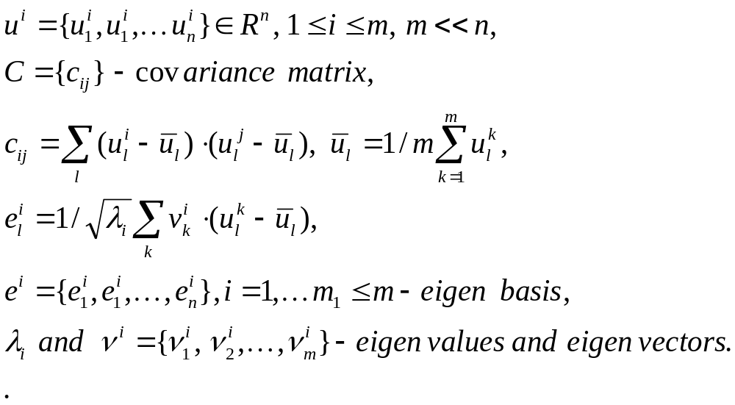
Eigen Objects

Slide 38
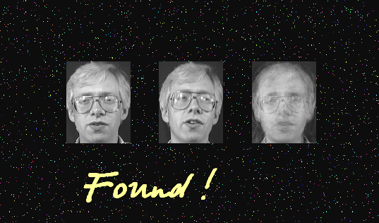
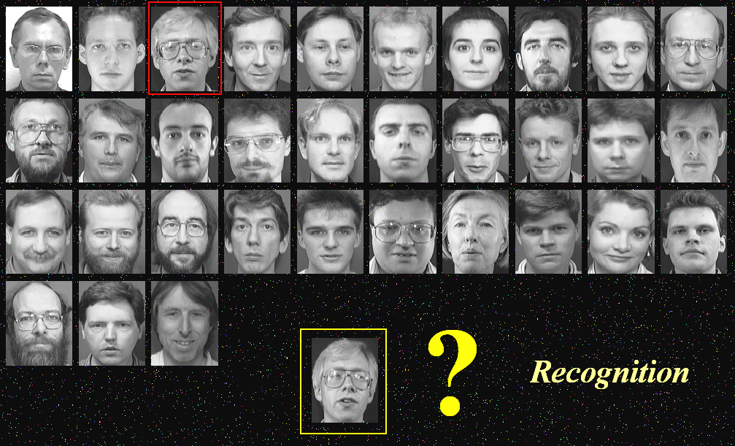



Eigen objects (continued)

Slide 39






Hidden Markov Model Definitions
- The set of states
- The set of measurements
- The state at time t
- The transition probability matrix
- The conditional probability matrix
- The starting states distribution

Slide 40
Hidden Markov Model
Algorithms
Model parameters estimation
Recognition
Viterbi algorithm

Slide 41



Embedded HMM for Face Recognition
Model-
- Face ROI partition
Notes:
Get the english picture!!!

Slide 42





Face recognition
using Hidden Markov Models
One person – one HMM
Stage 1 – Train every HMM
Stage 2 – Recognition
Pi - probability
Choose max(Pi)
1
…
n
i
Notes:
Get the more clear pictures!

Slide 43
OpenCV Functionality
Basic structures and operations
Image Analysis
Structural Analysis
Object Recognition
Motion Analysis and Object Tracking
3D Reconstruction

Slide 44
Motion Analysis and Object Tracking
Background subtraction
Motion templates
Optical flow
Active contours
Estimators

Slide 45
Background Subtraction
Background model (normal distribution)
Background statistics functions:
  Average
  Standard deviation
  Running average

Slide 46

Running average
Computes the sum of two images:

Slide 47

Background Subtraction Example
Notes:
Reconsider this slide!

Slide 48


Motion Templates
Object silhouette
Motion history images
Motion history gradients
Motion segmentation algorithm
MHG
silhouette
MHI

Slide 49


Motion Segmentation Algorithm
Two-pass algorithm labeling all motion segments

Slide 50

Motion Templates Example
Motion templates allow to retrieve the dynamic characteristics of the moving object

Slide 51

Optical Flow
Block matching technique
Horn & Schunck technique
Lucas & Kanade technique
Pyramidal LK algorithm
6DOF (6 degree of freedom) algorithm
Optical flow equations:

Slide 52





Pyramidal Implementation of the optical flow algorithm
Image Pyramid Representation
Iterative Lucas – Kanade Scheme
J image
I image
Location of point u on image u^{L}=u/2^{L}
Spatial gradient matrix
Standard Lucas – Kanade scheme for optical flow computation at level L d^{L}
Guess for next pyramid level L – 1
Finally,
Generic Image
(L-1)-th Level
Image pyramid building
L-th Level
Optical flow computation

Slide 53



6DOF Algorithm
Parametrical optical flow equations:
Notes:
Reconsider this slide!

Slide 54





Active Contours
Snake energy:
Internal energy:
External energy:
Two external energy types:

Slide 55
Estimators
Kalman filter
ConDensation filter

Slide 56

Kalman object tracker

Slide 57
OpenCV Functionality
Basic structures and operations
Image Analysis
Structural Analysis
Object Recognition
Motion Analysis and Object Tracking
3D Reconstruction

Slide 58
3D reconstruction
Camera Calibration
View Morphing
POSIT

Slide 59



Camera Calibration
Define intrinsic and extrinsic camera parameters.
Define Distortion parameters

Slide 60


Camera Calibration
Now, camera calibration can be done by holding checkerboard in front of the camera for a few seconds.
And after that you’ll get:
3D view of etalon
Un-distorted image

Slide 61



View Morphing

Slide 62




POSIT Algorithm
Perspective projection:
Weak-perspective projection:

Slide 63
OpenCV web sites
http://www.intel.com/research/mrl/research/opencv/
http://sourceforge.net

Slide 64
References
Gunilla Borgefors. Distance Transformations in Digital Images.Computer Vision, Graphics and Image Processing 34, 344-371,(1986).
G. Bradski and J. Davis. Motion Segmentation and Pose Recognition with Motion History Gradients. IEEE WACV'00, 2000.
P. J. Burt, T. H. Hong, A. Rosenfeld. Segmentation and Estimation of Image Region Properties Through Cooperative Hierarchical Computation. IEEE Tran. On SMC, Vol. 11, N.12, 1981, pp.802-809.
J.Canny.A Computational Approach to Edge Detection, IEEE Trans. on Pattern Analysis and Machine Intelligence, 8(6), pp.679-698 (1986).
J. Davis and Bobick. The Representation and Recognition of Action Using Temporal Templates. MIT Media Lab Technical Report 402,1997.
Daniel F. DeMenthon and Larry S. Davis. Model-Based Object Pose in 25 Lines of Code. In Proceedings of ECCV '92, pp. 335-343, 1992.
Andrew W. Fitzgibbon, R.B.Fisher. A Buyer’s Guide to Conic Fitting.Proc.5 th British Machine Vision Conference, Birmingham, pp. 513-522, 1995.
Berthold K.P. Horn and Brian G. Schunck. Determining Optical Flow. Artificial Intelligence, 17, pp. 185-203, 1981.

Slide 65
References
M.Hu.Visual Pattern Recognition by Moment Invariants, IRE Transactions on Information Theory, 8:2, pp. 179-187, 1962.
B. Jahne. Digital Image Processing. Springer, New York, 1997.
M. Kass, A. Witkin, and D. Terzopoulos. Snakes: Active Contour Models, International Journal of Computer Vision, pp. 321-331, 1988.
J.Matas, C.Galambos, J.Kittler. Progressive Probabilistic Hough Transform. British Machine Vision Conference, 1998.
A. Rosenfeld and E. Johnston. Angle Detection on Digital Curves. IEEE Trans. Computers, 22:875-878, 1973.
Y.Rubner.C.Tomasi,L.J.Guibas.Metrics for Distributions with Applications to Image Databases. Proceedings of the 1998 IEEE International Conference on Computer Vision, Bombay, India, January 1998, pp. 59-66.
Y. Rubner. C. Tomasi, L.J. Guibas. The Earth Mover’s Distance as a Metric for Image Retrieval. Technical Report STAN-CS-TN-98-86, Department of Computer Science, Stanford University, September, 1998.
Y.Rubner.C.Tomasi.Texture Metrics. Proceeding of the IEEE International Conference on Systems, Man, and Cybernetics, San-Diego, CA, October 1998, pp. 4601- 4607. http://robotics.stanford.edu/~rubner/publications.html

Slide 66
References
J. Serra. Image Analysis and Mathematical Morphology. Academic Press, 1982.
Bernt Schiele and James L. Crowley. Recognition without Correspondence Using Multidimensional Receptive Field Histograms. In International Journal of Computer Vision 36 (1), pp. 31-50, January 2000.
S. Suzuki, K. Abe. Topological Structural Analysis of Digital Binary Images by Border Following. CVGIP, v.30, n.1. 1985, pp. 32-46.
C.H.Teh, R.T.Chin.On the Detection of Dominant Points on Digital Curves. - IEEE Tr. PAMI, 1989, v.11, No.8, p. 859-872.
Emanuele Trucco, Alessandro Verri. Introductory Techniques for 3-D Computer Vision. Prentice Hall, Inc., 1998.
D. J. Williams and M. Shah. A Fast Algorithm for Active Contours and Curvature Estimation. CVGIP: Image Understanding, Vol. 55, No. 1, pp. 14-26, Jan., 1992. http://www.cs.ucf.edu/~vision/papers/shah/92/WIS92A.pdf.
A.Y.Yuille, D.S.Cohen, and P.W.Hallinan. Feature Extraction from Faces Using Deformable Templates in CVPR, pp. 104-109, 1989.
Zhengyou Zhang. Parameter Estimation Techniques: A Tutorial with Application to Conic Fitting, Image and Vision Computing Journal, 1996.

Slide 67
Using drawing primitives in image restoration task
Detect and remove “straight” scratches using line iterators
Detect and remove arbitrary scratches using edge detector with subsequent contour analysis
Call Hawk here

Slide 68



Using contours and geometry to classify shapes
Given the contour classify the geometrical figure shape (triangle, circle, etc)

Slide 69
OpenCV shape classification capabilities
Contour approximation
Moments (image&contour)
Convexity analysis
Pair-wise geometrical histogram
Fitting functions (line, ellipse)

Slide 70
Contour approximation
Min-epsilon approximation (Imai&Iri)
Min#-approximation (Douglas-Peucker method)
Hawk

Slide 71
Moments
Image moments (binary, grayscale)
Contour moments (faster)
Hu invariants

Slide 72

Line and ellipse fitting
Algebraic ellipse fitting
Fitting lines by m-estimators
Notes:
Draw more thick ellipse here!

Slide 73

Using OpenCV to do color segmentation
Locate all nonoverlapping geometrical figures of the same unknown color

Slide 74
OpenCV segmentation capabilities
Edge-based approach
Histogram
Color segmentation

Slide 75
Edge-based segmentation
Smoothing functions (gaussian filter^{IPL}, bilateral filter)
Apply edge detector (sobel, laplace, canny, gradient strokes)
Find connected components in an inverted image

Slide 76
Pyramid segmentation
Water down the color space in order to join up the neighbor image pixels that are close to each other in XY and color spaces
Call Hawk here

Slide 77
Histogram
Calculate the histogram
Separate the object and background histograms
Find the objects of the selected histogram in the image
Call Hawk here

Slide 78

Using OpenCV to detect the 3D object’s position
Calibrate the camera
Reconstruct the position and orientation of the rigid 3D body given it’s geometry

Slide 79
Camera calibration routines, ActiveX

Slide 80
Reconstruction task
Given
camera model
3D coordinates of the feature points
and 2D coordinates corresponding projections on the image
Reconstruct the 3D position and orientation

Slide 81
Reconstruction task (continued)
POSIT algorithm for 3D objects
FindExtrinsicCameraParams for arbitrary objects

Slide 82
Using of Kalman filter with histograms for tracking

Slide 83
Using of HMM models for recognizing shapes

Slide 84
Technical content
Software requirements
OpenCV structure
Data types
Error Handling
I/O libraries (HighGUI, CvCAM)
Scripting
  Hawk
  Using OpenCV in MATLAB
OpenCV lab (code samples)

Slide 85
Software Requirements
Win32 platforms:
  Win9x/WinNT/Win2000
  C++ Compiler (makefiles for Visual C++ 6.0,Intel C++ Compiler 5.x,Borland C++ 5.5, Mingw GNU C/C++ 2.95.3 are included ) for core libraries
  Visual C++ to build the most of demos
  DirectX 8.x SDK for directshow filters
  ActiveTCL 8.3.3 for TCL demos
  IPL 2.2+ for the core library tests
Linux/*NIX:
  C++ Compiler (tested with GNU C/C++ 2.95.x, 2.96, 3.0.x)
  TCL 8.3.3 + BWidgets for TCL demos
  Video4Linux + Camera drivers for most of demos
  IPL 2.2+ for the core library tests

Slide 86
OpenCV structure
OpenCV
Open source
Open source
DShow filters, Demo apps,
Scripting Environment
Intel Image
Processing
Library
OpenCV(C++ classes, High-level C functions)
Switcher
Low level C-functions
Open source
Open source
IPP
(Optimized low level functions)

Slide 87
Data Types
Image (IplImage);
Matrix (CvMat);
Histogram (CvHistogram);
Dynamic structures (CvSeq, CvSet, CvGraph);
Spatial moments (CvMoments);
Helper data types (CvPoint, CvSize, CvTermCriteria, IplConvKernel and others).
Multi-dimensional array

Slide 88
Error Handling
There are no return error codes
There is a global error status that can be set or checked via special functions
By default a message box appears if error happens

Slide 89
Portable GUI library (HighGUI)
Reading/Writing images in several formats (BMP,JPEG,TIFF,PxM,Sun Raster)
Creating windows and displaying images in it. HighGUI windows remember their content (no need to implement repainting callbacks)
Simple interaction facilities: trackbars, getting input from keyboard
and mouse (new in Win32 version).

Slide 90
Portable Video Capture Library (CvCAM)
Single interface for video capture and playback under Linux and Win32
Provides callback for subsequent processing of frames from camera or AVI-file
Easy stereo from 2 USB cameras or stereo-camera

Slide 91

Scripting I: Hawk
Visual Environment
ANSI C interpreter (EiC) as a core
Plugin support
Interface to OpenCV,IPL and HighGUI via plugins
Video support

Slide 92
Scripting II:
OpenCV + MATLAB
Design principles and data types organization
Working with images
Working with dynamic structures
Example

Slide 93
Design Principles and
Data Types Organization
Simplicity: Use of native MATLAB types (matrices, structures), rather than introducing classes
Compatibility: … with Image Processing Toolbox
Irredundancy: matrix and basic image processing operations are not wrapped
myscript.m:
[dst …] = cv<func>( src …)
mxArray’s, matlab error codes
cvmex.dll:
// data type conv., error handling
void mexFunction (…) { … }
IplImage’s, CvSeq …, CV error codes
cv.dll:
cvFunc( src …, dst …) {…}

Slide 94
Working with Images
Morphology: Erosion, Dilation, Open, Close …
  % erosion with 3x3 rectangular element
  B=cverode(A,[3,3,1,1],’rect’,1);
Feature Detection: Canny, MinEigenVal, GoodFeaturesToTrack …
  % strong corners detection (quality level = 0.1, min distance = 10)
  corners=cvgoodfeaturestotrack(A,0.1,10[,region_mask]);
Point Tracking:
  % Optical Flow on pyramids: window 10*2+1x10*2+1, 4 scales
  ptsB=cvoptflowpyrlk(imgA,imgB,ptsA,10,4);
CAMSHIFT:
  % Color object tracking, default termination criteria (epsilon = 1):
  [new_window,angle,size]=cvcamshift(img, window[, 1]);
As well as pyramids, color segmentation, motion templates, floodfill, moments, adaptive threshold, template matching, hough transform, distance transform …

Slide 95
Working with Dynamic Structures
Contours: retrieving, drawing, approximation …
  % get all the connected components of binary image,
  % don’t approximate them
  contours=cvfindcontours(img,’ccomp’,’none’);
  r1 = contours(1).rect; % get bounding box of the first contour
  ch21 = contours(2).child(1) % get the first child of the second contour
  p = ch21.pt; % get Nx2 array of vertices of the child
  img = cvdrawcontours( img, p, ‘g’ ); % draw the child contour % on the image with green
new_contours = cvapprox(contours,’dp’,2) % approximate all contours using Douglas-Peucker method with accuracy = 2.
Geometry: skeletons, convex hulls, matching contours
  % compare contours via pair-wise histogram comparison
  err = cvmatchcontours( contours(1), contours2(5), ‘pgh’)

Slide 96
Example:
% Camshift tracker, enhanced with noise filter
function new_window = track_obj( img, obj_hist, window, thresh )
probimg = cvcalcbackproject( img, obj_hist );
probimg = cvclose( probimg, 3, 2 ); % remove small holes via morphological ‘close’ operation
probimg = cvthresh( probimg, thresh );
  contours = cvfindcontours( probimg, ‘external’ );
  mask_img = zeros(size(contours));
  for i = 1:length(contours)
    if contous(i).rect(3)*contous(i).rect(4) < 30
    contours(i).pt = []; % remove small contours;
    end
  end
  mask_img = cvfillcontours( mask_img, contours, ‘w’ );
  new_window = cvcamshift( mask_img, window );

Slide 97

Victor Eruhimov:
Questions?

Slide 98

Trainings
Go to lab…

