Slide 1
Chapter1: Scalable Computer Platforms and Models
the basic unit in time : second(s)
the two basic information units : byte(B), bit(b)
other information units: word, doubleword, quadword
workload unit : flop ( # of floating-point operations )
unit for computing speed : flop/s
unit for information transfer rate : bytes per second B/s
execution rate of a processor : million instruction per second (MIPS)
Binary interpretation
  information units such as bits, bytes, or word
Decimal interpretation
  other units such as execution time, power, weight, pin count, and computational workload, etc

Slide 2
Notations and Conventions for Numbers
Prefix | Abbreviation | Meaning | Numeric Value
milli | m | One thousandth | 10⁻³
micro | µ | One millionth | 10⁻⁶
nano | n | One billionth | 10⁻⁹
pico | p | One trillionth | 10⁻¹²
femto | f | One quadrillionth | 10⁻¹⁵
atta | a | One quintillionth | 10⁻¹⁸
kilo | K or k | Thousand | 10³ or 2¹⁰
mega | M | Million | 10⁶ or 2²⁰
giga | G | Billion | 10⁹ or 2³⁰
tera | T | Trillion | 10¹² or 2⁴⁰
peta | P | Quadrillion | 10¹⁵ or 2⁵⁰
exa | E | Quintillion | 10¹⁸ or 2⁶⁰

Slide 3
Computer Generations in 50 Years
Generation Period | Technology and Architecture | Software and Operating System | Representative Systems
First 1946 ~ 1956 | Vacuum tubes and relay Memory, single-bit CPU With accumulator-based Instruction set | Machine/assembly Language, programs without subroutines | ENIAC, IBM701, Princeton IAS
Second 1956 ~ 1967 | Discrete transistors, core memory, floating-point accelerator, I/O channels | Algol and Fortran with compilers, batch processing OS | IBM 7030, CDC 1604, Univac LARC
Third 1967 ~ 1978 | Integrated circuits, pipelined CPU, microprogrammed control unit | C language, Multiprogramming, Timesharing OS | PDP-11, IBM 360/370, CDC 6600
Fourth 1978 ~ 1989 | VLSI microprocessors, Solid-state memory. Multiprocessors, vector supercomputers | Symmetric Multiprocessing, Parallelizing compilers, Message-passing libraries | IBM PC, VAX 9000, Cray X/MP
Fifth 1990~present | ULSI circuits, scalable parallel computers, Workstation clusters. Intranet, Internet | Java, micorkernels, multithreading, distributed OS, World-Wide Web | IBM SP2, SGI Origin 2000, Digital TruCluster

Slide 4
Scalable Computer Architecture
A computer system, including all its hardware and software resources, is scalable if it can scale up to accommodate ever-increasing performance and functionality demand and/or scale down to reduce cost
  scale up : improve its resources
  scale down : decrease its resources
Functionality and Performance : The scaled-up system should provide more functionality or better performance
Scaling in Cost : The cost paid for scaling up must be reasonable
  no more than n or nlogn times
Compatibility : The same components(hw, sw) should still be usable with little change
The Computer Pyramid (Fig 1.1)

Slide 5
Converging System Architecture
  3 Architectures for Scalable Parallel Computers
    Shared-nothing Architecture
    Shared-disk Architecture
    Shared-memory Architecture
Shell architecture : a custom-designed circuitry interfaces a commodity microprocessor to the rest of the node, cache, a local memory, NIC, and a disk
  processor가 upgrade 되거나 바뀔 경우 : shell만 바뀌면 됨
  node : follows a shell architecture
Macro-architecture : overall structure of a computer system
Micro-architecture : processor and the shell surrounding it

Slide 6
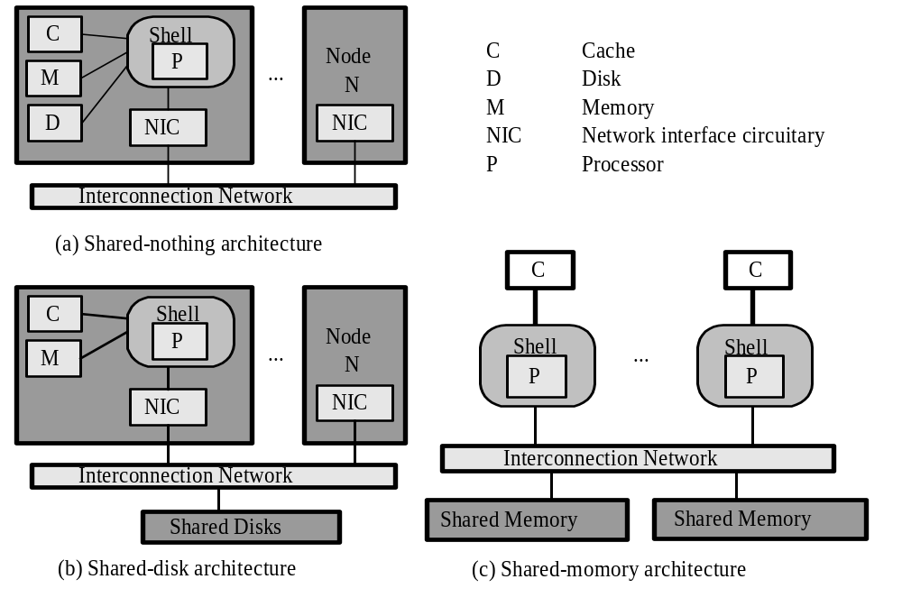
Common architecture for scalable parallel computers

Slide 7
Dimensions of Scalability
Scaling : improving or reducing system resources
Processor vs. Node
  Processor : the CPU which is including one or more instruction pipelines, floating point units, and caches, among other things
  Node : the thing which may have one or more processors, a local memory, and other circuitry
  Each generation has improved from the previous generations
Resource Scalability
Application Scalability
Technology Scalability

Slide 8
Resource Scalability I
To gain higher performance or functionality
increase the machine size (# of processors)
invest more storage(cache, main memory, disks)
improve the software
Size Scalability : measures the maximum # of processors a system can accommodate
  SMP system : 64 processors
  IBM SP2 : 512 processors
단순히 processor만 더하는 것이 아니라, communication subsystem을 improve해야 할 필요도 있음
Scaling Up in Resources : to invest more memory, bigger off-chip caches, bigger disks

Slide 9
Resource Scalability II
Real system have an upper limit on the maximum memory capacity
  IBM SP2 : 2GB memory per node
  Cray T3D : 64MB
Software Scalability
  newer version OS with more efficient kernel functions, supports for larger address space,
  better compiler with more efficient optimizations
  more efficient mathematical and engineering libraries
  More easy-to-use application software
  More user-friendly programming environment

Slide 10
Application Scalability
The same program should run with proportionally better performance on a scaled-up system
Scalability in Machine Size : How well the performance will improve with additional processors
  n-processor computer system을 DB server로 사용하는 경우, 2n개로 증가시키면 transaction 처리 속도가 2배로 증가하느냐? ( yes →the system scales well over machine size)
Scalability in Problem Size : How well the system can handle larger problems with larger data size and workload
Notes:
Many practical parallel applications have built-in limitations regarding machine size and problem size
  e.g. a parallel radar signal processing program may use at most 256 processors and handle at most 100 radar channels.
Application/machine pair : a system
It also depends on the memory capacity, I/O capacity, and communication capability of the machine

Slide 11
Technology Scalability I
A scalable system can adapt to changes in technology
Generation (Time) Scalability
A system can be scaled up using the next-generation components such as a faster processor, a faster memory, a newer version of OS.
  IBM PC : processor는 바꾸어도 monitor, hard drive, printer등은 그대로 사용가능
    SW가 upgraded system에서 수정 없이도 더 빠르게 동작함.
Space Scalability
  The ability of a system to scale from a certain place to multiple buildings and geographic regions
SMP, MPP : limited space scalability
Internet : excellent space scalability

Slide 12
Technology Scalability II
Heterogeneity Scalability
How well a system can scale up by integrating hw and sw components supplied form different designers or vendors
use components with a standard, open architecture and interface
Software portability in scalable parallel computers
  e.g.
  - IBM Parallel Operating Environment (POE) : scalable over any size of RS6000 system
  RS6000 system의 각 node가 PowerPC workstation 또는 SP2일 경우에도, Ethernet 또는 high-performance switch(HPS) of SP2, 노드가 지역적으로 떨어져 있어도, parallel program이 수정 없이 수행가능
  - PVM(parallel virtual machine) : a parallel program can run on a network of nodes from different vendors

Slide 13
Parallel Machine Model : 5 Semantic Attributes I
A parallel machine model can be characterized by five semantic attributes and several performance attributes
Homogeneity : How alike the processors of a parallel computer behave when executing a parallel program
  SISD, SIMD, MIMD (Flynn’s classification)
Synchrony : How tightly synchronized the processes are
  PRAM(parallel random access model) : synchronous at instruction level
  real MIMD : asynchronous
  BSP(bulk synchronous parallel) model : the processes synchronize with one another only at the end of every superstep(a bulk of L instructions)
  loosely synchronous scheme: a parallel program is divided into a sequence of phases

Slide 14
Parallel Machine Model : 5 Semantic Attributes II
Interaction Mechanism :How parallel processes may interact to affect the behavior of on another
  shared variable
  message passing (all variables accessible by a process are invisible to other processes)
  Multiprocessor : an asynchronous MIMD interacting through shared variables
  Multicomputer: an asynchronous MIMD machine with message passing

Slide 15
Parallel Machine Model : 5 Semantic Attributes III
Address Space : set of memory locations accessible by the process
  single address space
    PRAM model from the programmer’s viewpoint
  multiple address space
Memory Model : specifies how the machine model handles shared-memory conflicts
  consistency rule 사용
  EREW(exclusive read exclusive write) : PRAM
  CREW(concurrent read exclusive write)
    at each cycle, a memory cell can be read by multiple processors, but can be written by at most one processor
  CRCW(concurrent read concurrent write)
    concurrent write conflicts can be resolved by prespecified access policy

Slide 16
Parallel Machine Model :Performance Attributes
Machine size n : # of processors
Workload W (Mflop): # of computation operations in a program
P_{peak} : peak speed of processor
Speed P_{n}=W / T_{n} (Mflop/s)
Speedup S_{n}=T₁ / T_{n}
T₁: sequential execution time
T_{n}: parallel execution time
Efficiency E_{n} = S_{n} / n

Slide 17
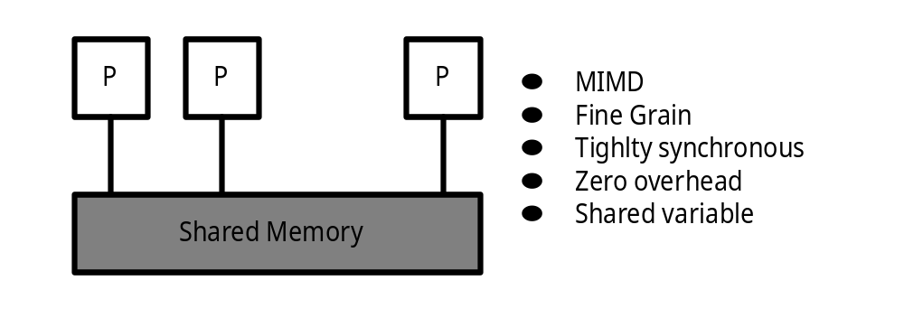
PRAM Model
Parallel random Access Model : theoretical machine model
Machine size n can be arbitrarily large
basic time step : cycle
n process로 구성된 parallel program의 i-th process는 i-th processor에서 수행됨
각 processor는 한 cycle에 한 instruction수행

Slide 18
3 Types of Operations in a Parallel Program
Computation Op. : arithmetic/logic, data transfer, & control flow
  traditional sequential program
Parallelism Op. : to manage process
  creation and termination, context switching, & grouping
Interaction Op.: to communicate and to synchronize process
Sources of overhead
: parallelism & interaction operations

Slide 19
Overheads
Parallelism overhead caused by process management
Communication overhead caused by processors exchanging information
Synchronization overhead in executing synchronization operations
Load imbalance overhead incurred, when some processors are idle while the others are busy
이와 같은 overhead로 인해, n개의 processor를 사용했을 때의 speedup은 n이 아니다.

Slide 20
Abstract Machine Model
parallel algorithm을 설계, 분석하는데 사용
PRAM Model
BSP(bulk synchronous parallel) Model
  program executes as a strict sequence of supersteps
Phase Parallel Model
  as a sequence of phase
    parallelism phase
    Computation phase
    Interaction phase

Slide 21
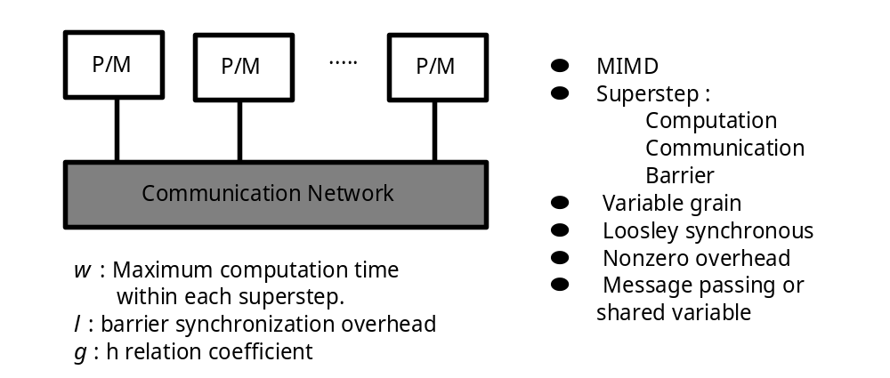
BSP(bulk synchronous parallel) Model

Slide 22
Physical Machine Model
SIMD machine
parallel vector processor (PVP)
symmetric multiprocessor (SMP)
massively parallel processor (MPP)
cluster of workstations (COW)
  low-cost variation of MPPs
distributed shared memory (DSM) multiprocessor

Slide 23
Semantic Attributes of Parallel Machine Models
Attributes | PRAM | PVP/SMP | DSM | MPP/COW
Homogeneity | MIMD | MIMD | MIMD | MIMD
Synchrony | Instruction-level synchronous | Asynchronous or loosely synchronous | Asynchronous or loosely synchronous | Asynchronous or loosely synchronous
Interaction mechanism | Shared variable | Shared variable | Shared variable | Message passing
Address Space | Single | Single | Single | Multiple
Access cost | UMA | UMA | NUMA | NORMA
Memory model | EREW, CREW or CRCW | Sequential consistency | Weak ordering is widely used | N/A
Example machines | Theoretical model | IBM R50, Cray T-90 | Stanford DASH, SGI Origin 2000 | Cray T3E, Berkeley NOW

Slide 24
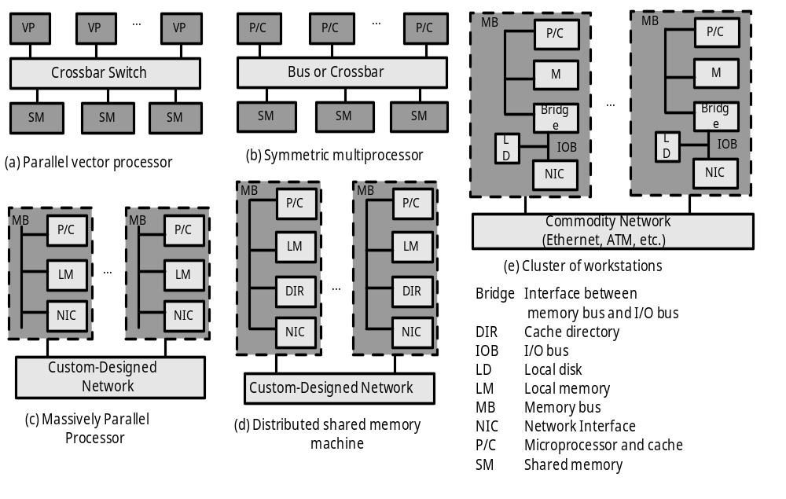
Five physical parallel computer models : PVP, SMP, MPP, DSM, and COW

Slide 25
Parallel Vector Processor
Cray C-90, Cray T-90, NEC SX-4
small number of powerful custom-designed vector processors (at least 1 Gflop/s)
custom-designed, high-bandwidth crossbar switch network
cache대신에 vector register, instruction buffer사용
In T-90, the shared memory can pump data to a processor at 14 GB/s

Slide 26
Symmetric Multiprocessor
IBM R50, SGI Power Challenge,
DEC Alpha server 8400
uses commodity microprocessors with on-chip and off-chip caches
High speed snoopy bus
Every processor has equal access to the shared memory, the I/O devices, and OS services
Most PVPs and SMPs have at most 64 processors
  caused by using a centralized shared memory and a bus or crossbar system interconnect

Slide 27
Massively Parallel Processor
Higher parallelism with distributed memory architecture
refer to a very large-scale computer system
  uses commodity microprocessors in processing nodes
  physically distributed memory
  interconnection with high communication bandwidth and low latency
  scaled up to hundreds or even thousands of processors
  asynchronous MIMD, blocking message-passing operation으로 동기화
  each process has its private address space
Intel Paragon & TFLOP

Slide 28
Distributed Shared-Memory machines
Stanford DASH : Cache directory(DIR) is used to support distributed coherent caches
Cray T3D : special hw/sw extensions at arbitrary block-size level
SMP와의 차이점: memory is physically distributed among different nodes
user에게는 single address space같이 보이게 함

Slide 29
Clusters of Computers
Digital’s TruCluster, IBM SP2, Berkeley NOW
low-cost variation of MPPs
  node : headless workstation (monitor, keyboard, mouse등이 없는 complete workstation), SMP or PC
  low-cost commodity network, Ethernet, FDDI, Fiber-Channel, ATM switch
  The network interface is loosely coupled to the I/O bus in a node
  Local disk
  A complete OS resides on each node
many cost/performance advantages over MPPs
Notes:
COW의 OS: Unix + add-on software layer to support single system image, availability, parallelism, communication, and load balancing
SP2는 MPP로도 간주될 수 있음, high-performance switch가 사용된 것을 제외하면 cluster 구조임
MPP구조에는 local disk가 없음.
MPP : nodes들이 tightly coupled : 노드들이 high-speed, proprietary communication network으로 연결

Slide 30
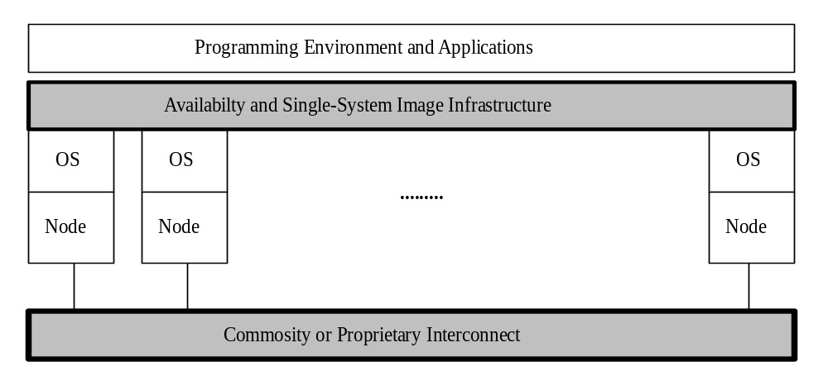
Cluster
A collection of complete computers (nodes), that are physically interconnected by a high- performance network or a LAN
Node : SMP server, workstation, PC
All cluster nodes should work together collectively as a single, integrated computing resources

Slide 31
5 architectures concepts of clusters
Cluster Nodes: complete computer + standard OS
Single-System Image : SSI technique으로 single resource concept을 구현
Internode Connection : commodity network, Ethernet, FDDI, Fiber-Channel, ATM
Enhanced Availability : system의 availability를 증진시킬 수 있는 cost-effectiveness 제공
Better Performance
  Superserver : n-node cluster의 각 node가 m clients를 serve할 수 있으면, 전체적으로 동시에 mn clients를 serve
  Minimize the time to execute a single large job by distributed parallel processing

Slide 32
Architectural Comparisons
Clusters, SMPs, MPPs, distributed systems
Internode communication
  MPP, cluster : message passing
    MPP의 경우 DSM이 hw로 지원되면 single address space 가능
    Multiple run queues, are coordinated to balance the workload
  distributed system : shared files in the server are used
    independent multiple queues
  SMP : shared memory
    maintain a single address space
    single run queue for all processors

Slide 33
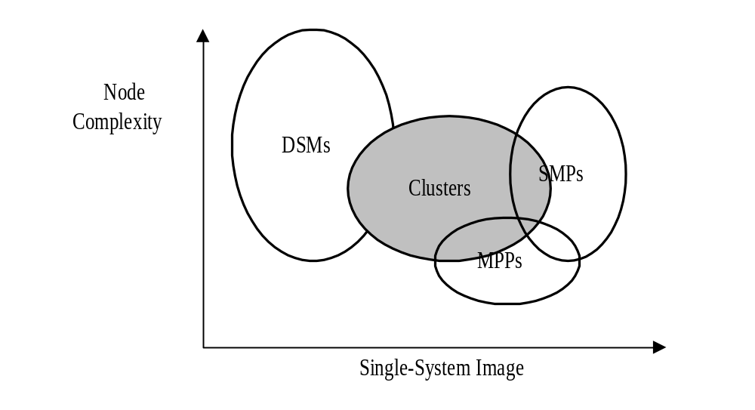
Overlapped design space of clusters, MPPs, SMPs, and distributed computer systems
node complexity : hw/sw capability

Slide 34
Benefits of Clusters I
Usability : 각 노드가 traditional platform이므로, 익숙한 환경에서 응용 프로그램을 개발, 수행 가능
  DB vendor들도 cluster에서 수행될 수 있도록 수정된 제품을 내 놓음 (IBM DB2 Parallel Edition, Oracle, Sybase)
Availability :비싸지 않은 commodity component를 활용하여 higher availability제공
  the percentage of time a system is available for productive use
  Processors and Memories, Disk Arrays, Operating system : 이들이 모두 복수개 존재하고, shared component로 만드는 Sw technique으로 fault에 대처할 수 있다.

Slide 35
Benefits of Clusters II
Scalable Performance
  A cluster’s computing power can increase with added nodes.
  scale in processor, memory, disks, and even I/O devices
  SMP는 shared memory(memory bus)가 bottleneck인 반면, cluster에서 각 program은 local memory를 활용하면서 각 노드에서 수행됨
Performance/Cost Ratio
  In comparison with PVP supercomputer or MPP, the price of a cluster with the same peak performance is one or two orders of magnitude lower
  Table 1.8

Slide 36
Scalable Design Principles
Principle of independence
Principle of balanced design
Principle of design for scalability
Principle of latency hiding (at chap. 5 )

Slide 37
Principle of Independence I
to make the components (hw, Sw) of a system independent of one another
Processor를 next generation으로 upgrade했을 경우, 그 시스템의 나머지 component들을 upgrade하지 않아도 higher performance를 얻을 수 있도록 함
  The algorithm should be independent of the architecture
  The application should be independent of the platform
  The programming language should be independent of the machine
  The node should be independent of the network, and the network interface should be independent of the network topology

Slide 38
Principle of Independence II
Internet is independent of the type of host, interconnection hardware, and application software
  PC ~ supercomputers from different vendors
  Ethernet, FDDI
  different software to browse the web
2 techniques to realize the independence principle
  Separating architecture from implementation
    Architecture : A precise model(or specification)of the common behavior or functionalities of a family of computer system or system components
    Implementation : A specific realization of model.
  Using Standard Components
    industry standard
    ISO, ANSI. IEEE standard committee

Slide 39
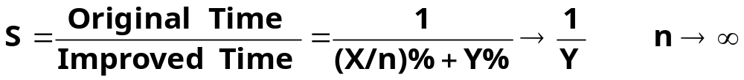
Principles of Balanced Design I
to minimize any performance bottleneck
avoid single point of failure : the failure of one component breaks down the entire system
Amdahl’s law
  Suppose an application program is grouped into two types of computation structure : part X and part Y. The two parts take X% and Y% of the total execution time, respectively:
  If X is improved to run n times as fast, the speedup S
  Implications of Amdahl’s law
    optimize the larger part X
    The best speedup is upper bounded by the value 1/Y
    The slow part Y : bottleneck, minimize the Y

Slide 40
Principles of Balanced Design II
Amdahl’s Rule
  The processing speed should be balanced against the memory capacity and the I/O speed
  1 MIPS computational speed should be balanced with 1MB of memory capacity and 1 Mb/s of I/O rate
Notes:
peak speed대신에 지속적인 computation speed Mflop/s사용하는 것이 Amdahl rule을 더 잘 관찰할 수 있음.

Slide 41
Design for Scalability
The system can either scale up to provide higher performance or scale down to allow affordability or greater cost-effectiveness
Overdesign
  is designed not to barely satisfy the minimal requirements of a current-generation system
  include additional features that anticipate improvement from scale-up systems in the future
  Ex. : address space in modern processor design
Backward Compatibility
  consider the requirements of scaled-down system
  Ex. : Intel 486DX and 486SX : 내부적으로 두 칩은 같지만, DX의 FPU이 SX에서는 disable

Slide 42
