Slide 1

Super-Resolution
Deepesh Jain
EE 392J – Digital Video Processing
Stanford University
Winter 2003-2004

Slide 2
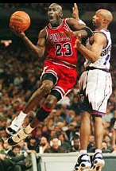
Motivation
Create High Resolution Video from a low-resolution one
Create High Resolution Image(s) from a video or collection of low-res images. Applications:
  Action Packed Sports Images (Basketball dunk, Gymnastics, etc)
  Astronomy
  Medical Imaging
This project – Create a high-res image from bunch of low-res ones (constraints: global motion – shift & rotation)

Slide 3
Approach
Image Registration – Motion Estimation
Projection onto High-Res grid
  Nonuniform Interpolation
  Frequency Domain
  Iterative Back Projection (IBP)
  POCS (Projection onto convex sets)
Registration
Projection
Low-res Images
Registration
(sub-pixel grid)
High Res Grid

Slide 4
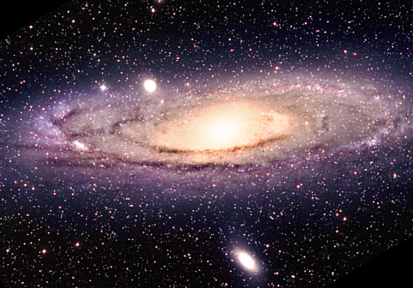
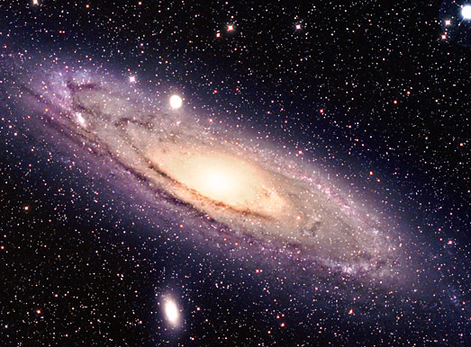
1.1 Registration (angle)
Rotation Calculation
  Correlate 1st LR image with all LR images at all angles
  OR
  Calculate energy at all angles for all LR images. Correlate energy vector to find the rotation angle
Angle_{i} = max index(correlation(I₁(θ), I_{i} (θ)))
LR image 1
LR image 2
i = 2,3,..,N (number of LR images)
Energy at angle I_{i}(θ)
Energy at angle I₂(θ)

Slide 5
1.2 Registration (shift)
Shift Calculated using Frequency Domain Method
F_{i} (u^{T}) = e^{j2πuΔs}F₁(u^{T})
Δs = angle( F_{i} (u^{T}) / F₁(u^{T}) )
2πu
Δs → [Δx Δy]^{T}
u → [f_{x} f_{y}]
Used only 6% lower u (high freq could be aliased)
Used least square to calculate Δs

Slide 6
2.1 Frequency Domain
Input → Down-sampled aliased images
Goal I→ Correct the low-freq aliased data
Goal II → Predict the lost high freq values
-π
π
-π
π
Original High-Res
Down-sampled
Aliased (fix it)
Lost (find it)
-π/2
π/2
π
-π
π
Up-sampled
Desired High-Res

Slide 7
2.2 Projection onto High-res grid
Papoulis-Gerchberg Algorithm (special case of POCS)
Correct the low-freq values. Assumes high-freq part to be zero.
Projection onto 2 convex sets
  Known pixel values
  Known Cut-off freq in the HR image
Algorithm:
I (known pixel positions) = Known Values
I_fft = fft₂(I)
I_fft(higher Freq) = 0
I= ifft₂ (I_fft)

Slide 8
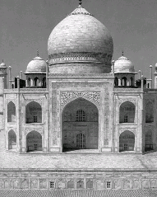
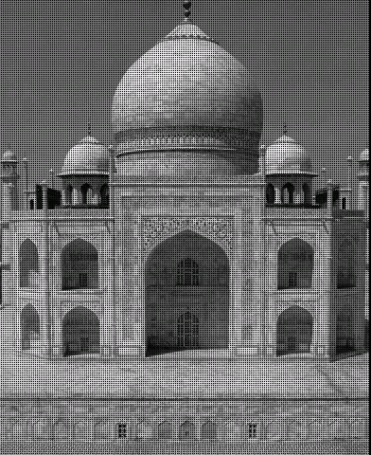
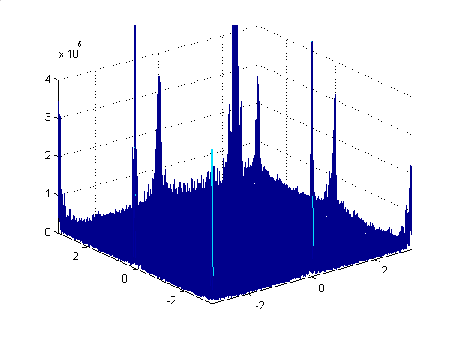
Papoulis – Gerchberg Algorithm
Initial Setup
Taj Mahal – Low-res image I
FFT(Reconstructed image)
Reconstructed image from known pixels

Slide 9
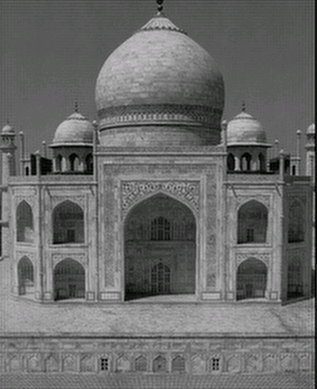
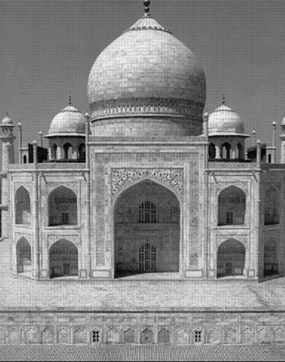
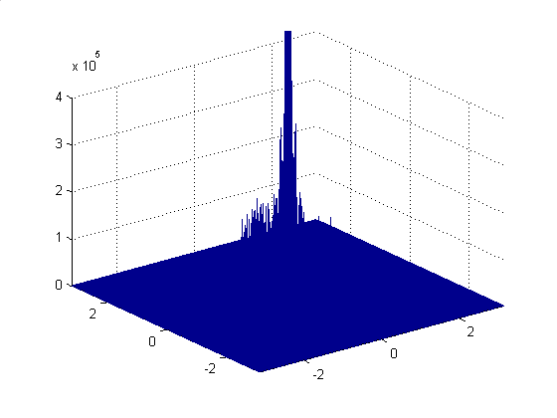
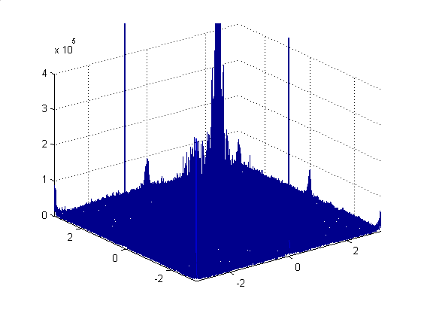
Papoulis – Gerchberg Algorithm
Known Pixel
Values
Image at iteration 0
Image after 1st iteration
I(high freq) =0
FFT

Slide 10
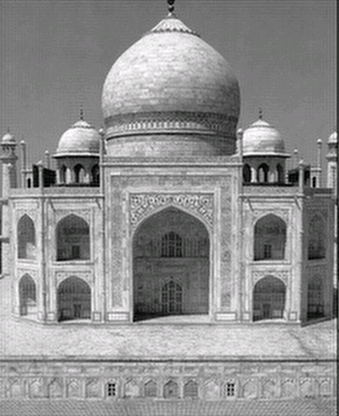
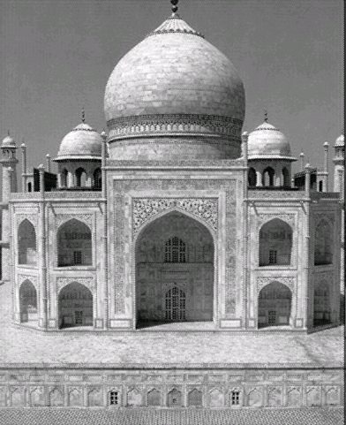
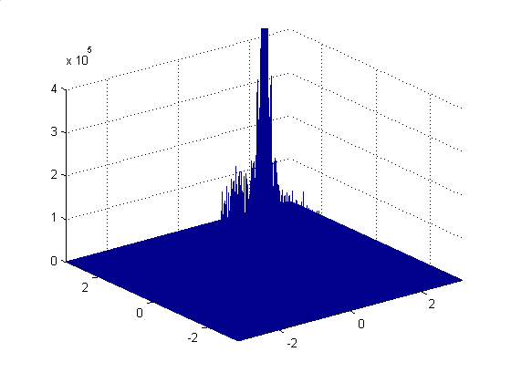
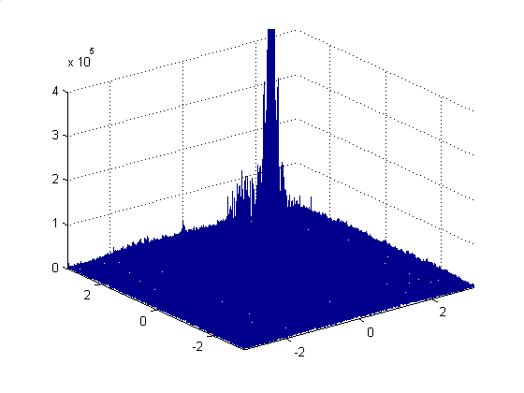
Papoulis – Gerchberg Algorithm
Known Pixel
Values
Image at iteration 1
Image after 10 iterations
I(high freq) =0
FFT

Slide 11
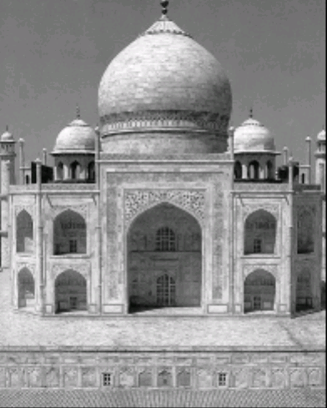

Papoulis – Gerchberg Algorithm
After 50 iterations
Taj Mahal – Low-res image 1
Bilinear Interpolation
Bicubic Interpolation
SR Reconstructed image

Slide 12
Results (Real images)
  Took 4 snaps using a high-res digital camera
  Cropped the same part of each image
  Applied SR algorithm & compared it with bicubic interpolation
Results (Synthetic Images)
  Constructed 4 low-res images by shifting and down-sampling 1 high-res image.
  Applied SR algorithm & compared it with bicubic interpolation

Slide 13
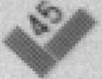
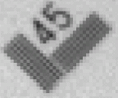
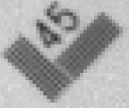
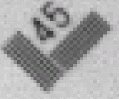
Results (Real Images - I)
Original Low-res images
(Courtesy: Patrick Vandewalle)

Slide 14
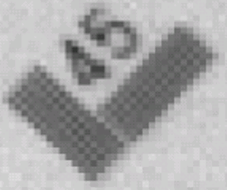
Results (Real Images - I)
Bicubic Interpolation

Slide 15
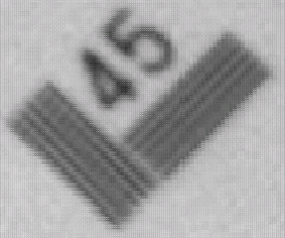
Results (Real Images - I)
Super-resolution

Slide 16
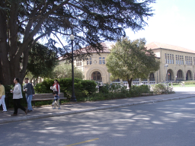
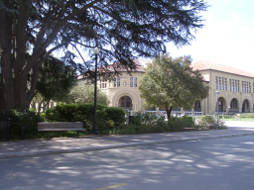
Results (Real Images - II)
Low-Res Image I
Low-Res Image II
  Didn’t WORK !!!
  Motion was not restricted to shifts & rotation
  Images had affine mapping.
  Rule I – Need Correct Registration

Slide 17
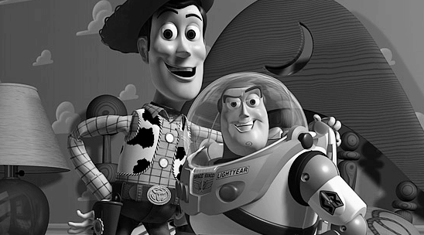
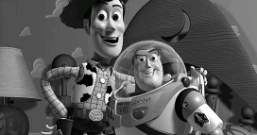
Results (Synthetic Image - I)
Original High-Res
Down-sampled

Slide 18
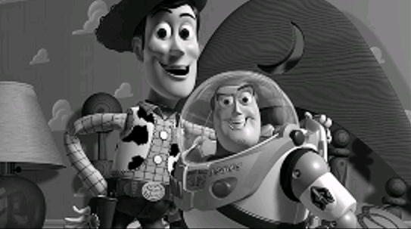
Results (Synthetic Image - I)
Bicubic Interpolation

Slide 19
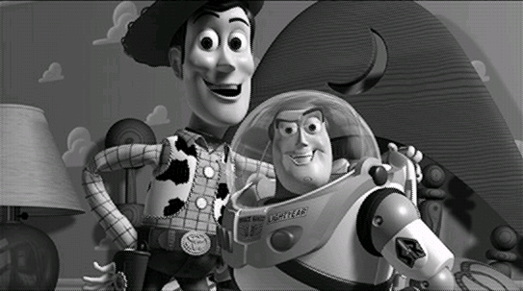
Results (Synthetic Image - I)
Super-Resolution

Slide 20

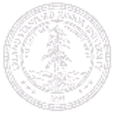
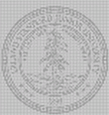
Results (Synthetic Image - II)
Original
Bicubic
SR
  Why didn’t SR work???
  Low-res images were created by forcing shifts at critical velocities
  Rule II → If low-res images are at critical velocities, can’t create good HR image

Slide 21
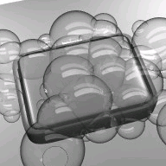
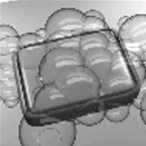
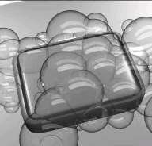
Results (Synthetic Image - III)
Original
Bicubic
SR
  Why did SR work so well???
  Low-res images were created by forcing shifts at non-critical velocities
  Rule III → If low-res images have all the info about high-res then HR image can be perfectly constructed

Slide 22
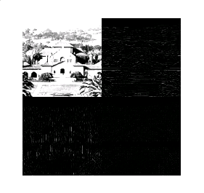
Future Work
  Superresolution with multiple motions between frames → create high res video
  Predict the high-res frequency components using wavelet methods
Predict
Predict
Predict

Slide 23
Acknowledgements
  Prof John Apostolopoulos
  Prof Susie Wee
  Patrick Vandewalle
  Q & A ???
  Comments !!!!

