Slide 1
EGES 510
Note on HW2, Problem 7(b)
  Create Butterworth filter using “for” loops
  Don’t use Matlab “butter” function
Today
  Finish Chapter 4
Next week
  Start Chapter 9
  Quiz on 9.1 – 9.3

Slide 2
Computational Cost of Filtering

Slide 3
Convolution vs Correlation
Convolution
  Reflects filter h
  Spatial domain: g(x,y) = f(x,y) * h(x,y)
  Frequency domain: G(u,v) = F(u,v) H(u,v)
Correlation
  Doesn’t reflect filter h
  Spatial domain: g(x,y) = f(x,y) ○ h(x,y)
  Frequency domain: G(u,v) = F*(u,v) H(u,v)

Slide 4
Note on Computer Lab 2
Imfilter
  Does correlation in spatial domain
  Assumes origin of the filter is at the center
Frequency domain filtering
  G(u,v) = F*(u,v) H(u,v)
  Assumes origin of filter is at the upper left
To fix offset
  Shift mask h(x,y) so its center is at (1,1)
  Can do with circshift(h, [-N/2 –N/2])
(Show example of impulse, both ways)

Slide 5
Smoothing Filters
Types
  Box average
  Ideal low pass
  Butterworth
  Gaussian
Spatial and frequency domain profiles
Behavior when applied to step edge

Slide 6
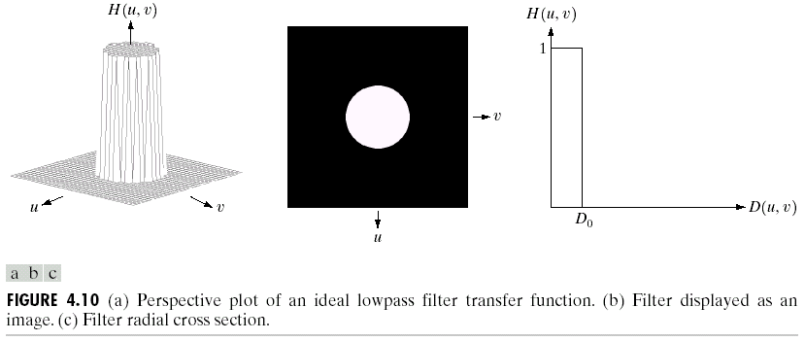
Ideal Low Pass Filter

Slide 7
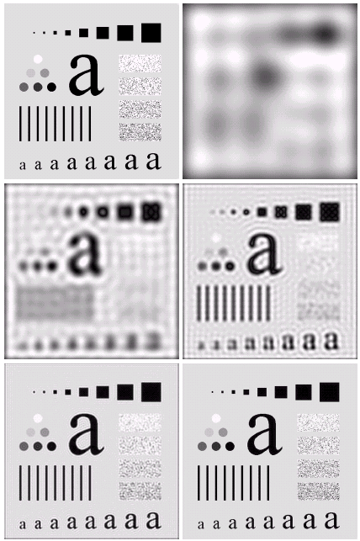

Note “ringing” near sharp edges

Slide 8
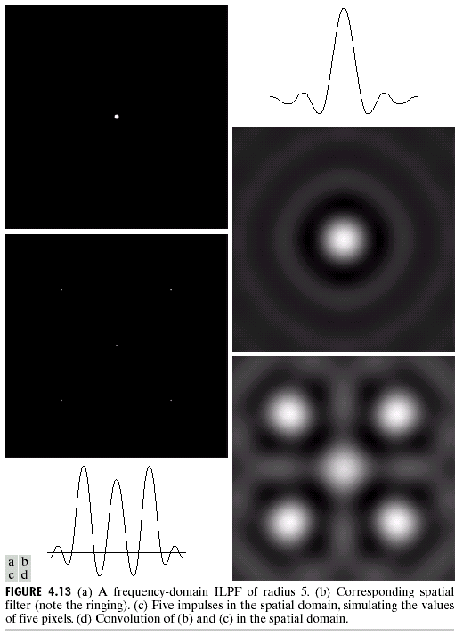
“Ringing” due to the form of the ILPF in the spatial domain (ie, a sinc function)

Slide 9
Matlab Example
(run ILPF.m)

Slide 10
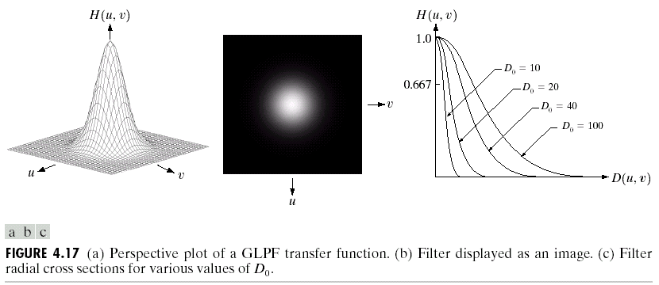
Gaussian Lowpass Filter
A gaussian in the spatial domain also has the form of a gaussian in the frequency domain
No ringing, but allows high frequencies to pass

Slide 11
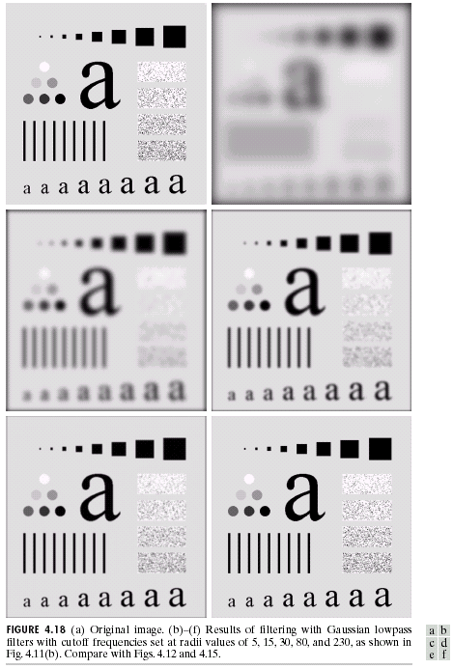

Slide 12
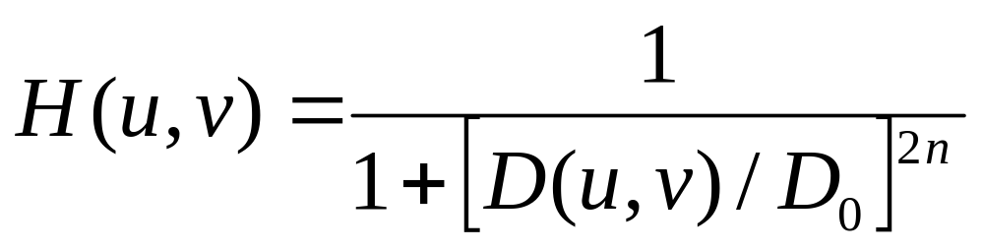
Butterworth Lowpass Filter
Definition
  D(u,v) is distance from (0,0) to (u,v)
  D0 is cutoff frequency
  N is the “order” of the filter
Advantages
  Reduces “ringing” while keeping clear cutoff
  Tradeoff between amount of ringing and sharpness of cutoff

Slide 13
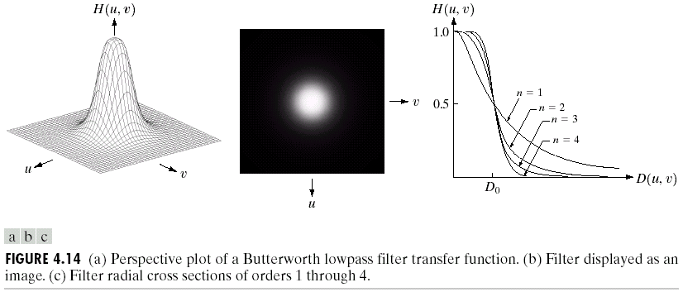

Slide 14
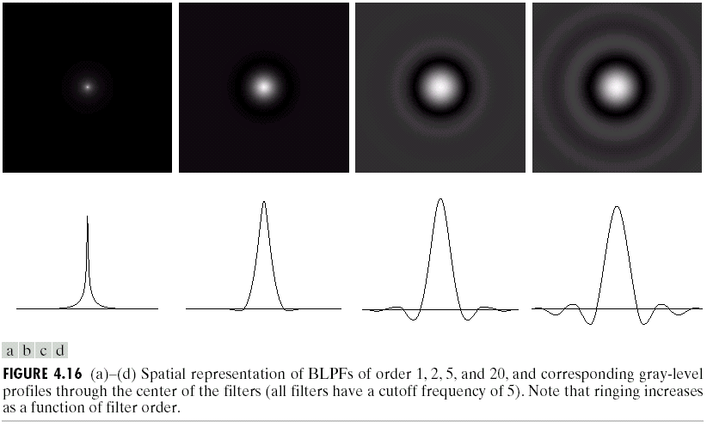

Slide 15
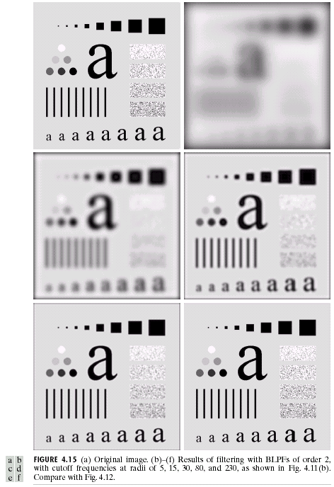

Slide 16
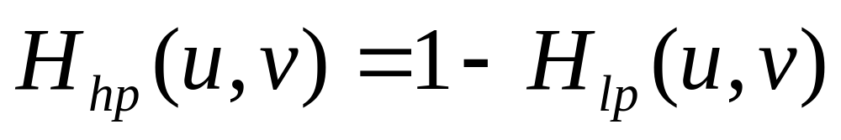
Sharpening Filters
Can obtain by
Types
  Ideal high pass
  Butterworth high pass
  Gaussian high pass
  Laplacian

Slide 17
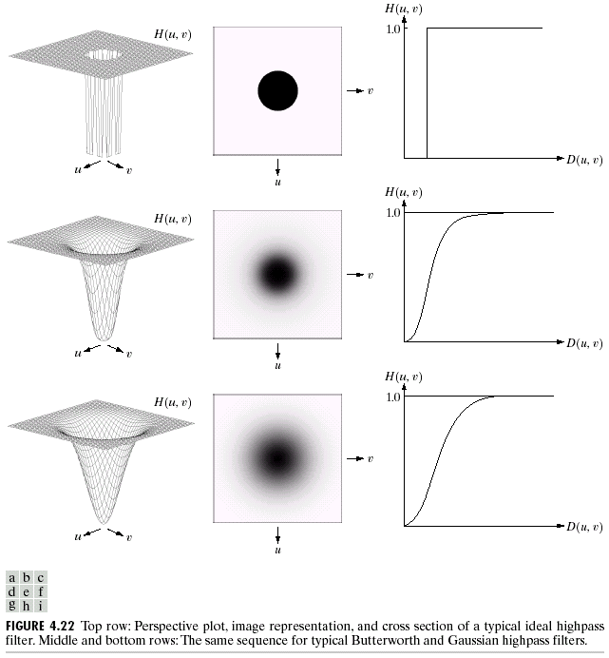

Slide 18
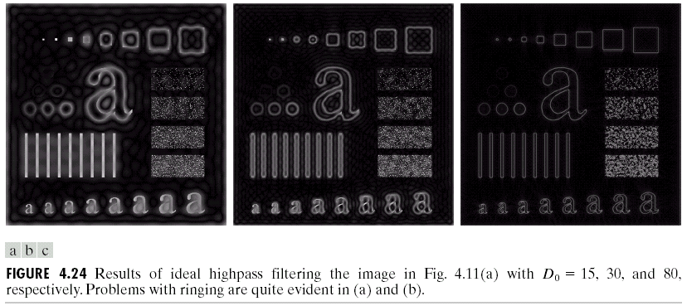

Slide 19
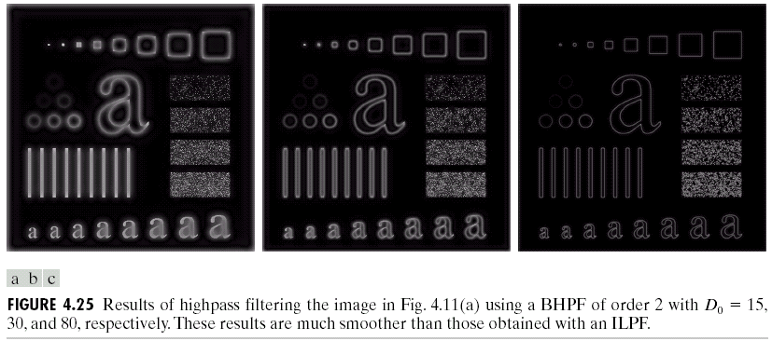

Slide 20
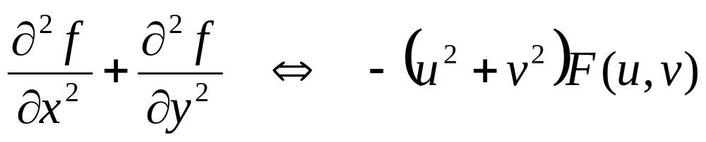
Laplacian
Fourier pairs

Slide 21
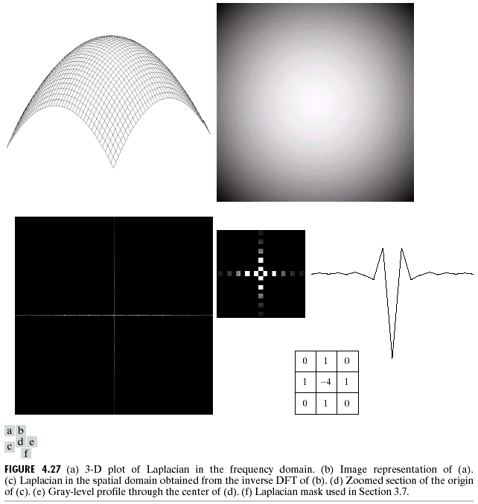

Slide 22
Notch Filters
(actually in section 5.4.3)
A filter that gets rid of periodic noise
Or can enhance structure at a certain frequency
Examples:
  Image mosaics
  Scan line noise
  Halftoning noise

Slide 23
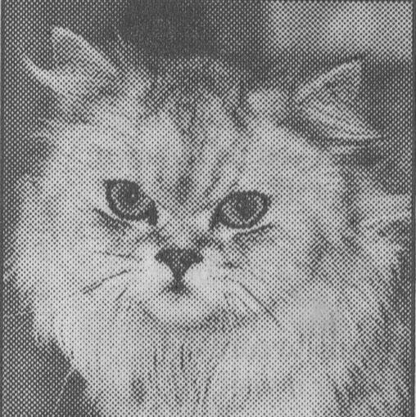
Half Toning Noise

Slide 24
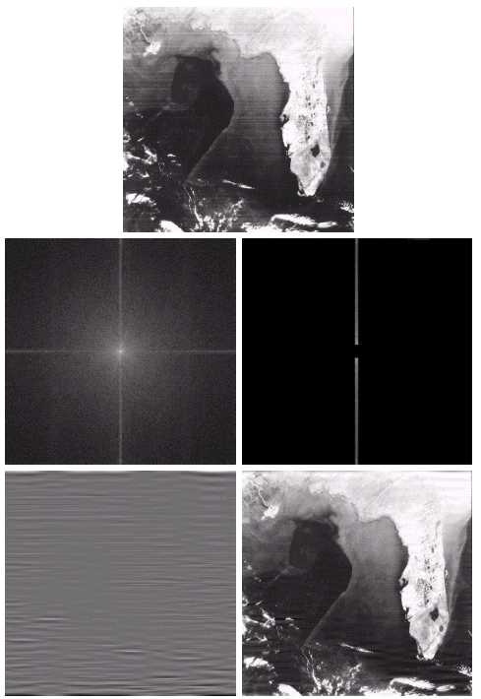
Scan Line Noise

Slide 25
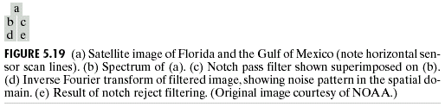

Slide 27
Template Matching
Problem:
  You have an example (template) of an object in one image
  You want to find occurrences of that object in another image
Can use correlation (template with image) and look for large peaks

Slide 28
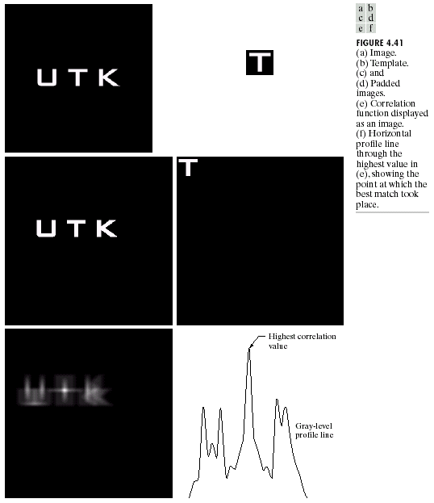

Slide 29
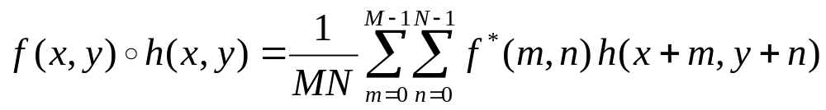
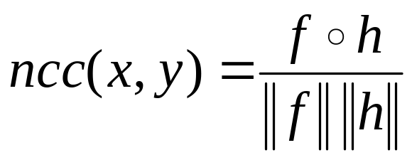
A Problem with Straight-forward Cross-Correlation
The correlation score is higher where the image f is bright, regardless of the match with the template h
Solution: Normalize score by dividing by the magnitudes of f and h
Define magnitudes
Like dot product of vectors

Slide 30
Example
Matlab normxcorr2
Image sequence of street corner
Try tracking car in two images

