Slide 1
Improv Systems
OVERVIEW
2006

Slide 2
The Improv Advantage
Breakthrough configurable DSP architecture
Industry’s most efficient DSP and compiler combination*
Industry’s most versatile DSP to meet designer’s application specific needs
  Black-box Application Cores for Media Processing and VoIP
  Highly Flexible Design methodology & development environment
  Complete SoC integration and methodology
Industry’s only high level language based multi-processor DSP architecture
Highest MIPs/mm² – Lowest power/MIP
Optimized application support for key DSP markets
Proven technology
Jazz DSPTM is the first and only truly configurable DSP !
*Certified by EEMBC. Telemark score July 2002

Slide 3
Improv’s Key Value Proposition
Improv’s technology allows our customers to rapidly create highly competitive solutions for high volume application markets
High Performance Applications
  Create application-optimized processing engines for your target market
  Instruction-level parallelism combined with custom instructions/accelerators
Rapid Time-to-Market Deployment
  Rapid methodology to design advanced processing engines
  Create application-optimized processing engines specific to your needs
  Fully automated path from application to implementation
Enables Design for Profit
  Lowest performance to power ratio versus any product on the market
  Control balance between performance and die size
  Programmability allows multiple products from a single die

Slide 4
Product Portfolio
Core Processor
Technology
Jazz DSP
Processor
Jazz PSA Standard
Jazz PSA Composer
Jazz PSA Rehearsal Boards
Tool Suites and
Development Boards
“Crescendo” - Media Processing
“Acappella” - Voice-Over Packet
“Tempo” – Wired & Wireless
Application
Solution Kits

Slide 5
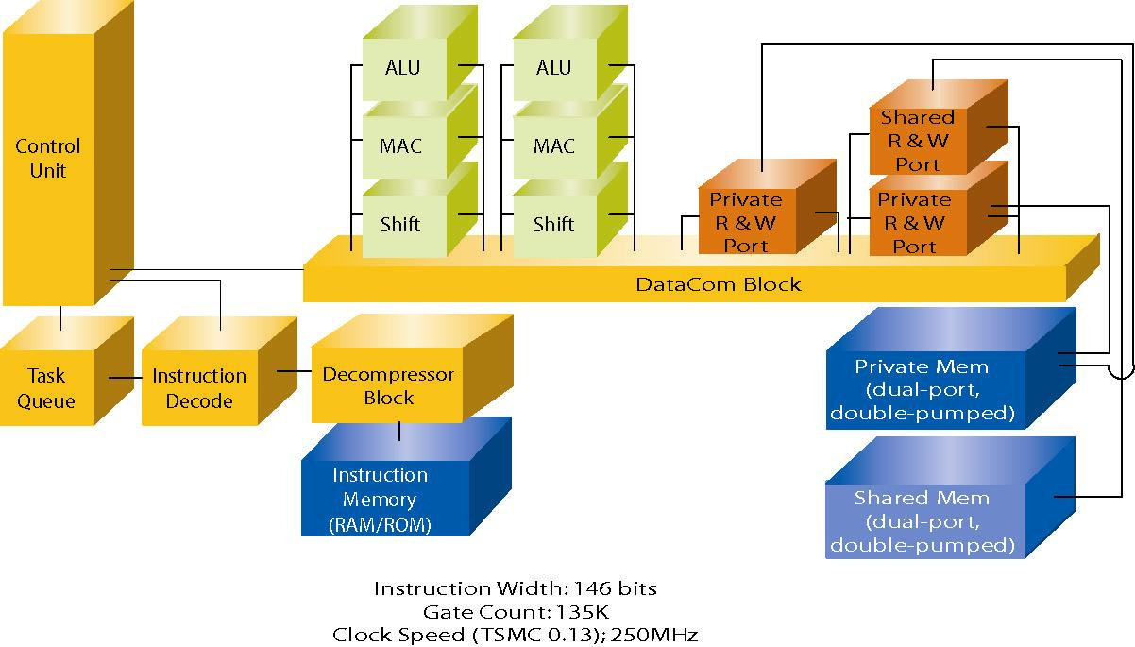
Improv Jazz DSP Processor
High Throughput Performance
  Highly customizable
  Scalable performance
  Designer-defined instructions and units
  SIMD operations
  High speed data movement
Low Power – < 0.4 mW/MHz in 0.18um technology at 1.8V
  Higher performance at lower clock speeds (parallelism)
  Power management modes give you control over consumption
Rapid Development – Application to RTL flow in 1 day
  High level language, structured development methodology
  Rapid convergence on application-optimized DSPs

Slide 6
Key Features – Jazz DSP Processor
VLIW Processor Architecture
  Parallel resource execution & 2 Stage Pipeline
  Different processor configurations achieve 1-16 operations per instruction
  VLIW Instruction Overlays give designers control over balance between parallelism & instruction width
Multi-Processor Structure
  Zero Glue via Q-Bus interface
  Available in 32 and 16 bit data path versions
  Interrupt Task queue allowing exception based calls
Instruction Compression
  Innovative technique yields significant (>70%) savings for non-loop code
Low Power support
  IDLE Mode (Static State Held)
  SLEEP Mode (Glitch Free 98% clock shut down)
DSP conscious Addressing Modes
  Index
  Bit-Reversed
  Circular Buffer

Slide 7
Jazz DSP Processor Enhancements
Over 300 enhancements implemented in the Jazz Composer Tool Suite, Rehearsal Boards and JazzDSP including:
  Significant RTL reduction
  Support for C and Java software environments and IDEs
  Compiler enhancements increasing performance and reducing code size
  Enhanced power management and low power modes/operation
  Complete automated generation of processors and all interface blocks
  Random testing of DDCUs and memories; instruction-based testing suites
  Upgrade to latest Xilinx FPGAs on Jazz PSA Rehearsal boards
  Processor diagramming and printing
  Support for the new Spirit IP 1.2/2.0 Standards

Slide 8
Improv Jazz DSP & Solution Kit – Product Road Map Overview
Release
1.0 - 1.3
Release
2.0 - 2.3
Release
3.0
Release
4.0
120 MHz
- 0.4 mW/MHz
- 32-Bit Fixed-Point
- Standard Tool Suite
- Flat VLIW
- Multiprocessor Cores
150 MHz
- 0.1 mW/MHz
- Power Management
- 16- And 32-Bit
- Overlaid VLIW
- Hot Loader
- Composer Tool Suite
- AMBA/AHB Interface
- On-Chip Debug
- Jazz HBI/Jazz TSI
- Jazz DCI/DMA
200 MHz
- RISC/VLIW Hybrid
- Floating Point
- Bandwidth Manager
- OCP Interface
- Configurable Pipeline
- Advanced Power Mgmt.
250 MHz
- SoC Composer
- Task Merging
- Dynamic Load Balancing
- Asynchronous Datapath
VoIP
“Acappella”
Media
“Crescendo”
Wired/Wireless
“Tempo”
Automotive
“Coda”

Slide 9
Improv Application Support
Improv
Jazz DSP
Application Customization using Improv Jazz Composer and Solution Kits
4-Channel Home
VoIP Solution
MP3 Codec
Engine
Inmarsat
Satellite Modem
Multi-Function
Printer Engine
Encryption
Engine
2-Channel Home
VoIP Solution
MPEG4/H264
Decoding Engine
xDSL
Modem
16 Channel IAD
VoIP Solution
MPEG2/MPEG4
Codec

Slide 10
Improv’s Application Solution Kits
Voice Over IP & Packet Solutions - Improv AcappellaTM
  G.72x codecs, G.168 echo cancellation, complete voice processing framework
  Customer-Proven – Philips, NeoPace, ITRI, KLSI, TelGen
  Acappella HomeTM and Acappella IADTM have been delivered and implemented in silicon today
  Implemented in silicon today
Media Processing for Consumer Devices - Improv CrescendoTM
  MPEG4, MPEG2, Dolby Digital (AC-3), JPEG, JPEG2000 solutions completed
  MP3, Advanced Audio and AMR solutions under development
  Implemented in silicon today
Wired and Wireless LAN Connectivity – Improv TempoTM
  In partnership with HelloSoft
  802.11 b & g – combined modem
  Production release in Q2-2005
  Lead customer projects underway

Slide 11
Improv Application Enhancements for Video & Audio
Significant development steps supports today’s video and audio technology including:
  Implementation of Multiple Video Standards (MPEG2, MPEG4, H264/AVC, WMV)
  Implementation of H264 Baseline, Main and High Profiles
  Implementation of Windows Media (9/10)
  Implementation of AAC Audio Decoder & Integrated Audio Engine (AAC, MP3, Dolby Digital)
  Implementation of Digital Image compression and decompression (JPEG)
  Implementation of cores, memory interfaces and source code for high definition video
  Integration of security blocks & full crypto functionality (AES, DES, 3-DES, …) supporting advanced DRM (WMVDRM10)
  Integration of Media post-processing including scaling, rotation, de-blocking, de-ringing..etc. for improved quality
  Features Low power operation and integrated power management features
  Complete Software Suite and Linux (2.6) platform with fully programmable integrated development tools

Slide 12
SoC Integration Package
Improv provides a complete SoC integration package to fully support its
uniquely configurable architecture
H/W Integration Blocks
  Host Bus Interface (JazzHBITM) – Support for AMBA, MIPS and custom busses
  Data Channel Interface (JazzDCITM) – Off-core memories and DMA control
  Time-Slot Interface (JazzTSITM) – Time-division multiplex (TDM) interface to data
  Serial Stream Interface (JazzSSITM) – Serial data interface
H/W Debug Integration
  Integration of JTAG on-chip debug interface with other SoC blocks
Host Software Layer
  Streaming media interface and application-specific APIs for RTOS and processor software support
System-level Verification Environment for co-execution with other SoC blocks

Slide 13
Why an Improv Solution Kit ?
Complete hardware/software solution bundle for a target application
  Rapid development of advanced chip capabilities
  Rapid entry into high-value markets
  Custom processor cores created using the Jazz DSP Composer™ including hardware accelerators and custom instructions (DDCUs)
Full source descriptions and configuration capabilities for both hardware and software
  Software modules for key media components
  Software framework including complete host API to interact with the DSP core
  Create additional value-added capabilities and features
  Integration with other aspects of a complete SoC; e.g., memory controllers, custom interfaces
Robust SoC Integration Platform
  Direct support for major on-chip buses including multi-layer AMBA™ (AHB)
  DMA and Memory Interfaces for high-speed memory connections
  Host software package provides ANSI-C API for configuring, controlling and running application modules

Slide 14
Improv’s Portfolio of IP Summary
Base Architecture
  Jazz DSP – configurable VLIW processor
  PSA – multiprocessor core structure
SOC Integration Blocks
  Host Bus Interface – AMBA and OCP bus integration
  Data Channel Interface – Media-aware DMA controller
  Time Domain Manager – time slice data interface
  Cool Jazz – full on-chip debug (JTAG) integration
Tool Technology
  Composer – graphical tool for creating custom platforms, processors and accelerators
  VLIW Compiler
  Profiling and Analysis Tools
  Java and C-based system-level design methodology
  Instruction-Set Simulator
  Automatic Generation of RTL databases and EDA scripts
Media Solutions
  MPEG4 ASP and SP Encode and Decode
  MPEG2 Video Decoder
  H264 Video Decoder
  Windows Media Video and Audio Decoders
  JPEG and JPEG2000
  Dolby Digital and Prologic Decoders
  Beatnik Audio Engine
  MP3 and MPEG level 1&2 Audio Decoders
VoIP Solutions
  Voice Codecs – G.711, G.726, G.728, G.729 a/e, G.723.1
  G.168/G.165 Line Echo Cancellation
  Dial Tone Management (DTMF), caller id receiver/generator, comfort noise generation, voice activity detection, fax pass-through, v.18 (hearing impaired services)
  Telephony PBX interface, conferencing
Telecom Solutions
  Accelerators for FFT, Viterbi, Galois, B-PSK/Q-PSK, Barker Correlator, Fast Walsh Transform, equalization, general FIR/IIR filtering

Slide 15
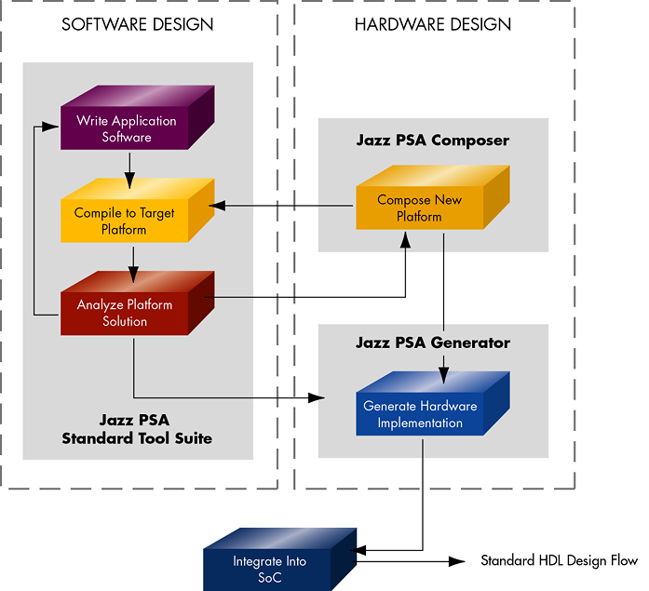
Improv Jazz-PSA Tool Suite
“Programmable System Architecure” (PSA)
Software design tools including industry-leading VLIW compiler and advanced profiler/analysis tool
Intuitive graphical environment for building application–optimized processors
Advanced profiling and analysis capabilities
Complete verification and debug environment and simulation support (functional, cycle-accurate, ISS, FPGA and on-chip)
Automatic generation of RTL and scripts for backend ASIC flow

Slide 16
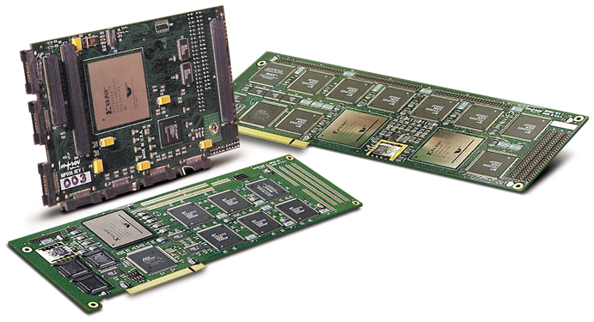
Jazz PSA Rehearsal^{TM –} Tools & Development Boards
Processor and System Verification
  Jazz PSA RehearsalTM XE2-6K
  Dual FPGA (2-4 processor)
  configuration; PCI-based
  Jazz PSA RehearsalTM AI-1
  Daughter card for the ARM Integrator™ Development Board
  Map “Composed” JazzTM processors onto FPGA technology, execute and test application code - includes full debugger support
  Use same test bench for functional, ISS and RehearsalTM board simulation
  Windows NT drivers – Multiple Configurations
Integrated Development Boards for RISC/DSP Development
  ARM Integrator Development Board with direct AMBA/AHB connection
  MIPS Malta Development Board integration

Slide 17
Jazz PSA Supporting Tools & Products Overview
Jazz PSA - Standard Tool Suite
  Full software development suite including compiler, profiler/analyzer, debugger, assembler, instruction-set simulator and development environment
  Redistribution to customers for completed chip programming
Jazz PSA - Composer Tool Suite
  Three-levels of customization – core (w/interfaces), processors and accelerators
  Create custom processors optimized for your application domain
  Advanced profiling and analysis tools
Jazz PSA - Rehearsal Development Boards
  Map custom cores onto Xilinx FPGA parts
  Integration and drivers with Windows NT, ARM Integrator and MIPS Malta boards
  Daughter cards for media and VoIP

Slide 18
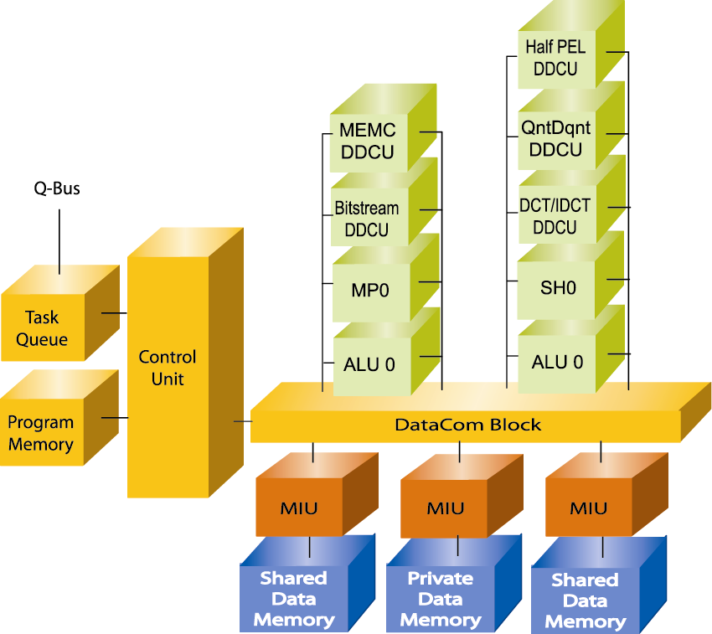
Platform Design Example: MPEG-4 “SP” Processor
MPEG-4 @ 128kbit/s
  Decode CIF at 30fps running at 28MHz
  Encode CIF at 30fps at 120Mhz
Pre-integration with ARM & MIPS processors
Use host DMA Channel for MB access
Area (tradeoff area and performance) 230K(w/DDCUs) – 105K gates
Power consumption: ~25 mW in .13um technology
Data memory: 27KByte
Program memory ~60KByte

Slide 19
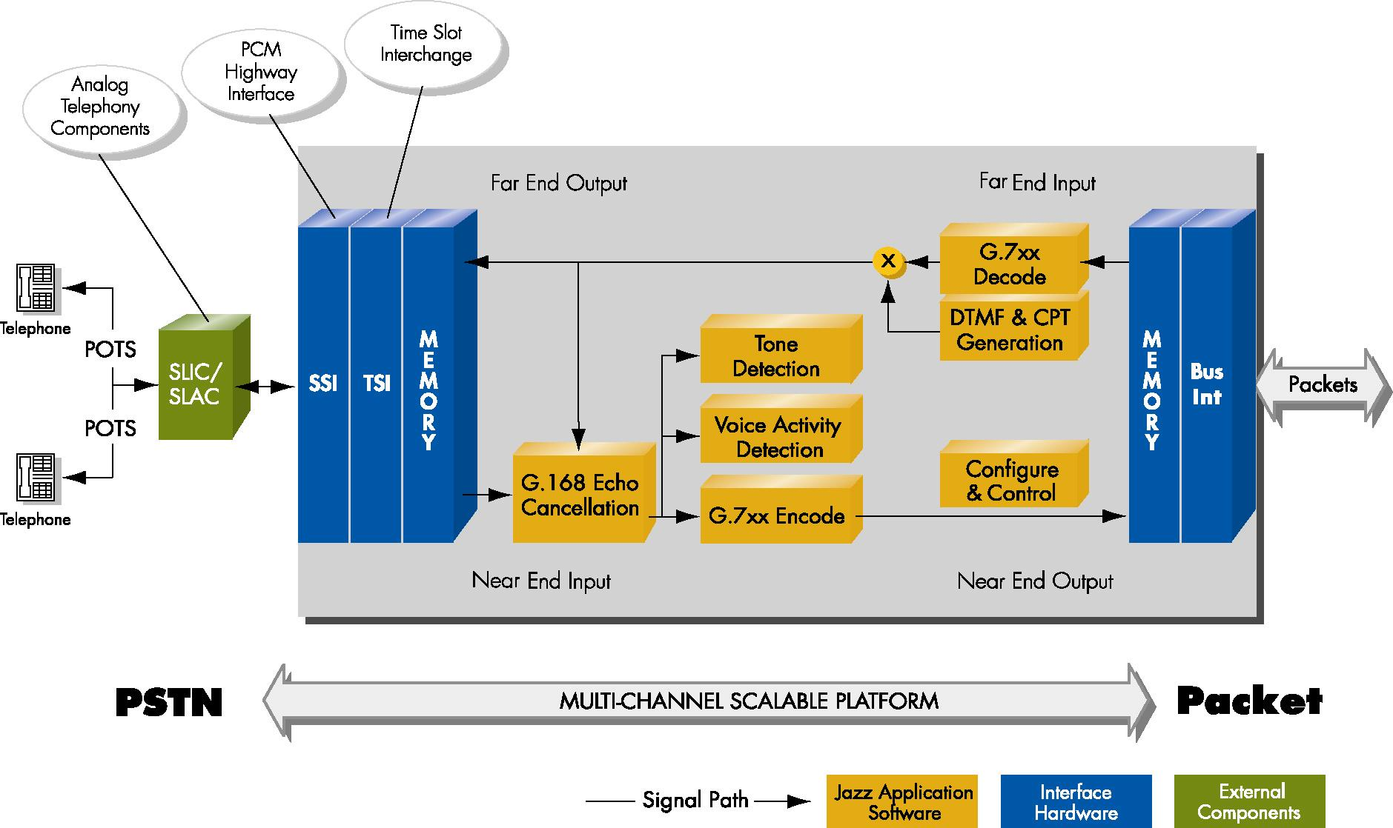
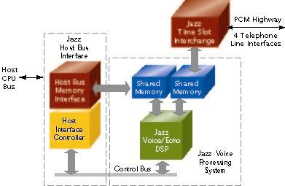
Platform Design Example: VoIP “Acappella Home”TM
4 Channels @ 100 MHz – G.729a/e, G.726, G.711, G.728, G.723.1, G.168 LEC, DTMF, CNF, VAD, Caller-ID, Conferencing
175K Gates + 30 Kbytes Data + 125 Kbytes IM
30 mW (gates ~ not including memories)
Jazz Voice DSPTM optimized for Home applications
Jazz Time Slot Interchange (JazzTSITM) block allows flexible integration into PCM highway
Pre-Integration with ARM and MIPS processors

Slide 20
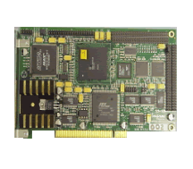
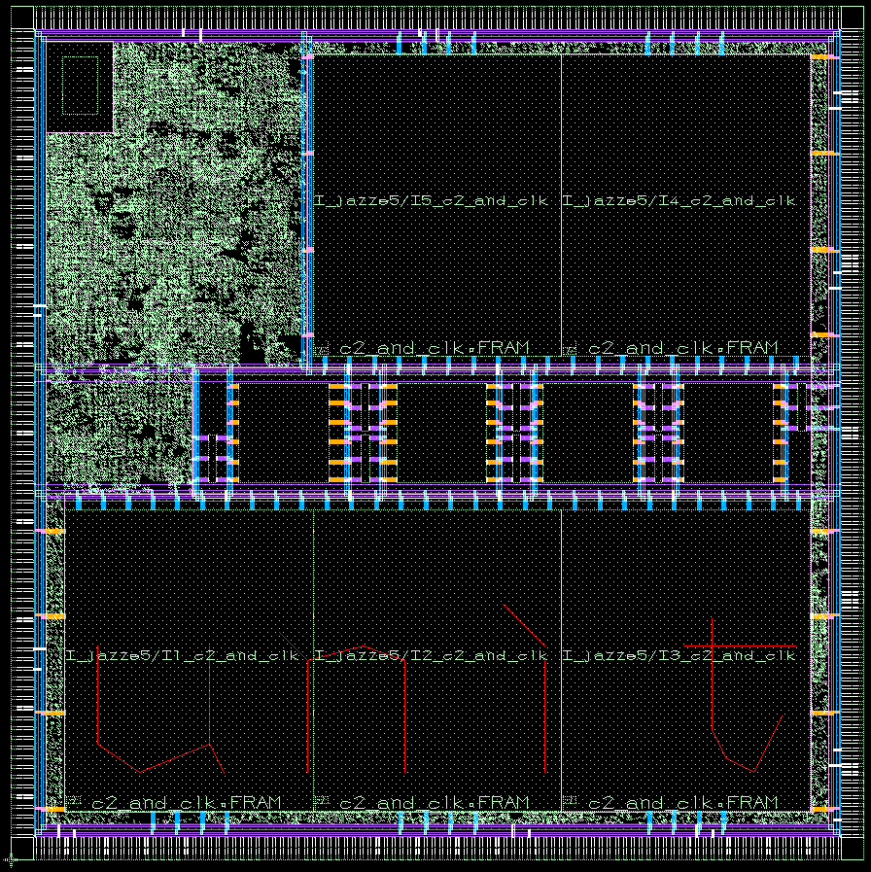
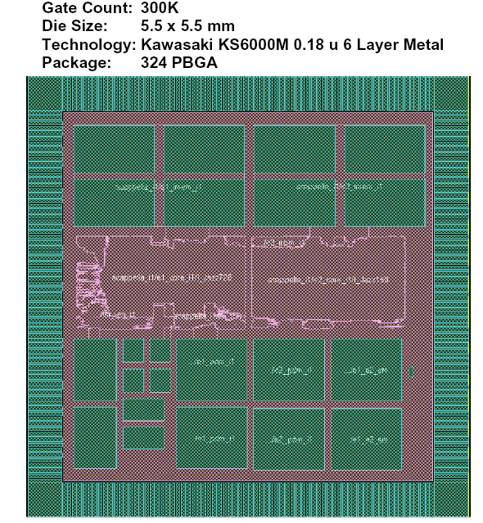

Process Support & Various Silicon Proven Examples
Implemented in Multiple Process Technologies
  TSMC 0.18/0.13µm, UMC 0.18µm, SMIC 0.18µm, ST 0.18µm, IBM 0.18µm, Hynix 0.18µm, KLSI 0.25µm
Implemented using Multiple Back-End Flows
  Cadence, Magma, Synopsys
Ex.1 Philips Semiconductor
.2um, 5-layer UMC Process
5 Processor General Chip
12.78 x 12.45 mm, 6.4M gates
100 MHz
304 HBGA
Ex.2 Kawasaki LSI
.18um, 6-layer KLSI Process
2 Processor Acappella IAD
5.5 x 5.5 mm, 300K logic gates
100 MHz
324 PBGA

Slide 21
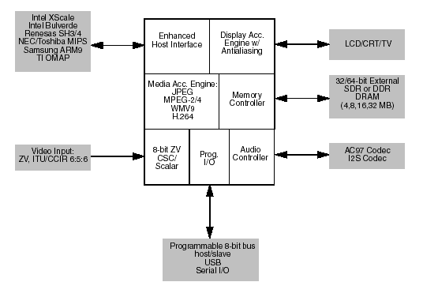
Customer Silicon Implementation:
Mobile Media Companion Chip
“Media Acceleration Engine” is a direct implementation of Improv’s Jazz Crescendo BMP
Improv Software Images and Codec support for Media Engine:
  MPEG2 Video Decoder (ML@MP up to NTSC)
  MPEG2 Video Decoder + MPEG L1/L2 Audio Decoder
  MP3 Audio Decoder
  JPEG Codec (including MotionJPEG)
  MPEG4 ASP Video Decoder (L0-L5 up to D1)
  MPEG4 SP Video Codec (L0-L3 up to CIF)
  H264 Baseline Video Decoder (up to CIF)
  Windows Media 9 Video Decoder (up to D1)
  TSMC 0.13 um

Slide 22
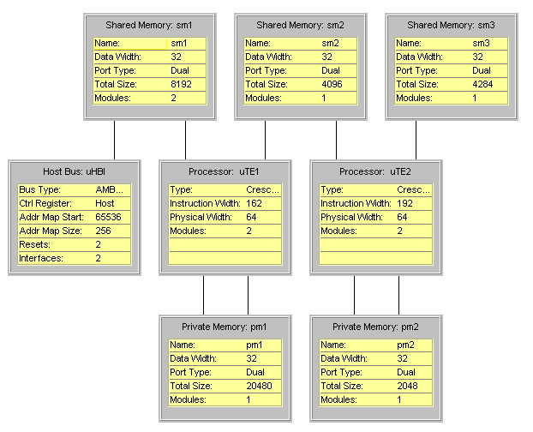
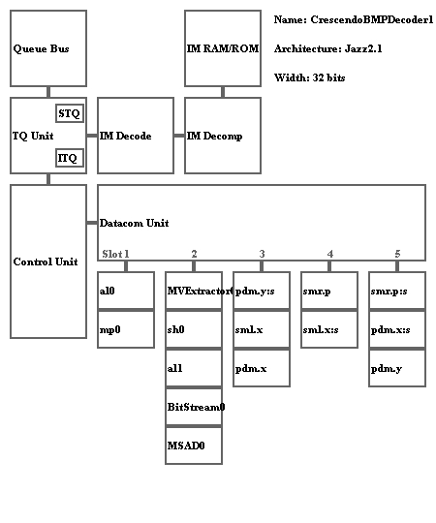
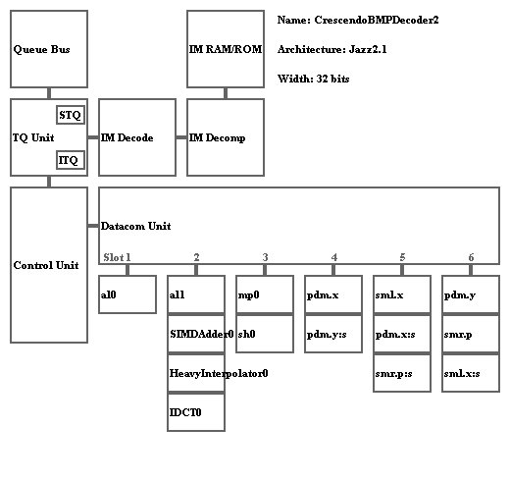
Customer Silicon Implementation:
Broadcast Quality - Media Processor & Codec
Two 32-bit Improv Jazz DSP’s running @ 100 MHz
Implementation of MPEG2/MPEG4/H264 SoC
Integrated Graphic / Video Processor
Utilizes Improv Crescendo BMP Solution Kit
On-chip 2-D Graphics, Microcontroller, DDR Memory Controller, and various other peripherals
UMC 0.18um

Slide 23
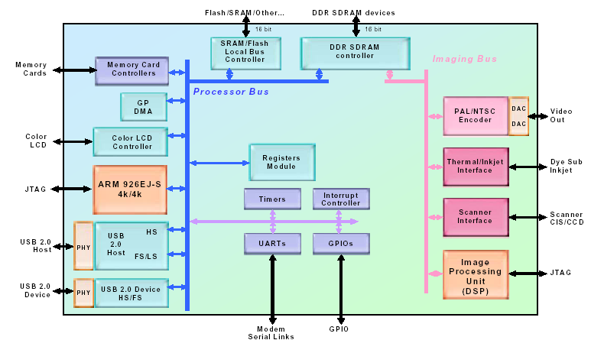
Customer Silicon Implementation:
Multi-Function Printer Chip
Improv 16 bit DSP for image processing and JPEG decoding
Combined with ARM 924EJ-S processor (250 MHz)
Improv DSP running at 175 MHz on TSMC 0.13um process (13g)
6 months license to tape-out
Image processor software developed by customer; JPEG software provided by Improv

Slide 24
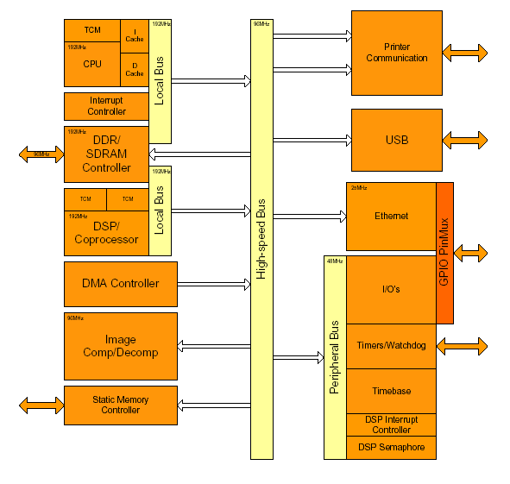
Customer Silicon Implementation:
Multi-Function Printer Chip
Improv 16-bit DSP Processor for high-speed image compression
Combined with ARC Microprocessor running WindRiver OS
Two chips: 120 MHz implemented on TSMC 0.18um process and 150 MHz on 0.13um process
6 months license to tape-out
All software developed by customer using Improv software development tool suite

Slide 25
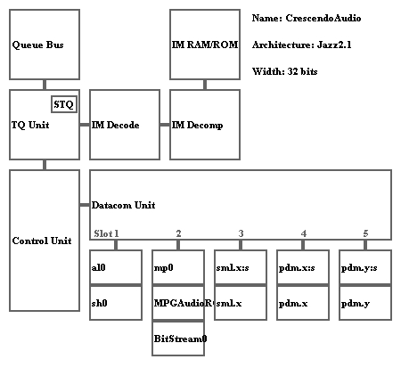
Customer Silicon Implementation:
MP3 Audio & Video - SoC
Integrated MP3 / Video Player
Utilizes Crescendo SMP Solution Kit
Single 32-bit Jazz DSP @ 100 MHz
On-chip Graphics, Microcontroller, DDR Memory Controller, and various other peripherals
SMIC 0.18um

Slide 26












Customer List
Internal ASSP Groups
Fabless Companies
ASIC Customers and Vendors

Slide 27
Conclusions
Improv’s Configurable VLIW DSP processor architecture provides high performance processing engines and rapid design methodology to meet aggressive Time to Market requirements
Flexible – programmable architecture meet the needs of broad application support and firmware upgradeability
Complete Software Solution kits for vertical markets
Integration and implementation tools and methodology
Silicon implemented and customer proven technology

