Slide 1
FPGA2
MICTOR 케이블
FPGA1
PHY 보드
MICTOR 커넥터
40pin Header
FPGA와 연결된 커넥터

Slide 2
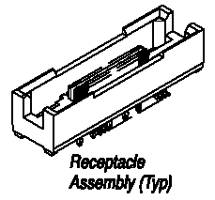
Manufacturer Part #: | 5767054-1
Manufacturer: | Tyco Electronics / AMP
Description: | MICTOR Connectors 38P RECEPTACLE
Product Highlights:
Connector
Receptacle
Mated Stack Height (Vertical) = 6.60 mm
Number of Positions = 38
Vertical Mount Angle

