Slide 1

IEC 61499
Automation Objects
  Architecture of the Eclipse based AutomationObjects Designer
Andreas Herz © 2007 info@automationobjects.org

Slide 2
Why Eclispe?
IEC 61499
Automation Objects
Eclipse is more than a Java IDE
  it has an open, extensible architecture
  built out of large of plugin-ins
  everybody can contribute plug-ins
Social implications
  every programmer can be a tool smith
  creating opportunities for further extensions makes it possible for the tool smith to benefit from the work of others
  it has to be easy to install and manage plug-ins
Andreas Herz © 2007 info@automationobjects.org

Slide 3
Everything is a Plugin
IEC 61499
Automation Objects
Plugin == Component
  set of contributions
  smalles unit of a Eclipse unit
Extension point
  named entity for collection contributions
  (example: extension point to add code converter to the IEC 61499 Editor)
Extension
  a contribution
  (example: a code converter from ST to Java)
Plugin
Plug-in
RPC-Platform
Eclipse Runtime
Extension
Extensionpoint
Andreas Herz © 2007 info@automationobjects.org

Slide 4
AO Designer Architecture
IEC 61499
Automation Objects
fb.codeformator.java
fb.codeformator.java
fb.editor.fbt.code
fb.generator.fbt.java2java
fb.generator.fbt.ST2java
fb.editor.fbt.xml
fb.generator.fbt.<ANY>
fb.editor.res.properties
fb.editor.dev.properties
fb.editor.res.xml
fb.editor.res.<ANY>
fb.editor.fbt.<ANY>
fb.editor.dev.resources
fb.editor.dev.<ANY>
fb.editor.sys.devices
fb.editor.sys.properties
fb.editor.sys.<ANY>
fb.create.project.dc
fb.create.logic
fb.create.project.<ANY>
fb.create.file.device
fb.create.file.resource
fb.create.file.<ANY>
fb.editor.fbt
fb.generator.fbt
fb.editor.res
fb.editor.dev
fb.editor.sys
fb.core
fb.create.project
fb.create.file
RPC-Platform
Eclipse Runtime
Andreas Herz © 2007 info@automationobjects.org

Slide 5
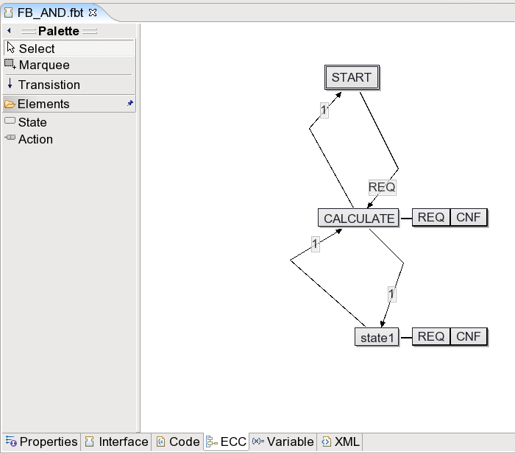
Basic FunctionBlock Editor
IEC 61499
Automation Objects
fb.codeformator.java
fb.codeformator.java
fb.editor.fbt.code
fb.editor.fbt.properties
fb.editor.fbt.interface
fb.editor.fbt.variable
fb.editor.fbt.xml
fb.editor.res.properties
fb.editor.dev.properties
fb.editor.res.xml
fb.editor.res.<ANY>
fb.editor.dev.resources
fb.editor.dev.<ANY>
fb.editor.sys.devices
fb.editor.fbt.ecc
fb.editor.sys.properties
fb.editor.sys.<ANY>
fb.create.project.dc
fb.create.logic
fb.create.project.<ANY>
fb.create.file.device
fb.create.file.resource
fb.create.file.<ANY>
fb.editor.fbt
fb.editor.res
fb.editor.dev
fb.editor.sys
fb.core
fb.create.project
fb.create.file
RPC-Platform
Eclipse Runtime
Andreas Herz © 2007 info@automationobjects.org

Slide 6
Advantage for the AO Designer
IEC 61499
Automation Objects
Development
  IEC 61499 Designer has an open, extensible and clean architecture
  No or less code dependencies
  everybody can contribute plug-ins
Social implications
  every programmer can be a tool smith.
  vendors can customize the AO Designer to there products.
  loose coupling of vendors which developed for the AO Designer.
Andreas Herz © 2007 info@automationobjects.org

Slide 7
<Headline>
Automation Objects
Andreas Herz © 2007 info@automationobjects.org

