Slide 1
Overview

Slide 2
In addition you will have:
· True thin client architecture
· Hot deployment
· Multi channel communication including connection to CTI
· Flexible and user operable report creation
· Fully scalabe architecture
Use our standard applications for those functions that are common to every business
Create your own functionality for those functions that are unique to your way of operation
And this without extensive programming in less time than it takes you to implement today’s standard application software

Slide 3
Applications with
jACOB Designer
jIncident (Incident Management)
jSales
(SalesForceAutomation)
jServiceDesk
(Internal and external
Helpdesk)
jMaintenance
(Plant Maintenance)
jCRM
(easy to use
CRM System)
CTI enabled
Fully Integrated
Multilingual
Functionality
complete
Fully Integrated
Multilingual
Functionality
complete
Fully Integrated
Multilingual
Functionality
complete
Fully Integrated
Multilingual
Functionality
complete
available
In Progress

Slide 4




Modularity
Core Engine & Runtime
Applications
Modules

Slide 5
Runtime Architecture: 3 Layers
Client Layer/
Presentation Layer
Browser (Internet Explorer 5.x, 6.x)
http://vudb0007:8080/jacob/index.jsp
WebSphere, WebLogic, Tomcat
Middle Layer/
Business Layer
jACOB Runtime
(jacob.war = Standard Web application)
jACOB Application
Database
Data Layer
Oracle
Oracle
Legend
jACOB
Third Party
Customizable

Slide 6
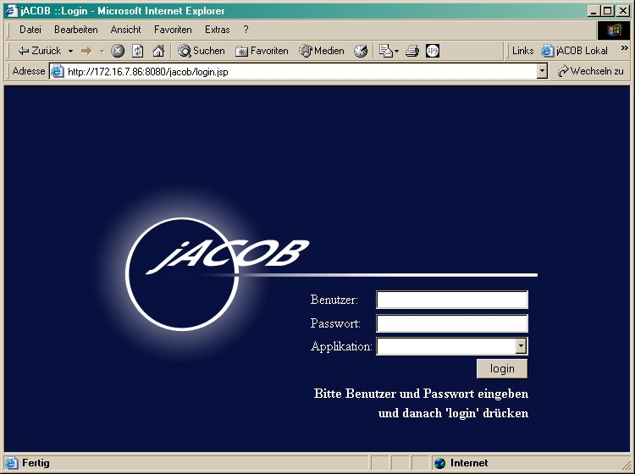
Scalability
(Load-) Balancer:
By means of a load balancer user sessions could be uniformly distributed across all jACOB nodes. There are 2 types of load balancers existing: hardware balancers (e.g. from Cisco) or software balancers (e.g. Pound).
Another solution is to use the Tomcat 5 balancer webapp which could be used to redirect requests to the jACOB login page URL.
(Load-)Balancer
(Third-Party)
jACOB
Node 1
jACOB
Node 2
jACOB
Node N
...
jACOB
Internal
Database
Application
Databases
Oracle
Oracle

Slide 7

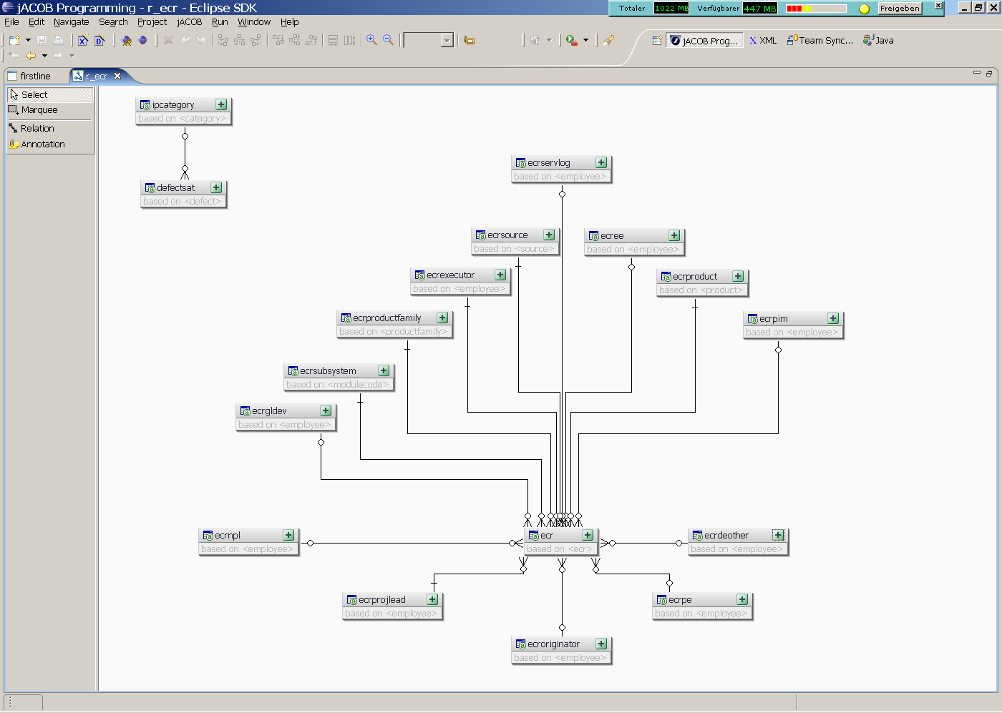
Designer - Introduction
Based on best of breed Eclipse
Java development environment.
Powerful editors to create application
screens and data structures.
Full debugging functionality of jACOB
applications running in remote
environment (Tomcat).
Maintenance of different, separated
jACOB application projects.
Ready to go wizards to create
new jACOB application projects for
different purposes.

Slide 8
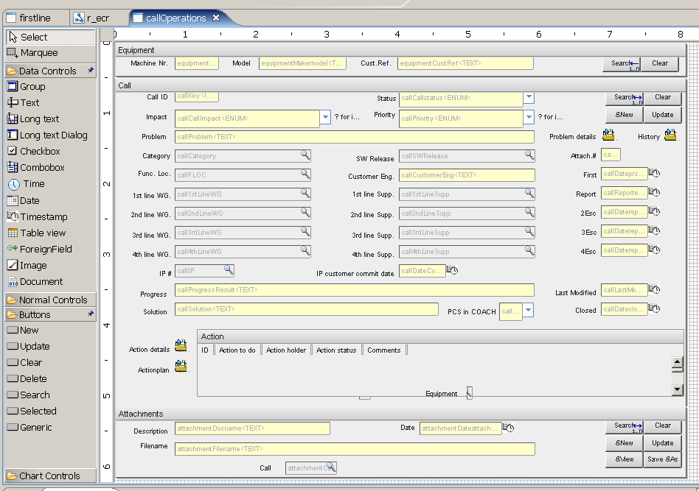
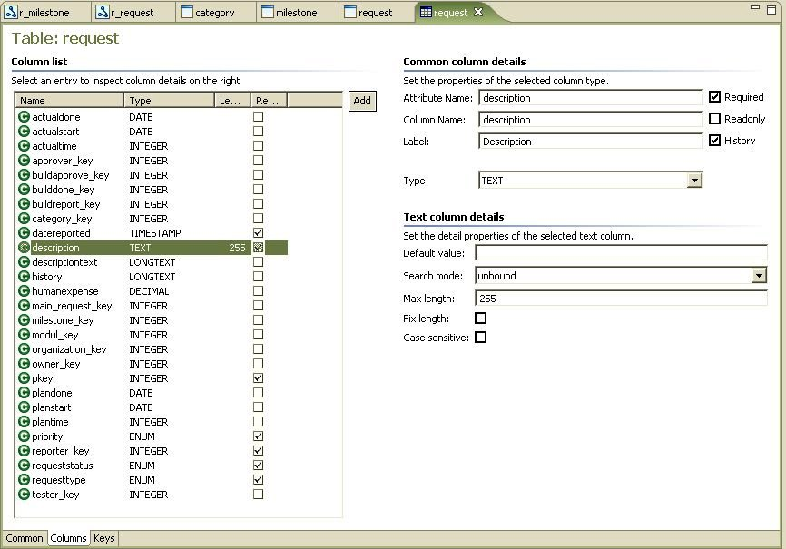
Designer - Editors
Graphical screen editors with drag&drop
functionality and powerful editing tools
functioning like guards to keep elements in line.
“Jump to Java hook” functionality out
off all editors, i.e. to easily glue business
logic to screen and data elements.
Graphical relation/relation set editors
with drag&drop functionality and test
mode to inspect result in screen editors.
Editors for tables, fields and keys with the
ability to reverse engineer already existing
databases.

Slide 9
Roadmap
Customer
User
Interface
Email-Management
SelfHelp
Document
Management
Core Engine
&
Runtime
Designer
(Applications with
jACOB Designer)
Workflow
Content
Management
Ad-hoc
ReportWriter

