Slide 1

Modeling Inheritance
Andreas Herz © 2005 sales@tarragon-software.de

Slide 2
Modeling Inheritance
Why?
One of the issues that may arise in designing your enterprise objects—whether you’re creating a schema from scratch or working with an existing database schema—is the modeling of inheritance relationships.
A Customer object naturally inherits certain characteristics from a Person object, such as name, address, and phone number. In inheritance hierarchies, the parent object is usually rather generic so that less generic subclasses of a related type can easily be added. So, in addition to the Customer object, a Client object also naturally derives from a Person object.
Andreas Herz © 2005 sales@tarragon-software.de

Slide 3
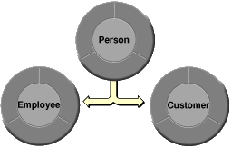
Modeling Inheritance
How?
Using jACOB, you can build data models that reflect object hierarchies. That is, you can design database tables to support inheritance.
Andreas Herz © 2005 sales@tarragon-software.de

Slide 4
Modeling Inheritance
Deciding to Use
Using inheritance adds another level of complexity to your data model, data source, and thus to your application. While it has its advantages, you should use it only if you really need to.
?!
Andreas Herz © 2005 sales@tarragon-software.de

Slide 5
Modeling Inheritance
Three types
The three approaches of inheritance that can are supported by jACOB.
Vertical Mapping (to be done)
Horizontal Mapping (to de done)
Single-Table Mapping
Andreas Herz © 2005 sales@tarragon-software.de

Slide 6
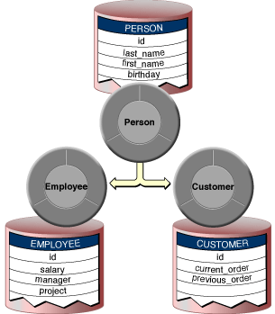
Modeling Inheritance
Vertical Mapping
In this approach, each class is associated with a separate table. There is a Person table, an Employee table, and a Customer table. Each table contains only the attributes defined by that class.
Andreas Herz © 2005 sales@tarragon-software.de

Slide 7
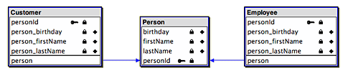
Modeling Inheritance
Vertical Mapping
Implementation:
Create a to-one relationship from each child (Employee and Customer) to the parent (Person) entity.
Add in the Inheritance tab of the child entity (Employee, Customer) the parent entity Person.
Andreas Herz © 2005 sales@tarragon-software.de

Slide 8
Modeling Inheritance
Vertical Mapping
Advantages:
A subclass can be added at any time without modifying the parent.
Existing subclasses can be modifying without affecting others.
Database constraints can be used at any level of inheritance.
The primary vitue of this approach is its clean „normalized design“.
Disadvantages:
Every layer of class hirarchy requires a join table to resolve the relationship.
Each subclass record needs at least n database records. Where n is the level of inheritance.
Complex database reconfiguration if inheritance changed!
Slow search.
Andreas Herz © 2005 sales@tarragon-software.de

Slide 9
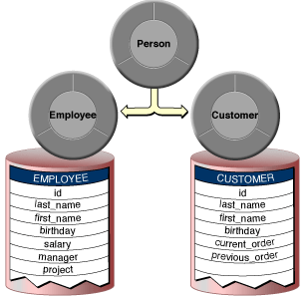
Modeling Inheritance
Horizontal Mapping
In this approach, you have separate tables for Employee and Customer that each contain columns for Person. The Employee and Customer tables contain not only their own attributes, but all of the Person attributes as well.
Andreas Herz © 2005 sales@tarragon-software.de

Slide 10
Modeling Inheritance
Horizontal Mapping
Implementation:
Create a ghost entity Person.
Add in the Inheritance tab of the child entity (Employee, Customer) the ghost parent (Person) entity.
All attributes of the ghost table will copied to all inheritance entities.
The ghost table will not be part of the physical database.
Andreas Herz © 2005 sales@tarragon-software.de

Slide 11
Modeling Inheritance
Horizontal Mapping
Advantages:
a subclass can be added at any time without modifying the parent
Existing subclasses can be modifying without affecting others
It is the most efficient mapping approach if you fetch instances of only one leaf subclass at a time.
Disadvantages:
complex search of parent entity. One single search per subclass.
No to-Any relation possible from the parent entity (Person)
The number of tables that need to be altered is equal to the number of subclasses.
Andreas Herz © 2005 sales@tarragon-software.de

Slide 12
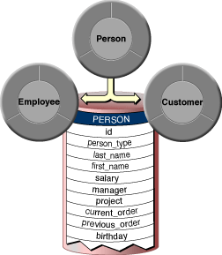
Modeling Inheritance
Single-Table Mapping
Put all of the data in one table that contains all superclass and subclass attributes. The attributes that don’t apply for each object have null values. You fetch an Employee or Customer by using a query that returns just objects of the specified type (the table includes a type column to distinguish records of one type from the other)
Andreas Herz © 2005 sales@tarragon-software.de

Slide 13
Modeling Inheritance
Single-Table Mapping
Implementation:
Create a entity Person with an int attribute type.
Create a new table alias Employee from the entity Person
In the Table Alias Editor, assign a restricting condition to the Employee entity that distinguishes its rows from the rows of other entities ( person.type=2).
Ensure via table hook that each new Employee record has the attribute type=2.
Andreas Herz © 2005 sales@tarragon-software.de

Slide 14
Modeling Inheritance
Single-Table Mapping
Advantages:
This approach is faster than the other two methods for deep fetches.
Unlike vertical or horizontal mapping, you can retrieve superclass (Person) objects with a single fetch, without performing joins.
Adding a subclass or modifying the superclass requires changes to just one table.
Disadvantages:
Single-table mapping results in tables that have columns for all of the attributes of each entity in the inheritance hierarchy.
Unable to use the not null constraint on subclass attributes.
It also results in many null row values.
They may conflict with some database design philosophies.
Andreas Herz © 2005 sales@tarragon-software.de

