Slide 1

  How to deploy my first jACOB Application!
  (this requires jACOB Designer v2.6.28 or greater)
Andreas Herz © 2006 info@openjacob.org

Slide 2
Programming with jACOB
Agenda:
Create a new jACOB project in eclipse.
Build the war file of your new project.
Deploy the war file into jakarta tomcat.
Accept the license.
Hotdeploy a „jacapp“ via eclipse into tomcat.
Andreas Herz © 2006 info@openjacob.org

Slide 3
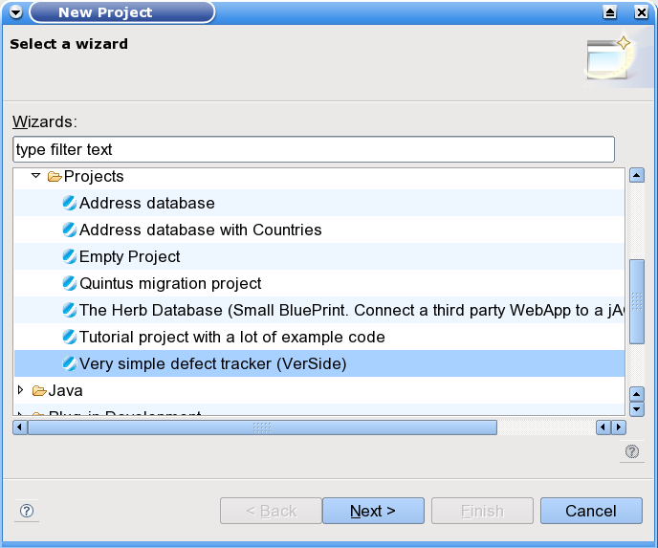
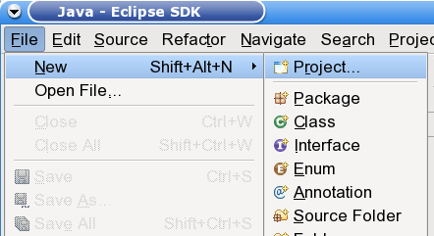
Create a new jACOB Project in Eclipse
After successfully installaing the jACOB Eclipse Plug In you may start the project wizard.
If you press [finish], Eclipse creates the project, switches automatically to the jACOB programming perspective and opens the new jACOB project.
Andreas Herz © 2006 info@openjacob.org

Slide 4
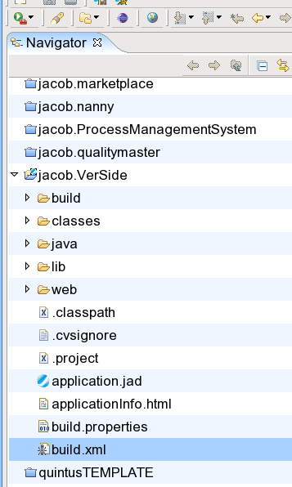
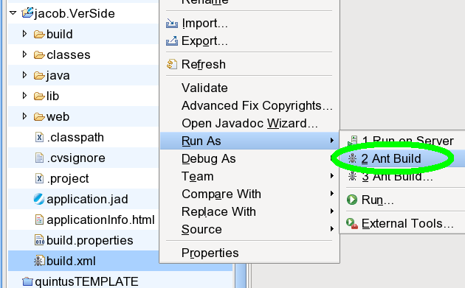
Build the war file of your new project
Switch from the jACOB Perspective to the Resource- or Java-Perspective and execute
the build.xml file (Context menu on the build.xml file).
Andreas Herz © 2006 info@openjacob.org

Slide 5
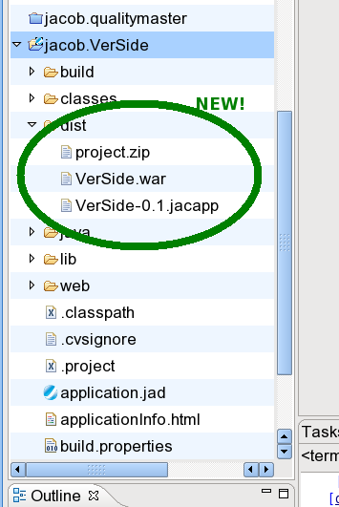
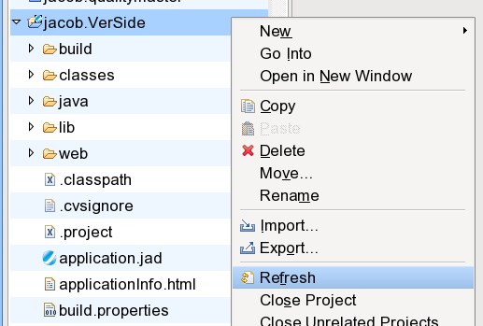
Build the war file of your new project
After a successful execution of the build.xml you have a valid Web Application Archive (war)
for deployment. The war file will be stored in the <MyProject>/dist directory.
Note: you have to refresh your project to reflect the new file system content!
Andreas Herz © 2006 info@openjacob.org

Slide 6
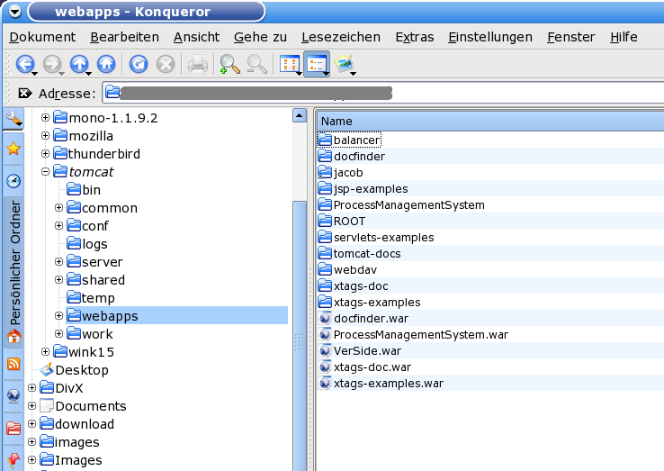
Deploy the war file into the jakarta tomcat
Success!
You have built your first jACOB application with a valid build-in database. Now you may copy the war file into the tomcat/webapps directory and start/restart the tomcat. No additional configuration is required.
Andreas Herz © 2006 info@openjacob.org

Slide 7
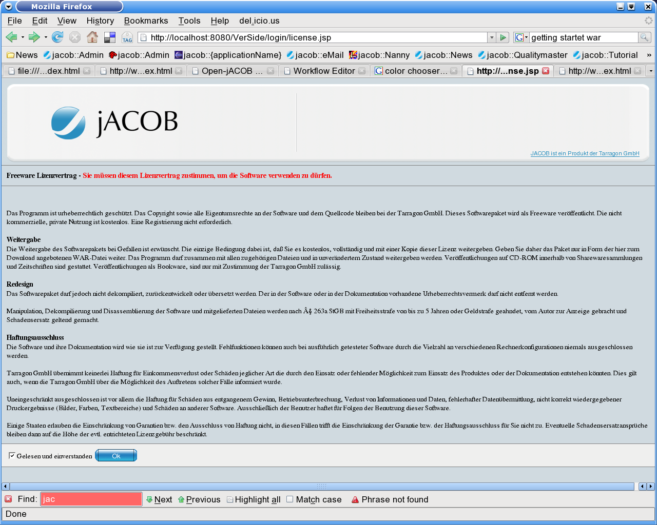
Accept the license
After you have started your tomcat with your new application, it is mandatory to accept
the license agreement!
Open the Url of your application: http://localhost:8080/VerSide/
(Be in mind – VerSide is our demo application, the links means: http://yourcomputer:yourTomcatPort/yourOpenjACOB_Application)
Andreas Herz © 2006 info@openjacob.org

Slide 8
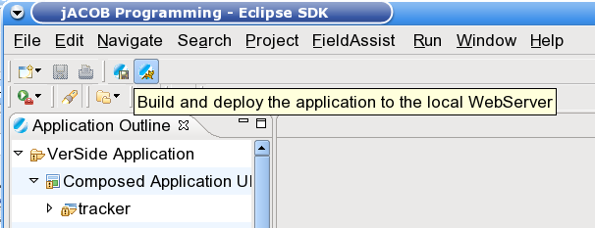
Hot deploy a „jacapp“ via eclipse into tomcat
Note: It is only necessary to deploy the war file once.
After changes in your project, you may deploy the small jacapp (jacob application).
Database, UI Design, business rules, scheduled jobs, SOAP Adapter, ...all information is stored in this file.
Press the button to deploy into the running tomcat – that is all.
Andreas Herz © 2006 info@openjacob.org

