Slide 1

  What is a „Relation Set“ in the context of
  jACOB?
Andreas Herz © 2005 sales@tarragon-software.de

Slide 2
Programming with jACOB
First of all jACOB is divided into three different layers.
Andreas Herz © 2005 sales@tarragon-software.de

Slide 3
Programming with jACOB
First of all jACOB is divided into three different layers.
Database layer for Oracle,
mySQL, SQLServer,..
Andreas Herz © 2005 sales@tarragon-software.de

Slide 4
Programming with jACOB
First of all jACOB is divided into three different layers.
company
employee
manager
jACOB Data Abstraction
Layer
organisation
Database layer for Oracle,
mySQL, SQLServer,..
Andreas Herz © 2005 sales@tarragon-software.de

Slide 5
Programming with jACOB
First of all jACOB is divided into three different layers.
User interface layer for
HTML or XUL.
company
employee
manager
jACOB Data Abstraction
Layer
organisation
Database layer for Oracle,
mySQL, SQLServer,..
Andreas Herz © 2005 sales@tarragon-software.de

Slide 6
Programming with jACOB
A „Relation Set“ is part of the „Logical Data Layer“ and is a collection of
relations between the logical data tables (table aliases).
User interface layer for
HTML or XUL.
company
employee
manager
jACOB Data Abstraction
Layer
organisation
Database layer for Oracle,
mySQL, SQLServer,..
Andreas Herz © 2005 sales@tarragon-software.de

Slide 7
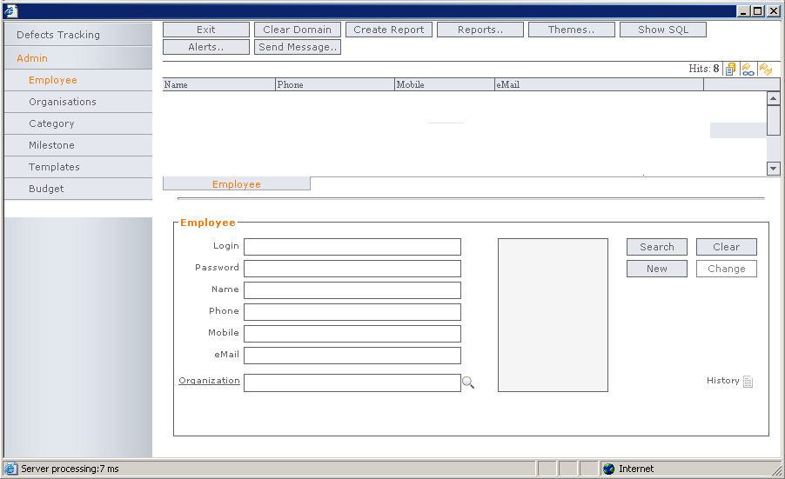
Programming with jACOB
Now we know the definition of a „Relation Set“.
But what is the practical usage of a „Relation Set“ in a jACOB application?
?
Andreas Herz © 2005 sales@tarragon-software.de

Slide 8
Programming with jACOB
Let's show an example.
1. Assign a „Relation Set“ to a search button.
Andreas Herz © 2005 sales@tarragon-software.de

Slide 9
Programming with jACOB
2. Click the search button.
click
Andreas Herz © 2005 sales@tarragon-software.de

Slide 10
Programming with jACOB
3. The search result will be displayed.
Andreas Sonntag
Mike Döring
Achim Böken
Andreas Herz
ASonntag@ibis-software.de
Mike.Doering@tarragon-software.de
A.Boeken@tarragon.software.de
A.Herz@FreeGroup.de
Andreas Herz © 2005 sales@tarragon-software.de

Slide 11
Programming with jACOB
4. Click on a row to display the whole data record and its related data.
.
Andreas Sonntag
Mike Döring
Achim Böken
Andreas Herz
ASonntag@ibis-software.de
Mike.Doering@tarragon-software.de
A.Boeken@tarragon.software.de
A.Herz@FreeGroup.de
MyLoginId
*****************
Andreas Sonntag
+49 775 123456789
0171 123456789
asonntag@ibis-software.de
IBIS Software GmbH
Andreas Herz © 2005 sales@tarragon-software.de

Slide 12
Programming with jACOB
„Relation Sets“ provide a powerful mechanism to define and handle
complex relations between data tables without any line of code or SQL.
Andreas Sonntag
Mike Döring
Achim Böken
Andreas Herz
ASonntag@ibis-software.de
Mike.Doering@tarragon-software.de
A.Boeken@tarragon.software.de
A.Herz@FreeGroup.de
company
MyLoginId
employee
manager
*****************
organization
Andreas Sonntag
+49 775 123456789
asonntag@ibis-software.de
IBIS Software GmbH
Andreas Herz © 2005 sales@tarragon-software.de

