Slide 1

  What is a „Table Alias“ in the context of
  jACOB?
Andreas Herz © 2005 sales@tarragon-software.de

Slide 2
Programming with jACOB
What is a Table Alias?
First of all jACOB is divided into three different layers.
Andreas Herz © 2005 sales@tarragon-software.de

Slide 3
Programming with jACOB
What is a Table Alias?
First of all jACOB is divided into three different layers.
Database layer for Oracle,
mySQL, SQLServer,..
Andreas Herz © 2005 sales@tarragon-software.de

Slide 4
Programming with jACOB
What is a Table Alias?
First of all jACOB is divided into three different layers.
company
employee
manager
jACOB Data Abstraction
Layer
organisation
Database layer for Oracle,
mySQL, SQLServer,..
Andreas Herz © 2005 sales@tarragon-software.de

Slide 5
Programming with jACOB
What is a Table Alias?
First of all jACOB is divided into three different layers.
User interface layer for
HTML or XUL.
company
employee
manager
jACOB Data Abstraction
Layer
organisation
Database layer for Oracle,
mySQL, SQLServer,..
Andreas Herz © 2005 sales@tarragon-software.de

Slide 6
Programming with jACOB
What is a Table Alias?
A 'Table Alias' is part of the 'Data Abstraction Layer' and is a reference to a physical database Table.
User interface layer for
HTML or XUL.
company
employee
manager
jACOB Data Abstraction
Layer
organisation
Database layer for Oracle,
mySQL, SQLServer,..
Andreas Herz © 2005 sales@tarragon-software.de

Slide 7
Programming with jACOB
What is a Table Alias?
Why is it a fundamental part in jACOB to define „Table Aliases“?
If you are familiar with SQL, the following statement will help to find the answer:
SELECT manager.name, employee.name
FROM person AS employee
INNER JOIN person AS manager
ON employee.managerID = manager.personID;
company
employee
manager
jACOB Data Abstraction
Layer
organisation
Database layer for Oracle,
mySQL, SQLServer,..
Andreas Herz © 2005 sales@tarragon-software.de

Slide 8
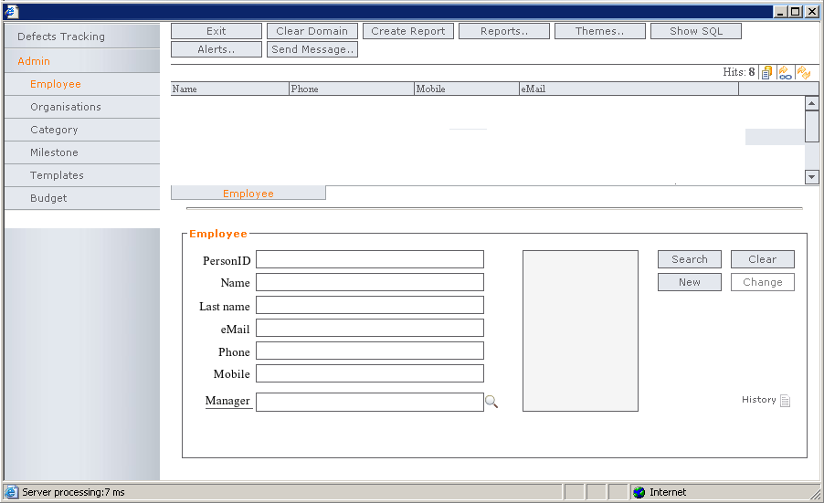
Programming with jACOB
What is a Table Alias?
If you want to handle the command structure of a company (stored in
the table person) you must define two aliases employee and manager
to represent them in one form.
Andreas Herz © 2005 sales@tarragon-software.de

Slide 9
Programming with jACOB
What is a Table Alias?
The logical database layer of jACOB loads the records from the table person and stores them in the alias employee and manager. The presentation layer retrieves this records and display them in the UI.
company
employee
manager
organisation
Andreas Herz © 2005 sales@tarragon-software.de

