Slide 1
Welcome to Your Computer
If you have speakers or headphones, please hook them up to your computer and turn them on to best experience this presentation. Hit the escape key to exit this presentation early at any time.
Notes:
Hi, my name is _______________ and I am a volunteer with Free IT Athens. I'm here to show you around your new computer. Hit the escape key to exit this presentation at any time.

Slide 2
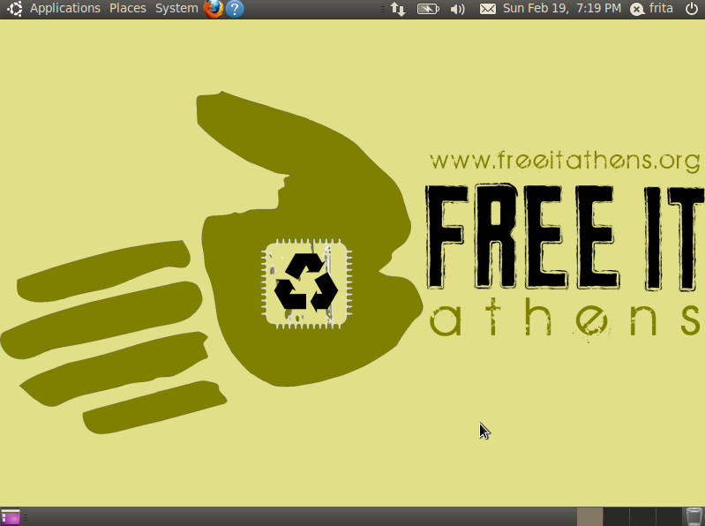
Notes:
The operating system on this computer is called Ubuntu – it means “humanity towards others.” An operating system is essentially the computer program that runs on your computer all the time. It allows you load programs, browse the Web, and interact with your computer hardware. Examples of other operating systems are Microsoft Windows and Apple Mac OS.
What is Ubuntu? Ubuntu is a free and open source operating system hosted by Canonical, Ltd. A United Kingdom-based technology company. Canonical gives its software away at no cost and sells services attached to Ubuntu such as corporate technical support, online cloud storage and digital entertainment. But don't worry, our volunteers here at Free IT Athens are willing to help you should anything go wrong with your computer.

Slide 3
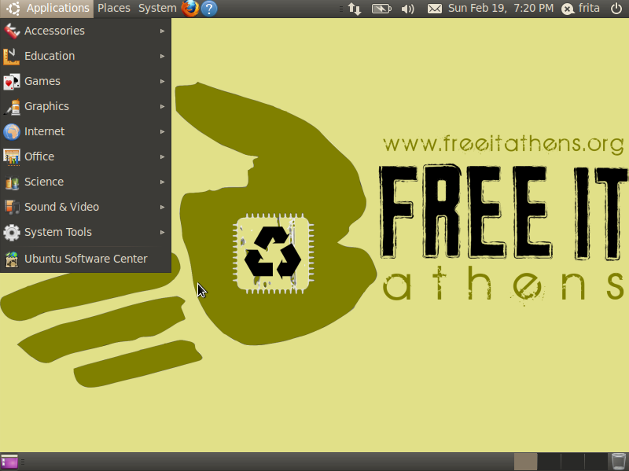
Notes:
At the top of the screen is a panel which is responsible for launching other applications and provides useful utilities.
On the left side of the panel are three menus. The first one is Applications. This is where you'll find all the programs that come with your computer. They're organized by category. We'll look at starting a program later.

Slide 4
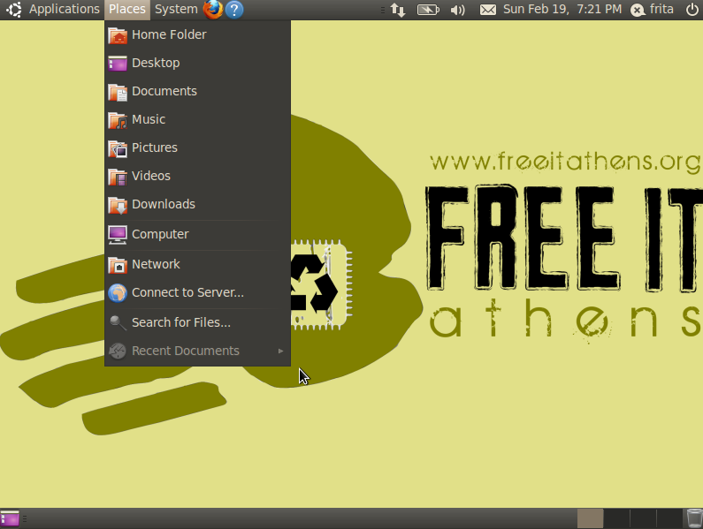
Notes:
Places is where you go to get to your files and folders.

Slide 5
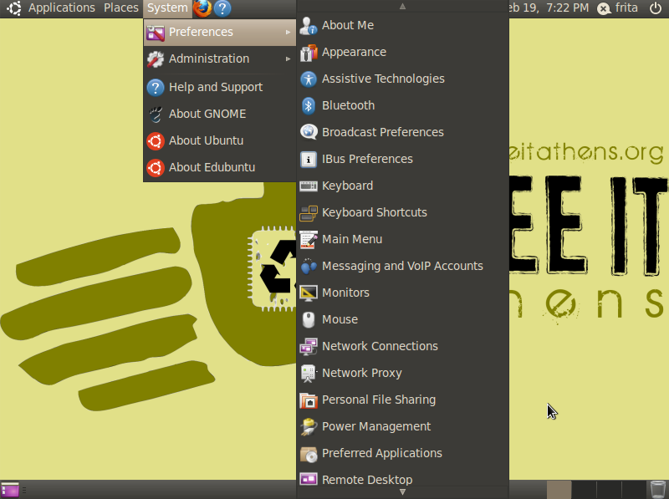
Notes:
System is where you go to change settings for your computer. Under Preferences, there are setting that only affect your own user account, such as the wallpaper. Under Administration, there are settings that affect the entire computer, such as configuring a printer.

Slide 6
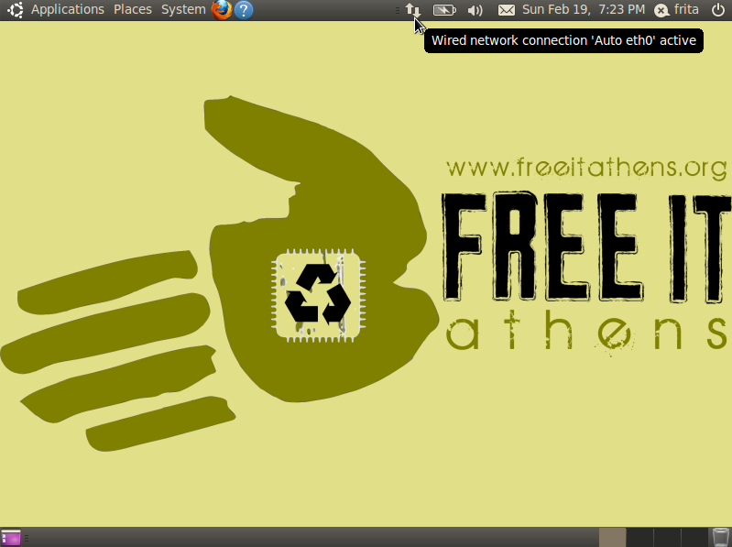
Notes:
This icon shows if you have an active internet connection.

Slide 7
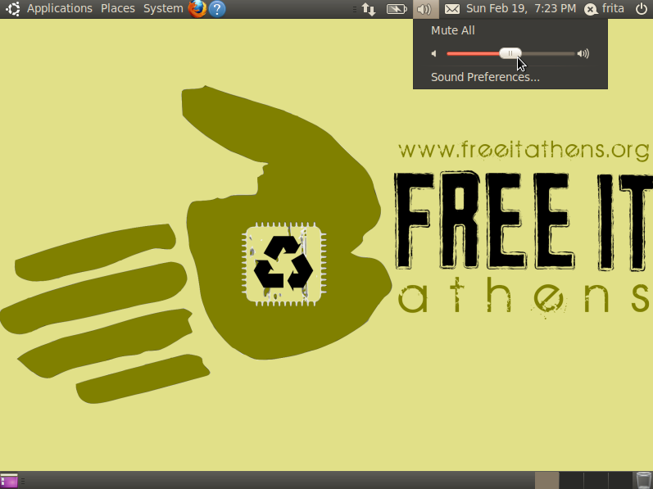
Notes:
This icon shows your volume level. You can click it to change the volume.

Slide 8
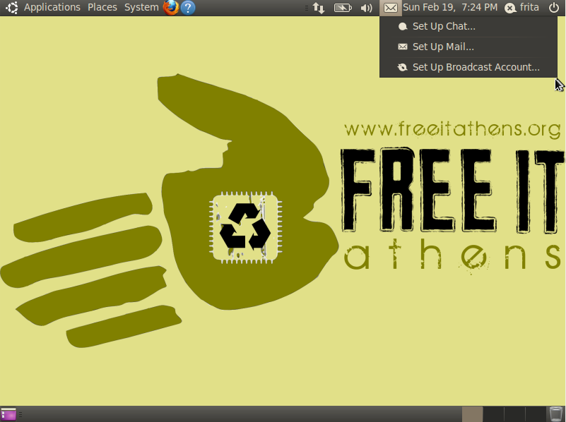
Notes:
From this icon you can configure your email, chat, and broadcast accounts. Broadcast accounts are social media like facebook and twitter. If you do this, the icon will change color to notify you when you have new messages.

Slide 9
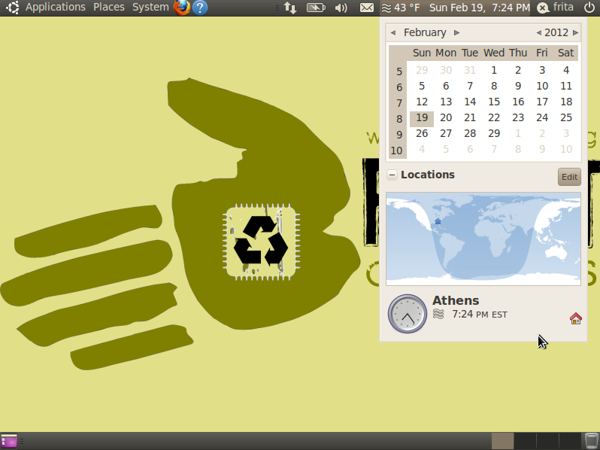
Notes:
If you click on the time, a calendar appears. You can set your location to see the weather.

Slide 10
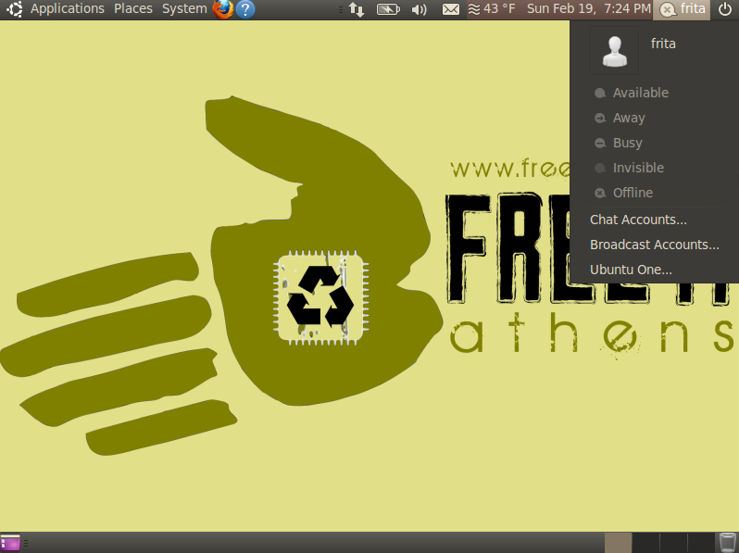
Notes:
If you set up chat accounts, you can change your status here.

Slide 11
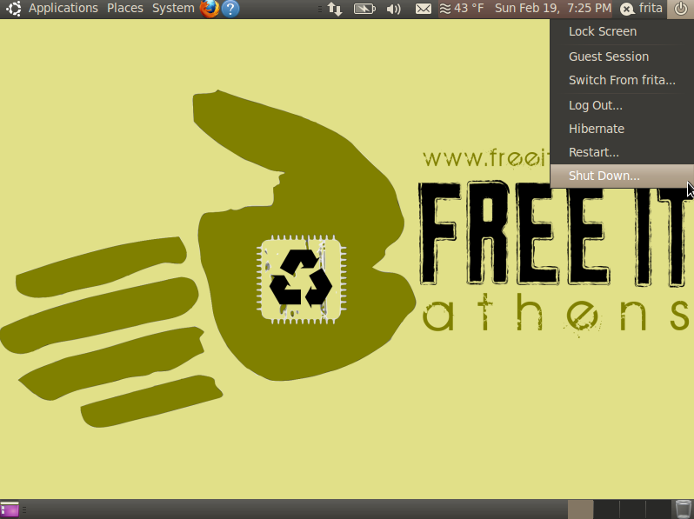
Notes:
The last icon is the power symbol. From here you can click shut down to turn off your computer. If you add more users to your computer, you can also use this to log out so that other users can log in.
We recommend that you don't delete any of the icons in the top panel.

Slide 12

Notes:
Now lets look at the bottom panel!
The first icon is the “show desktop” icon. Clicking this icon will minimize the windows of all the programs you have open.

Slide 13
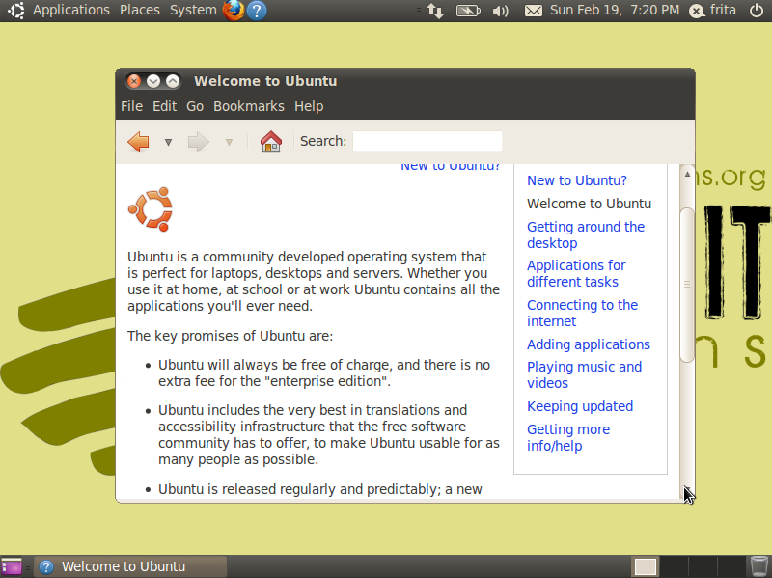
Notes:
The middle of the bottom panel shows you what windows you have open. You can click on a window's entry in the bottom panel to select it. Here is what it looks with one window open.

Slide 14

Notes:
The next four icons show your workspaces. A workspace lets you switch between groups of windows.

Slide 15

Notes:
The last icon is your Trash. When you delete a file, it is moved to Trash. If you accidentally delete a file, you can click on Trash and choose to restore it. You can also empty Trash to permanently remove all the files in it.

Slide 16
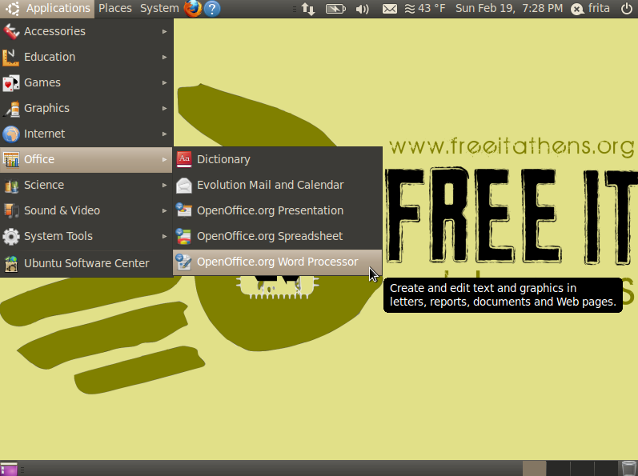
Notes:
That was a quick overview of the desktop environment.
Now lets look at starting a program. Imagine that we need to write a report. We will look through the Applications menu for suitable programs. If we can't tell by its name what a program does, let our mouse pointer rest on it for a few second and a popup will appear that explains what the program is for. Here we've found the OpenOffice Word Processor. To start it, we'll just click on its entry in the menu.

Slide 17
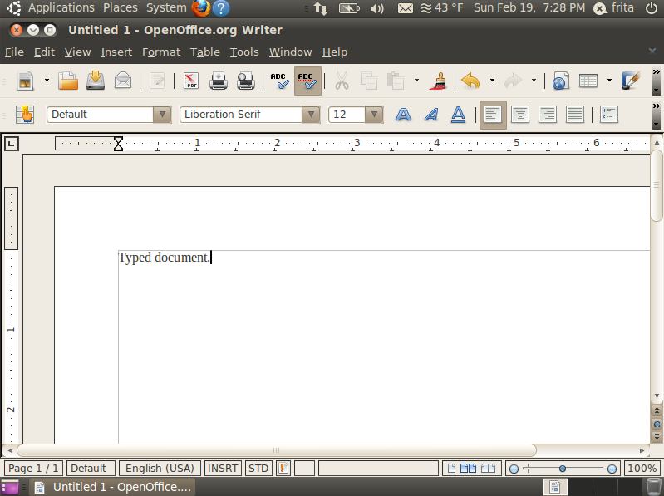
Notes:
Now the word processor has started and we can write our report.

Slide 18
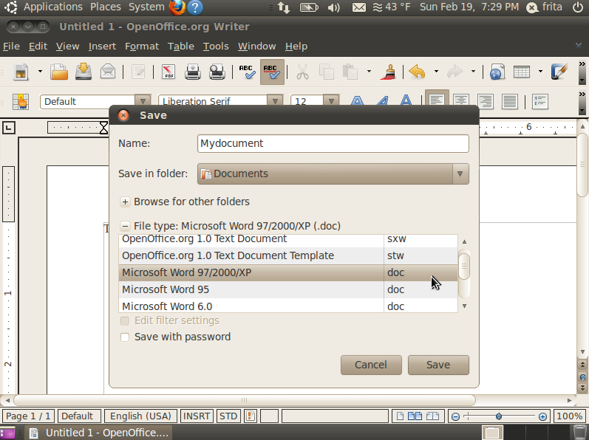
Notes:
When we're ready to save our report we'll click on the “file” menu and choose “save as”. OpenOffice can read and write file in many different formats, but other programs like Microsoft Office do not support all the file formats that OpenOffice does. A good choice if we're going to send our report to someone else is the “Microsoft Word 97” format.

Slide 19
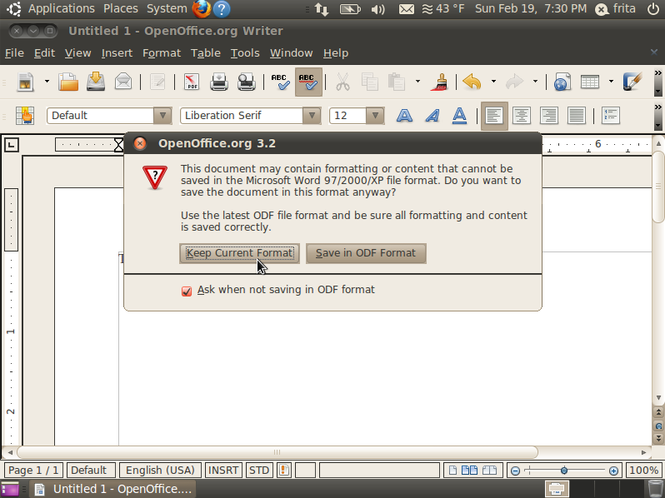
Notes:
OpenOffice will ask if we really meant to save the document in the Microsoft format, and we'll tell it yes, keep the format we choose.
After this, our file is saved. If we're finished working on our report, we can exit OpenOffice by clicking the “X” in the top-left of the window.

Slide 20
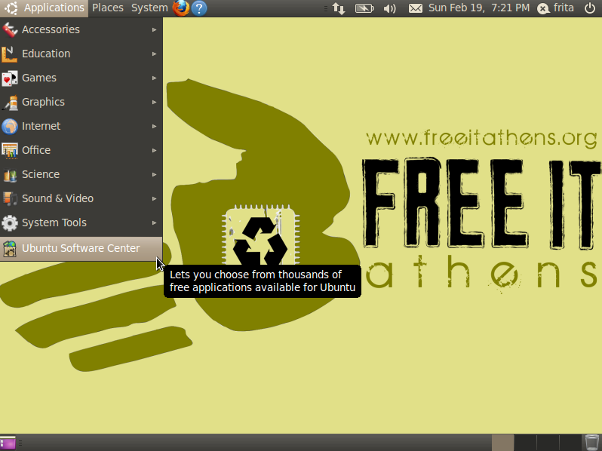
Notes:
What if you look through your applications menu but can't find a program to do what you want? If this happens, turn to the ubuntu software center to find and install new programs on your computer.
The software center requires an internet connection to function.

Slide 21
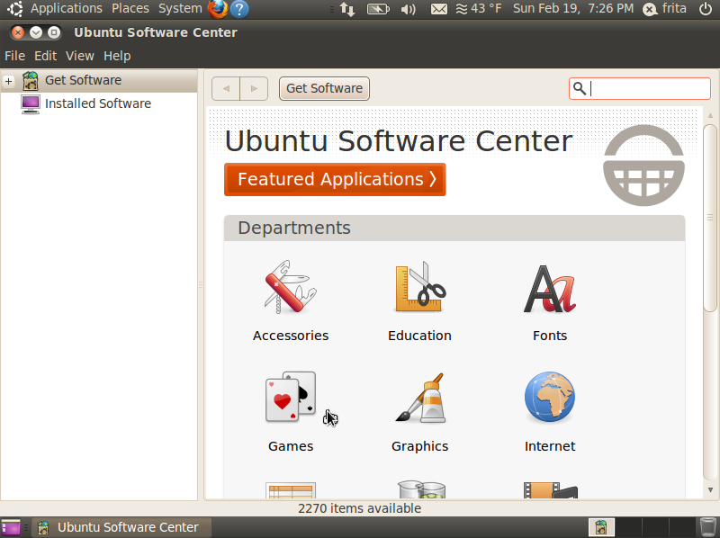
Notes:
In the software center, programs are organized by category. You click on a category to see the programs in that category and any subcategories. Let's say we're looking for a hearts card game. We'd click on the games category.

Slide 22
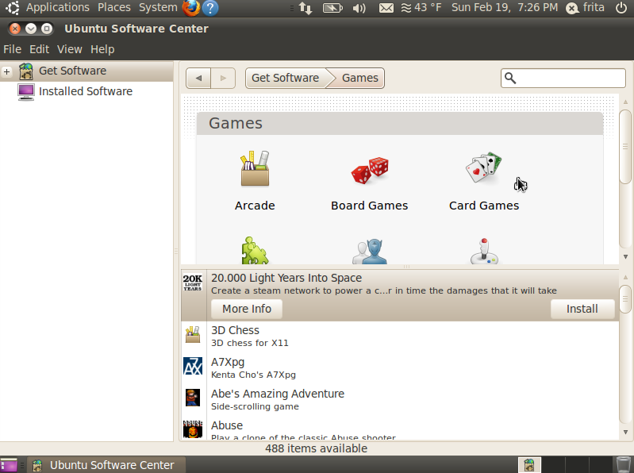
Notes:
Then we'd click on the card games subcategory.

Slide 23
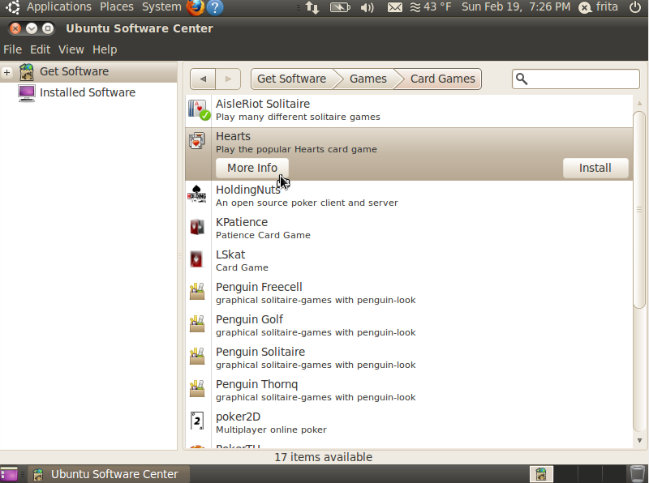
Notes:
Once we're there, in the list of available programs we'd see hearts. We can click on more information.

Slide 24
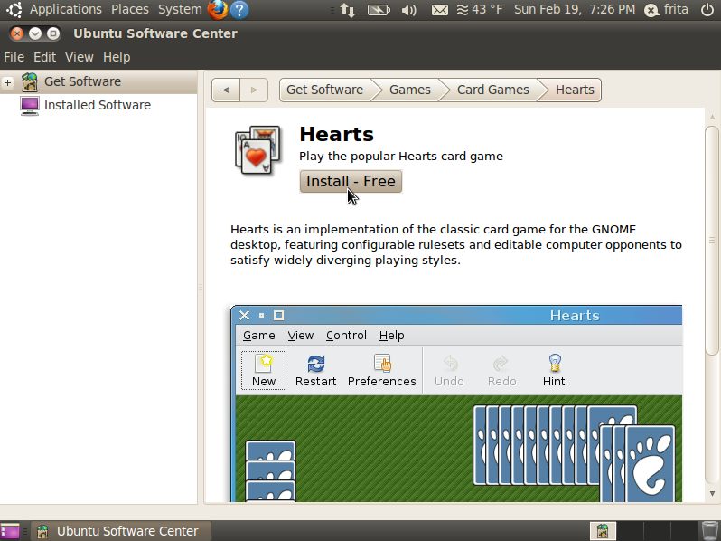
Notes:
The “more information” screen will describe the program, show us a screenshot, and give us a button to click to download and install the program.

Slide 25
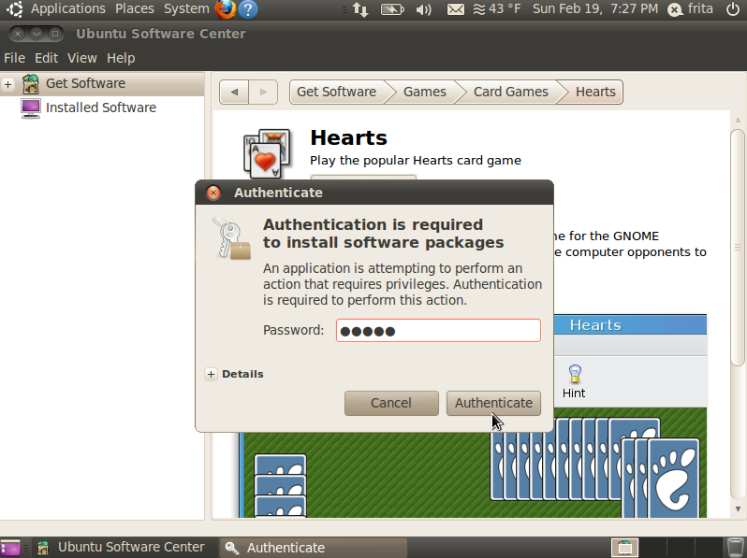
Notes:
Before you can install a new program, you have to provide your password. Ubuntu asks you for your password before you do anything that affects the entire computer.

Slide 26
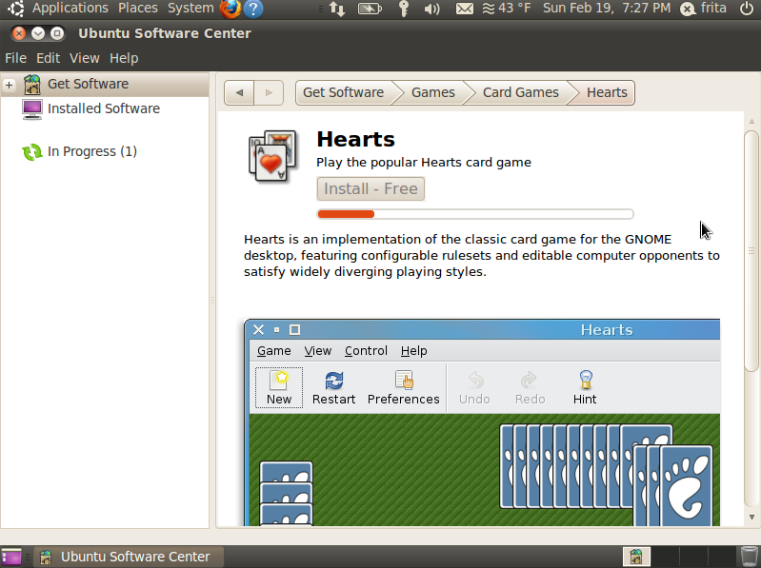
Notes:
Now Hearts will start to install.

Slide 27
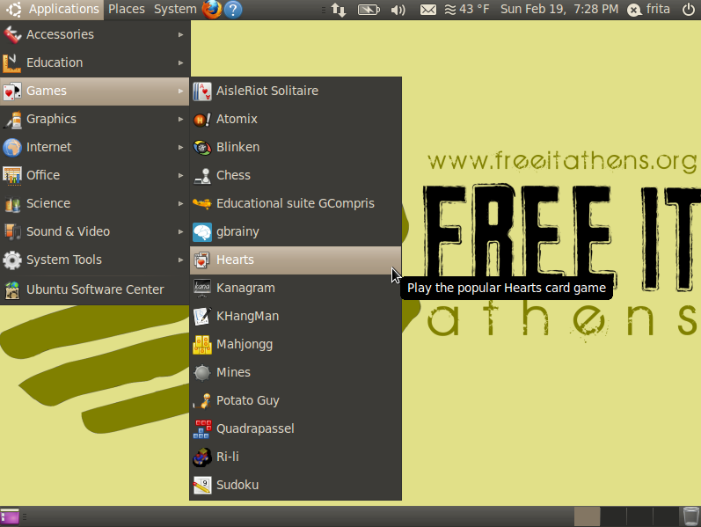
Notes:
Once it's finished installing, we can find it in the applications menu.

Slide 28
Enjoy your computer!
http://www.freeitathens.org/
Notes:
Hopefully this quick overview was enough to get you started exploring. We hope you enjoy using your new computer.

