Slide 1

US Market Entry
MBA 741
Group 3:
Tony Chase
Megan Parmelee
Shakira Pena

Slide 2
Agenda
Methods of Research
Market Focus
Understanding the Competition
Understanding FDA Requirements
Recommendations

Slide 3
Methods of Research
Dun and Bradstreet​
Competitors overview, size, financial statements, etc. ​
Mordor Intelligence​
Rehabilitation Device Market details now and in the future​
Donna Haire; CEO, The Eriah Group - Global Regulatory, Quality, Clinical, & Medical Affairs Consulting​
Understanding US regulations for medical devices
New York Sports Teams Websites
To identify orthopedic and hospital partnership trends
Notes:
https://www.mordorintelligence.com/industry-reports/rehabilitation-equipment-market

Slide 4
Market Focus
Rehabilitation Equipment Market
Global market currently at $14.9B in 2022
Projections to reach $19.8B in 2027
Projected growth rate of 5.9%
Lack of consolidation in marketplace
Professional Sports Team Focus
174 professional sports teams in the US
5 cities with sports teams in all professional sports leagues
Chicago, Los Angeles, New York, Seattle, Washington

Slide 5
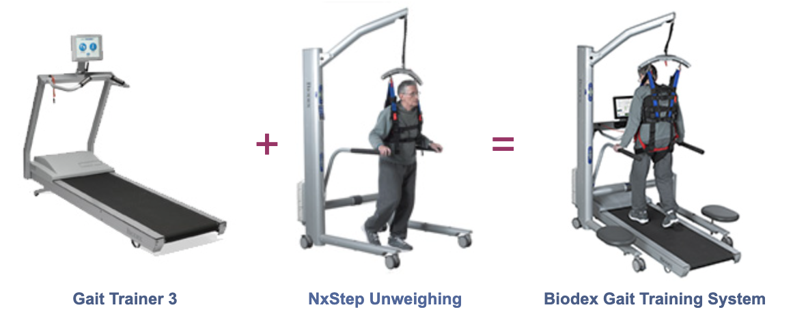
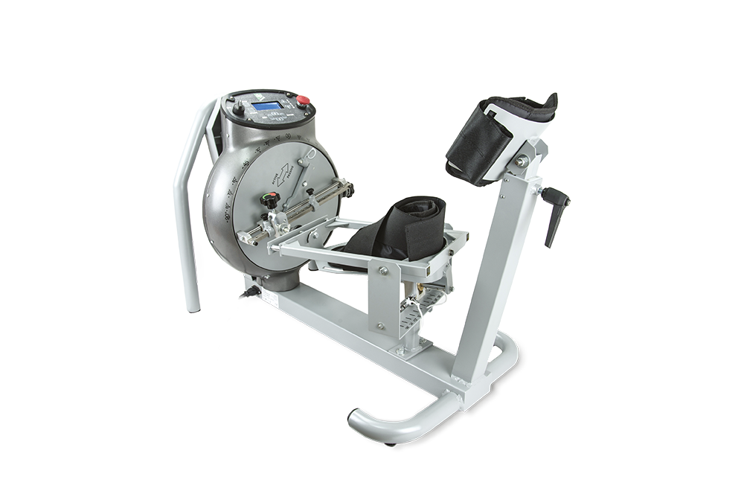
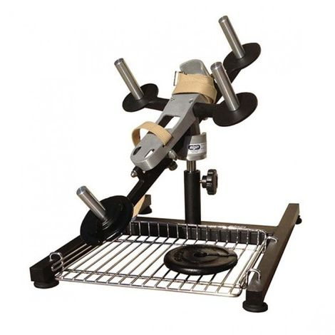
Understanding the Competition
Biodex Medical Systems
Biodex Gait Trainer- $22,000
Biodex Unweighing System
Biodex Balance System
Medisport IT
Medislipper 1000
Elgin Division
Elginex Elgin Leg and Ankle Exerciser - $1,500
Notes:
Biodex Medical Systems:
https://www.biodex.com/sites/default/files/900521lateral.pdf
https://www.biodex.com/physical-medicine/products/treadmills/gait-trainer-3/biodex-gait-training-system
Medisport IT:
https://payamehrco.com/sites/default/files/catalog/MEDI%20SLIPPER%201000.pdf
https://www.medisport.it/site/en/MedisportElettromedicale?sku=EL202
Elgin Division:
https://www.healthproductsforyou.com/m-elginex-corporation.html
https://www.healthproductsforyou.com/p-elginex-elgin-leg-and-ankle-exerciser.html

Slide 6
Understanding FDA Requirements
Class I Medical Device
No design controls
Reasonable assurance of the device's safety and effectiveness
Utilizes general controls
Examples: Standard disposable masks, stethoscopes, bandages
Class II Medical Device
Design controls present
Moderate risk to safety and effectiveness
Utilizes special controls
Examples: blood pressure cuffs, contact lens, wheelchairs Apple Watch
Notes:
Quality system regulations 21 CFR Part 80020

Slide 7
Recommendation Step 1 Pre-Market Process
Proof of concept will require protocol, target population, and intended outcomes
Combined safety study
Take into account FDA’s feedback
Answer the ‘what’ (Diagnose, treat, and measures) and lay out the ‘design controls’
Check for bench testing and provide documentation for verification testing
What data currently exists? How are they testing? Documentation of testing + protocol?
Bring in additional help; how have you tried to raise money so far? Who have you reached out to among investors?
Will need to make connections; consult a think tank potentially
Consider an ‘investor pitch deck’; great insight of what investors typically ask

Slide 8
Recommendation Step 2
Price Point
$15,000
Recurring Streams of Income
Physical equipment leasing
Software subscription based model

Slide 9
Recommendation Step 3 Market Entry Point
Enter New York as first market in the US
Hospital for Special Surgery | New York Presbyterian Hospital
5 Teams NY Mets (MLB) NY Knicks and NJ Nets (NBA) NY Red Bulls (MLS) NY Liberty (WNBA) | 3 Teams NY Yankees (MLB) NY Giants (NFL) NYC FC (MLS)
#1 Orthopedic Residency Hospital in US | #7 Orthopedic Residency Hospital in US
- HSS Educational Institute - HSS Research Institute - HSS Innovation Institute | - 7 campuses around NY - Over 6,500 physicians, 20,000 employees and over 2m visits annually
Notes:
Hospital for Special Surgery:
https://www.hss.edu/professional.asp
NY Presbyterian:
https://www.nyp.org/about
Hospital Rankings:
https://ryortho.com/2009/07/the-best-orthopedic-hospitals-in-america/

Slide 10

Questions?

Slide 11
Appendix of Resources Part 1
Atlantic Health. (n.d.). New York Jets Partnership - Atlantic Health. Retrieved June 17, 2022, from https://www.atlantichealth.org/about-us/partnerships/ny-jets-partnership.html
Atlantic Yards Report. (2020, November 11). The Barclays Center, the Brooklyn Nets, and three hospitals pursuing sponsorships. Retrieved June 14, 2022, from https://atlanticyardsreport.blogspot.com/2019/12/the-barclays-center-brooklyn-nets-and.html
Biodex Medical Systems Inc. (n.d.). Balance SystemTM SD - Balance - Physical Medicine | Biodex. Biodex Medical Systems. Retrieved June 15, 2022, from https://www.biodex.com/physical-medicine/products/balance/balance-system-sd
Center for Devices and Radiological Health. “QS Regs for Device Good Manufacturing Practices.” U.S. Food and Drug Administration, FDA, https://www.fda.gov/medical-devices/postmarket-requirements-devices/quality-system-qs-regulationmedical-device-good-manufacturing-practices.
“CFR - Code of Federal Regulations Title 21.” Accessdata.fda.gov, https://www.accessdata.fda.gov/scripts/cdrh/cfdocs/cfcfr/CFRSearch.cfm?CFRPart=890&showFR=1&subpartNode=21%3A8.0.1.1.32.6.
Chase, Tony, and Donna Haire. “Interview with Donna Haire; CEO, The Eriah Group - Global Regulatory, Quality, Clinical, & Medical Affairs Consulting.” 27 June 2022.
ESPN. (n.d.). WNBA Teams. ESPN.Com. Retrieved June 4, 2022, from https://www.espn.com/wnba/teams
Gotham FC. (n.d.). Partners. Retrieved June 15, 2022, from https://www.gothamfc.com/partners
Health Products For You. (n.d.). Home Health Care Products & Medical Supplies. Retrieved June 20, 2022, from https://www.healthproductsforyou.com/error404
Hospital for Special Surgery. (n.d.). Your Partner in Musculoskeletal Health. Retrieved June 21, 2022, from https://www.hss.edu/professional.asp
Hospital for Special Surgery. (2019, September 5). The New York Knicks and Hospital for Special Surgery Announce Renewed and Expanded Multi-Year Marketing Partnership. Retrieved June 15, 2022, from https://news.hss.edu/the-new-york-knicks-and-hospital-for-special-surgery-announce-renewed-and-expanded-multi-year-marketing-partnership/
“Industry Market Research, Reports, and Statistics.” IBISWorld, https://www.ibisworld.com/industry-statistics/market-size/colleges-universities-united-states/.
Notes:
Hospital for Special Surgery:
https://www.hss.edu/professional.asp
NY Presbyterian:
https://www.nyp.org/about
Hospital Rankings:
https://ryortho.com/2009/07/the-best-orthopedic-hospitals-in-america/

Slide 12
Appendix of Resources Part 2
Major League Baseball. (2019, April 18). The New York Mets extend partnership with Hospital for Special Surgery to be the presenting partner of the Mets Academy in the Dominican Republic. MLB.Com. Retrieved June 18, 2022, from https://www.mlb.com/press-release/mets-extend-partnership-with-hospital-for-special-surgery
Medisport. (n.d.). MEDISLIPPER 1000 ACTIVE/PASSIVE. Retrieved June 17, 2022, from https://www.medisport.it/site/en/MedisportElettromedicale?sku=EL202
MLB. (n.d.). The Official Site of Major League Baseball. MLB.Com. Retrieved June 2, 2022, from https://www.mlb.com/
Mordor Intelligence. (n.d.). Rehabilitation Equipment Market Size, Trends, Analysis (2022 - 27). Retrieved June 2, 2022, from https://www.mordorintelligence.com/industry-reports/rehabilitation-equipment-market
National Women’s Soccer League. (n.d.). National Women’s Soccer League Official Site | NWSL. Retrieved June 5, 2022, from https://www.nwslsoccer.com/
NBA. (n.d.). NBA.com | The official site of the National Basketball Association. Retrieved June 1, 2022, from https://www.nba.com/
New York Presbyterian. (n.d.-a). About Us | NewYork-Presbyterian. Retrieved June 19, 2022, from https://www.nyp.org/about
New York Presbyterian. (n.d.-b). NewYork-Presbyterian Sponsorships | NYP. Retrieved June 10, 2022, from https://www.nyp.org/sponsorships
“Procurement.” University of North Carolina at Chapel Hill - Knowledge Base, https://policies.unc.edu/TDClient/2833/Portal/KB/?CategoryID=21547.
RyOrtho. (2009, July 21). The Best Orthopedic Hospitals in America. Orthopedics This Week. Retrieved June 16, 2022, from https://ryortho.com/2009/07/the-best-orthopedic-hospitals-in-america/
Stadium Maps. (2021, July 9). A breakdown of all 151 Major League Sports franchise locations by city. Retrieved June 3, 2022, from https://www.stadium-maps.com/facts/sports-franchises.html
Notes:
Hospital for Special Surgery:
https://www.hss.edu/professional.asp
NY Presbyterian:
https://www.nyp.org/about
Hospital Rankings:
https://ryortho.com/2009/07/the-best-orthopedic-hospitals-in-america/

