Slide 1
Sensor Significance
13-08-2025

Slide 2
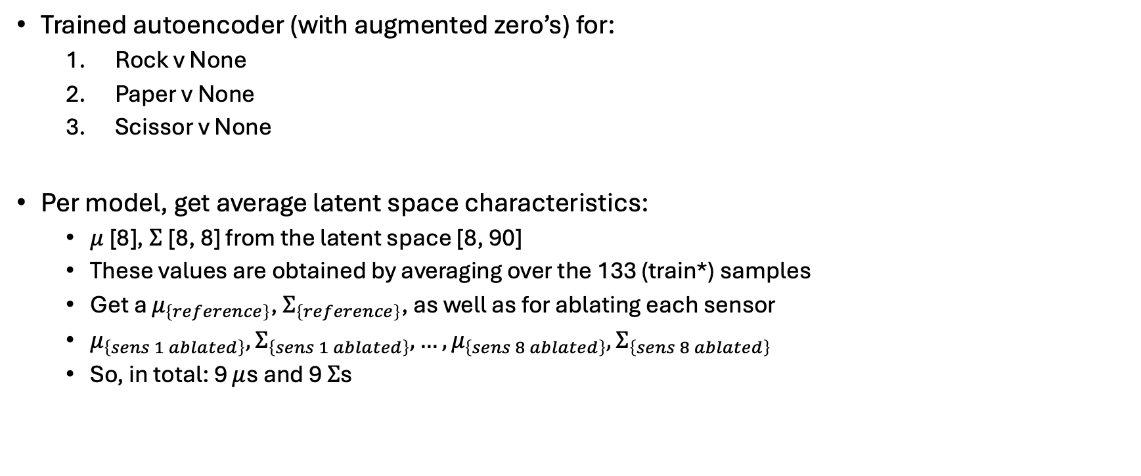
Approach
Trained autoencoder (with augmented zero’s) for:
Rock v None
Paper v None
Scissor v None
Per model, get average latent space characteristics:
$μ$ [8], $Σ$[8, 8] from the latent space [8, 90]
These values are obtained by averaging over the 133 (train*) samples
Get a $μ_{\left\{reference\right\}}$, $Σ_{\left\{reference\right\}}$, as well as for ablating each sensor
$μ_{\left\{sens 1 ablated\right\}}, Σ_{\left\{sens 1 ablated\right\}}, …, μ_{\left\{sens 8 ablated\right\}}, Σ_{\left\{sens 8 ablated\right\}}$
So, in total: 9 $μ$s and 9 $Σ$s
* Should probably use validation data here

Slide 3
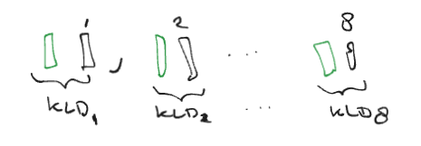
Approach
For each model (i.e.: Rock v None, …)
For each of these mu and Sigma’s compute the KLD between the reference distribution and the ablated sensor distribution.

Slide 4
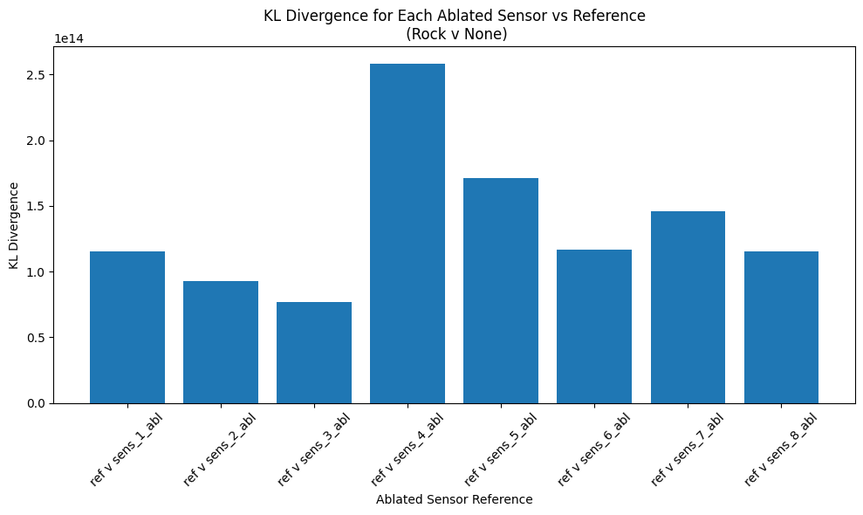
Results

Slide 5
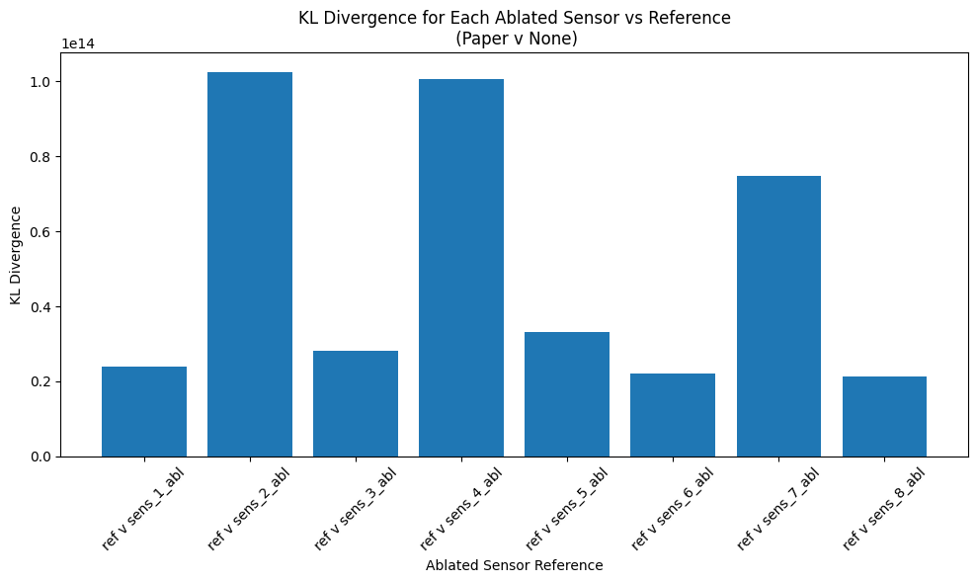
Results

Slide 6
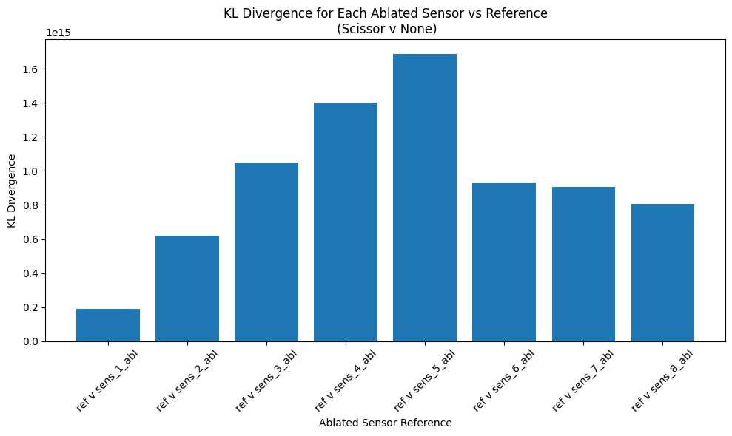
Results

Slide 7
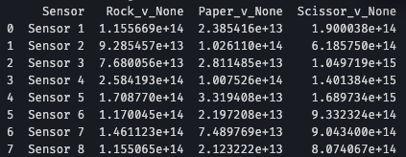
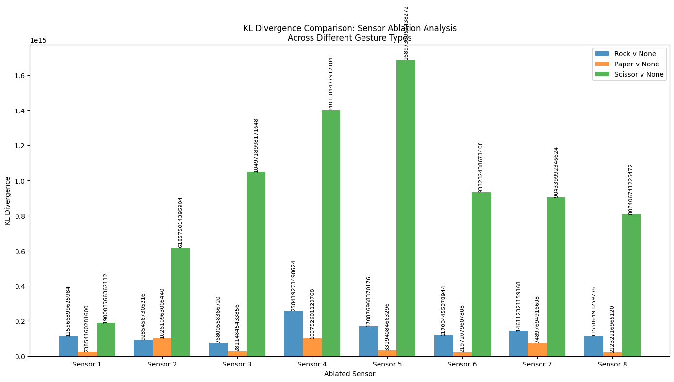
Results

Slide 8
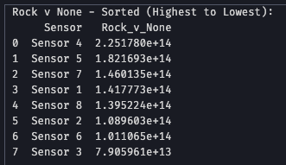
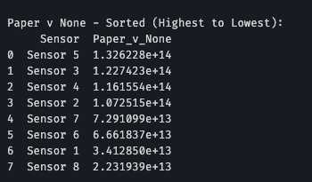
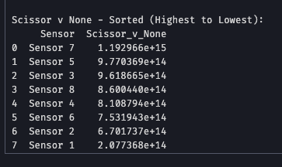
Sensors 5, 4, 3 are most important it seems

Slide 9
Considerations
Work on validation data instead of train data?
Need to perform a check if the latent spaces are Gaussians

