Slide 1
MODE Lab
Freek Hens 28-08-2025

Slide 2
Data
All rock, paper, scissor data -> torch.Size([296, 1, 8, 400])
Extract 9 features for each of the 8 channels and flatten -> (296, 72)
feats = [
rms(sig),
waveform_length(sig),
zero_crossings(sig),
slope_sign_changes(sig),
median_freq(sig, fs),
sample_entropy(sig),
shannon_entropy(sig),
wavelet_energy(sig),
higuchi_fd(sig),
]
Shannon Entropy, Sample Entropy, Zero Crossings, Waveform Length, RMS, Slope Sign Changes and Fractal Dimension

Slide 3
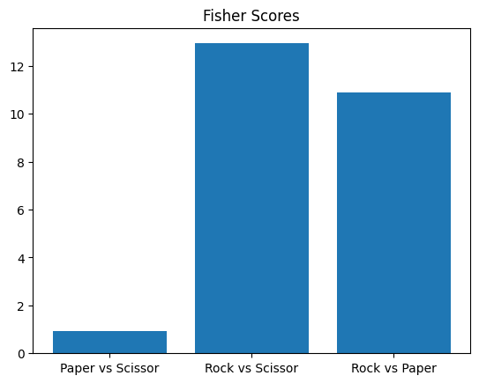
Fisher scores comparing the three classes in feature space
Rock feature matrix (296, 72)
Paper feature matrix (296, 72)
Scissor feature matrix (296, 72)
def compute_fisher_scores(data1, data2):
m1 = np.mean(data1, axis=0)
m2 = np.mean(data2, axis=0)
v1 = np.var(data1, axis=0, ddof=0)
v2 = np.var(data2, axis=0, ddof=0)
scores = (m1 - m2)**2 / (v1 + v2 + 1e-12)
return np.max(scores)

Slide 4
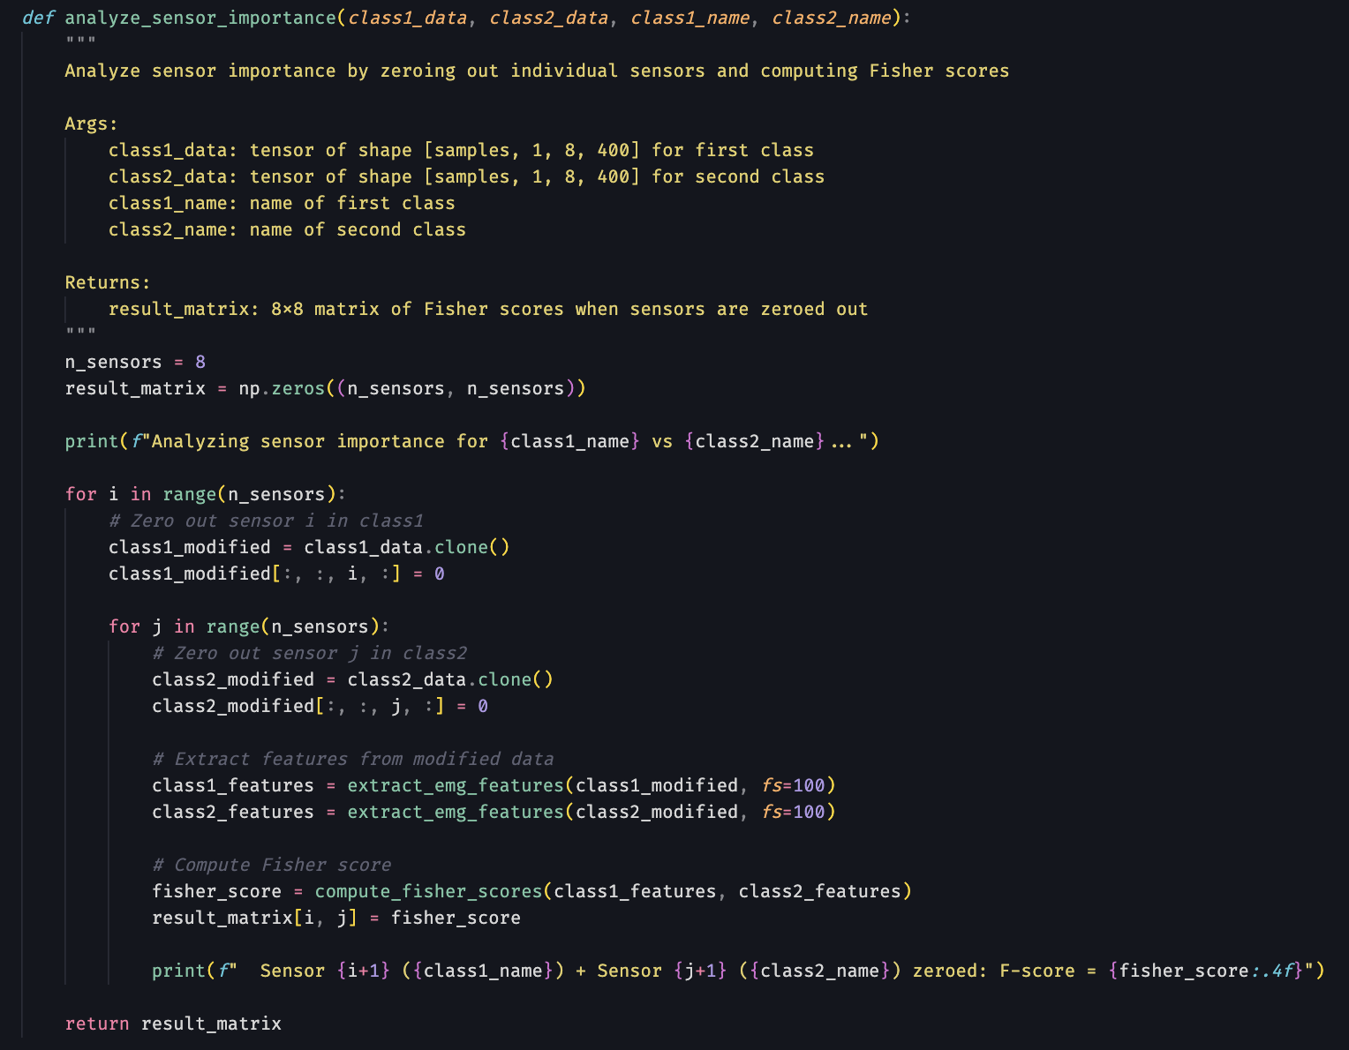
Analyze sensor importance by zeroing out individual sensors and computing Fisher scores
for x
class 1 ablate
for y
class 2 ablate
compute_fisher(class1, class2)

Slide 5
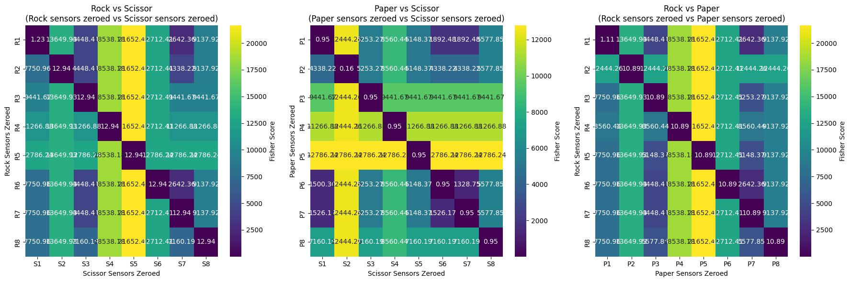
Analyze sensor importance by zeroing out individual sensors and computing Fisher scores
for x
class 1 ablate
for y
class 2 ablate
compute_fisher(class1, class2)

Slide 6
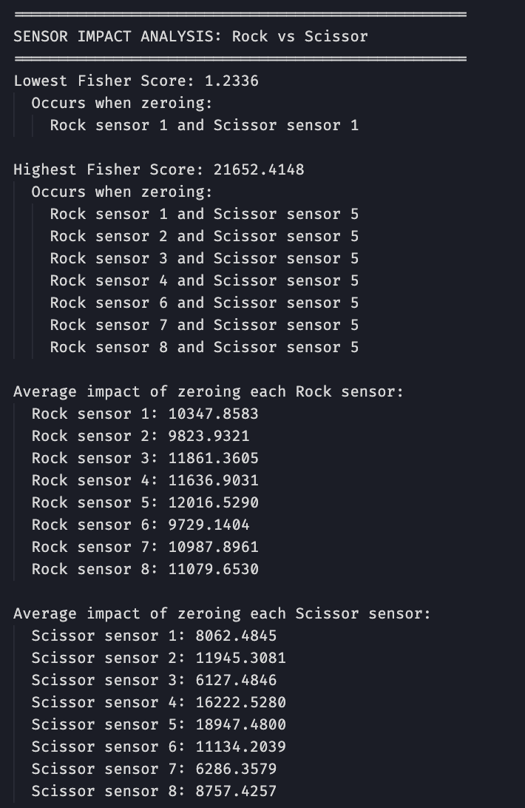
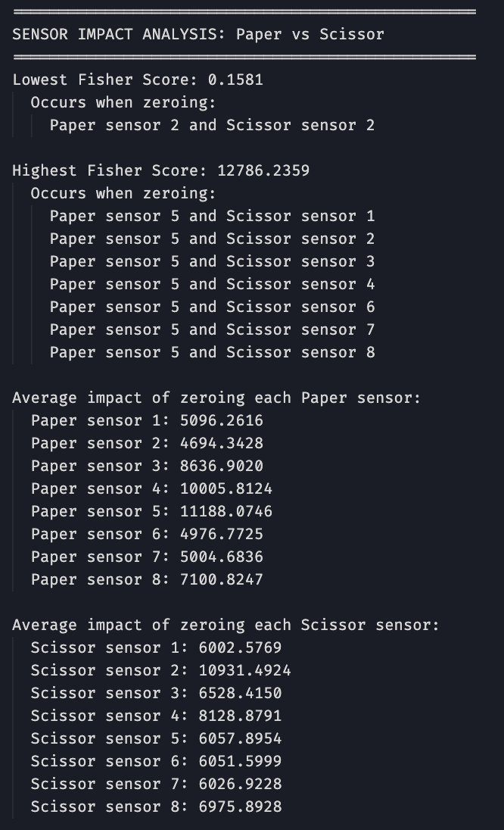
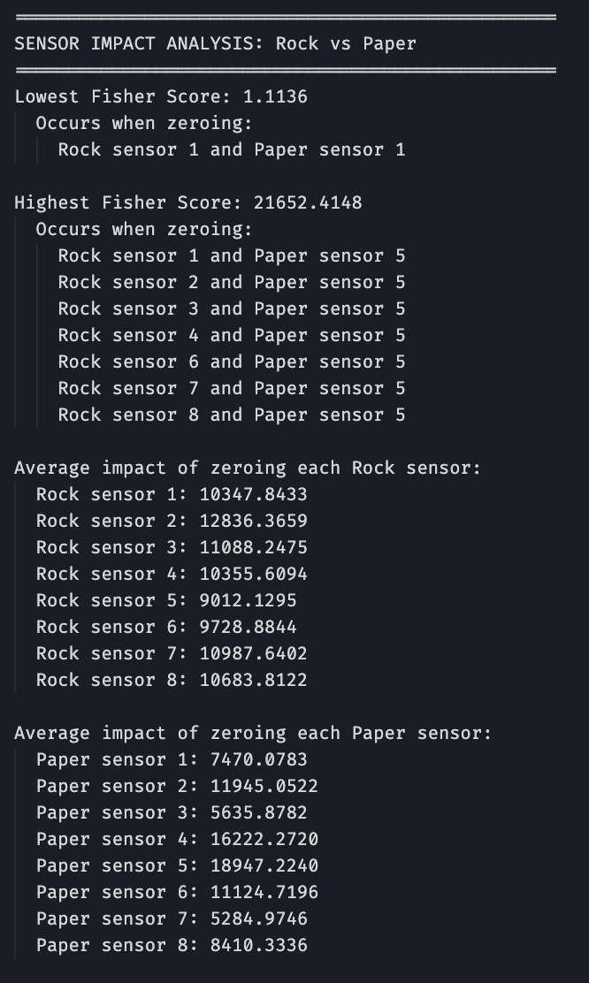

Slide 7
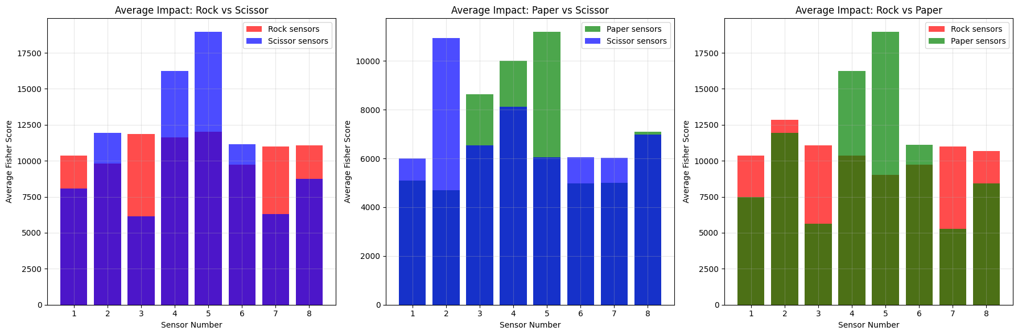
Impact on Fisher score visualized

Slide 8
