Slide 1
Finals Presentation: Greek Mythology
NLP & Information Retrieval – Final Group Project
Elyesa Duru 50251140 Dilara Alkanalka 50251145 Tim Leute 50251142 Hamidreza Rahimian 50251141

Slide 2
Motivation & Goals
Greek mythology is complex: many characters, interwoven relationships
Text-based resources are fragmented and hard to explore intuitively
Goal: Create a graph-based platform to interactively explore mythological connections
Added value: Combine educational exploration with smart search features

Slide 3
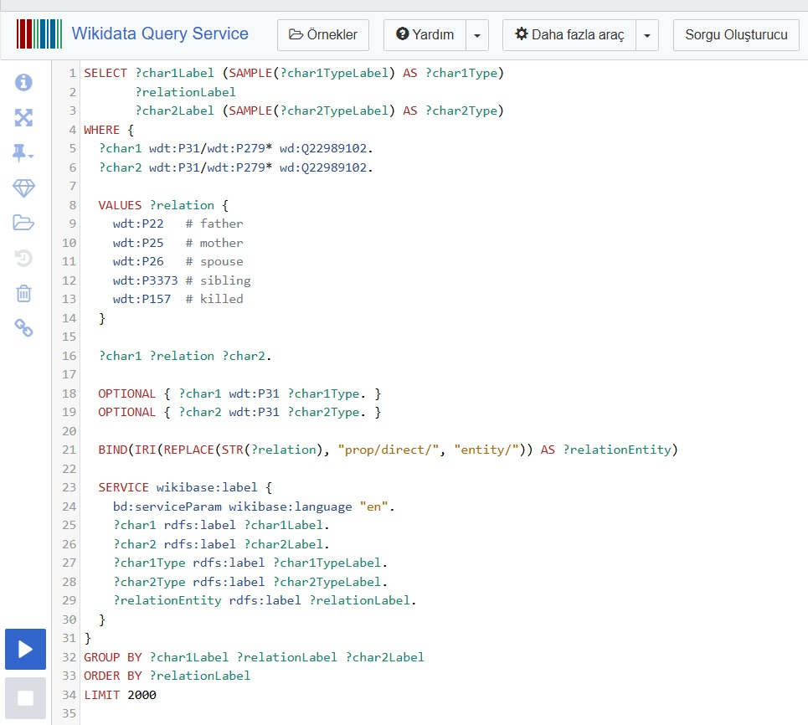
How did we get our data?
Dataset: Wikidata – Query Service using SPARQL on Greek mythology.
Wikidata items are identified by a „Q“ code.
Item „Zeus“ corresponds to Q34201
Properties are identified with a „p“ code.
Property „father“ corresponds to code „p22“

Slide 4
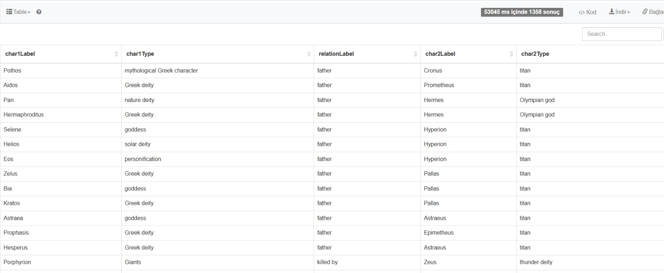
How did we get our data?
We gathered mythological characters and types(god/deity/titan etc.) with their relations to other characters
We imported this as a cvs file (1358 rows)

Slide 5
System Architecture & Technologies
Early version: Local Python + CSV + JS → performance issues
Final version: Neo4j Sandbox, HTML + JavaScript, Neo4j driver/API
Benefits: Cloud-based, Fast, Responsive, Visually rich

Slide 6
Core Features
Graph Exploration: visualization, search, filtering
Shortest Path Queries: relationship path between characters
Character Similarity Matching: sliders input, vector comparison (Euclidean distance)

Slide 7
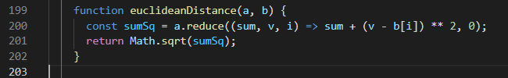
Character Similarity - Example
User and characters have trait profiles.
We compare them using Euclidean distance.
Smaller distance = better match.

Slide 8
Evaluation
Method: 5 test queries, manual relevance scores (0-2 scale)
Metrics Used: Precision@5, MAP, NDCG@5
Results: Precision@5 = 1.0 (4/5 cases), MAP = 1.0, NDCG@5 = 0.80 - 1.00
Other possibilities of Evaluation: User Surveys

Slide 9
Demo Time ✨
Live walk-through:
- Graph visualization
- Shortest path
- Similarity matching using slider UI

Slide 10
Teamwork & Task Distribution
Tasks chosen based on personal interests
Workload balanced across the team
Everyone contributed equally
Dilara: Data Retrieval and Initial Code Testing with Python, Information Retrieval, Powerpoint, Report
Elyesa: Neo4j-Character Analysis, Report, Presentation, Team Mentoring
Tim: Character-Analysis-Evaluation, Report, UI
Hamidreza: Neo4j-Migration and Neo4j-Shortes-Path, Information Retrieval, Report

Slide 11
Conclusion & Outlook
Graph-based approach = intuitive, visual, and scalable
Character similarity feature adds personalization
Future Ideas: Expand mythologies, add roles,functions or more information

Slide 12
Thank You / Q&A
Questions?
Github: [freely1967/Myth_Project: Finals Group Project for NLP]
Website: [Greek Mythology Relationship Explorer]

Slide 13
References
Baeza-Yates, R., & Ribeiro-Neto, B. (1999). Modern information retrieval (1st ed.). Addison-Wesley.
Baeza-Yates, R., & Ribeiro-Neto, B. (2011). Modern information retrieval: The concepts and technology behind search (2nd ed.). Addison-Wesley.
Manning, C. D., Raghavan, P., & Schütze, H. (2008). Introduction to information retrieval. Cambridge University Press.
Pastor-Sánchez, J., Kontopoulos, E., Saorín, T., Bebis, T., & Darányi, S. (2021). Greek mythology as a knowledge graph: From Chaos to Zeus and beyond. Semantic Web Journal. Retrieved from https://www.semantic-web-journal.net/system/files/swj2754.pdf
Lecture 04. (2025). Information Retrieval and Web Search [Lecture slides]. Department of Computer Science and Engineering, Chung-Ang University.

