Slide 1

AI 芯片
— AI 芯片基础
计算时延 Latency
ZOMI

Slide 2
Talk Overview
AI 计算体系
深度学习计算模式
计算体系与矩阵运算
AI 芯片基础
通用处理器 CPU
从数据看 CPU 计算
通用图形处理器 GPU
AI专用处理器 NPU/TPU
计算体系架构的黄金10年

Slide 3
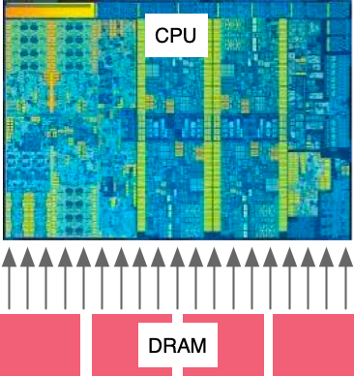
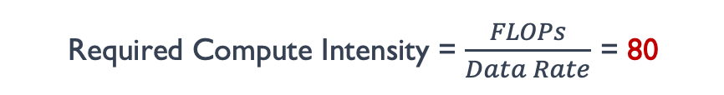
计算强度
How many operations must I do on some data to make it worth the cost of loading it?
2000 GFLOPs FP64
Required Compute Intensity = $\frac{FLOPs}{Data Rate}$ = 80
200 GBytes / sec
= 25 Giga-FP64 / sec
(FP64 = 8 bytes)
So for every number load from memory, Need to do 80 Operations on it to break even.

Slide 4
内存、带宽 >> 时延
更应该关注

Slide 5
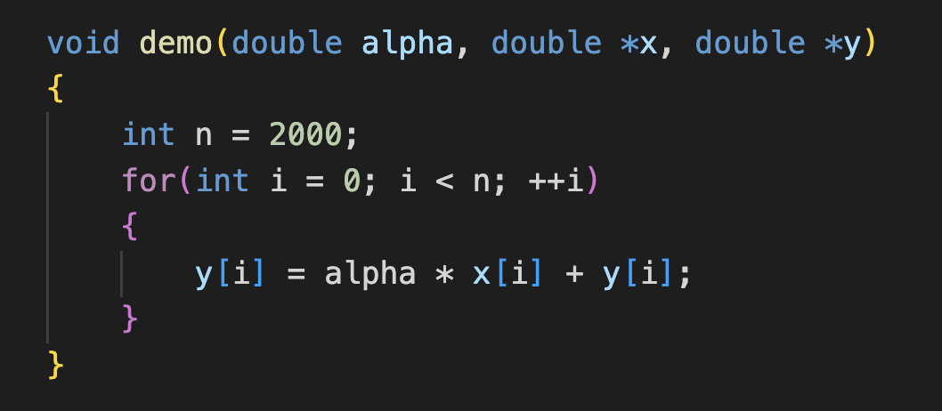
AX+Y 计算 DEMO
2FLOPs：multiply & add
2 Memory Loads: x[i] & y[i] (per element)
Single Operation: FMA(fused multiply-add)

Slide 6
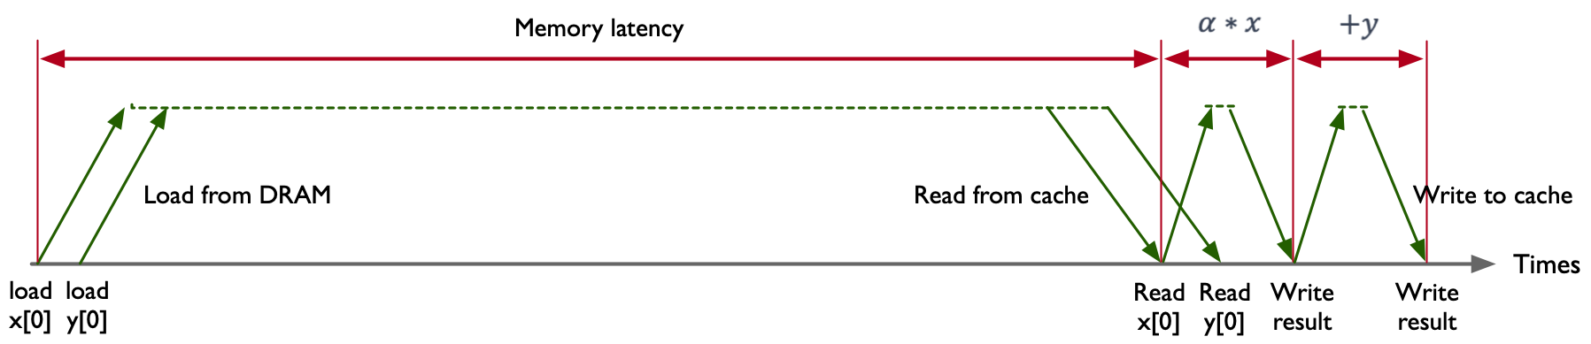
AX+Y 计算 DEMO
2FLOPs：multiply & add
2 Memory Loads: x[i] & y[i] (per element)
Single Operation: FMA(fused multiply-add)

Slide 7
AX+Y 计算 DEMO

Slide 8
光与电的传播速度
Speed of Light = 300,000,000 M/S
Computer Clock = 3,000,000,000 Hz
所以在一个时钟周期内光的传播速度为 100mm

Slide 9
光与电的传播速度
Speed of Light = 300,000,000 M/S
Computer Clock = 3,000,000,000 Hz
Speed of Electricity = 60,000,000 M/S
所以在一个时钟周期电流的传播速度为 20mm

Slide 10
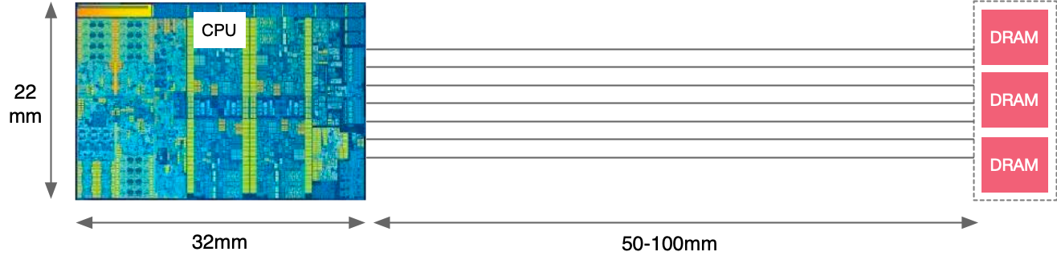
光与电的传播速度
Speed of Light = 300,000,000 M/S
Computer Clock = 3,000,000,000 Hz
Speed of Electricity = 60,000,000 M/S

Slide 11
处理器内部

Slide 12
AX+Y 计算 DEMO
Intel Exon 8280
Memory Bandwidth: 131 GB/sec
Memory latency: 89 ns
11,659 bytes can be moved in 89 ns
AXY demo move 16 byes per 89 ns latency
Memory efficiency = 0.14%

Slide 13
AX+Y 计算 DEMO
memory bus is idle 99.86% of the time

Slide 14
AX+Y 的内存利用率
 | AMD Rome 7742 | Intel Xeon 8280 | NVIDIA A100
Memory B/W(GB/sec) | 204 | 131 | 1555
DRAM Latency(ns) | 122 | 89 | 404
Peak bytes per latency | 24,888 | 11,659 | 628,220
Memory Efficiency | 0.064% | 0.14% | 0.0025%

Slide 15
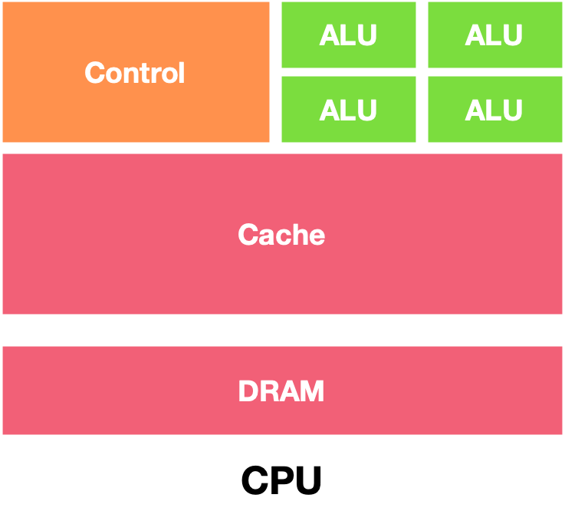
CPU 架构图
CPU主要擅长是逻辑控制，而非计算。

Slide 16
引用
https://www.youtube.com/watch?v=3jHi8E5C-18
https://www.youtube.com/watch?v=-P28LKWTzrI
https://www.youtube.com/watch?v=3l10o0DYJXg

Slide 17
Notes:
17

