Slide 1
RoPE

Slide 2





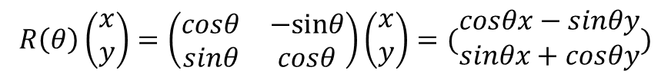

前置数学
旋转矩阵
$$R\left(θ\right)=\left(\begin{matrix}cosθ & −sinθ \\ sinθ & cosθ\end{matrix}\right)$$
逆时针旋转$θ$
$$=cosθ+isinθ=e^{iθ}$$
复数表示
旋转矩阵作用于复平面
$$R\left(θ\right)\left(\begin{matrix}x \\ y\end{matrix}\right)=\left(\begin{matrix}cosθ & −sinθ \\ sinθ & cosθ\end{matrix}\right)\left(\begin{matrix}x \\ y\end{matrix}\right)=(\begin{matrix}cosθx−sinθy \\ sinθx+cosθy\end{matrix})$$
$$=(cosθ+isinθ)(x+iy)$$
共轭复数
$$z=a+ib$$
$$z^{∗}=a−ib$$

Slide 3
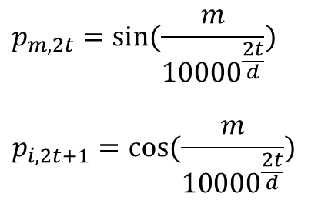








RoPE
定义
$$S_{N}={\{w_{i}\}}_{i=1}^{N}$$
单词token id序列例如[11, 23, 35, 65, 3, 77]
$$E_{N}={\{x_{i}\}}_{i=1}^{N}$$
单词token对应的embedding序列 $R^{d}$
$$f_{qkv}(x_{m}, m)$$
$x_{m}$位置编码函数
绝对位置编码函数
旋转式位置编码
$$f_{qkv}\left(x_{m}, m\right)=W_{qkv}(x_{m}+p_{m})$$
$$p_{m}∈R^{d}$$
$${<f}_{q}\left(x_{m}, m\right), f_{q}\left(x_{n}, n\right)> =g(x_{m},{ x}_{n}, m−n)$$
计算m到n的attention时候，希望引入相对位置信息m-n
$$p_{m,2t}=sin⁡(\frac{m}{{10000}^{\frac{2t}{d}}})$$
$$p_{i,2t+1}=cos⁡(\frac{m}{{10000}^{\frac{2t}{d}}})$$
$$t⊂[0,1,…,d−1]$$

Slide 4



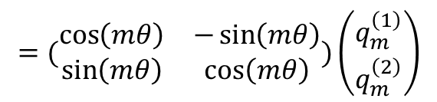

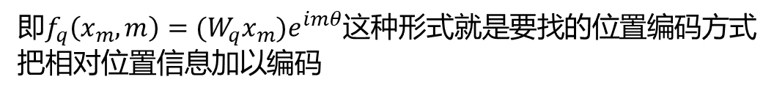

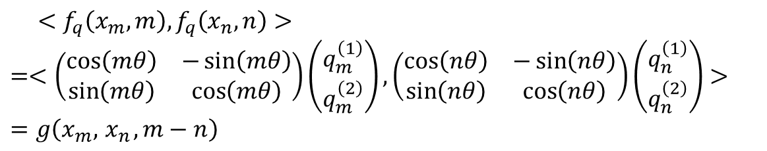

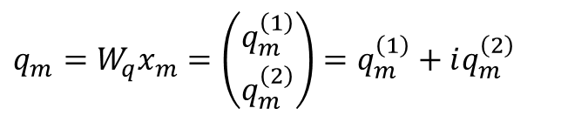
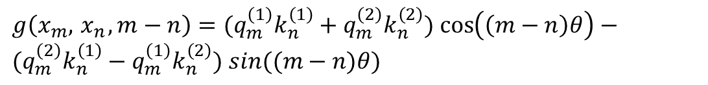
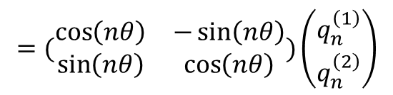
推导
假设d=2
$$W_{q}x_{m}=q_{m}^{\left(1\right)}+iq_{m}^{\left(2\right)}$$
$$g\left(x_{m},{ x}_{n}, m−n\right)=Re[\left(W_{q}x_{m}\right){\left(W_{k}x_{n}\right)}^{∗}e^{i(m−n)θ}]$$
$$W_{k}x_{n}=k_{n}^{\left(1\right)}+ik_{n}^{\left(2\right)}$$
$Re$表示复数的实数部分， ${\left(W_{k}x_{n}\right)}^{∗}$表示$W_{k}x_{n}$的共轭
$${\left(W_{k}x_{n}\right)}^{∗}=k_{n}^{\left(1\right)}−ik_{n}^{\left(2\right)}$$
$$f_{q}\left(x_{m}, m\right)=(W_{q}x_{m})e^{imθ}$$
$$e^{i(m−n)θ}=\cos\left(\left(m−n\right)θ\right)+isin((m−n)θ)$$
$$f_{k}\left(x_{n}, n\right)=(W_{k}x_{n})e^{inθ}$$
$g\left(x_{m},{ x}_{n}, m−n\right)=(q_{m}^{\left(1\right)}k_{n}^{\left(1\right)}+q_{m}^{\left(2\right)}k_{n}^{\left(2\right)})$ $\cos\left(\left(m−n\right)θ\right)−(q_{m}^{\left(2\right)}k_{n}^{\left(1\right)}−q_{m}^{\left(1\right)}k_{n}^{\left(2\right)})$ $sin((m−n)θ)$
$$q_{m}=W_{q}x_{m}=\left(\begin{matrix}q_{m}^{\left(1\right)} \\ q_{m}^{\left(2\right)}\end{matrix}\right)=q_{m}^{\left(1\right)}+iq_{m}^{\left(2\right)}$$
$${ <f}_{q}\left(x_{m}, m\right), f_{q}\left(x_{n}, n\right)>$$
$$=<\left(\begin{matrix}\cos\left(mθ\right) & −\sin\left(mθ\right) \\ \sin\left(mθ\right) & \cos\left(mθ\right)\end{matrix}\right)\left(\begin{matrix}q_{m}^{\left(1\right)} \\ q_{m}^{\left(2\right)}\end{matrix}\right),\left(\begin{matrix}\cos\left(nθ\right) & −\sin\left(nθ\right) \\ \sin\left(nθ\right) & \cos\left(nθ\right)\end{matrix}\right)\left(\begin{matrix}q_{n}^{\left(1\right)} \\ q_{n}^{\left(2\right)}\end{matrix}\right)>$$
$$=g\left(x_{m},{ x}_{n}, m−n\right)$$
$$f_{q}\left(x_{m}, m\right)={(q}_{m}^{\left(1\right)}+iq_{m}^{\left(2\right)})(\cos\left(mθ\right)+isin(mθ))$$
$$=(\begin{matrix}\cos\left(mθ\right) & −\sin\left(mθ\right) \\ \sin\left(mθ\right) & \cos\left(mθ\right)\end{matrix})\left(\begin{matrix}q_{m}^{\left(1\right)} \\ q_{m}^{\left(2\right)}\end{matrix}\right)$$
$$f_{k}\left(x_{n}, n\right)={(q}_{n}^{\left(1\right)}+iq_{n}^{\left(2\right)})(\cos\left(nθ\right)+isin(nθ))$$
即$f_{q}\left(x_{m}, m\right)=(W_{q}x_{m})e^{imθ}$这种形式就是要找的位置编码方式
把相对位置信息加以编码
$$=(\begin{matrix}\cos\left(nθ\right) & −\sin\left(nθ\right) \\ \sin\left(nθ\right) & \cos\left(nθ\right)\end{matrix})\left(\begin{matrix}q_{n}^{\left(1\right)} \\ q_{n}^{\left(2\right)}\end{matrix}\right)$$

Slide 5


词向量维度一般化
$$f_{q}\left(x_{m}, m\right)=(W_{q}x_{m})e^{imθ}$$
对于 token 序列中的每个词嵌入向量，首先计算其对应的 query 和 key 向量，然后对每个 token 位置都计算对应的旋转位置编码，接着对每个 token 位置的 query 和 key 向量的元素按照 两两一组 应用旋转变换，最后再计算 query 和 key 之间的内积得到 self-attention 的计算结果。
$$f_{k}\left(x_{n}, n\right)=(W_{k}x_{n})e^{inθ}$$

