Slide 1
H T T P
(Hyper Text Transfer Protocol)

Slide 2

Agenda
HTTP 개요
HTTP 동작방식
  요청(request)
  응답(response)
HTTP 요청방법
  GET
  POST
  URL 구조

Slide 3
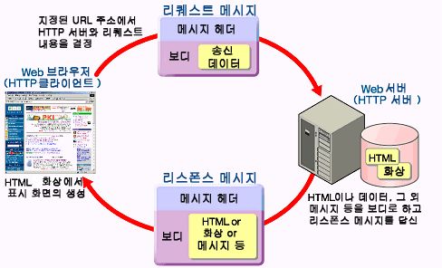
HTTP 개요
Notes:
Reduce complexity and improve communication between teams

Slide 4
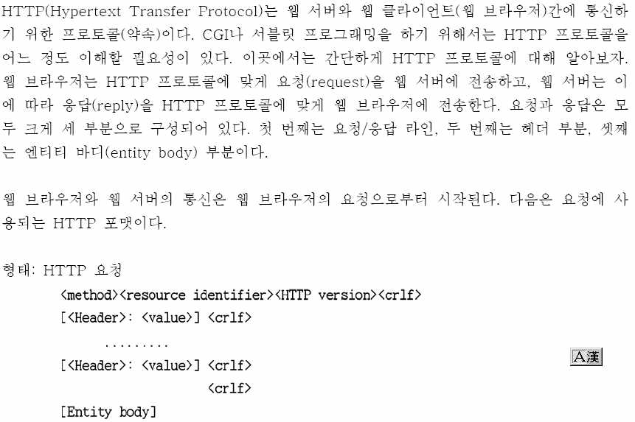
HTTP 동작방식
Notes:
Reduce complexity and improve communication between teams

Slide 5
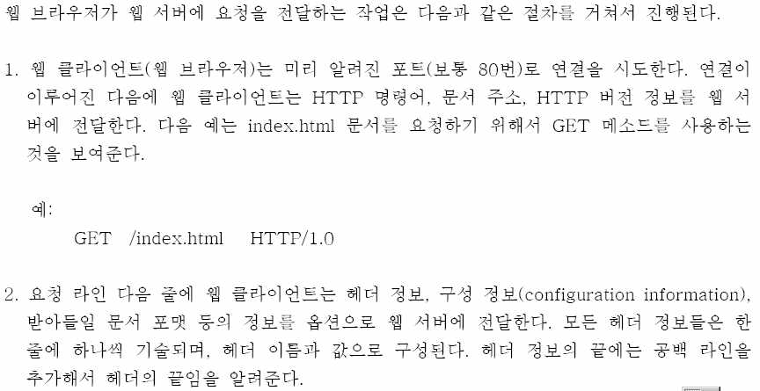
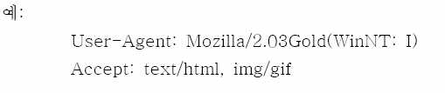
HTTP 동작방식 (요청1)
Notes:
Reduce complexity and improve communication between teams

Slide 6
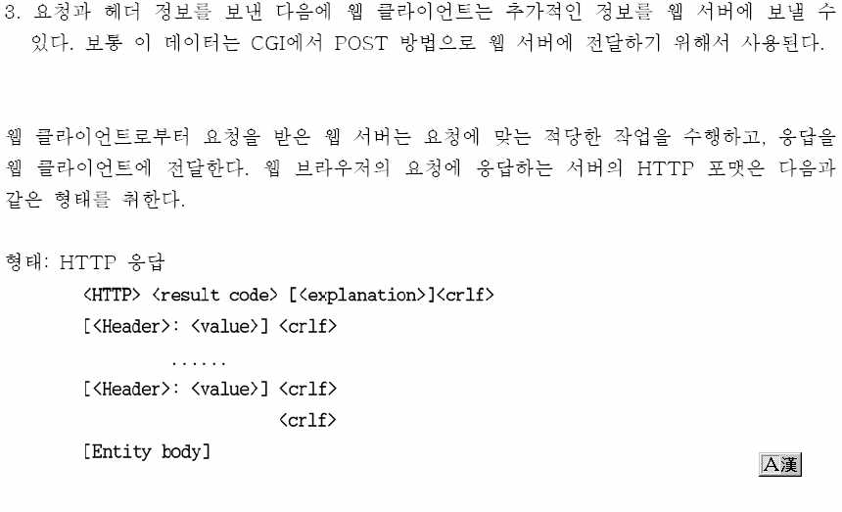
HTTP 동작방식 (요청2)
Notes:
Reduce complexity and improve communication between teams

Slide 7
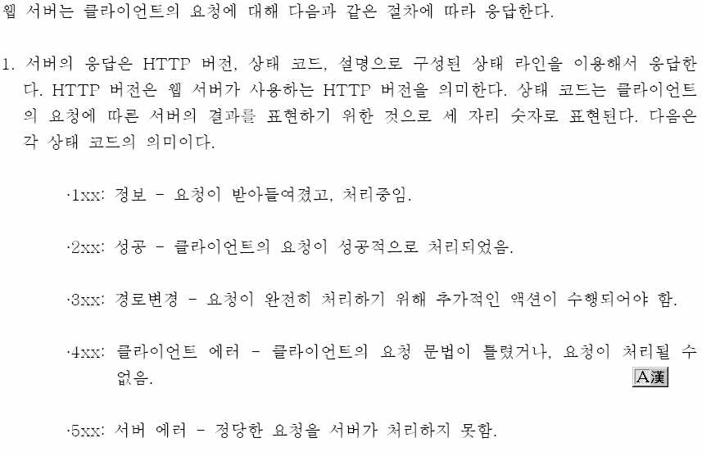
HTTP 동작방식 (응답1)
Notes:
Reduce complexity and improve communication between teams

Slide 8

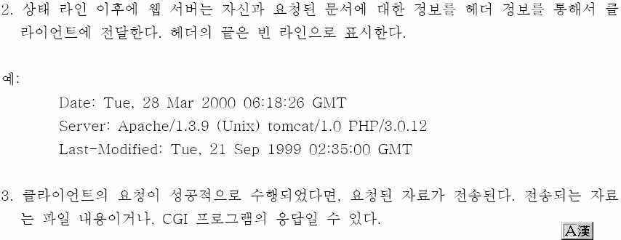
HTTP 동작방식 (응답2)
Notes:
Reduce complexity and improve communication between teams

Slide 9
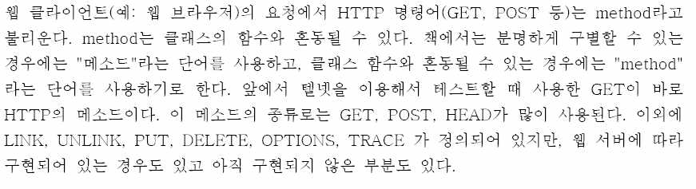
HTTP 요청방식
Notes:
Reduce complexity and improve communication between teams

Slide 10
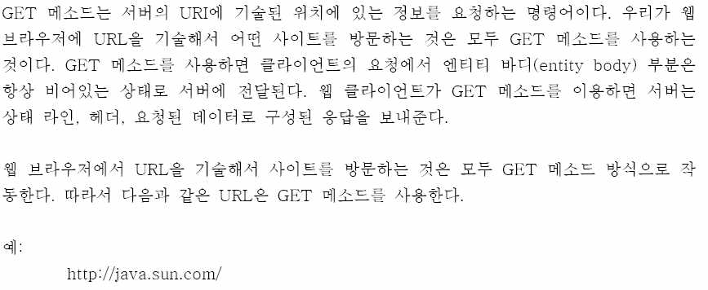
HTTP 요청방식-GET 메쏘드
Notes:
Reduce complexity and improve communication between teams

Slide 11
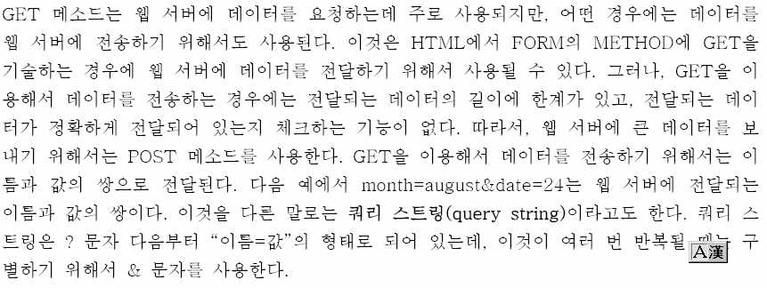
HTTP 요청방식-POST 메쏘드
Notes:
Reduce complexity and improve communication between teams

Slide 12
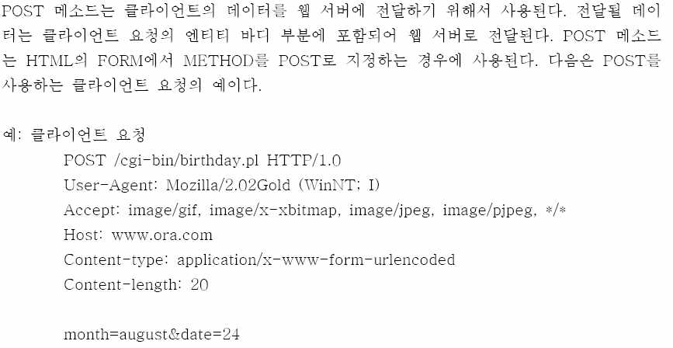
HTTP 요청방식-POST 메쏘드
Notes:
Reduce complexity and improve communication between teams

Slide 13
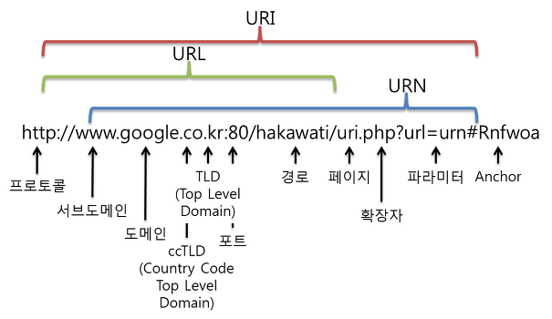
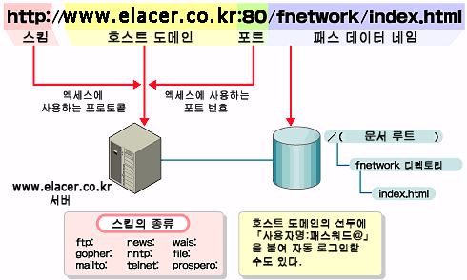
URL 구조
Notes:
Reduce complexity and improve communication between teams

Slide 14
THANK YOU

