Slide 1
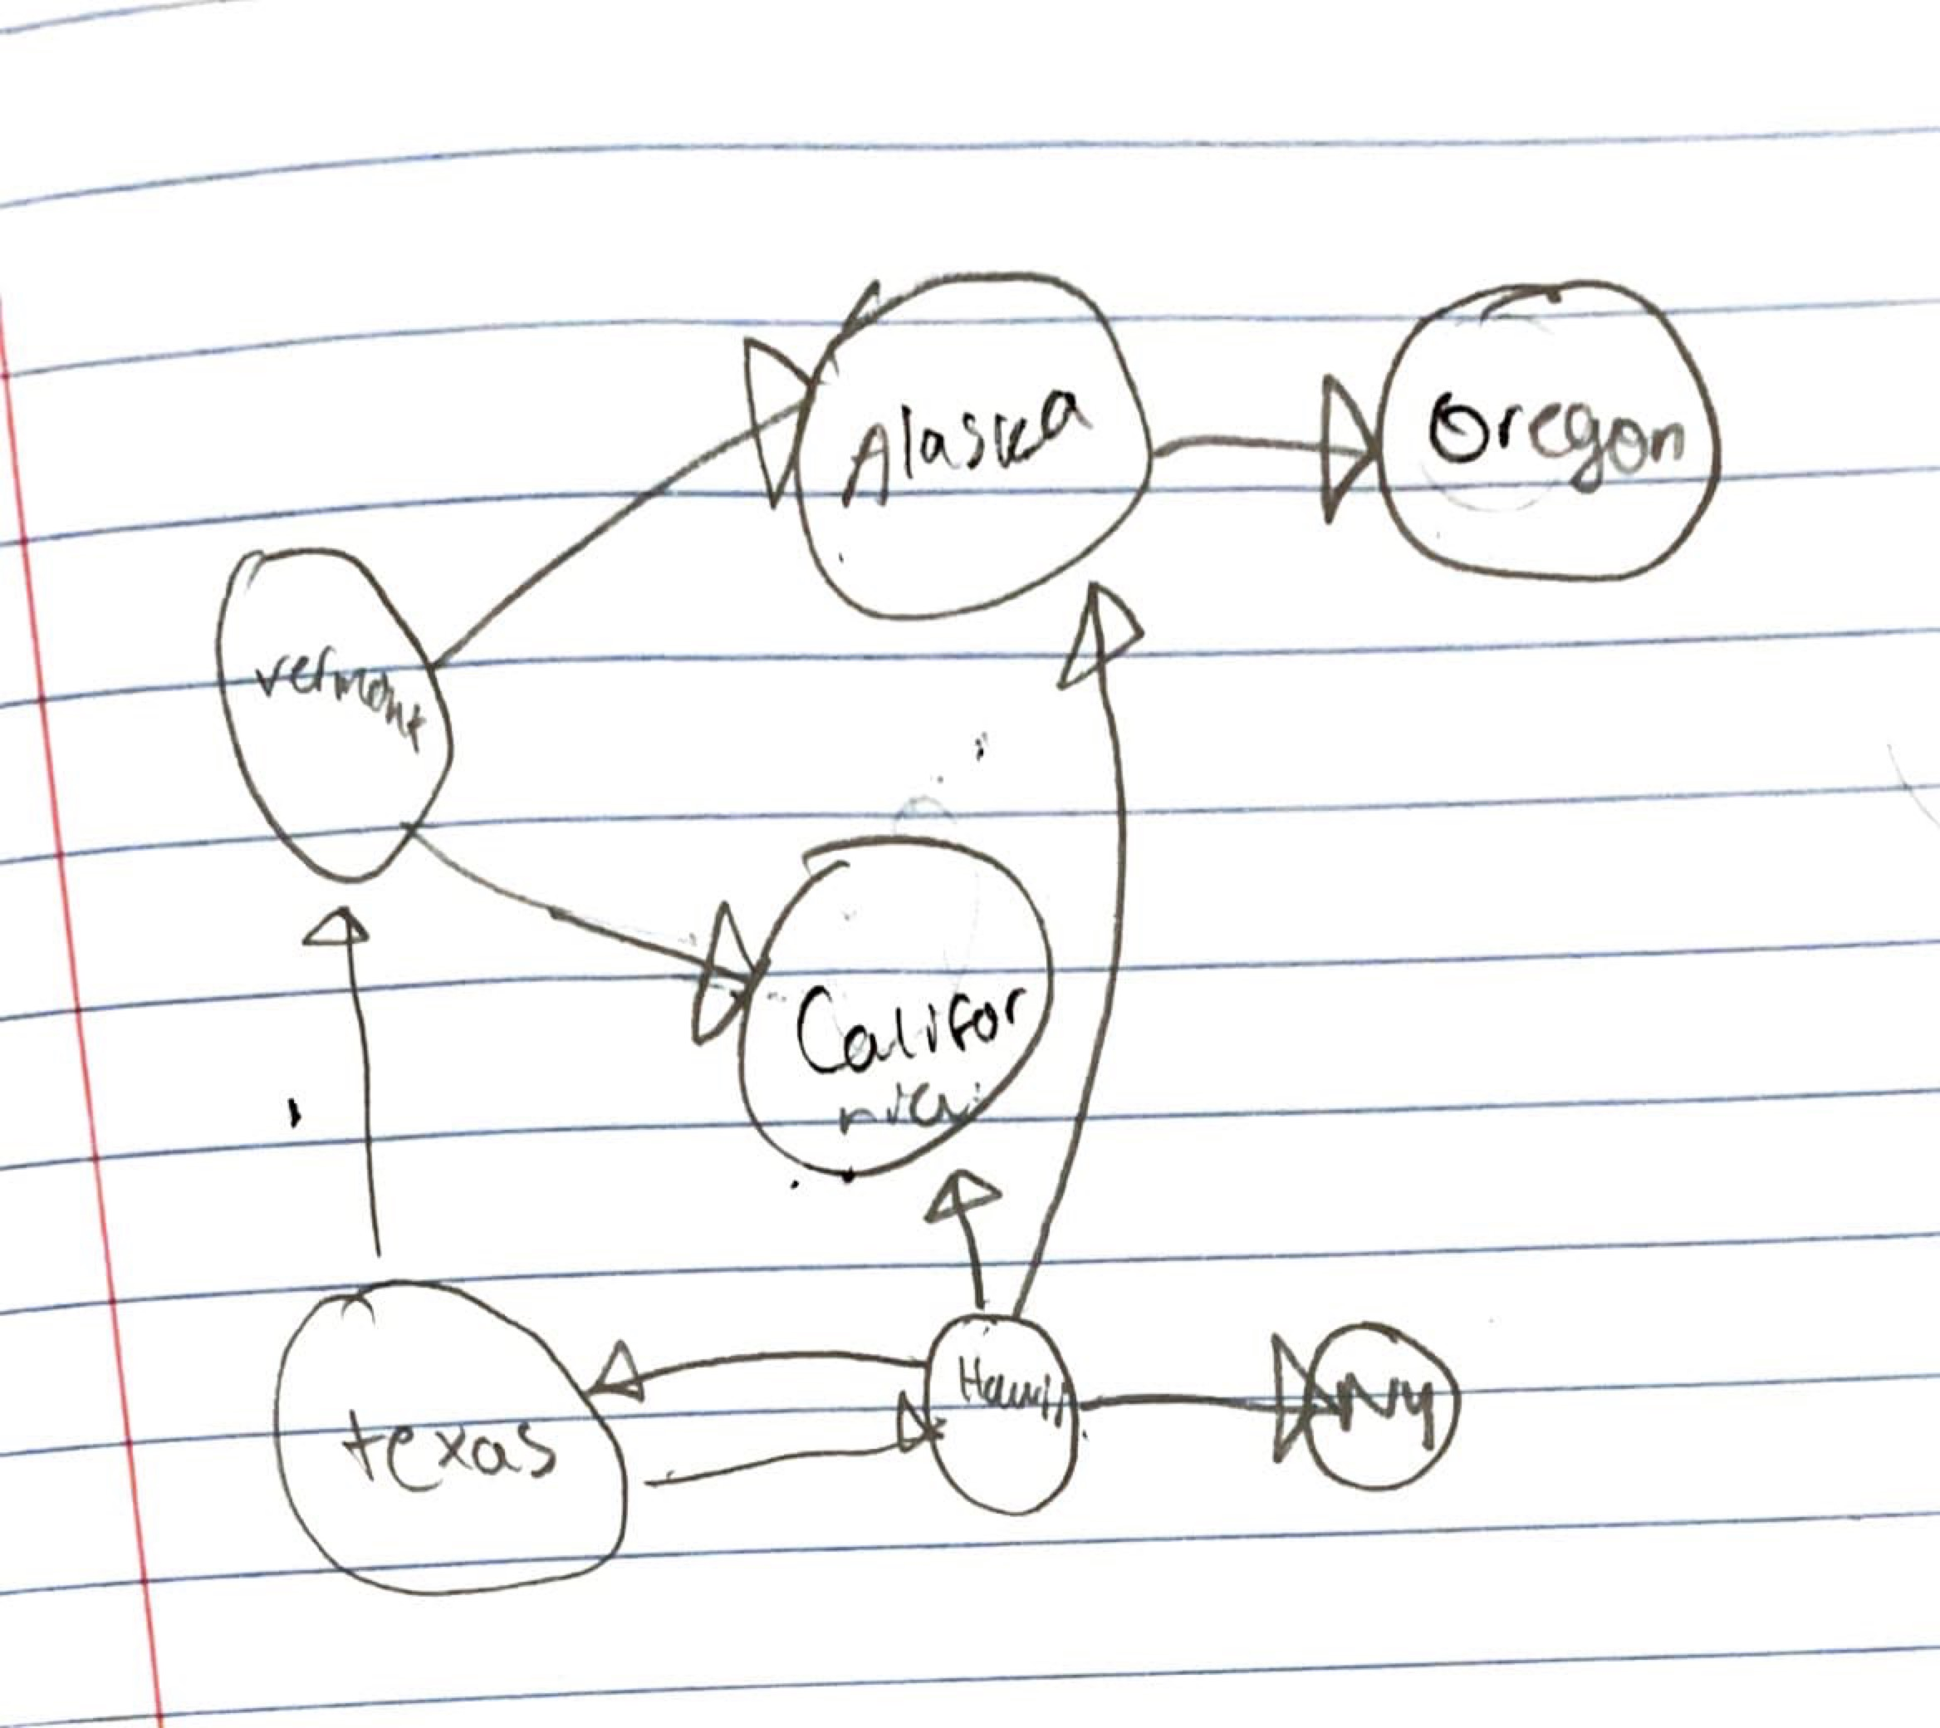
CMSC204
Kartchner
V(StateGraph) = {Oregon, Alaska, Texas, Hawaii, Vermont, NewYork, California}
E(StateGraph) = {(Alaska, Oregon), (Hawaii, Alaska), (Hawaii, Texas), (Texas, Hawaii), (Hawaii, California), (Hawaii, New York), (Texas, Vermont), (Vermont, California), (Vermont, Alaska)}
1. Draw the StateGraph
{Oregon, Alaska, Texas, Hawaii, Vermont, NewYork, California}
{(Alaska, Oregon), (Hawaii, Alaska), (Hawaii, Texas), (Texas, Hawaii), (Hawaii, California), (Hawaii, New York), (Texas, Vermont), (Vermont, California), (Vermont, Alaska)}

Slide 2

a. Show the adjacency matrix that would describe the edges in the graph. Store the vertices in alphabetical order
States
Alaska
California
Hawii
New York
Oregon
Texas
Vermont
 | A | C | H | NY | O | T | V
A | 0 | 0 | 1 | 0 | 0 | 0 | 1
C | 0 | 0 | 1 | 0 | 0 | 0 | 1
H | 0 | 0 | 0 | 0 | 0 | 0 | 0
NY | 0 | 0 | 1 | 0 | 0 | 0 | 0
O | 1 | 0 | 0 | 0 | 0 | 0 | 0
T | 0 | 0 | 1 | 0 | 0 | 0 | 0
V | 0 | 0 | 0 | 0 | 0 | 1 | 0
3. b. Show the adjacency lists
that would describe the edges in the graph
Alaska
California
Hawaii
New York
Oregon
Texas
Vermont
Oregon Null
Null
Texas Vermont→California→ Null
Null
Null
Hawaii→Alaska→Oregon→Null
Alaska→Oregon→Null

Slide 3
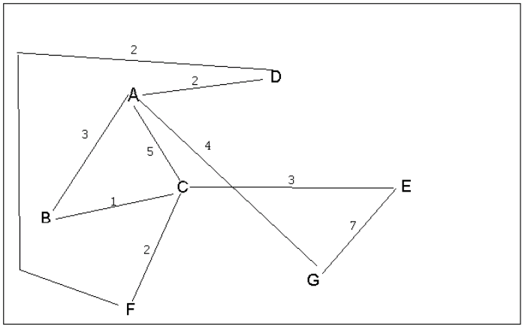
4 a. Which of the following lists the graph nodes in depth first order beginning with E?
A) E, G, F, C, D, B, A
B) G, A, E, C, B, F, D
C) E, G, A, D, F, C, B
D) E, C, F, B, A, D, G
4 b. Which of the following lists the graph nodes in breadth first order beginning at F?
A) F, C, D, A, B, E, G
B) F, D, C, A, B, C, G
C) F, C, D, B, G, A, E
D) a, b, and c are all breadth first traversals

Slide 4
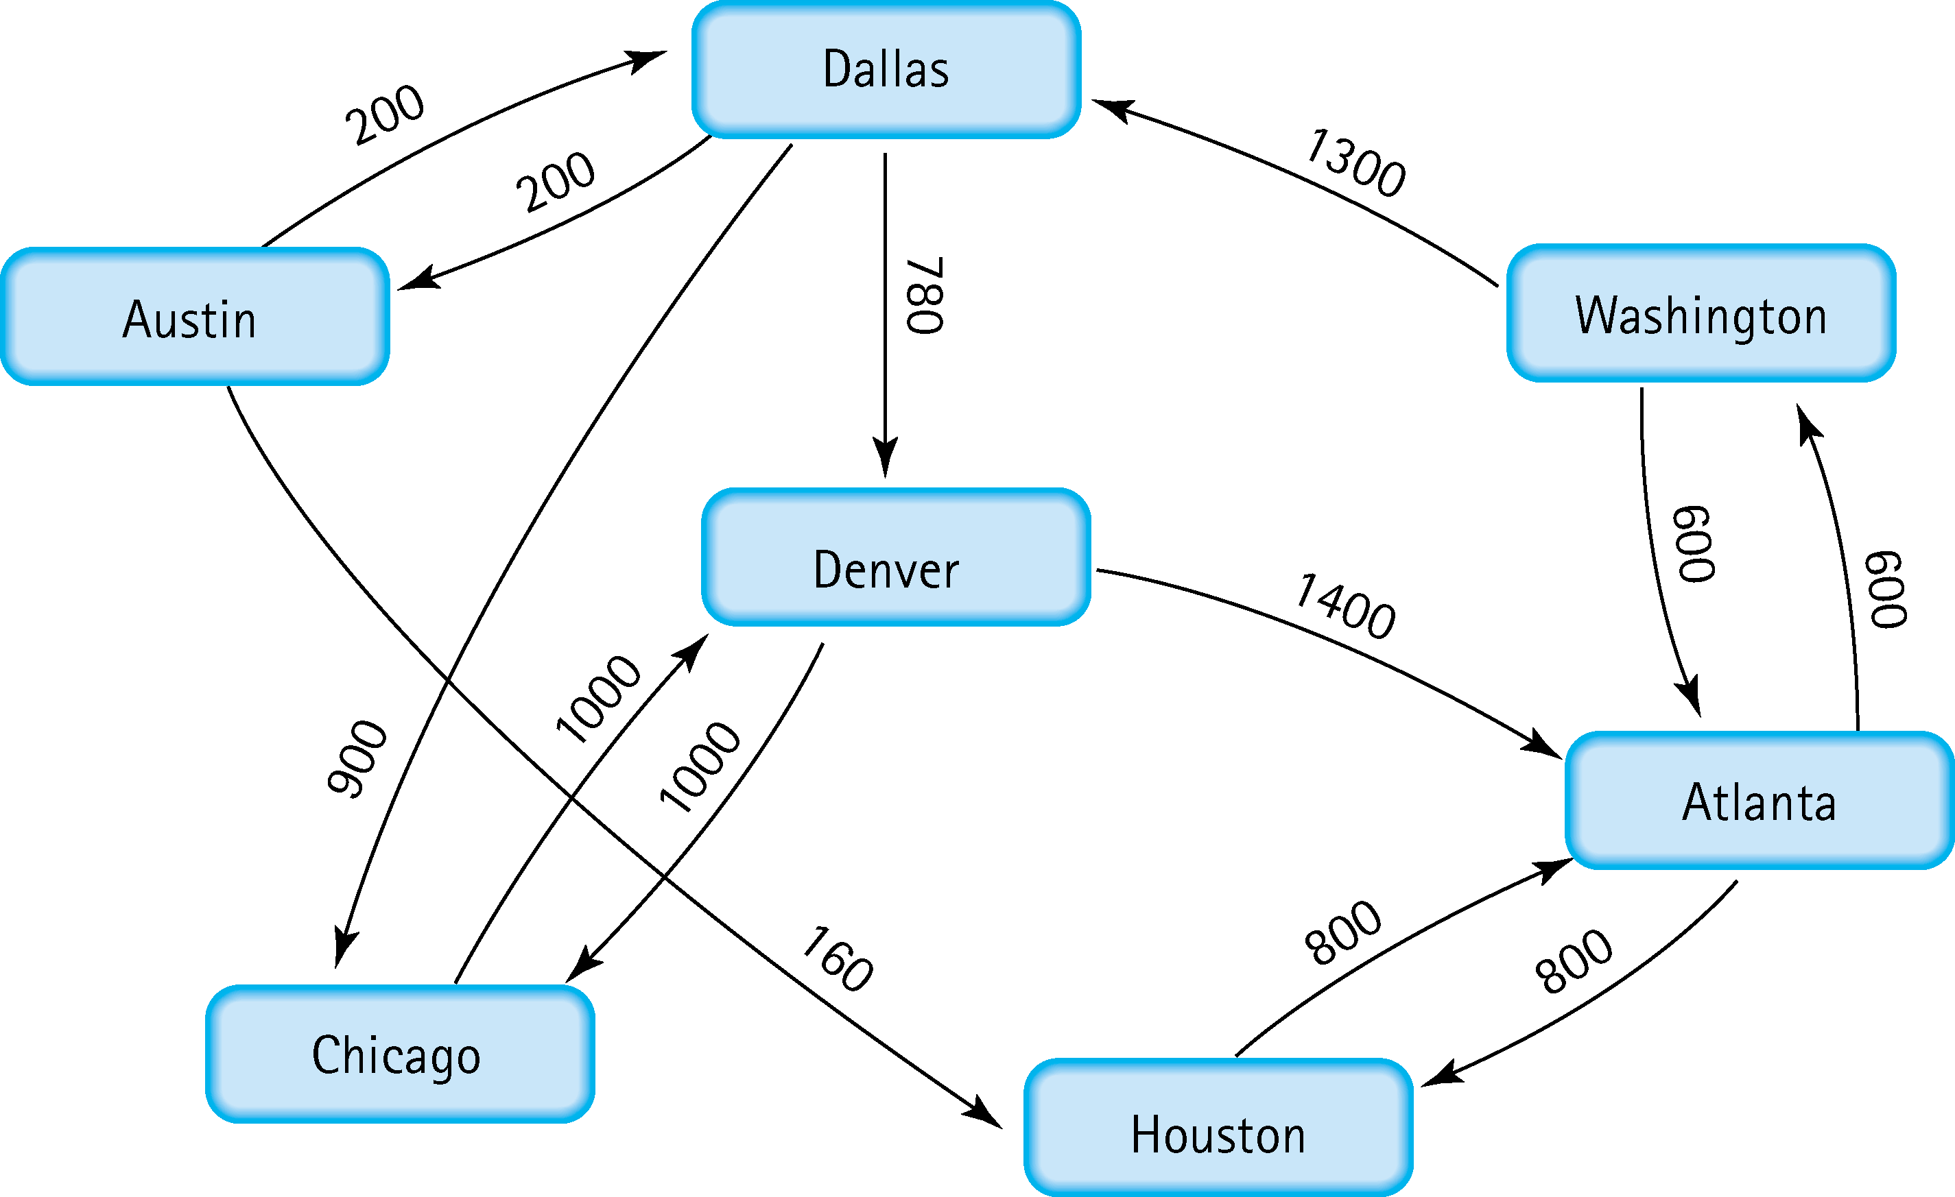
5. Find the shortest distance from Atlanta to every other city
Atlanta→Washington
Atlanta→Houston
Atlanta→Washington→Dallas
Atlanta→Washington→Dallas→Austin
Atlanta→Washington→Dallas→Chicago
Atlanta→Washington→Dallas→Denver

Slide 5
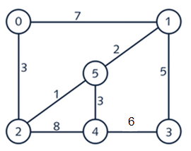


6. Find the minimal spanning tree using Prim’s algorithm. Use
0 as the source vertex . Show the steps.

Slide 6



7. Find the minimal spanning tree using Kruskal’s algorithm.
Show the weights in order and the steps.

Slide 7
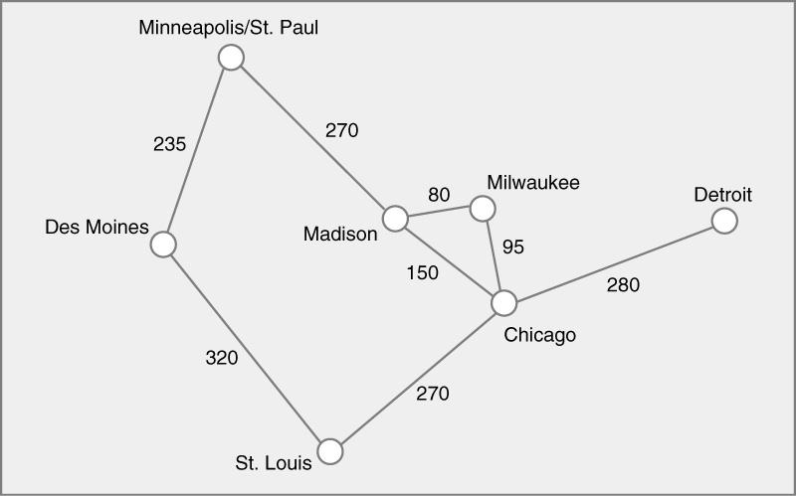
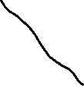

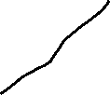

8. Find the minimal spanning tree using the algorithm you prefer. Use
Minneapolis/St. Paul as the source vertex

Slide 8
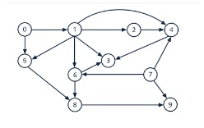
9. List the nodes of the graph in a breadth first topological ordering. Show the
steps using arrays predCount, topologicalOrder and a queue
0 → 1 →2→5→7→6→8→4→3→9

Slide 9
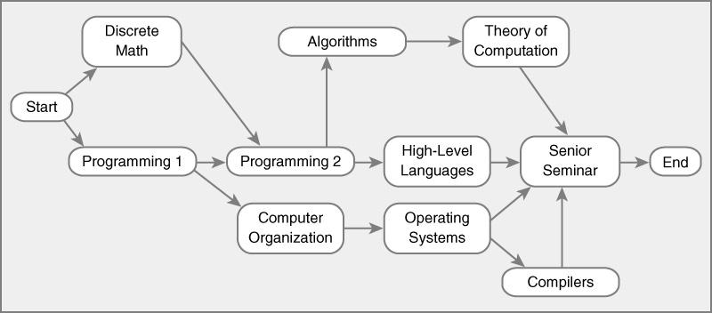
10. List the nodes of the graph in a breadth first topological ordering.
Start→Discrete Math→Programming 1→Programming 2→ Computer Organization → Algorithms → High-Levl Lang → Operating Systems → Theory of Computation → Compilers → Senior Seminar → End

