Slide 1





SSD: Single Shot MultiBox Detector
Wei Liu(1), Dragomir Anguelov(2), Dumitru Erhan(3), Christian Szegedy(3), Scott Reed(4), Cheng-Yang Fu(1), Alexander C. Berg(1)
UNC Chapel Hill(1), Zoox Inc.(2), Google Inc.(3), University of Michigan(4)

Slide 2
80
VOC2007 test mAP
Faster R-CNN, Ren 2015 73% mAP / 7 fps
70
Fast R-CNN, Girshick 2015 70% mAP / 0.4 fps
R-CNN, Girshick 2014
66% mAP / 0.02 fps
YOLO, Redmon 2016
66% mAP / 21 fps
All with VGGNet pretrained on ImageNet, batch_size = 1 on Titan X
30 40 50
Speed (fps)
10
20

Slide 3
80
VOC2007 test mAP
Faster R-CNN, Ren 2015 73% mAP / 7 fps
6.6x faster
SSD300
74% mAP / 46 fps
70
Fast R-CNN, Girshick 2015 70% mAP / 0.4 fps
R-CNN, Girshick 2014
66% mAP / 0.02 fps
YOLO, Redmon 2016
66% mAP / 21 fps
All with VGGNet pretrained on ImageNet, batch_size = 1 on Titan X
30 40 50
Speed (fps)
10
20

Slide 4
80
SSD512
77% mAP / 19 fps
VOC2007 test mAP
Faster R-CNN, Ren 2015 73% mAP / 7 fps
SSD300
74% mAP / 46 fps
11% better
70
Fast R-CNN, Girshick 2015 70% mAP / 0.4 fps
R-CNN, Girshick 2014
66% mAP / 0.02 fps
YOLO, Redmon 2016
66% mAP / 21 fps
All with VGGNet pretrained on ImageNet, batch_size = 1 on Titan X
30 40 50
Speed (fps)
10
20

Slide 5
80
SSD512
80% mAP / 19 fps
SSD300
77% mAP / 46 fps
VOC2007 test mAP
Faster R-CNN, Ren 2015 73% mAP / 7 fps
Single Shot
Two-Stage
box proposal + postclassify
70
Fast R-CNN, Girshick 2015
70% mAP / 0.4 fps
R-CNN, Girshick 2014
YOLO, Redmon 2016
66% mAP / 0.02 fps
66% mAP / 21 fps
10
20
30
Speed (fps)
40
50

Slide 6
Bounding Box Prediction
Classical sliding windows

Slide 7
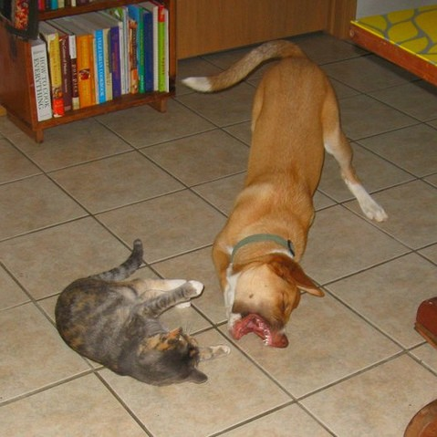
Bounding Box Prediction
Classical sliding windows
Is it a cat? No

Slide 8
Bounding Box Prediction
Classical sliding windows
Is it a cat? No
Discretize the box space densely
Notes:
滑动窗口，是对要检测空间的稠密采样

Slide 9

Bounding Box Prediction
Classical sliding windows
SSD and other deep approaches
Is it a cat? No
Discretize the box space densely
Notes:
窗口搜索策略：SSD 将输出一系列 离散化（discretization） 的 bounding boxes，这些 bounding boxes 是在 不同层次（layers） 上的 feature maps 上生成的，并且有着不同的 aspect ratio。

Slide 10
Bounding Box Prediction
Classical sliding windows
SSD and other deep approaches
Is it a cat? No
Discretize the box space densely

Slide 11
Bounding Box Prediction
Classical sliding windows
SSD and other deep approaches
Is it a cat? No
Discretize the box space densely
cat: 0.8 dog: 0.1
Notes:
精确位置定位

Slide 12
Bounding Box Prediction
Classical sliding windows
SSD and other deep approaches
Is it a cat? No
Discretize the box space densely

Slide 13
Bounding Box Prediction
Classical sliding windows
SSD and other deep approaches
Is it a cat? No
Discretize the box space densely

Slide 14
Bounding Box Prediction
Classical sliding windows
SSD and other deep approaches
Is it a cat? No
Discretize the box space densely

Slide 15
Bounding Box Prediction
Classical sliding windows
SSD and other deep approaches
dog: 0.4 cat: 0.2
Is it a cat? No
Discretize the box space densely

Slide 16
Bounding Box Prediction
Classical sliding windows
SSD and other deep approaches
dog: 0.4 cat: 0.2
Discretize the box space more coarsely Refine the coordinates of each box
Is it a cat? No
Discretize the box space densely
Notes:
先离散化候选框空间粗糙地，然后微调

Slide 17
SSD Output Layer
ConvNet
feature map

Slide 18
SSD Output Layer
ConvNet
small (e.g. 3x3) conv kernel
feature map

Slide 19
SSD Output Layer
ConvNet
default box small (e.g. 3x3)
conv kernel
feature map
Notes:
默认框，(anchor)

Slide 20
SSD Output Layer
box regression
multiclass probabilities
ConvNet
feature map

Slide 21
SSD Training
Match default boxes to ground truth boxes to determine true/false positives.
Loss = SmoothL1(box param) + Softmax(class prob)
Smooth L1 loss
box regression
Softmax loss
multiclass probabilities
ConvNet
feature map
Notes:
Match 跟训练时很相关，

Slide 22
Related Work

Slide 23
Related Work
MultiBox [Erhan et al. CVPR14]
P(objectness) for K boxes
Fully connected
Offsets for K boxes

Slide 24
Related Work
MultiBox [Erhan et al. CVPR14]
P(objectness) for K boxes
Fully connected
+
post classify boxes
Offsets for K boxes

Slide 25
Related Work
MultiBox [Erhan et al. CVPR14]
YOLO [Redmon et al. CVPR16]
P(objectness) for K boxes
multiclass prob for K boxes
Fully connected
Fully connected
+
post classify boxes
Offsets for K boxes
Offsets for K boxes

Slide 26
Related Work
MultiBox [Erhan et al. CVPR14]
YOLO [Redmon et al. CVPR16]
P(objectness) for K boxes
multiclass prob for K boxes
Fully connected
Fully connected
+
post classify boxes
Offsets for K boxes
Offsets for K boxes
Faster R-CNN [Ren et al. NIPS15]
P(objectness) Box offsets
Convolutional

Slide 27
Related Work
MultiBox [Erhan et al. CVPR14]
YOLO [Redmon et al. CVPR16]
P(objectness) for K boxes
multiclass prob for K boxes
Fully connected
Fully connected
+
post classify boxes
Offsets for K boxes
Offsets for K boxes
Faster R-CNN [Ren et al. NIPS15]
P(objectness) Box offsets
+
post classify boxes
Convolutional

Slide 28
Related Work
MultiBox [Erhan et al. CVPR14]
YOLO [Redmon et al. CVPR16]
P(objectness) for K boxes
multiclass prob for K boxes
Fully connected
Fully connected
+
post classify boxes
Offsets for K boxes
Offsets for K boxes
Faster R-CNN [Ren et al. NIPS15]
P(objectness) Box offsets
SSD
multiclass prob
Box offsets
+
post classify boxes
Convolutional
Convolutional
Notes:
每一个添加的特征层（或者在基础网络结构中的特征层），可以使用一系列 convolutional filters，去产生一系列固定大小的 predictions，具体见 Fig.2。对于一个大小为 m×n ，具有 p 通道的特征层，使用的 convolutional filters 就是 3×3×p 的 kernels。产生的 predictions，那么就是归属类别的一个得分，要么就是相对于 default box coordinate 的 shape offsets。 在每一个 m×n 的特征图位置上，使用上面的 3×3 的 kernel，会产生一个输出值。bounding box offset 值是输出的 default box 与此时 feature map location 之间的相对距离（YOLO 架构则是用一个全连接层来代替这里的卷积层）。

Slide 29

Contribution #1:
Multi-Scale Feature Maps
box regression
multiclass scores
ConvNet
Notes:
多尺度特征图,

Slide 30
Contribution #1:
Multi-Scale Feature Maps
box regression
multiclass scores
ConvNet
stride 2 convolution
Notes:
SSD 是基于一个前向传播 CNN 网络，产生一系列 固定大小（fixed-size） 的 bounding boxes，以及每一个 box 中包含物体实例的可能性，即 score。之后，进行一个 非极大值抑制（Non-maximum suppression） 得到最终的 predictions。

Slide 31
Contribution #1:
Multi-Scale Feature Maps
box regression
multiclass scores
box multiclass
regression
scores
ConvNet
stride 2 convolution
Notes:
多个卷积层上做，会有一个问题是，对于每个添加的特征层，我们使用一组卷积滤波器，可以得到一组固定数目的目标检测的预测 。对于一个尺寸为m*n，p通道的特征层，我们使用一个 3*3*p 的小核作为一个基础元素来预测一个可能检测的信息（类别信息，位置信息）.
如果使用同一个网络中的、不同层上的 feature maps，也可以达到相同的效果，同时在所有物体尺度中共享参数。
SSD 结构中，default boxes 不必要与每一层 layer 的 receptive fields 对应。本文的设计中，feature map 中特定的位置，来负责图像中特定的区域，以及物体特定的尺寸。加入我们用 m 个 feature maps 来做 predictions，每一个 feature map 中 default box 的尺寸大小计算如下：

Slide 32
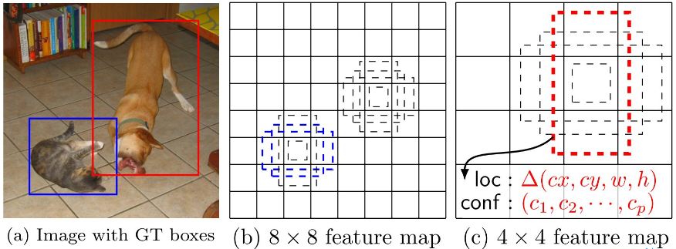
Multi-Scale Feature Maps
Notes:
先弄清楚下文所说的 default box 以及 feature map cell 是什么。看下图：
feature map cell 就是将 feature map 切分成 8×8 或者 4×4 之后的一个个 格子；
而 default box 就是每一个格子上，一系列固定大小的 box，即图中虚线所形成的一系列 boxes。

Slide 33
Multi-Scale Feature Maps
Faster R-CNN Objectness
SSD
Proposal, Ren 2015
vs.
4X4 feature map
8X 8 feature map
8X8 feature map
Notes:
在 Faster R-CNN中使用了 anchor boxes 实现不同大小和宽高比的物体提取 ，本文使用了类似的一组 default bounding boxes，和 Faster R-CNN 主要区别在于，我们是在不同尺度的特征层上进行 这些default bounding boxes 检测运算的。
每一个 box 相对于与其对应的 feature map cell 的位置是固定的。 在每一个 feature map cell 中，我们要 predict 得到的 box 与 default box 之间的 offsets，以及每一个 box 中包含物体的 score（每一个类别概率都要计算出）。 因此，对于一个位置上的 k 个boxes 中的每一个 box，我们需要计算出 c 个类，每一个类的 score，还有这个 box 相对于 它的默认 box 的 4 个偏移值（offsets）。于是，在 feature map 中的每一个 feature map cell 上，就需要有 (c+4)×k 个 filters。对于一张 m×n 大小的 feature map，即会产生 (c+4)×k×m×n 个输出结果。

Slide 34
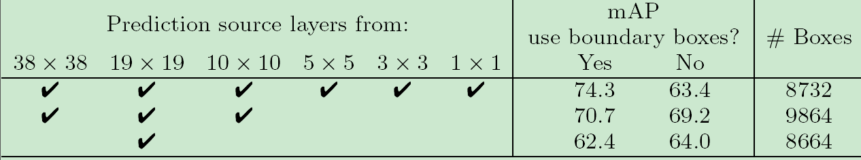
Multi-Scale Feature Maps Experiment

Slide 35
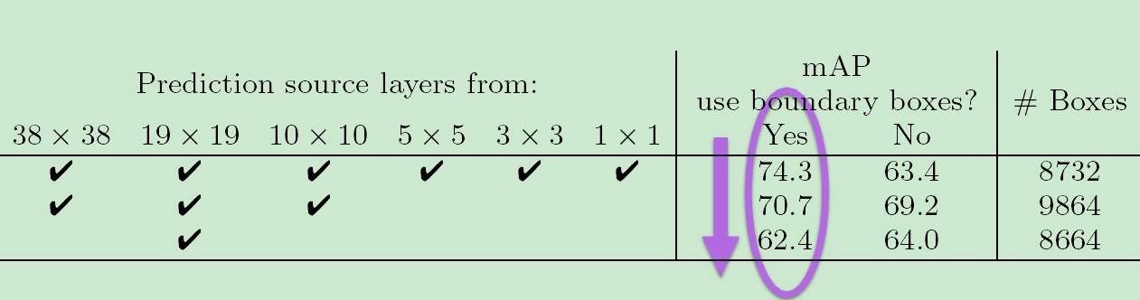
Multi-Scale Feature Maps Experiment

Slide 36

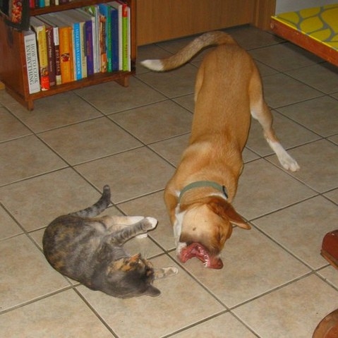

Multi-Scale Feature Maps Experiment
Prediction source layers from: |  |  |  |  |  | mAP use boundary boxes?
38 x38 | 19 x19 | 10 x10 | 5 x5 | 3 x3 | 1 x1 | Yes | No
4 | 4 | 4 | 4 | 4 | 4 | 74.3 | 63.4
4 | 4 | 4 |  |  |  | 70.7 | 69.2
 | 4 |  |  |  |  | 62.4 | 64.0
#Boxes
8732
9864
8664

Slide 37
Multi-Scale Feature Maps Experiment
Prediction source layers from: |  |  |  |  |  | mAP use boundary boxes?
38 x38 | 19 x19 | 10 x10 | 5 x5 | 3 x3 | 1 x1 | Yes | No
4 | 4 | 4 | 4 | 4 | 4 | 74.3 | 63.4
4 | 4 | 4 |  |  |  | 70.7 | 69.2
 | 4 |  |  |  |  | 62.4 | 64.0
# Boxes
8732
9864
8664
boundary boxes

Slide 38
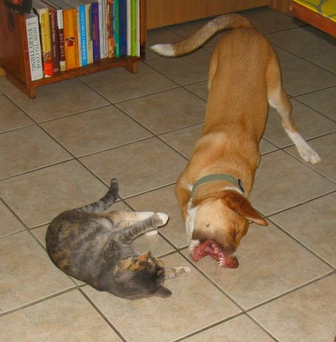
Contribution #2:
Splitting the Region Space
ConvNet
convolution

Slide 39
Contribution #2:
Splitting the Region Space
ConvNet
convolution
 | SSD300
include { ¹ , 2} box? 2 include { ¹ , 3} box? 3 | 4 4 4
number of Boxes | 3880 7760 8732
VOC2007 test mAP | 71.6 73.7 74.3
Notes:
我们的改进包括使用小卷积滤波器来预测边界框位置中的对象类别和偏移，使用用于不同宽高比检测的单独的预测器（滤波器），并且将这些滤波器应用于来自网络的后期的多个特征图以便执行 多尺度检测。

Slide 40
Contribution #2:
Splitting the Region Space
ConvNet
convolution
Use 38x38 feature map : +2.5 mAP
(conv4_3)
Notes:
Matching strategy：
如何将 groundtruth boxes 与 default boxes 进行配对，以组成 label 呢？
在开始的时候，用 MultiBox 中的 best jaccard overlap 来匹配每一个 ground truth box 与 default box，这样就能保证每一个 groundtruth box 与唯一的一个 default box 对应起来。
但是又不同于 MultiBox ，本文之后又将 default box 与任何的 groundtruth box 配对，只要两者之间的jaccard overlap 大于一个阈值，这里本文的阈值为 0.5。

Slide 41
Why So Many Default Boxes?
 | Faster R-CNN | YOLO | SSD300 | SSD512
# Default Boxes | 6000 | 98 | 8732 | 24564
Resolution | 1000x600 | 448x448 | 300x300 | 512x512

Slide 42
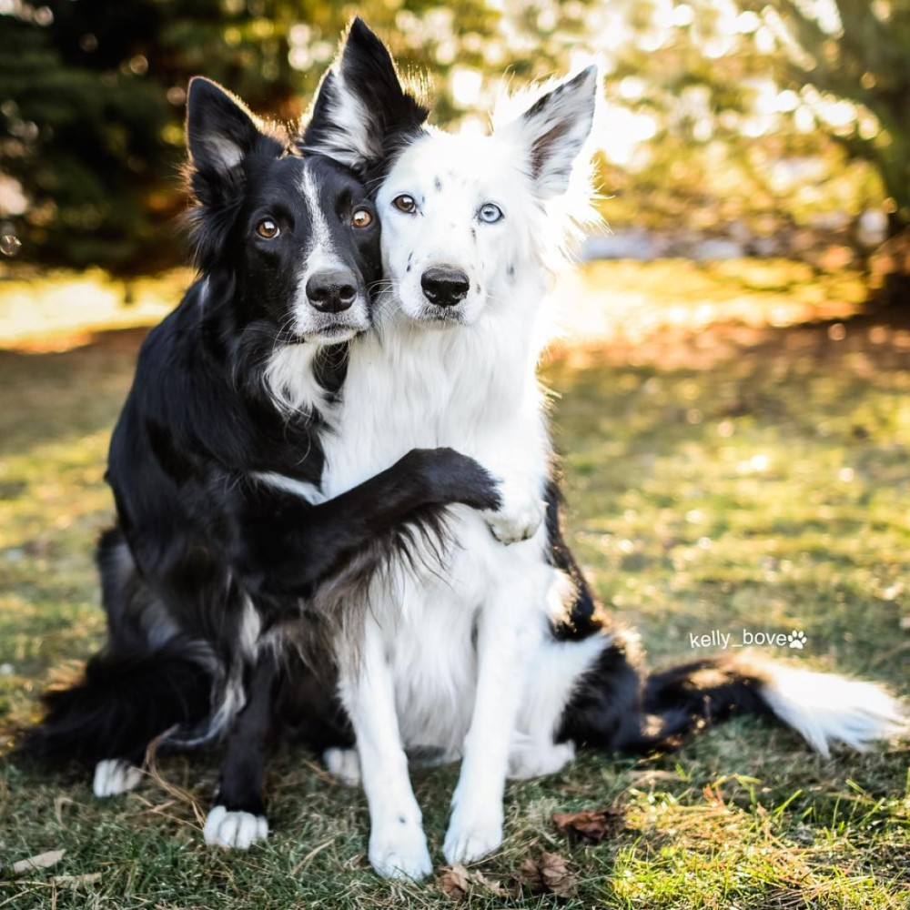
Why So Many Default Boxes?
 | Faster R-CNN | YOLO | SSD300 | SSD512
# Default Boxes | 6000 | 98 | 8732 | 24564
Resolution | 1000x600 | 448x448 | 300x300 | 512x512

Slide 43


Why So Many Default Boxes?
Faster R-CNN YOLO SSD300 SSD512
# Default Boxes 6000 98 8732 24564
Resolution 1000x600 448x448 300x300 512x512
GT

Slide 44

Why So Many Default Boxes?
 | Faster R-CNN | YOLO | SSD300 | SSD512
# Default Boxes | 6000 | 98 | 8732 | 24564
Resolution | 1000x600 | 448x448 | 300x300 | 512x512
GT
DETECTION

Slide 45
Why So Many Default Boxes?
 | Faster R-CNN | YOLO | SSD300 | SSD512
# Default Boxes | 6000 | 98 | 8732 | 24564
Resolution | 1000x600 | 448x448 | 300x300 | 512x512
GT
DETECTION
SmoothL1 or L2 loss for box shape averages among likely hypotheses

Slide 46
Why So Many Default Boxes?
 | Faster R-CNN | YOLO | SSD300 | SSD512
# Default Boxes | 6000 | 98 | 8732 | 24564
Resolution | 1000x600 | 448x448 | 300x300 | 512x512
GT
DETECTION
SmoothL1 or L2 loss for box shape averages among likely hypotheses
Need to have enough default boxes (discrete bins) to do accurate regression in each

Slide 47
Why So Many Default Boxes?
 | Faster R-CNN | YOLO | SSD300 | SSD512
# Default Boxes | 6000 | 98 | 8732 | 24564
Resolution | 1000x600 | 448x448 | 300x300 | 512x512
GT
DETECTION
SmoothL1 or L2 loss for box shape averages among likely hypotheses
Need to have enough default boxes (discrete bins) to do accurate regression in each
General principle for regressing complex continuous outputs with deep nets

Slide 48
Handling Many Default Boxes

Slide 49
Handling Many Default Boxes
•
Matching ground truth and default boxes

Slide 50
Handling Many Default Boxes
•
Matching ground truth and default boxes
GT
`
`

Slide 51


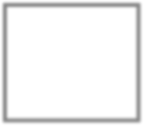
Handling Many Default Boxes
•
Matching ground truth and default boxes
GT
Default box
`
`

Slide 52
Handling Many Default Boxes
•
Matching ground truth and default boxes
GT
Default box
FP
TP
`
TP
`

Slide 53
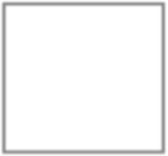
Handling Many Default Boxes
•
Matching ground truth and default boxes
GT
Default box
FP
TP
?`
TP
`

Slide 54
Handling Many Default Boxes
•
Matching ground truth and default boxes
GT
Default box
FP
TP
‣
Match each GT box to closest default box
?`
TP
`

Slide 55
Handling Many Default Boxes
•
Matching ground truth and default boxes
GT
Default box
FP
TP
‣
Match each GT box to closest default box
‣
Also match each GT box to all unassigned default boxes with IoU > 0.5
?
`
TP
`

Slide 56
Handling Many Default Boxes
•
Matching ground truth and default boxes
GT
Default box
FP
TP
‣
Match each GT box to closest default box
‣
Also match each GT box to all unassigned default boxes with IoU > 0.5
?
`
TP
•
Hard negative mining
`

Slide 57
Handling Many Default Boxes
•
Matching ground truth and default boxes
GT
Default box
FP
TP
‣
Match each GT box to closest default box
‣
Also match each GT box to all unassigned default boxes with IoU > 0.5
?
`
TP
•
Hard negative mining
`
•
Unbalanced training: 1-30 TP, 8k-25k FP

Slide 58
Handling Many Default Boxes
•
Matching ground truth and default boxes
GT
Default box
FP
TP
‣
Match each GT box to closest default box
‣
Also match each GT box to all unassigned default boxes with IoU > 0.5
?
`
TP
•
Hard negative mining
`
•
Unbalanced training: 1-30 TP, 8k-25k FP
•
Keep TP:FP ratio fixed (1:3), use worst- misclassified FPs.

Slide 59
SSD Architecture
Extra Convolutional Feature Maps
VGG16
Classifier : Conv: 3x3x(3x(Classes+4))
Classifier : Conv: 3x3x(6x(Classes+4))
Detections:8732 per Class
Non-Maximum Suppression
SSD
300
38
19
74.3mAP
46FPS
image
10
Conv: 3x3x(4x(Classes+4))
5
5
300
38
19
10
3
1

Slide 60
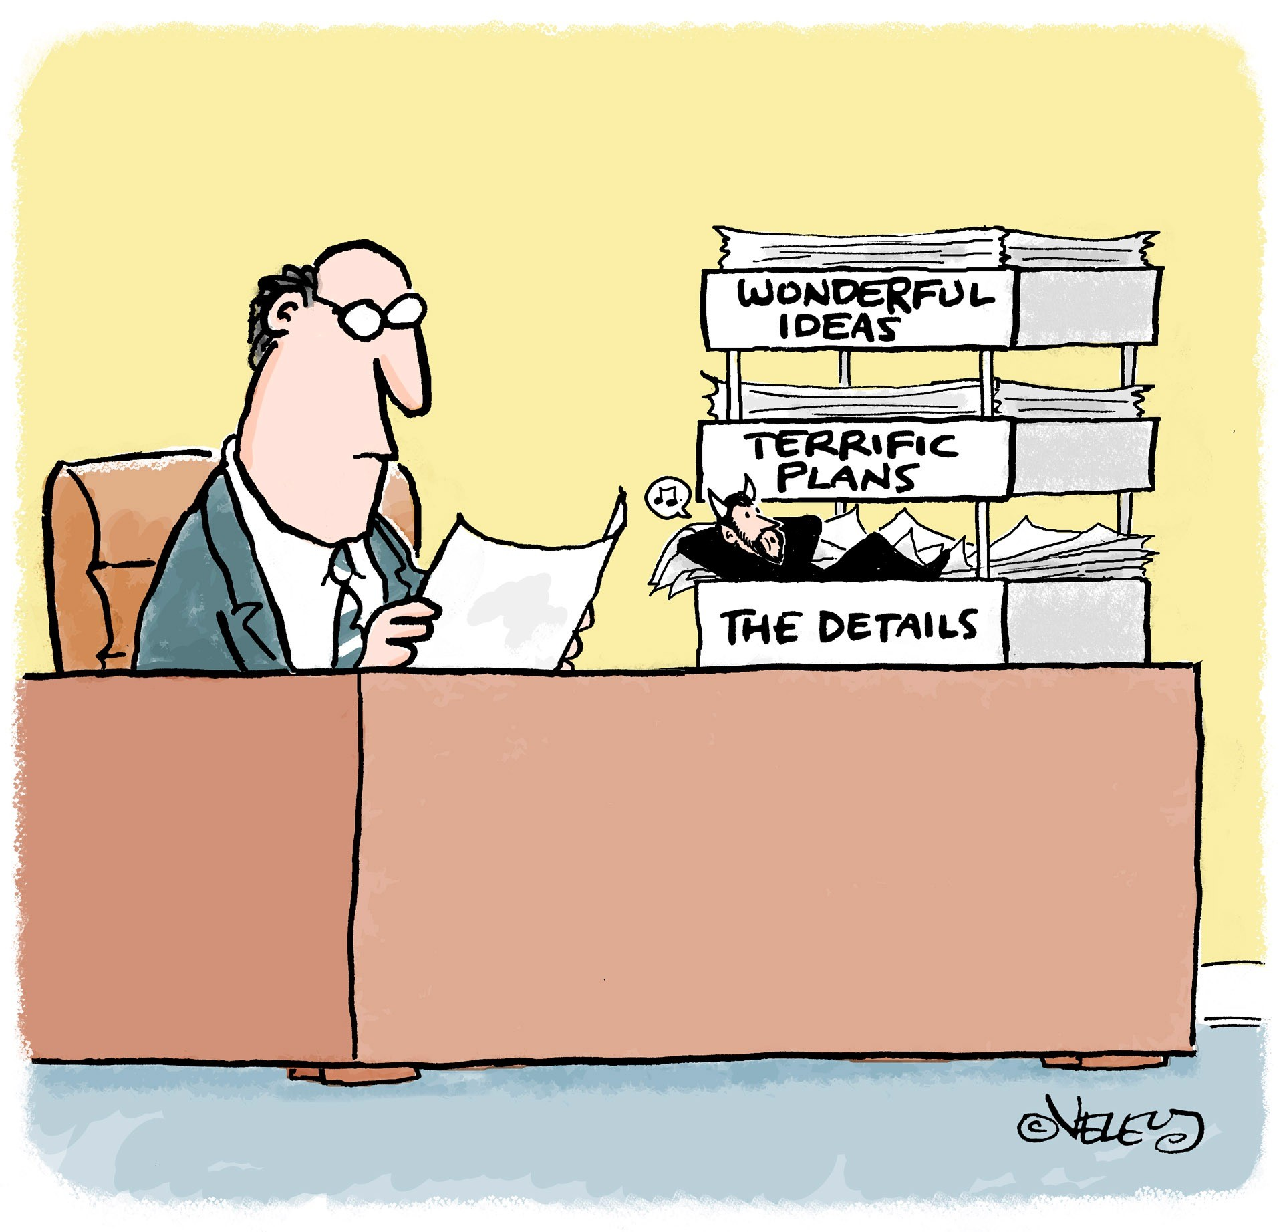
Contribution #3:
The Devil is in the Details

Slide 61
Data Augmentation

Slide 62
Data Augmentation
`
`

Slide 63
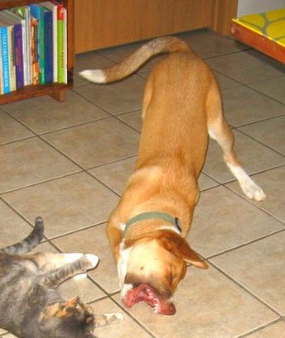
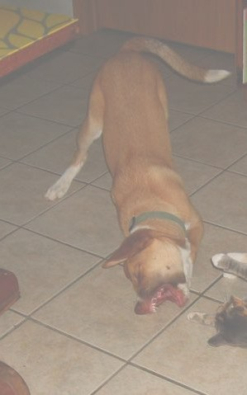
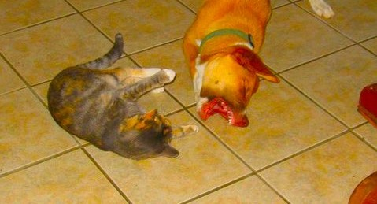
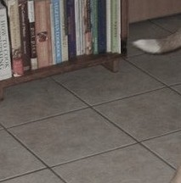
Data Augmentation
`
`
`
`
`

Slide 64
Data Augmentation
`
`
`
`
`
data augmentation | SSD300
horizontal flip random crop & color distortion | 4 4 4
VOC2007 test mAP | 65.5 74.3

Slide 65
Data Augmentation

Slide 66
Data Augmentation
`
`

Slide 67
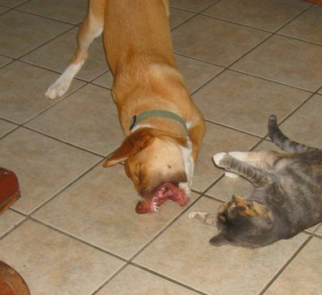
Data Augmentation
`
`
`
`
`
`
Random expansion creates more
small training examples

Slide 68
Data Augmentation
`
`
`
`
`
`
Random expansion creates more
small training examples
data augmentation | SSD300
horizontal flip random crop & color distortion random expansion | 4 4 4 4 4 4
VOC2007 test mAP | 65.5 74.3 77.2

Slide 69
Results on VOC2007 test
Method | mAP | FPS | batch size | # Boxes | Input resolution
Faster R-CNN (VGG16) | 73.2 | 7 | 1 | ⇠ 6000 | ⇠ 1000 x600
Fast YOLO YOLO (VGG16) | 52.7 66.4 | 155 21 | 1 1 | 98 98 | 448 x448 448 x448
SSD300 SSD512 SSD300 SSD512 | 74.3 76.8 74.3 76.8 | 46 19 59 22 | 1 1 8 8 | 8732 24564 8732 24564 | 300 x300 512 x512 300 x300 512 x512

Slide 70
Results on VOC2007 test
Method |  | mAP | FPS | batch size | # Boxes | Input resolution
Faster R-CNN (VGG16) |  | 73.2 | 7 | 1 | ⇠ 6000 | ⇠ 1000 x600
Fast YOLO |  | 52.7 | 155 | 1 | 98 | 448 x448
YOLO (VGG16) |  | 66.4 | 21 | 1 | 98 | 448 x448
SSD300 6.6x |  | 74.3 | 46 | 1 | 8732 | 300 x300
SSD512 | 76.8 |  | 19 | 1 | 24564 | 512 x512
SSD300 | 74.3 |  | 59 | 8 | 8732 | 300 x300
SSD512 | 76.8 |  | 22 | 8 | 24564 | 512 x512

Slide 71
Results on VOC2007 test
Method | mAP | FPS | batch size | # Boxes | Input resolution
Faster R-CNN (VGG16) | 73.2 | 7 | 1 | ⇠ 6000 | ⇠ 1000 x600
Fast YOLO YOLO (VGG16) | 52.7 66.4 | 155 21 | 1 1 | 98 98 | 448 x448 448 x448
SSD300 SSD512 SSD300 SSD512 | 74.3 76.8 74.3 76.8 | 46 19 59 22 | 1 1 8 8 | 8732 24564 8732 24564 | 300 x300 512 x512 300 x300 512 x512

Slide 72
Results on VOC2007 test
Method |  | mAP | FPS | batch size | # Boxes | Input resolution
Faster R-CNN (VGG16) |  | 73.2 | 7 | 1 | ⇠ 6000 | ⇠ 1000 x600
Fast YOLO |  | 52.7 | 155 | 1 | 98 | 448 x448
YOLO (VGG16) |  | 66.4 | 21 | 1 | 98 | 448 x448
SSD300 |  | 74.3 | 46 | 1 | 8732 | 300 x300
SSD512 10% | 76.8 |  | 19 | 1 | 24564 | 512 x512
SSD300 | 74.3 |  | 59 | 8 | 8732 | 300 x300
SSD512 | 76.8 |  | 22 | 8 | 24564 | 512 x512

Slide 73
Results on VOC2007 test
Method | mAP | FPS | batch size | # Boxes | Input resolution
Faster R-CNN (VGG16) | 73.2 | 7 | 1 | ⇠ 6000 | ⇠ 1000 x600
Fast YOLO YOLO (VGG16) | 52.7 66.4 | 155 21 | 1 1 | 98 98 | 448 x448 448 x448
SSD300 SSD512 SSD300 SSD512 | 74.3 76.8 74.3 76.8 | 46 19 59 22 | 1 1 8 8 | 8732 24564 8732 24564 | 300 x300 512 x512 300 x300 512 x512

Slide 74
Results on VOC2007 test
Method | mAP | FPS | batch size | # Boxes | Input resolution
Faster R-CNN (VGG16) | 73.2 | 7 | 1 | ⇠ 6000 | ⇠ 1000 x600
Fast YOLO | 52.7 | 155 | 1 | 98 | 448 x448
YOLO (VGG16) | 66.4 | 21 | 1 | 98 | 448 x448
SSD300 | 74.3 | 46 | 1 | 8732 | 300 x300
SSD512 | 76.8 | 19 | 1 | 24564 | 512 x512
SSD300 | 74.3 | 59 | 8 | 8732 | 300 x300
SSD512 | 76.8 | 22 | 8 | 24564 | 512 x512

Slide 75
Results on VOC2007 test
Method | mAP | FPS | batch size | # Boxes | Input resolution
Faster R-CNN (VGG16) | 73.2 | 7 | 1 | ⇠ 6000 | ⇠ 1000 x600
Fast YOLO YOLO (VGG16) | 52.7 66.4 | 155 21 | 1 1 | 98 98 | 448 x448 448 x448
SSD300 SSD512 SSD300 SSD512 | 74.3 76.8 74.3 76.8 | 46 19 59 22 | 1 1 8 8 | 8732 24564 8732 24564 | 300 x300 512 x512 300 x300 512 x512

Slide 76

Results on VOC2007 test
Method | mAP | FPS | batch size | # Boxes | Input resolution
Faster R-CNN (VGG16) | 73.2 | 7 | 1 | ⇠ 6000 | ⇠ 1000 x600
Fast YOLO YOLO (VGG16) | 52.7 66.4 | 155 21 | 1 1 | 98 98 | 448 x448 448 x448
SSD300 _{77.2} SSD512 _{79.8} SSD300 77.2 SSD512 79.8 | 74.3 76.8 74.3 76.8 | 46 19 59 22 | 1 1 8 8 | 8732 24564 8732 24564 | 300 x300 512 x512 300 x300 512 x512

Slide 77
Results on More Datasets

Slide 78
Results on More Datasets
Method
Method
Method | VOC2007 VOC2012 MS COCO ILSVRC2014 test test test-dev val2
Fast R-CNN Faster R-CNN YOLO | 70.0 | 68.4 | 19.7 | N/A
 | 73.2 | 70.4 | 21.9 | N/A
 | 63.4 | 57.9 | N/A | N/A
VOC2007
test
VOC2007
test
VOC2012
test
VOC2012
test
MS COCO
test-dev
MS COCO
test-dev
ILSVRC2014
val2
ILSVRC2014
val2
Fast R-CNN
Fast R-CNN
70.0
70.0
68.4
68.4
19.7
19.7
N/A
N/A
Faster R-CNN
73.2
70.4
21.9
N/A

Slide 79
Results on More Datasets
Method
Method
Method
VOC2007
test
VOC2007
test
VOC2007
test
VOC2012
test
VOC2012
test
VOC2012
test
MS COCO
test-dev
MS COCO
test-dev
MS COCO
test-dev
ILSVRC2014
val2
ILSVRC2014
val2
ILSVRC2014
val2
VOC2007 VOC2012 MS COCO ILSVRC2014
test test test-dev val2
Method
Fast R-CNN Faster R-CNN YOLO | 70.0 68.4 | 19.7 | N/A
 | 73.2 70.4 | 21.9 | N/A
 | 63.4 57.9 | N/A | N/A
Fast R-CNN
Fast R-CNN
Fast R-CNN
70.0
70.0
70.0
68.4
68.4
68.4
19.7
19.7
19.7
N/A
N/A
N/A
Faster R-CNN
Faster R-CNN
73.2
73.2
70.4
70.4
21.9
21.9
N/A
N/A
YOLO
63.4
57.9
N/A
N/A
SSD300
74.3
72.4
23.2
43.4

Slide 80
Results on More Datasets
Method
Method
Method
Method
VOC2007
test
VOC2007
test
VOC2007
test
VOC2007
test
VOC2012
test
VOC2012
test
VOC2012
test
VOC2012
test
MS COCO
test-dev
MS COCO
test-dev
MS COCO
test-dev
MS COCO
test-dev
ILSVRC2014
val2
ILSVRC2014
val2
ILSVRC2014
val2
ILSVRC2014
val2
VOC2007 VOC2012 MS COCO ILSVRC2014
test test test-dev val2
Method
Fast R-CNN Faster R-CNN YOLO | 70.0 68.4 | 19.7 | N/A
 | 73.2 70.4 | 21.9 | N/A
 | 63.4 57.9 | N/A | N/A
Fast R-CNN
Fast R-CNN
Fast R-CNN
Fast R-CNN
70.0
70.0
70.0
70.0
68.4
68.4
68.4
68.4
19.7
19.7
19.7
19.7
N/A
N/A
N/A
N/A
Faster R-CNN
Faster R-CNN
Faster R-CNN
73.2
73.2
73.2
70.4
70.4
70.4
21.9
21.9
21.9
N/A
N/A
N/A
YOLO
YOLO
63.4
63.4
57.9
57.9
N/A
N/A
N/A
N/A
SSD300
74.3
72.4
23.2
43.4
SSD300 | 74.3 | 72.4 | 23.2 | 43.4
SSD512 | 76.8 | 74.9 | 26.8 | 46.4

Slide 81
Results on More Datasets
Method
Method
Method
Method
Method
VOC2007
test
VOC2007
test
VOC2007
test
VOC2007
test
VOC2007
test
VOC2012
test
VOC2012
test
VOC2012
test
VOC2012
test
VOC2012
test
MS COCO
test-dev
MS COCO
test-dev
MS COCO
test-dev
MS COCO
test-dev
MS COCO
test-dev
ILSVRC2014
val2
ILSVRC2014
val2
ILSVRC2014
val2
ILSVRC2014
val2
ILSVRC2014
val2
VOC2007 VOC2012 MS COCO ILSVRC2014
test test test-dev val2
Method
Fast R-CNN Faster R-CNN YOLO | 70.0 68.4 | 19.7 | N/A
 | 73.2 70.4 | 21.9 | N/A
 | 63.4 57.9 | N/A | N/A
Fast R-CNN
Fast R-CNN
Fast R-CNN
Fast R-CNN
Fast R-CNN
70.0
70.0
70.0
70.0
70.0
68.4
68.4
68.4
68.4
68.4
19.7
19.7
19.7
19.7
19.7
N/A
N/A
N/A
N/A
N/A
Faster R-CNN
Faster R-CNN
Faster R-CNN
Faster R-CNN
73.2
73.2
73.2
73.2
70.4
70.4
70.4
70.4
21.9
21.9
21.9
21.9
N/A
N/A
N/A
N/A
YOLO
YOLO
YOLO
63.4
63.4
63.4
57.9
57.9
57.9
N/A
N/A
N/A
N/A
N/A
N/A
SSD300
SSD300
74.3
74.3
72.4
72.4
23.2
23.2
43.4
43.4
SSD300* | 77.2 | 75.8 | 25.1 | N/A
SSD512* | 79.8 | 78.5 | 28.8 | N/A
SSD512
76.8
74.9
26.8
46.4

Slide 82
COCO Bounding Box precision

Slide 83
COCO Bounding Box precision
mAP @ IoU 0.5 0.75 0.5:0.95
Faster R-CNN SSD512* | 45.3 | 23.5 | 24.2
 | 48.5 | 30.3 | 28.8
gain
+3.2
+6.8
+4.6

Slide 84
Future Work

Slide 85
Future Work
•
Object detection + pose estimation

Slide 86
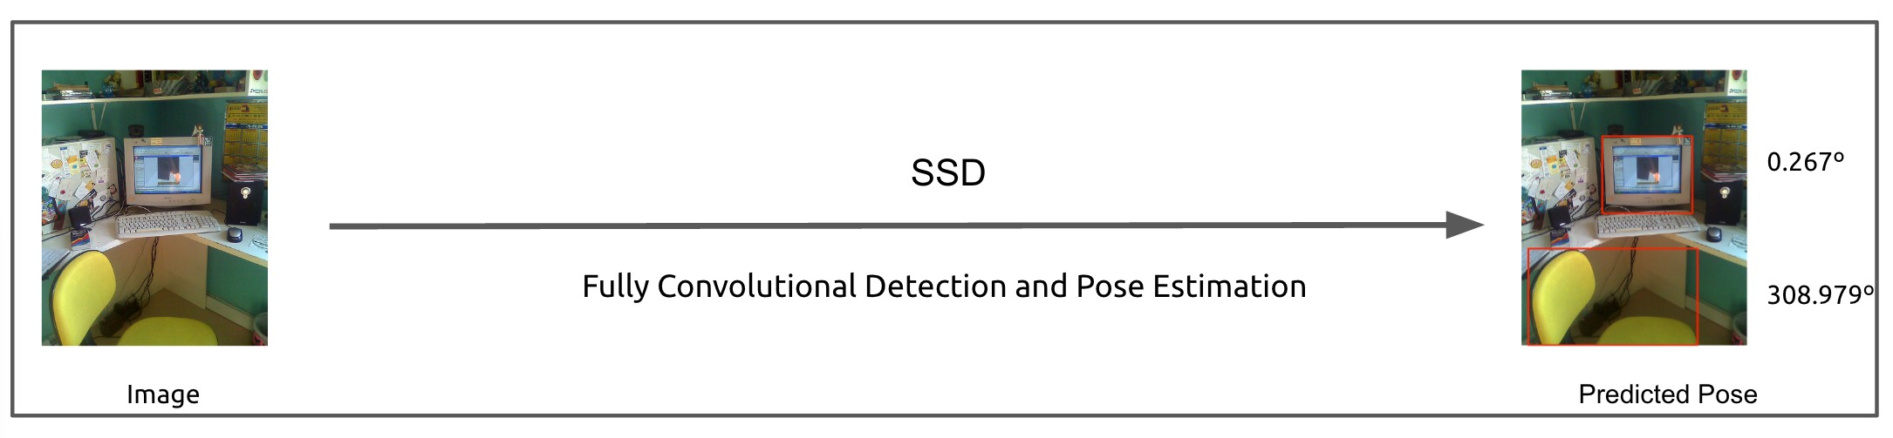
Future Work
•
Object detection + pose estimation
[Poirson et al, coming out at 3DV, 2016]

Slide 87
Future Work
•
Object detection + pose estimation
[Poirson et al, coming out at 3DV, 2016]
•
Single shot 3D bounding box detection

Slide 88
Future Work
•
Object detection + pose estimation
[Poirson et al, coming out at 3DV, 2016]
•
Single shot 3D bounding box detection
•
Joint object detection + tracking model

