Slide 1


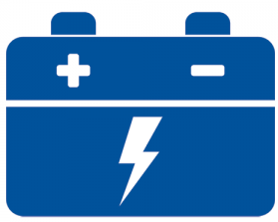




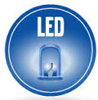
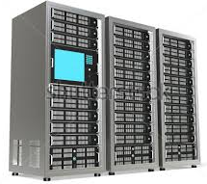
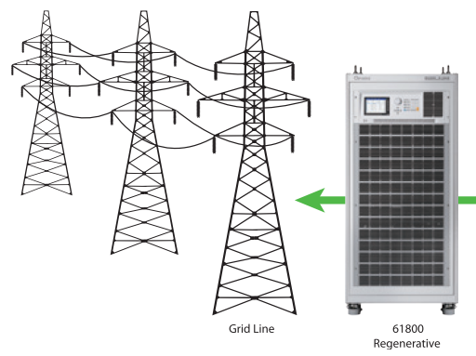


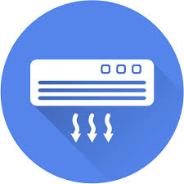

Lithium Ion Battery
Lead Carbon Battery
PV Array
PV Array
DC Power supply
DC E-Load
DC/DC Converter
PV Converter
PV Converter
DC/DC Converter
DC Bus
BI-Directional
Converter
BI-Directional
Converter
AC Bus
Grid Simulator
150 KWA
AC Load
50 KW
AC Load
50 KW
AC Source
150 KWA

Slide 2


Lithium Ion Battery
Lead Carbon Battery
PV Array
PV Array
DC Power supply
DC E-Load
DC/DC Converter
DC/DC Converter
DC/DC Converter
DC/DC Converter
DC Grid
AC Grid
Bi-Directional Converter
Bi-Directional Converter
Grid Simulator
150 KWA
AC Load
50 KW
AC Load
50 KW
AC Source
150 KWA

