Slide 1
Fall 2015
MATH 250: Calculus III

Slide 2
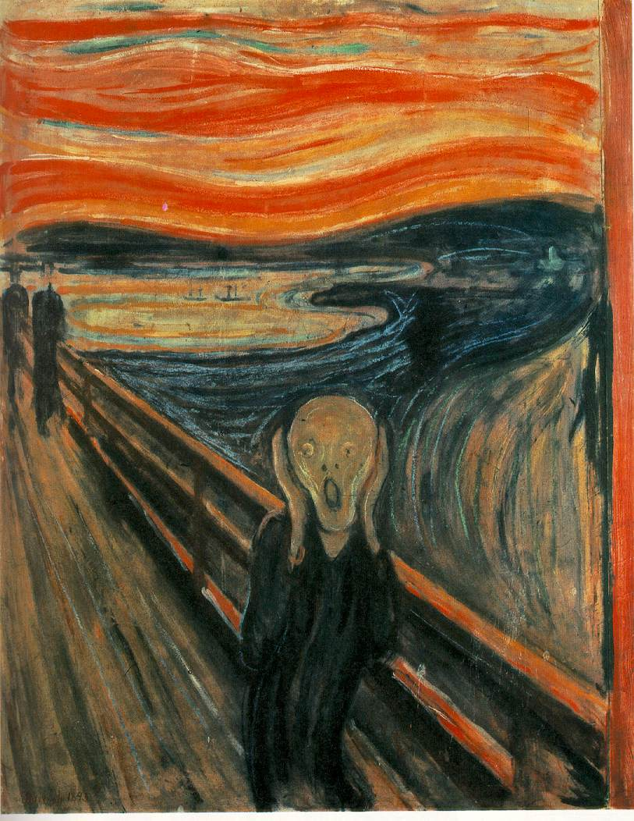

Slide 3
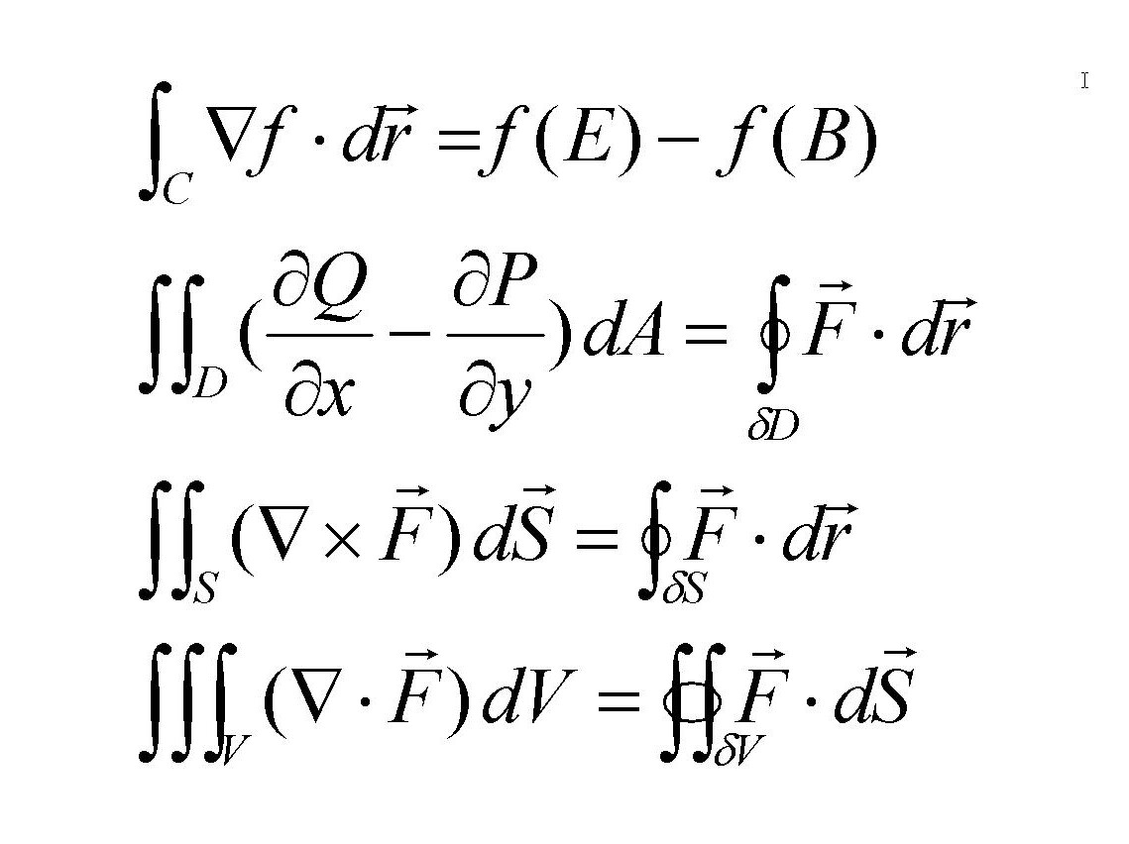

Slide 4
Course Topics
Review: Parametric Equations and Polar Coordinates
Vectors and Three-Dimensional Analytic Geometry
Calculus of Vector Functions
Differentiation in Several Variables
Multiple Integration
Line and Surface Integrals
Fundamental Theorems of Vector Calculus
The tentative detailed schedule of the course can be found at http://home.sandiego.edu/~pruski/m250f15schedule.html

Slide 5
Course learning outcomes
Students will demonstrate a working knowledge of multivariable calculus topics. This includes knowledge of theorems with complete assumptions.
Students will demonstrate the ability to use methods of multivariable calculus and perform computations accurately and efficiently.
Students will demonstrate the ability to solve problems, including applications outside of mathematics.
Students will be able to construct elementary calculus proofs independently.
Students will demonstrate the ability to communicate mathematical ideas clearly.

Slide 6
Attendance
Regular attendance is really necessary.
It is quite difficult to catch up with the material when you miss a class.
It becomes virtually impossible, if you miss several classes.

Slide 7
Pace of the course
will be EXTREMELY FAST, particularly in its first, relatively easier part.
In the past years, students called the pace of the course

Slide 8
INSANE!

Slide 9
HELLISH!

Slide 10
RIDICULOUS!

Slide 11
Calculus III should really be an
at least 5-unit course!

Slide 12

Be afraid… very afraid…

Slide 13
Another difficulty
The sequence of the course material is unfortunate – the first three chapters cover relatively easy material whereas the last four deal with really tough stuff.
Some students breathe with relief after the first test (“Hey, that’s not so bad – Pruski was just trying to scare us.”), and then …

Slide 14
WHAM!!!!

Slide 15
And then again and again
WHAM!
WHAM!!
WHAM!!!

Slide 16
Limited time for class discussion
Normally, in all my courses, not only do I encourage class discussion, but I try not to limit its scope. Calculus III – because of the huge amount of class material to cover – is the only course where I sometimes may need to limit questions in class in an attempt to balance individual students’ benefit vs. the benefit of the entire class.

Slide 17
But…
Use my help during office hours. Also,
before tests I will hold some additional office hours, especially for this class.

Slide 18
Calculus facts of life
A student is supposed to spend at least two hours at home for each class hour. Thus, you should expect spending at least 8 hours a week (more likely about 10 hours) doing your homework and preparing for quizzes/exams.
Since Calculus III is a course in mathematics, we will be doing some simple proofs. You will be expected to do some proofs in your homework assignments as well as during exams.

Slide 19
No emphasis on computations
Computations are way less important than setting up the problem correctly. Calculators and computers can do the computations; only people, however, can set the problems for computations. In this course, the concepts count much more than computations.

Slide 20
Consequently,
In class I will usually omit the computational details of, say, integrations. When doing your homework, you will be often encouraged to use integration tables, advanced calculators, or various Web tools, except for some problems that I will ask you to solve completely manually.

Slide 21
Calculator policy
Because of de-emphasizing computations, you will usually have little to compute during quizzes and exams.
No calculators beyond TI-83/4, smart phones, iPods, tablets, etc., are allowed on quizzes and exams

Slide 22
Office hours
Mondays 10:10 – 11:10
Tuesdays 2:20 – 3:50
Wednesdays 4:30 – 5:30
Fridays 2 – 3:30

Slide 23
Course webpage
A primitive webpage for the course is at
http://home.sandiego.edu/~pruski/m250f15.html
You should check the webpage daily for assignments, announcements, and links.
The best way to contact me is by using e-mail (pruski@sandiego.edu).

Slide 24
Assignments
Once or twice a week. Graded partly on effort.

Slide 25
Quizzes and exams
Pop-quizzes, approximately once a week.
Three tests: October 2, October 30, and December 4.
Final exam: Monday, December 16, 2:00 - 4:30.
No advanced calculators, smart phones, tablets, etc. allowed.

Slide 26
Grading criteria
90% and above A
80% - 90% B
60% - 80% C
50% - 60% D
(with pluses and minuses, appropriately)

Slide 27
Academic integrity
The Mathematics and Computer Science Department strongly promotes Academic Integrity. I hope issues related to academic integrity will not arise in our course. There have been some cases of cheating in math courses in the past – mainly the cases of submitting someone else’s work as well as cases of cheating during exams. Depending on the severity of the case, the possible consequences include: assigning the score of 0 on the given assignment, lowering the course grade, or even assigning an F in the course.

