Slide 1
P1025 QorIQ - UseCases

Slide 2
Agenda
P1025 Platform
Internet Gateway
SOHO Router
Voice Gateway
Security Gateway

Slide 3
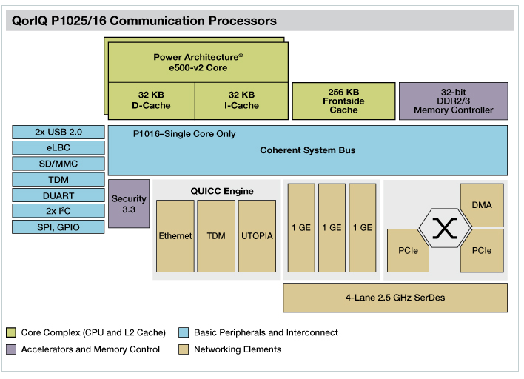
P1025 QorIQ Platform
Interfaces
3 GB Ethernet – ETSEC interfaces
QE:
4 UCC running in Fast Ethernet, TDM
1 UPC port – running utopia ATM AAL0, AAL5
Peripherals
UART/ SD/ MMC/ USB/ SPI/ GPIO/ PCIe

Slide 4
Internet Gateway
SMALL LAN
P1025
Internet
ETSEC1
ETSEC2
Frame Size | Throughput [Mbps]
64 | 184.36
128 | 321.64
256 | 513.07
512 | 1120.21
1024 | 2000
1280 | 2000
1518 | 2000

Slide 5
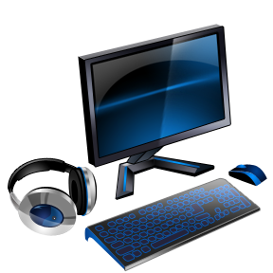
SOHO Router
P1025 - RDB
P1025
Internet
ETSEC1
ETSEC2
SWITCH
P1
P2
P3
P4

Slide 6
Voice Gateway
Local PBX
P1025 - RDB
P1025
Internet
RJ11
RJ11
RJ11
TDM - E1
QE-UCC TDM
ETSEC2
Remote Site VoIP
Remote PBX
P1025 RDB implement Voice/E1 to IP Translation (RTP)

Slide 7
Security Gateway
TBD

