Slide 1
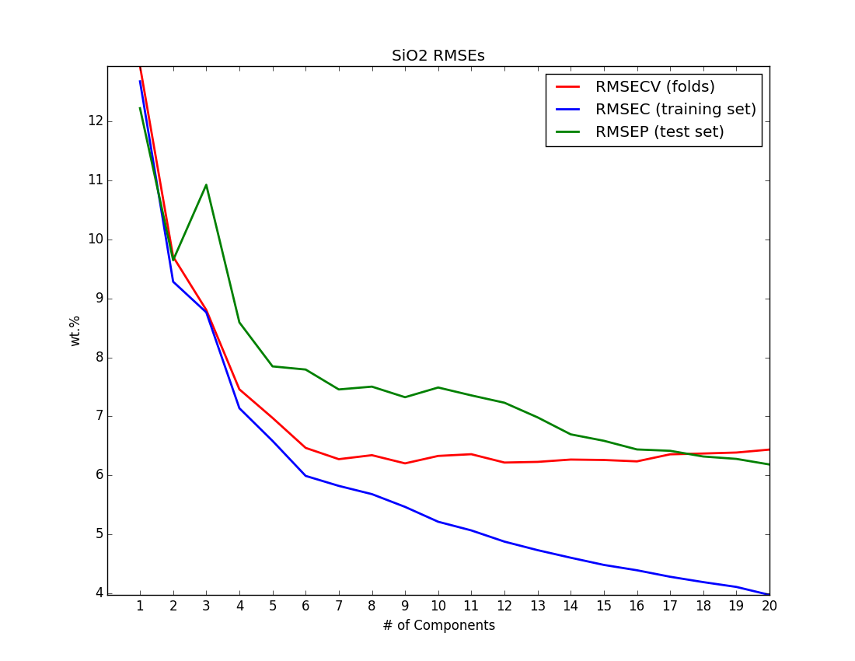
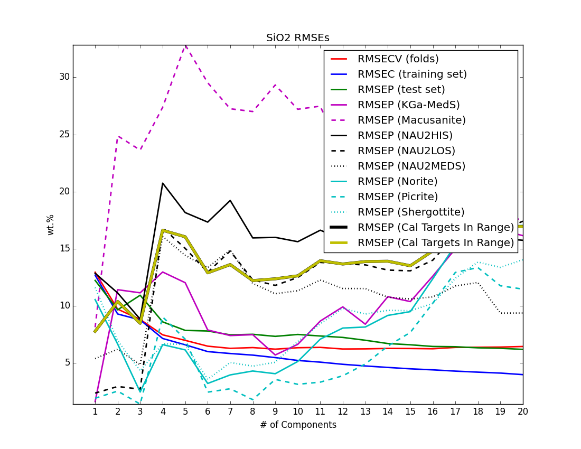
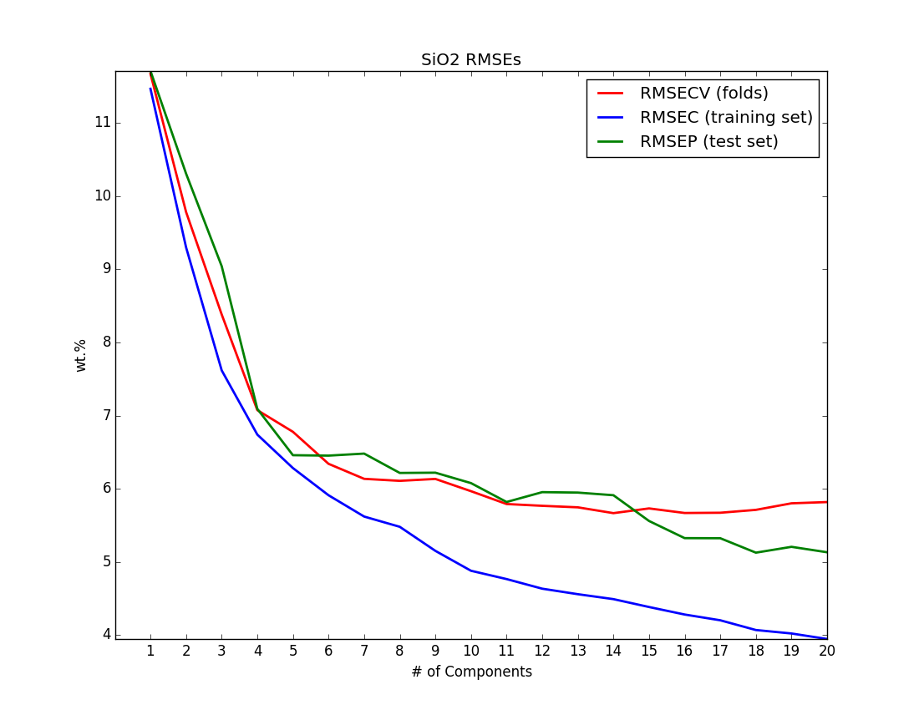
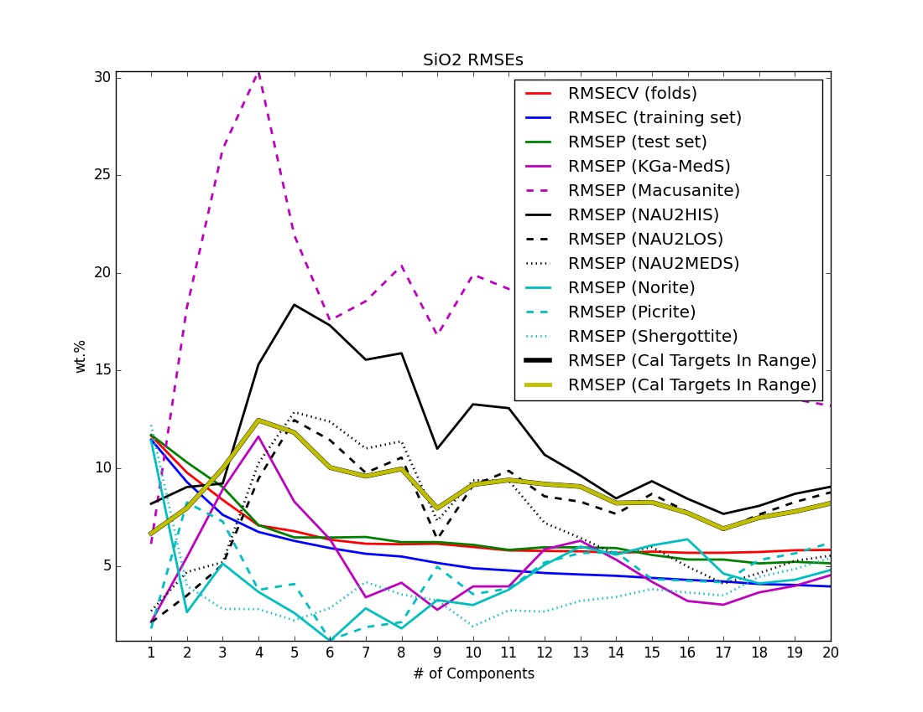
Norm1
Full Model
Norm1
Best Setting:
Norm 1
NC=6
Norm3
Norm3

Slide 2
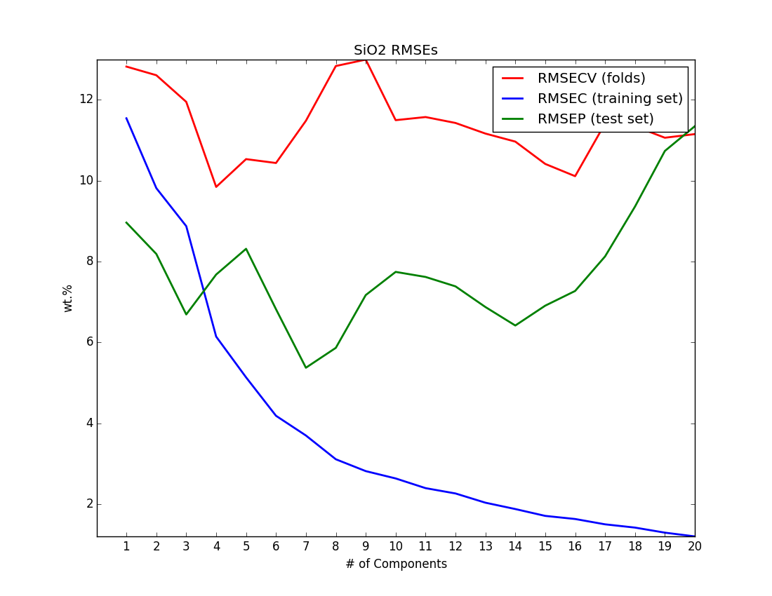
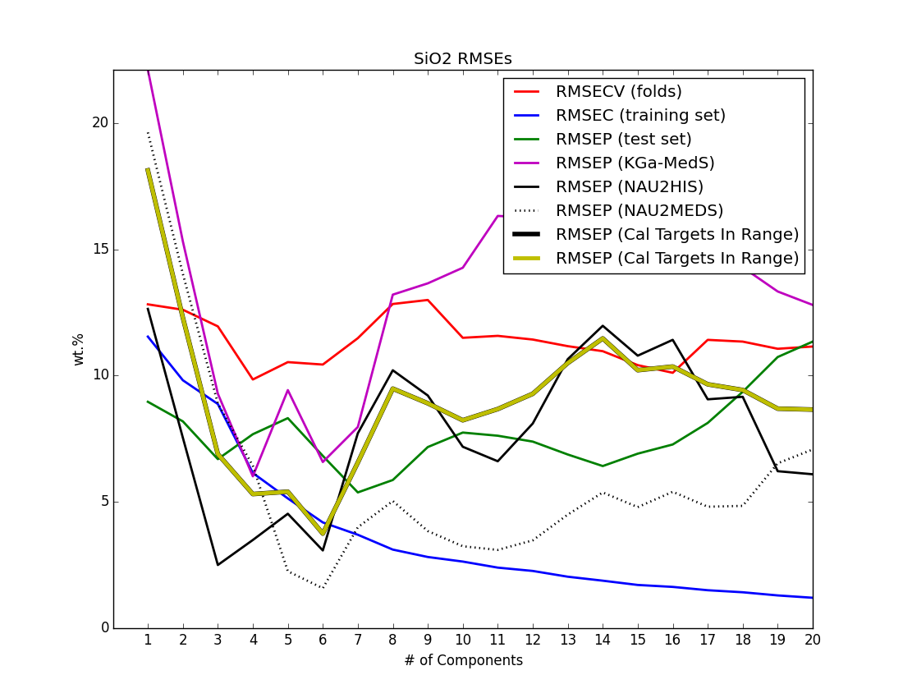
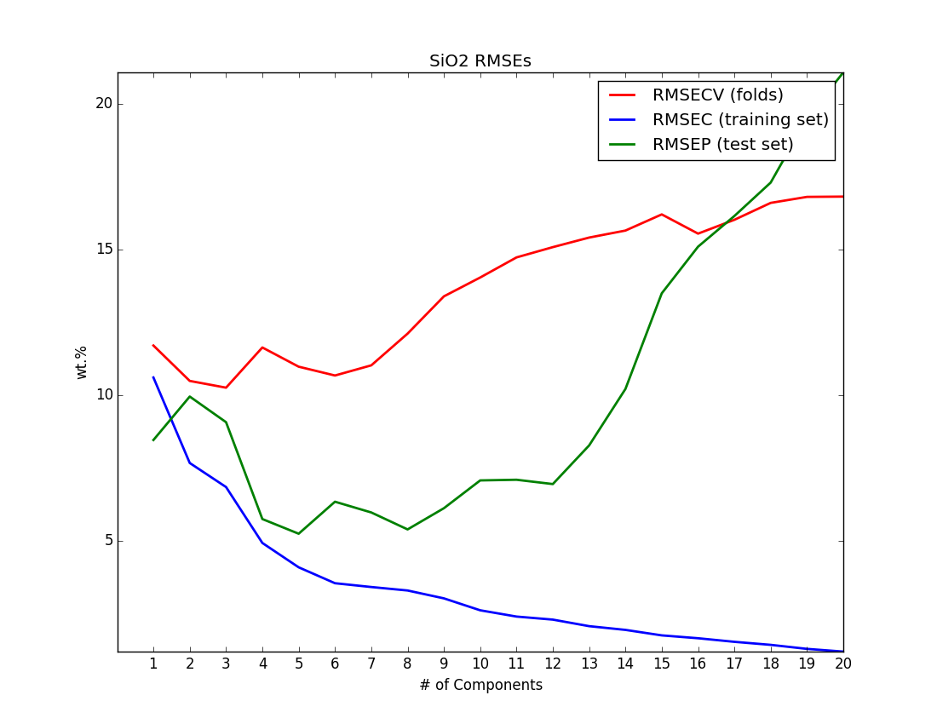
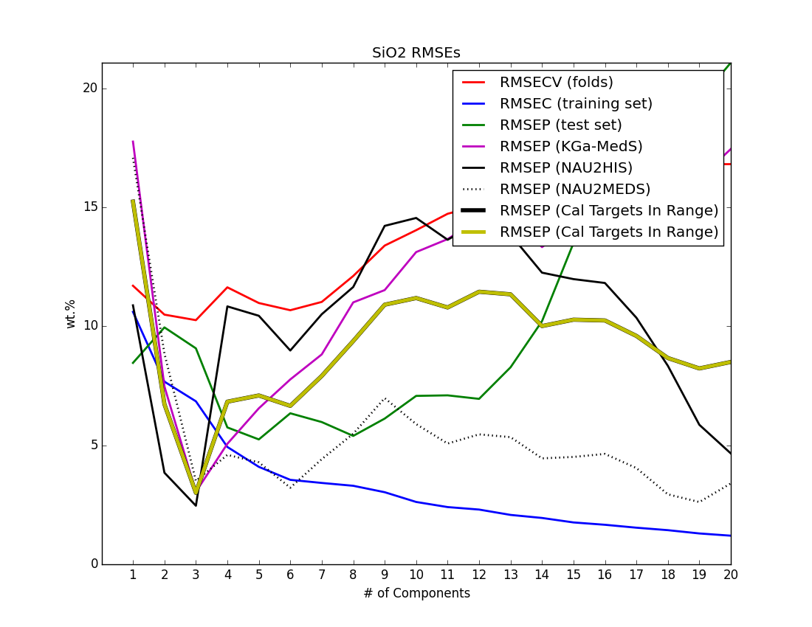
Norm1
Low Model (0-40)
Norm1
Best Setting:
Norm 3
NC=3
Norm3
Norm3

Slide 3
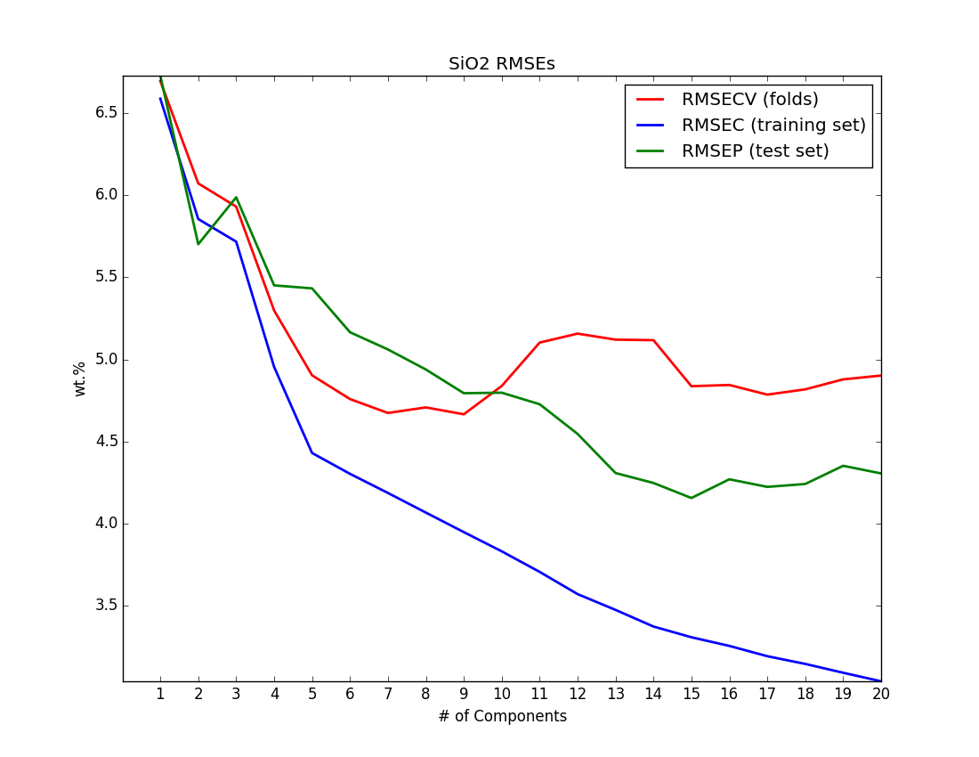
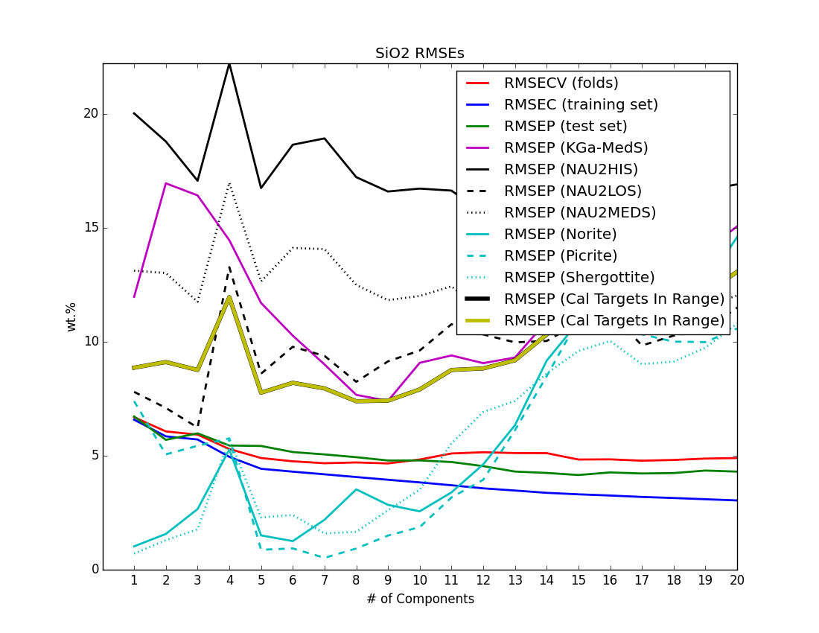
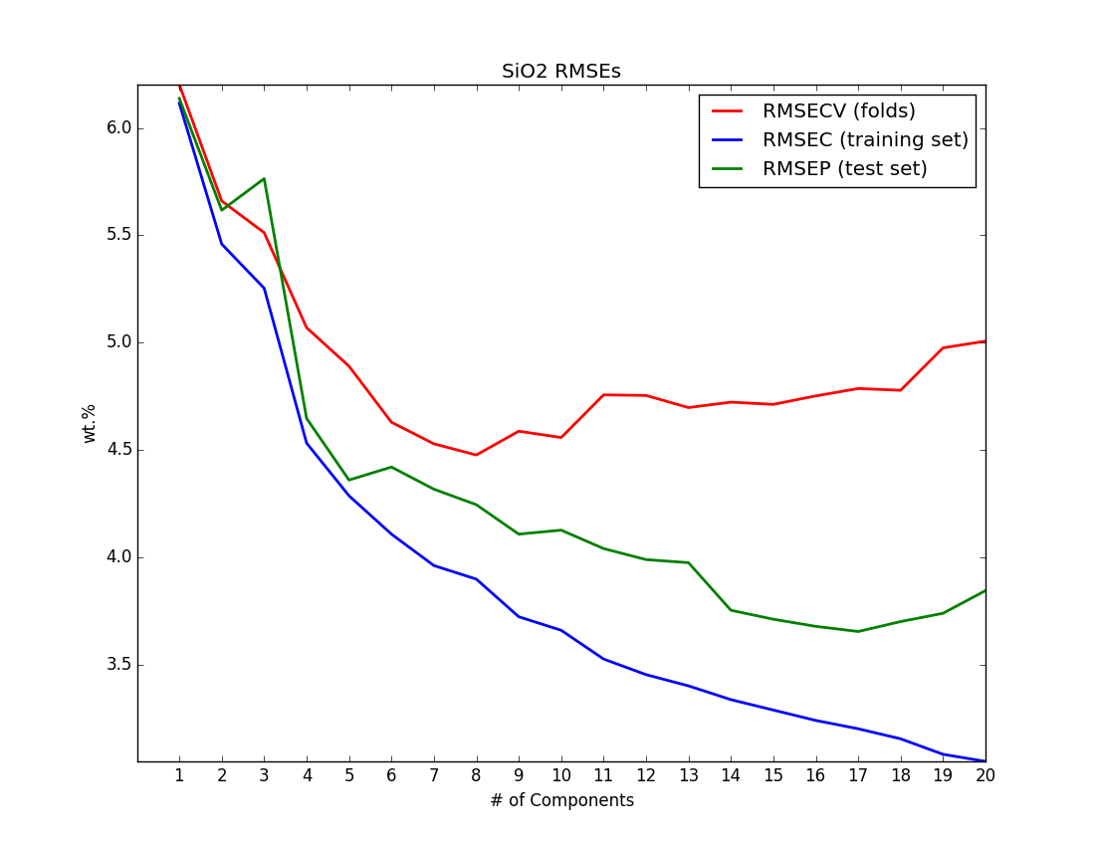
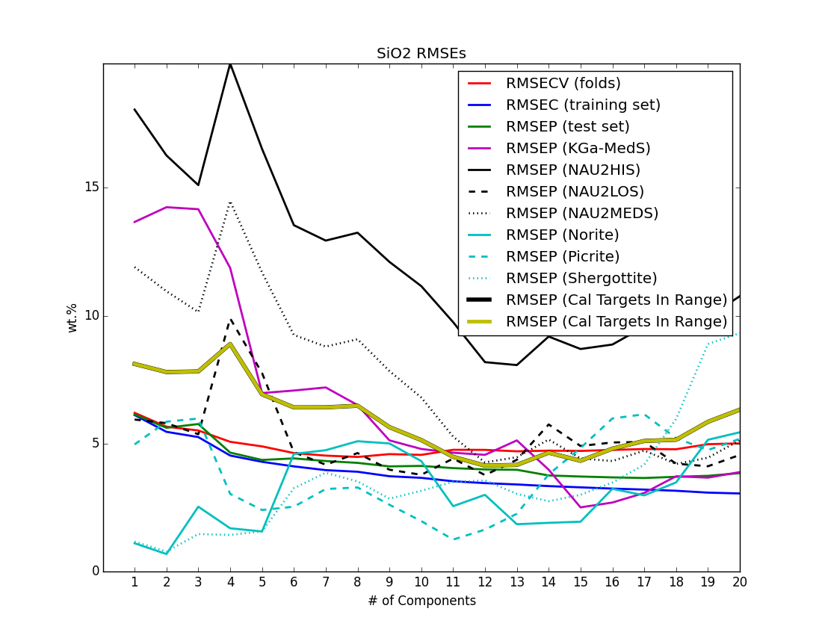
Norm1
Mid Model (30-70)
Norm1
Best Setting:
Norm 3
NC=7
Norm3
Norm3

Slide 4
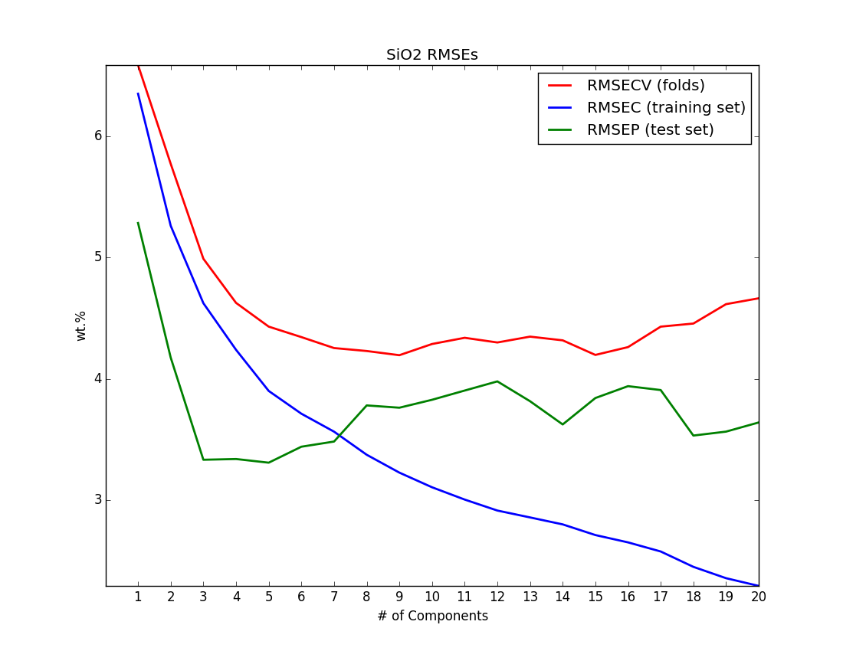
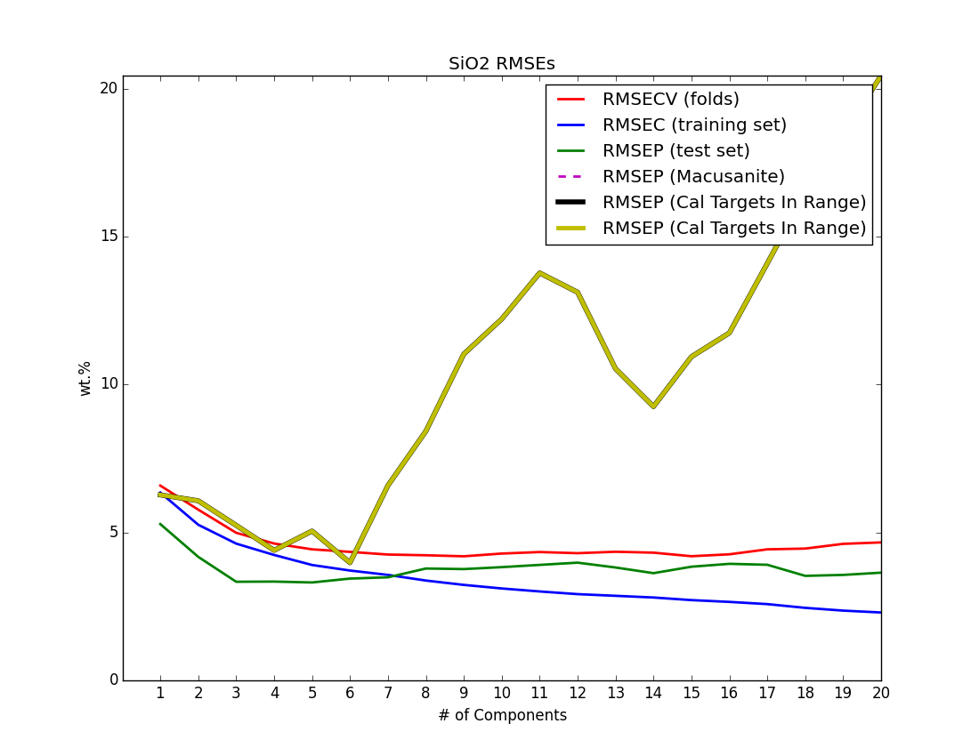
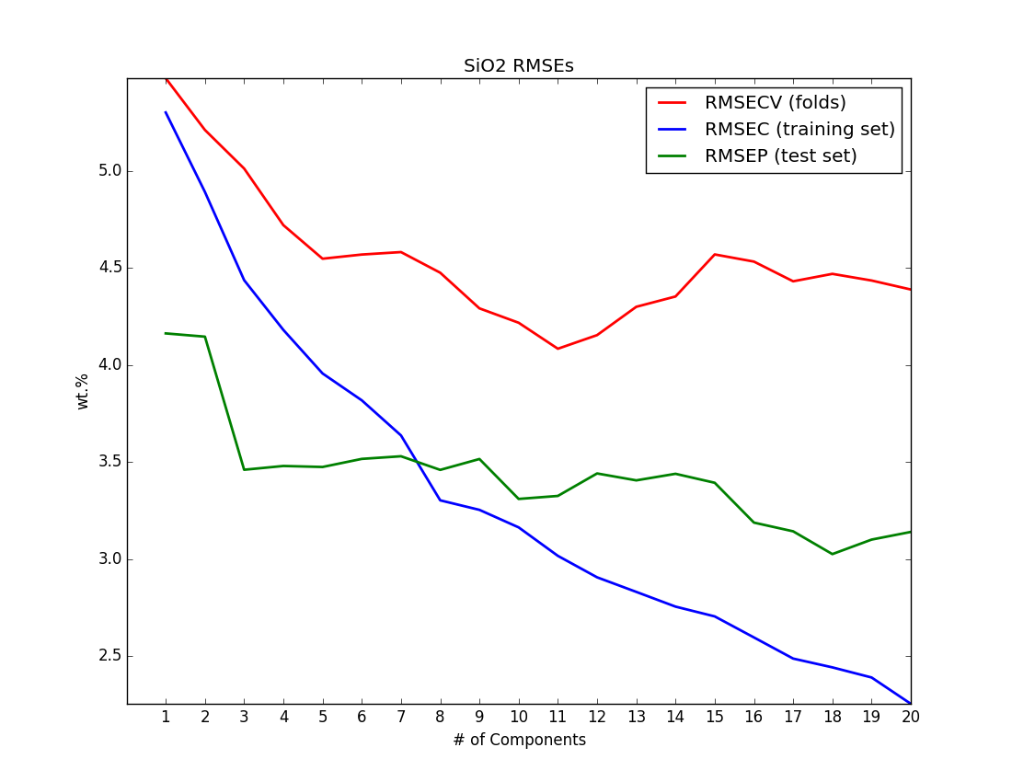
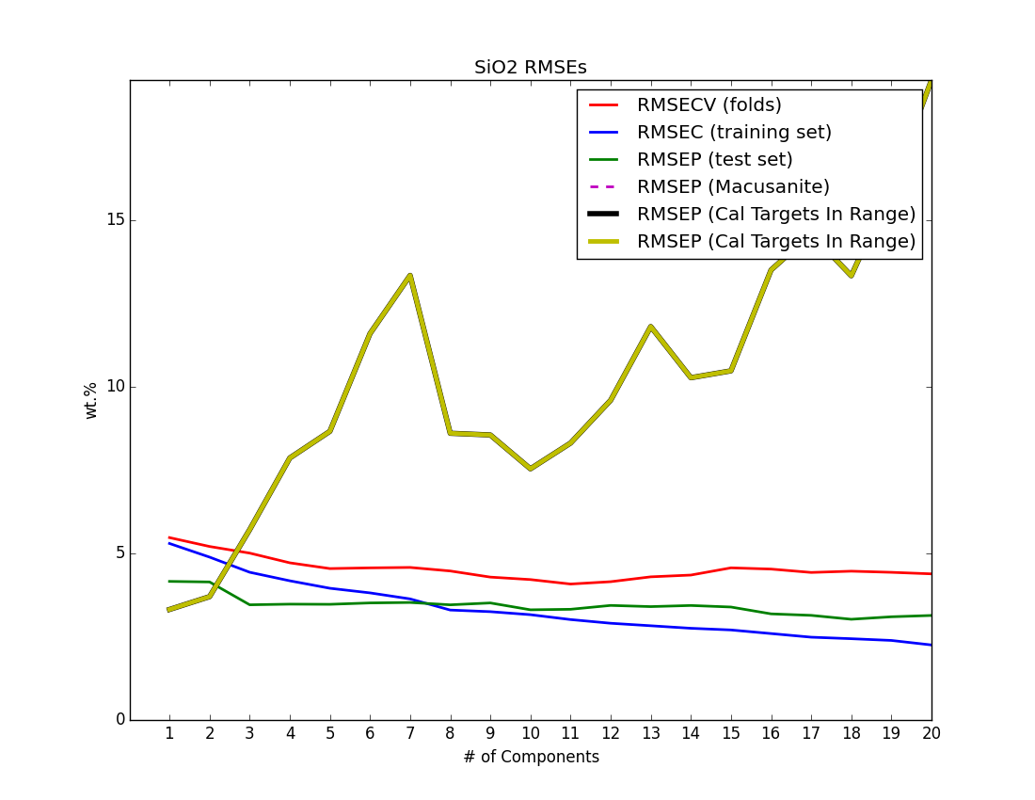
Norm1
High Model (60-100)
Norm1
Best Setting:
Norm 1
NC=6
Norm3
Norm3

Slide 5
Model | NC | Norm
Full | 6 | 1
Low (0-40) | 3 | 3
Mid (30-70) | 7 | 3
High (60-100) | 6 | 1

