Slide 1
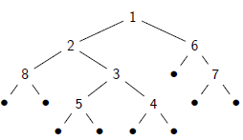
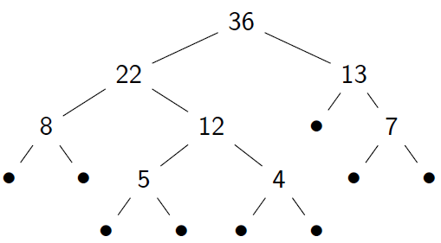
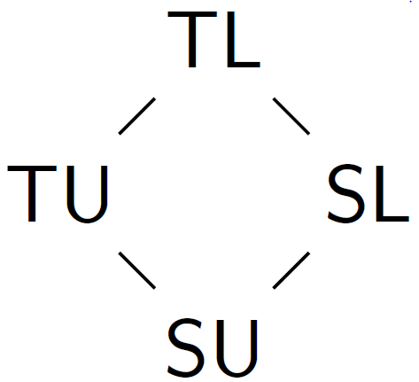

FreeST: context-free session types in a functional language
ETAPS
PLACES
2019
Bernardo Almeida, Andreia Mordido and Vasco T. Vasconcelos
Abstract
Example
FreeST is an experimental concurrent programming language. Based on a core linear functional programming language, it features primitives to fork new threads, and for channel creation and communication.
A powerful type system of context-free session types governs the interaction on channels. The compiler builds on a novel algorithm for deciding type equivalence of context-free session types.
Serialize a tree object on a channel. The aim is to transform a tree by interacting with a remote server. The client process streams a tree on a (single) channel. The server process reads a tree from the other end of the channel and, for each node received, sends back the sum of the integer values under (and including) that node.
Kinding
FreeST requires kinding. And the reason is on
polymorphism, not on context-free types.
Is !Int ;a a session type? Only if a is a session type itself. If a does not denote a session type, then !Int ;a is not a type.
To accommodate polymorphism, types are classified into kinds. Kinds are composed by a prekind (T, functional or S, session) and a multiplicity that control the number of times a value may be used in a given context (exactly one – linear, L or zero or more – unrestricted U).
data Tree = Leaf | Node Int Tree Tree
type TreeC = +{Leaf: Skip , Node: !Int;TreeC;TreeC;?Int}
1 transform : forall a => Tree –> TreeC;a –> (Tree, a)
2 transform tree c =
3 case tree of
4 Leaf –>
5 (Leaf , select Leaf c )
6 Node x l r –>
7 let c = select Node c in
8 let c = send x c in
9 let l , c = transform [TreeC ; ?Int ; a] l c in
10 let r , c = transform [?Int ; a] r c in
11 let y , c = receive c in
12 (Node y l r, c)
13
14 treeSum : forall a => TreeS;a –> (Int, a)
15 treeSum c =
16 match c with
17 Leaf c –>
18 ( 0 , c )
19 Node c –>
20 let x , c = receive c in
21 let l , c = treeSum [TreeS;!Int;a] c in
22 let r , c = treeSum [!Int;a] c in
23 let c = send ( x + l + r ) c in
24 (x + l + r, c)
Types
FreeST features as functional types the following:
Basic types, that is Int, Bool, Char, and (). Unrestricted and linear functions, T1 –> T2 and T1 –o T2. Pairs (T1,T2) and Datatypes [l1 : T1, ..., ln : Tn]
The session types are:
The terminated type Skip. Sequential composition, S1;S2. Messages !B and ?B. Choices, +{l1: S1, ..., ln :Sn} and &{l1: S1, ..., ln :Sn} and recursive types rec x . S
Polymorphism
Polymorphic variables are introduced solely with the forall construct. The call to function transform (line 9 of the example) effectively calls the function at type:
Tree –> TreeC ; TreeC ; ?Int;a –> (Tree, TreeC; ?Int;a) .
Expressions
FreeST blends expressions typical of functional languages and of session types.
The expressions inspired from functional languages include:
Basic values; term variables; lambda introduction (both Linear –o and unrestricted –>); pair introduction, (E1,E2), and elimination, let x, y = E1 in E2; datatype elimination, case expressions and conditional expressions if.
The session-type related expressions are:
Channel creation, new S; Message sending (send E) and receiving (receive E); Branch selection, select C E, and match, match E with C1 x –> E1 ,..., Cn x –> En.
FreeST is a polymorphic functional language with context-free session types
Features full type equivalence via a novel algorithm embedded in the compiler
FreeST generates Haskell code that can be later compiled with an Haskell compiler
Future:
Polymorphic type application inference
Transmission of arbitrary types
Acknowledgments: This work was supported by FCT through project Confident (PTDC/EEICTP/4503/2014), by the LASIGE research Unit (UID/CEC/00408/2019) and by Cost Action CA15123 EUTypes, supported by COST (European Cooperation in Science and Technology).

