Slide 1
FREESTONE COUNTY AMATEUR RADIO EMERGENCY SERVICE
TACTICAL MOBILE APP
COMPLETE OPERATOR FIELD GUIDE • MARINE-PROOF EDITION
Step-By-Step Illustrated Visual Instructions for Android & iOS
Unified Operations • Build 69 (v7.9.17) • November 2026
County Emergency Coordinator: Brian Davis (KG5TZT)

Slide 2
FOUNDATIONAL OPERATIONAL DOCTRINE
THE FOUR GOLDEN RULES OF TACTICAL MOBILE
RULE 1: CHARGE & VOLUME
Keep your device fully charged and set phone media volume to 100%. Emergency sirens and tone alerts need to cut through diesel engine roar and field noise.
RULE 2: FCC CALLSIGN ONLY
Always use your official FCC Amateur Radio callsign (e.g., W5FC or KG5TZT). Never use CB handles, first names only, or tactical nicknames when signing in.
RULE 3: 100% OFFLINE CAPABILITY
If cell towers drop or internet fails, DO NOT PANIC. This app is pre-cached in local phone memory. Your repeaters, maps, field manuals, and ICS forms stay accessible.
RULE 4: EVERYONE CAN SITREP — ONLY EC BRIAN DAVIS SETS POSTURE
Any operator can send real-time situational SITREPs silently. Only Emergency Coordinator Brian Davis (KG5TZT) or designated delegates can shift County Activation Levels or sound sirens.

Slide 3
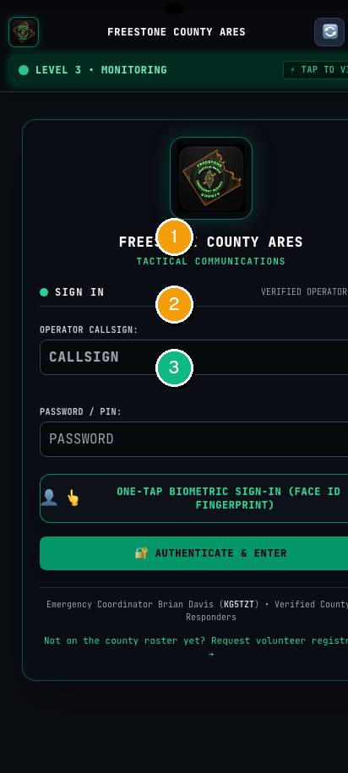
MODULE 01 • GETTING STARTED
SIGN IN & CLAIM YOUR OPERATOR CALLSIGN
🎯 WHAT THIS SCREEN IS FOR
Identifies who you are on the countywide incident board and unlocks tactical repeaters, rosters, and live field reporting.
⚡ STEP-BY-STEP ACTIONS (MARINE-PROOF)
1. Open the app on Android (from your home screen icon) or iOS (via Safari / Home Screen).
2. Tap the CALLSIGN box (Badge 1) and type your official FCC Amateur Callsign in capital letters.
3. Tap the PASSWORD / PIN box (Badge 2) and enter your county volunteer access code.
4. Tap ONE-TAP BIOMETRIC SIGN-IN (Badge 3) if you want to use Face ID / Fingerprint in the future.
5. Tap the green AUTHENTICATE & ENTER button (Badge 4) to enter the tactical net.
✔ HOW YOU KNOW IT WORKED: The screen clears, a green confirmation bar flashes, and your callsign appears in the top status bar.
💡 MARINE-PROOF FIELD TIP // CAUTION
If you are a new volunteer not yet approved by EC Brian Davis, tap 'Request Volunteer Registration' at the bottom. Your call will go to the EC queue for approval.

Slide 4
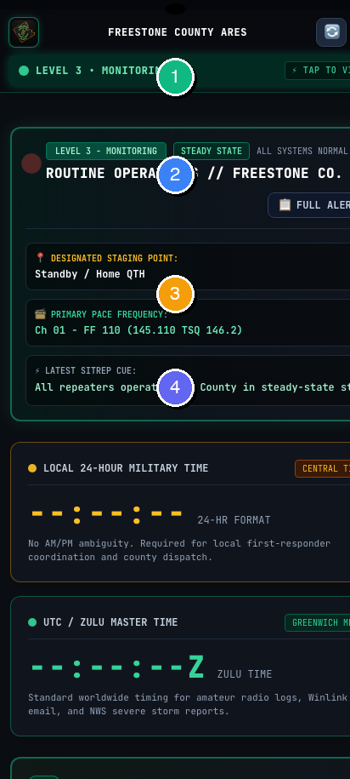
MODULE 02 • COMMAND DASHBOARD
THE INCIDENT COMMAND DASHBOARD (HOME BASE)
🎯 WHAT THIS SCREEN IS FOR
Your single pane of glass for county emergency posture, current incident orders, assigned staging locations, and active repeater channels.
⚡ STEP-BY-STEP ACTIONS (MARINE-PROOF)
1. Look at Badge 1 (Top Bar): Displays current County Posture (Level 1 Routine, Level 2 Standby, Level 3 Active Incident).
2. Look at Badge 2 (Operational Status): Shows active emergency incident title or 'Routine Monitoring'.
3. Look at Badge 3 (Primary PACE Frequency): Shows current designated channel (e.g. FF 110 - 145.110 MHz). Tune your radio to this immediately.
4. Check Badge 4 (Clocks): Always use the 24-Hour Central Local Time or Zulu UTC for all incident message logs.
✔ HOW YOU KNOW IT WORKED: The dashboard automatically refreshes every few seconds. Live incident updates broadcast directly to this screen.
💡 MARINE-PROOF FIELD TIP // CAUTION
Whenever an incident is declared, the top bar changes from green to red. Immediately tune your primary VHF radio to the frequency listed under Badge 3.

Slide 5
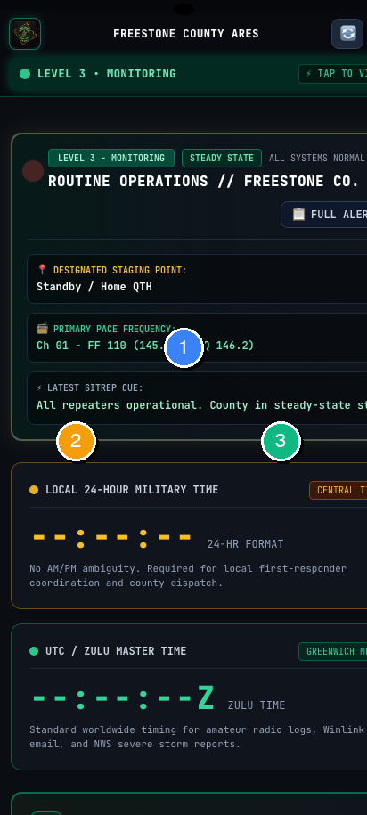
MODULE 03 • SITUATIONAL REPORTING
SUBMITTING A LIVE FIELD SITREP
🎯 WHAT THIS SCREEN IS FOR
Allows any field operator to report real-time observations (road closures, storm damage, flood levels) silently to Net Control without sounding sirens.
⚡ STEP-BY-STEP ACTIONS (MARINE-PROOF)
1. Scroll down on the dashboard to the QUICK FIELD SITREP card.
2. Tap the text box (Badge 1) and type your report using facts only (e.g. 'US-84 near Teague: trees across westbound lane').
3. Use Badge 2 to clear text if you made a typing mistake.
4. Tap the blue SUBMIT SITREP button (Badge 3) to broadcast into the county incident feed.
✔ HOW YOU KNOW IT WORKED: A green success notification appears, and your SITREP is added to the live log with your callsign and timestamp.
💡 MARINE-PROOF FIELD TIP // CAUTION
Do NOT report rumors or second-hand information. Follow the first-responder rule: 'If you didn't see it with your own eyes, verify it before submitting.'

Slide 6
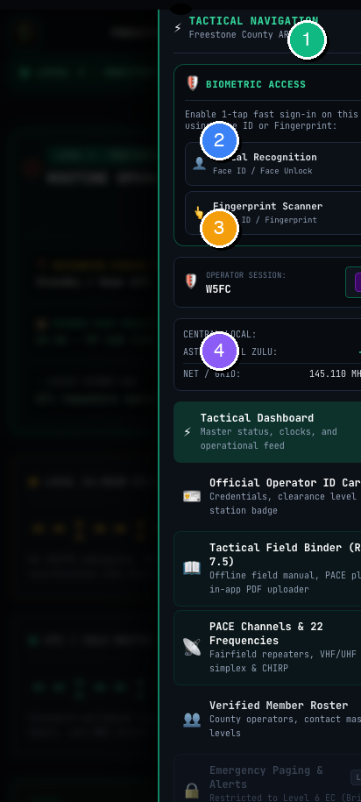
MODULE 04 • NAVIGATION & UTILITIES
TACTICAL NAVIGATION DRAWER & BIOMETRIC LOCK
🎯 WHAT THIS SCREEN IS FOR
Provides 1-tap navigation to all 12 operational modules, tactical clocks, Maidenhead grid locator, and biometric unlock settings.
⚡ STEP-BY-STEP ACTIONS (MARINE-PROOF)
1. Tap the green 'MENU' button (Badge 1) in the top right corner of any screen.
2. Use Badge 2 to toggle Facial Recognition or Fingerprint Scanner on or off.
3. Check Badge 3 to see synchronized Central Local time, Astronomical Zulu time, and Maidenhead grid square (EM11xq).
4. Tap any menu item in Badge 4 to immediately jump to Frequencies, Maps, Roster, or Manuals.
✔ HOW YOU KNOW IT WORKED: The side drawer slides open smoothly from the right side. Tapping 'CLOSE' or swiping right dismisses the menu.
💡 MARINE-PROOF FIELD TIP // CAUTION
Enabling Biometric Access lets you unlock the app during nighttime callouts with just your thumb or face, without fumbling to type a password.

Slide 7
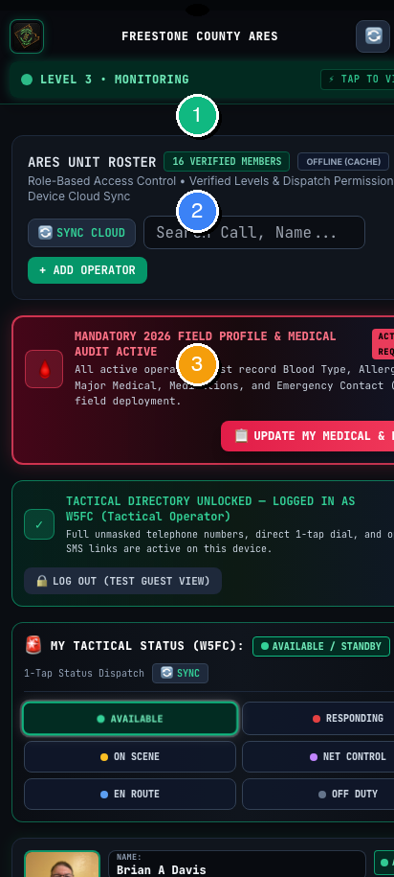
MODULE 05 • PERSONNEL ACCOUNTABILITY
OPERATOR ROSTER & DEPLOYMENT CHECK-IN
🎯 WHAT THIS SCREEN IS FOR
Maintains total personnel accountability. Lets Net Control know where you are deployed, your equipment capability, and your safety status.
⚡ STEP-BY-STEP ACTIONS (MARINE-PROOF)
1. Tap the green CHECK IN / UPDATE STATUS button (Badge 1) when beginning your shift.
2. Select your current tactical posture from Badge 2 (Available, En Route, On Scene, Staged, or Off-Duty).
3. Check the verified member list in Badge 3 to see all active operators, contact phone numbers, and tactical assignments.
✔ HOW YOU KNOW IT WORKED: Your callsign displays an active status badge on the dashboard roster, and Net Control can see you are ready for tactical traffic.
💡 MARINE-PROOF FIELD TIP // CAUTION
ALWAYS update your status to 'Off-Duty' when your operating shift is completed so Net Control does not dispatch tasks to an unattended station.

Slide 8
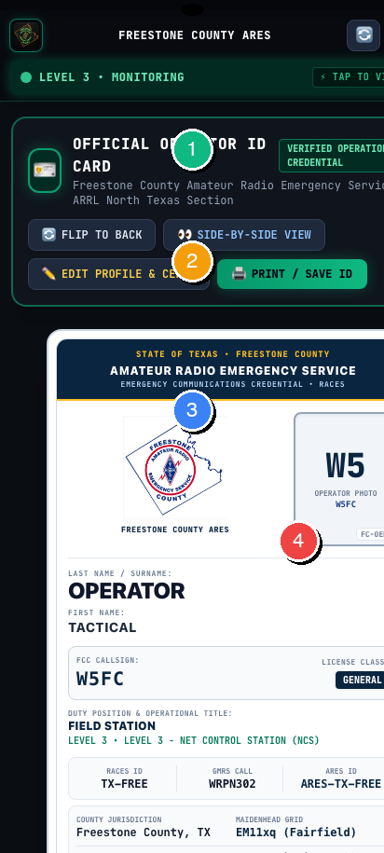
MODULE 06 • OFFICIAL CREDENTIALS
OFFICIAL OPERATOR CAC TACTICAL ID CARD
🎯 WHAT THIS SCREEN IS FOR
Serves as your official digital credential at law enforcement checkpoints, EOC entrances, and designated staging perimeters.
⚡ STEP-BY-STEP ACTIONS (MARINE-PROOF)
1. Open the ID Card tab from the menu or dashboard.
2. Badge 1 & 2 display your verified operational credential, FCC callsign, and assigned security clearance level.
3. Present the official barcode / QR scanner box (Badge 3) to checkpoint officers for rapid identity verification.
4. Tap the 'FLIP TO BACK' button (Badge 4) to display your emergency ICE contacts, blood type, and medical notes.
✔ HOW YOU KNOW IT WORKED: The card renders in high contrast. Tap 'PRINT / SAVE ID' to generate a full-resolution PDF copy for your wallet or badge lanyard.
💡 MARINE-PROOF FIELD TIP // CAUTION
Make sure your phone screen brightness is at maximum when presenting your digital ID card to officers at night roadblocks.

Slide 9
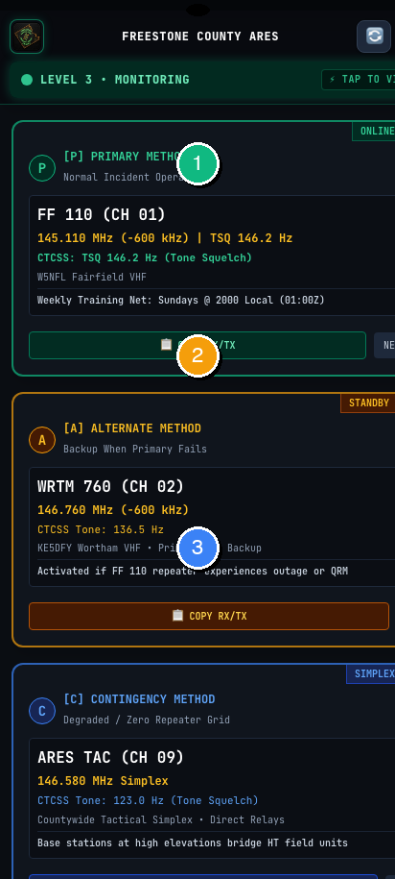
MODULE 07 • COMMS PACE PLAN
COMMUNICATIONS PACE PLAN & 22 FREQUENCIES
🎯 WHAT THIS SCREEN IS FOR
Your foolproof guide to county repeater channels, CTCSS tones, offsets, and simplex backup plans following FEMA PACE doctrine.
⚡ STEP-BY-STEP ACTIONS (MARINE-PROOF)
1. Check [P] PRIMARY METHOD (Badge 1): Fairfield VHF Repeater (145.110 MHz, -600 kHz, Tone 146.2). This is our main net.
2. Check [A] ALTERNATE METHOD (Badge 2): Wortham VHF Repeater (146.760 MHz, -600 kHz, Tone 136.5). Switch here if Fairfield fails.
3. Check [C] CONTINGENCY METHOD (Badge 3): Countywide Simplex (146.580 MHz Direct). Use if ALL repeaters lose commercial power.
4. Tap 'COPY RX/TX' to immediately copy frequencies to your device clipboard.
✔ HOW YOU KNOW IT WORKED: Each channel box displays exact transmit/receive frequencies, offset directions, and sub-audible tone squelch requirements.
💡 MARINE-PROOF FIELD TIP // CAUTION
If you hear Net Control declare 'PACE ALTERNATE', switch your radio immediately to Channel 02 (146.760 MHz). Do not stay on primary.

Slide 10
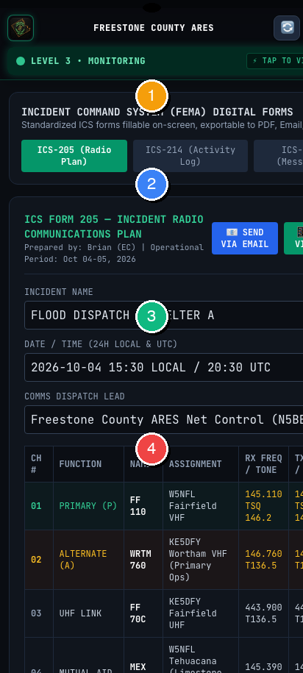
MODULE 08 • FORMAL TRAFFIC
INCIDENT COMMAND (ICS) DIGITAL FORMS
🎯 WHAT THIS SCREEN IS FOR
Standardized emergency message handling. Send ICS-213 General Messages, Radiograms, and Winlink formal traffic with zero errors.
⚡ STEP-BY-STEP ACTIONS (MARINE-PROOF)
1. Tap Badge 1 to select the required form: ICS-205 (Radio Plan), ICS-214 (Unit Log), or ICS-213 (General Message).
2. Enter the served agency name, incident name, and TO/FROM routing fields in Badge 2.
3. Type the exact formal message in Badge 3. Keep wording precise and verbatim.
4. Tap 'SEND VIA EMAIL / WINLINK' or 'TRANSMIT' in Badge 4 to route the form.
✔ HOW YOU KNOW IT WORKED: Forms format automatically to official FEMA NIMS specifications and can be downloaded as PDF or exported to Winlink Express.
💡 MARINE-PROOF FIELD TIP // CAUTION
When writing an ICS-213, never edit the wording given to you by served agency officials (Fire Chief, Sheriff, EOC Director). Transmit exactly as written.

Slide 11
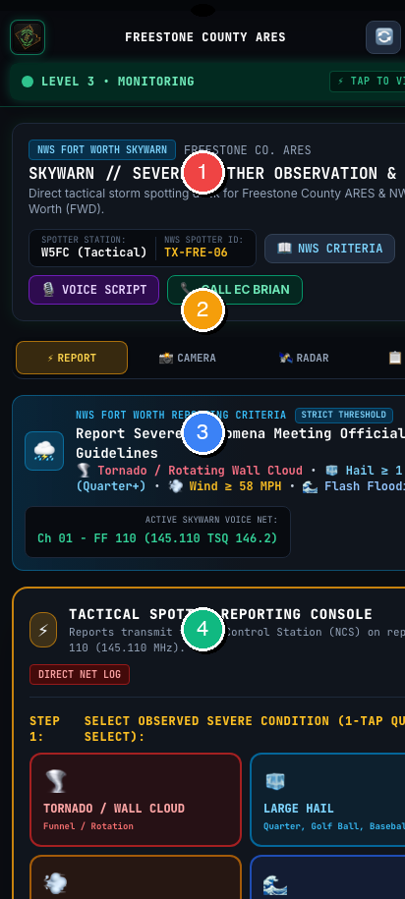
MODULE 09A • SEVERE WEATHER SPOTTER CONSOLE
SPOTTER REPORTING & ON-AIR VOICE SCRIPT
🎯 WHAT THIS SCREEN IS FOR
Rapid storm spotter reporting. Sends time-critical ground truth observations directly to Net Control and automatically generates your on-air repeater voice script.
⚡ STEP-BY-STEP ACTIONS (MARINE-PROOF)
1. Tap the severe weather hazard icon (Badge 1): 🌪️ Tornado / Wall Cloud, 🧊 Hail ≥ 1.00", 💨 Wind ≥ 58 MPH, 🌊 Flash Flood.
2. Quick-pick measured hail size or wind speed using the selector pills (Badge 2) (e.g. Golf Ball 1.75" or 60-69 MPH).
3. Tap '📍 AUTOFILL DEVICE GPS' (Badge 3) for live satellite lock. (iOS: Tap 'Allow While Using App' • Android: Tap 'While using the app'). Or select a Freestone Crossroads preset.
4. Tap the amber '📢 TRANSMIT REPORT TO NET CONTROL / EC' button (Badge 4). Read the generated on-air voice script directly over Repeater FF 110.
✔ HOW YOU KNOW IT WORKED: Locks your coordinates, elevation, and 6-char Maidenhead Grid. Transmitting logs the report countywide and generates your spoken transmission script.
💡 MARINE-PROOF FIELD TIP // CAUTION
MARINE-PROOF RULE: Never guess wind speeds or hail sizes. Use the calibrated size pills (Quarter = 1.00", Golf Ball = 1.75"). Spot from safety!

Slide 12
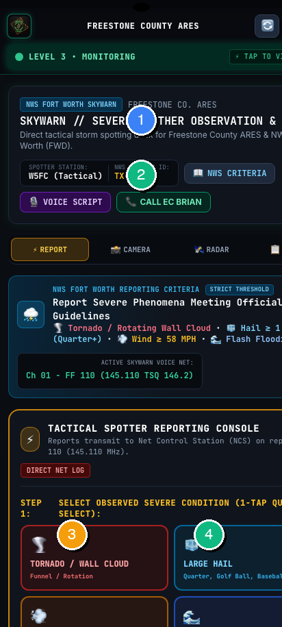
MODULE 09B • TACTICAL STORM CAMERA
HUD CAMERA, GEOTAGGING & SAVING TO PHONE
🎯 WHAT THIS SCREEN IS FOR
Captures photographic storm evidence with a cryptographic tactical watermark stamped onto the image, saving directly to your phone's Camera Roll and attaching to reports.
⚡ STEP-BY-STEP ACTIONS (MARINE-PROOF)
1. Aim device at the storm feature using the HUD reticle crosshairs, digital compass tape, and CST/Zulu clocks (Badge 1).
2. Tap '📸 OPEN CAMERA (SNAP & STAMP)' (Badge 2) to trigger your native camera viewfinder. Snap the photo.
3. Tap '💾 SAVE TO PHONE' (Badge 3): On iPhone/iPad (iOS), the Apple Share Sheet appears—tap 'Save Image' to put it in Apple Photos! On Android, it saves to Downloads/Gallery.
4. Tap '⚡ ATTACH TO REPORT' (Badge 4) to bind this watermarked image to your active storm report before transmitting.
✔ HOW YOU KNOW IT WORKED: The app stamps an unalterable tactical banner onto the photo: Callsign, Spotter ID, Latitude, Longitude, Maidenhead Grid, Elevation, Azimuth Bearing, and 24H/Zulu timestamps.
💡 MARINE-PROOF FIELD TIP // CAUTION
IPHONE USER NOTE: In iOS, tapping '💾 SAVE TO PHONE' opens the standard iOS Share Sheet. Always tap 'Save Image' to store the photo in your native Camera Roll.

Slide 13
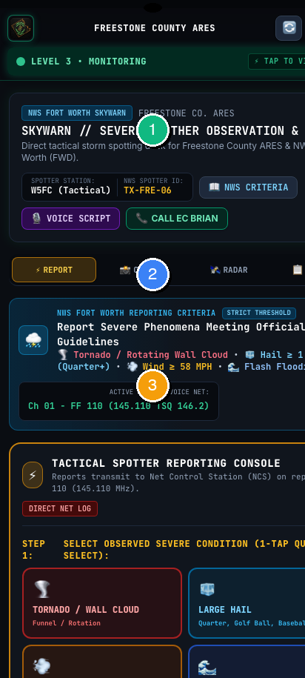
MODULE 09C • LIVE WEATHER RADAR
LIVE COUNTY NEXRAD WEATHER RADAR
🎯 WHAT THIS SCREEN IS FOR
Interactive real-time NEXRAD radar loop centered directly on Freestone County, providing storm cell tracking, precipitation intensity, and regional radar toggles.
⚡ STEP-BY-STEP ACTIONS (MARINE-PROOF)
1. Monitor the live interactive NEXRAD radar loop (Badge 1) centered on Fairfield, Teague, and Freestone County.
2. Use Station Switcher pills (Badge 2) to toggle radar feeds: Freestone County, KFWS (Dallas/Fort Worth), KGRK (Central TX), KHGX (Houston), KSHV (Shreveport).
3. Tap direct NWS resource links (Badge 3) for official NWS Fort Worth Storm Prediction Center convective outlooks and storm warnings.
4. Pinch to zoom in on storm rotation couples, hook echoes, and severe hail cores moving toward county lines.
✔ HOW YOU KNOW IT WORKED: Streams high-resolution composite reflectivity loops. Toggling stations gives line-of-sight elevation cuts from surrounding NWS radar installations.
💡 MARINE-PROOF FIELD TIP // CAUTION
When a supercell approaches from the west, switch to KFWS or KGRK radar stations to inspect mid-level rotation before it enters Freestone County.

Slide 14
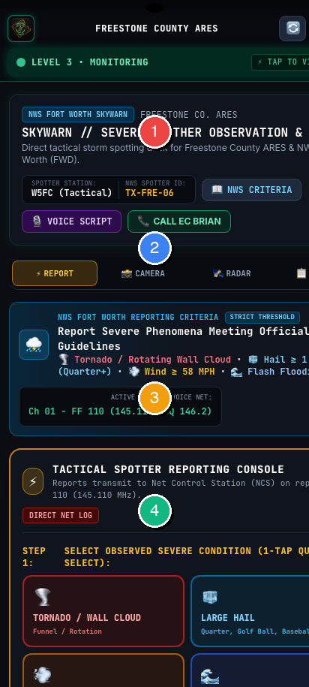
MODULE 09D • STORM LOG & NET RELAY
COUNTY STORM LOG & EMERGENCY NET RELAY
🎯 WHAT THIS SCREEN IS FOR
Real-time chronological log of all severe weather observations submitted across Freestone County, with photo evidence inspection and Net Control relay tools.
⚡ STEP-BY-STEP ACTIONS (MARINE-PROOF)
1. Review the active chronological feed of storm reports (Badge 1) submitted by mobile and stationary spotters.
2. Tap any photo thumbnail (Badge 2) to open the full-screen photo inspection modal and examine storm structure in high resolution.
3. Net Control operators tap '🎙️ GENERATE NET RELAY SCRIPT' (Badge 3) for standardized on-air relay across HF/VHF emergency nets.
4. Tap '📤 WINLINK PACKET EXPORT' (Badge 4) to generate a formatted text report for digital HF RMS gateway transmission when voice repeaters are overloaded.
✔ HOW YOU KNOW IT WORKED: Maintains an unalterable incident timeline of weather ground-truth observations, synchronizing across all connected county responder devices.
💡 MARINE-PROOF FIELD TIP // CAUTION
NET CONTROL TIP: Use the generated Net Relay Script to give NWS Fort Worth instant, formatted reports without having to transcribe handwritten notes.

Slide 15
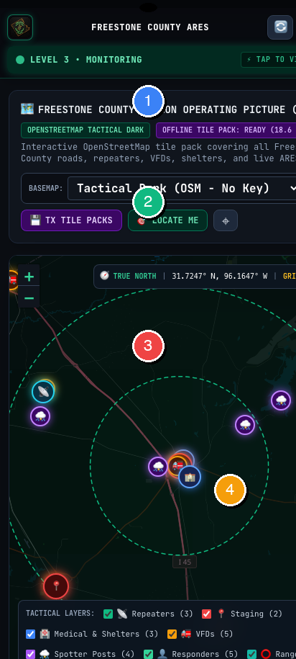
MODULE 10 • OFFLINE MAPPING
OFF-GRID COUNTY TACTICAL MAPS & APRS
🎯 WHAT THIS SCREEN IS FOR
Provides full topographic and road navigation without cellular service, displaying repeater towers, shelters, and live tactical hazard pins.
⚡ STEP-BY-STEP ACTIONS (MARINE-PROOF)
1. The blue beacon (Badge 1) shows your exact real-time GPS location on the county grid.
2. Green and yellow markers (Badge 2) show key infrastructure: Fairfield Tower, Wortham Tower, EOC, Red Cross Shelters.
3. Red markers (Badge 3) highlight active road closures, flooded bridges, and downed power lines.
4. Tap 'DROP TACTICAL PIN' (Badge 4) to mark an obstacle at your current position.
✔ HOW YOU KNOW IT WORKED: Map tiles are stored in your device's offline cache. Zooming and panning work even in airplane mode.
💡 MARINE-PROOF FIELD TIP // CAUTION
Before deploying into rural parts of Freestone County, open this tab once while on Wi-Fi so all regional map tiles are refreshed in cache.

Slide 16
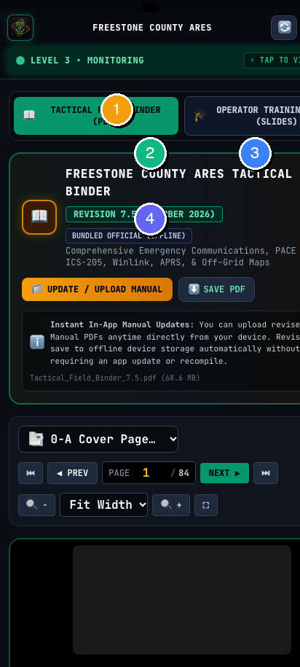
MODULE 11 • FIELD MANUAL
TACTICAL FIELD BINDER (OFFLINE PDF READER)
🎯 WHAT THIS SCREEN IS FOR
Complete offline access to the official 84-page Freestone County ARES Field Manual, deployment checklists, and radio programming guides.
⚡ STEP-BY-STEP ACTIONS (MARINE-PROOF)
1. Tap the CHAPTER JUMP dropdown (Badge 1) to quickly leap to PACE Plans, Winlink setups, or LiFePO4 battery guides.
2. Use the PREV and NEXT buttons (Badge 2) or type a page number to flip through documents.
3. Use the zoom dropdown and fullscreen button (Badge 3) to inspect detailed radio circuit schematics.
4. Tap 'SAVE PDF' (Badge 4) to download an offline copy to your phone's files folder.
✔ HOW YOU KNOW IT WORKED: The built-in PDF viewer renders the complete 84-page manual without needing third-party Adobe or Google Drive apps.
💡 MARINE-PROOF FIELD TIP // CAUTION
You can upload a revised Field Manual PDF anytime using the 'UPDATE / UPLOAD MANUAL' button. Revisions save permanently to your phone.

Slide 17
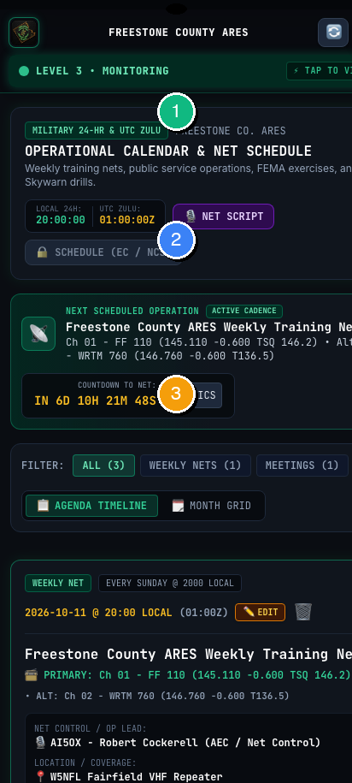
MODULE 12 • SCHEDULES & DRILLS
ARES OPERATIONS CALENDAR & TRAINING NETS
🎯 WHAT THIS SCREEN IS FOR
Keeps you informed of upcoming weekly training nets, monthly club meetings, Skywarn spotter classes, and countywide emergency exercises.
⚡ STEP-BY-STEP ACTIONS (MARINE-PROOF)
1. Review upcoming weekly training net dates and Net Control Station (NCS) assignments in Badge 1.
2. Review county emergency exercises, SET drills, and public service event dates in Badge 2.
3. Tap 'SYNC TO PHONE' (Badge 3) to automatically export all ARES net times into your Android Google Calendar or iOS Apple Calendar.
✔ HOW YOU KNOW IT WORKED: Events display exact start times in both Central Local and Zulu time, along with designated operating frequencies.
💡 MARINE-PROOF FIELD TIP // CAUTION
Freestone County ARES weekly training nets are held every Sunday evening at 2000 Local (8:00 PM) on the Fairfield 145.110 MHz repeater.

Slide 18
⚠️ RESTRICTED ACCESS SECTION
APPENDIX: LEADERSHIP & DELEGATED OPERATORS ONLY
The following modules cover Emergency Coordinator administrative authority, County Activation Posture shifts, and Countywide Siren Paging.
Restricted to Emergency Coordinator Brian Davis (KG5TZT) and officially designated acting EC delegates.

Slide 19
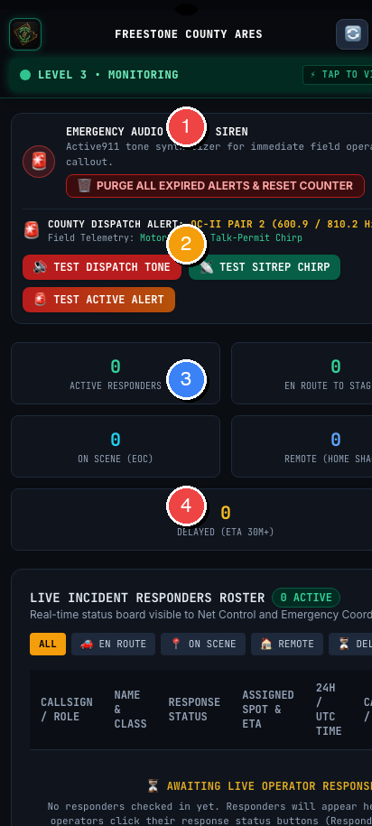
APPENDIX A • LEADERSHIP ONLY
COUNTYWIDE EMERGENCY PAGING & SIREN BROADCAST
🎯 WHAT THIS SCREEN IS FOR
Transmits immediate piercing acoustic sirens and priority emergency pages to every active operator device in Freestone County.
⚡ STEP-BY-STEP ACTIONS (MARINE-PROOF)
1. Select the required siren pattern from Badge 1 (Level 3 Emergency Siren, Standby Chime, or Severe Weather Alert).
2. Test siren tone audio using the buttons under Badge 2 before triggering a live emergency broadcast.
3. Review the active responder board (Badge 3 & 4) to monitor how many operators have checked in as 'En Route' or 'On Scene'.
4. Tap 'PURGE EXPIRED ALERTS' to clear past incident callouts once an incident is demobilized.
✔ HOW YOU KNOW IT WORKED: Activating an alert plays a 3-tone siren on all connected member phones, even if their devices are locked or sleeping.
⚠️ LEADERSHIP DIRECTIVE // RESTRICTED ACCESS
AUTHORITY RESTRICTION: Only EC Brian Davis (KG5TZT) or an operator with active delegation can access this dispatch board.

Slide 20
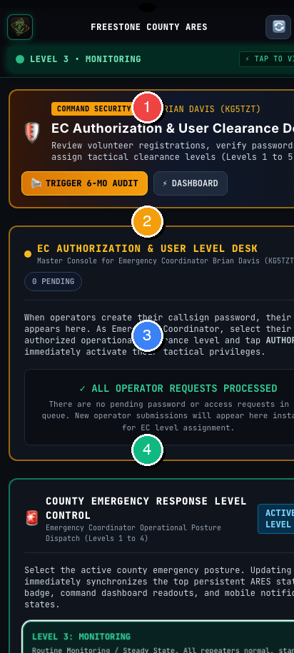
APPENDIX B • LEADERSHIP ONLY
EC SECURITY DESK, CLEARANCE & DELEGATION
🎯 WHAT THIS SCREEN IS FOR
Allows the Emergency Coordinator to authorize new volunteers, adjust operational clearance levels (1 to 5), and grant out-of-town delegation.
⚡ STEP-BY-STEP ACTIONS (MARINE-PROOF)
1. Badge 1 confirms administrative authority for County Emergency Coordinator Brian Davis (KG5TZT).
2. Check Badge 2 & 3: Review incoming volunteer registration requests and tap 'AUTHORIZE' to grant system credentials.
3. Check Badge 4 (COUNTY RESPONSE LEVEL CONTROL): Tap to shift county posture (Level 1 Normal, Level 2 Standby, Level 3 Active Incident).
4. Use the Out-of-Town Delegation card to temporarily delegate activation and siren authority when the EC is away.
✔ HOW YOU KNOW IT WORKED: Shifting the county response level updates the top status bar across all operator devices countywide within 5 seconds.
⚠️ LEADERSHIP DIRECTIVE // RESTRICTED ACCESS
DELEGATION RULE: When returning to Freestone County, always toggle delegation back to OFF to restore sole executive authority to KG5TZT.

Slide 21
EMERGENCY QUICK REFERENCE
FREESTONE COUNTY ARES COMMUNICATIONS CHEAT SHEET
EMERGENCY COORDINATOR
Brian Davis (KG5TZT) • County EC
Responsible for County Activation Posture, incident assignments, and EOC coordination.
PRIMARY REPEATER [P]
FF 110: 145.110 MHz (-600 kHz offset, TSQ 146.2 Hz)
Fairfield high-elevation site. Primary countywide operations & weekly training nets.
ALTERNATE REPEATER [A]
WRTM 760: 146.760 MHz (-600 kHz offset, CTCSS Tone 136.5 Hz)
Wortham site. Secondary countywide backup when Primary repeater experiences outage.
TACTICAL SIMPLEX [C]
ARES TAC: 146.580 MHz Simplex (Direct point-to-point)
Contingency method used when commercial electrical grid and all repeaters fail.

