Slide 1
Introduction to Game Design

Slide 2




Who Am I?
Chris Gardner
Chairman – DevSpace Technical Conference
Sr. Software Engineer – Trainer Road
Microsoft MVP – VS & Dev Technologies
MCT Regional Lead – Eastern US

Slide 3
Road Map
Tools
Design Fundamentals
Components
World
Inputs
Demo Time

Slide 4

Tools
There is no golden hammer in game development
Page Source: http://deviq.com/golden-hammer
Image Source: http://deviq.com/Media/Default/Article/golden-hammer/GoldenHammer.jpg

Slide 5
Engine Based Tools
Kudo / Project Spark
Scratch
http://scratch.mit.edu/
Construct 2
https://www.scirra.com/

Slide 6
Engine Based Tools
Unity
http://unity3d.com/
Unreal Engine
https://www.unrealengine.com/
CryEngine
http://www.cryengine.com

Slide 7
Ground Up Tools
Native
Platform specific
MonoGame (XNA)
http://www.monogame.net/
DirectX
http://msdn.microsoft.com/directx
OpenGL
https://www.opengl.org/

Slide 8
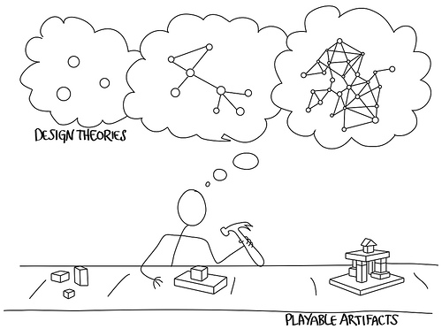
Game Design Fundamentals
Everything you need to know before getting started

Slide 9
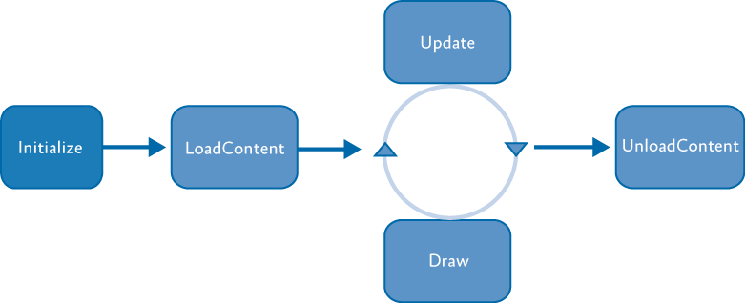
General Architecture
Game Loop

Slide 10
Initialize
Prepare all global objects for the game
Timers
World / Level constants
Components

Slide 11
Load Content
Load and store external asset from storage
Textures
Sprites / Sprite Sheets
Audio

Slide 12
Update
Process any necessary changes to the world
Process user input
Run AI
Update necessary objects
Collision detection
State changes
Score
Lives

Slide 13
Draw
Create all screen changes
Place updates on the Back Buffer
Swap Back Buffer with current screen content

Slide 14
Unload Content
Release necessary resources

Slide 15
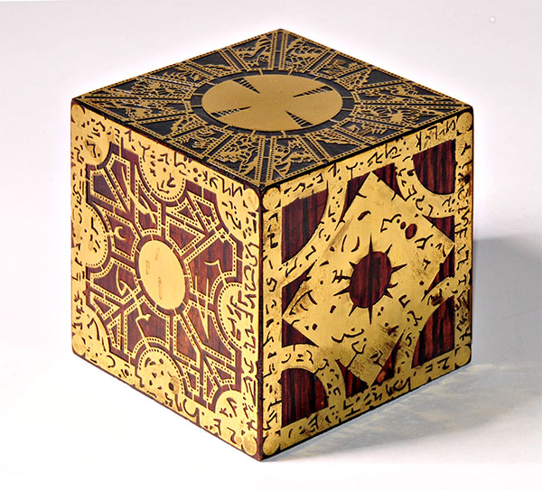
Component Design
“Breaking up, it’s easy to do” – Violent Femmes
Page Source: http://www.365horrormovie.com/2011/03/18/hellraiser-revelations/lament-configuration-box/
Image Source: http://www.365horrormovie.com/wp-content/uploads/2011/03/Lament-Configuration-Box.jpg

Slide 16
Game Components
Act as independent, reusable objects that fallow the same basic form as the overall game.
Contain functions that correspond to each stage in the game loop

Slide 17
Separation of Concerns
Components should only worry about their concerns
Components can, and should, view the world to make decisions
Components cannot “change” the world, only themselves.
The world should deal with interactions between components and other components or the world

Slide 18
Suggested Order
Update
The world updates the world
The world tells every component to update
The world ensures consistency
Components did not break world rules
Component interactions
Component removal
Draw
World draws relevant items to screen

Slide 19
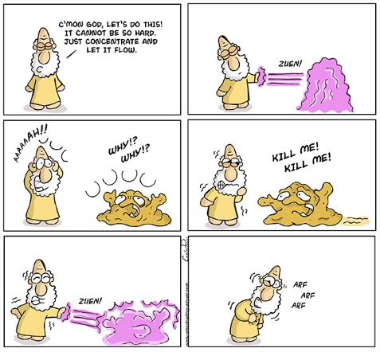
The World
I don’t have a God complex, I’m a game designer
Page Source: http://www.onceuponasaturday.com/478-first-sketches/
Image Source: http://www.onceuponasaturday.com/wp-content/uploads/2014/09/525-–-First-Sketches.jpg

Slide 20
What does the World do?
Time
Keep a running timer.
Base things off of timing offset

Slide 21
What does the World do?
Physics
Physics engines are available
Havok: http://www.havok.com/havok-sales

Slide 22
What does the World do?
Camera
Even if the camera is a player (FPS)
The player component only knows about itself
The world can ensure only necessary object are displayed
Don’t waste processor time rendering things you can’t see
Remember, just because you can’t see it doesn’t mean it’s not there

Slide 23
What does the World do?
State
Check inputs
Update control object: Either
Present both current and last control state
Present single object that evaluated the changes between the two

Slide 24
What does the World do?
Events
Timing based
Create a new enemy every second
World based
Day / night changes
Position based
Enemies created when you pass a point

Slide 25
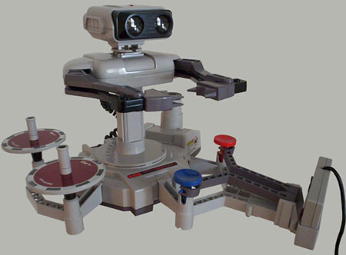
Inputs
Remember to make them usable
Page Source: http://balduin.wordpress.com/2007/01/16/rob-the-nintendo-famicom-robot/
Image Source: http://www.bermuda.ch/balduin/blog/rob.jpg

Slide 26
Types of Inputs
Digital
Analog
Natural
Network

Slide 27
Digital
Keyboard
Mouse
Buttons
Scroll Wheel
Controllers
Buttons
D-Pad
Touch
Tap

Slide 28
Analog
Mouse
Movement
Scroll Wheel
Controllers
Analog Sticks
Triggers
Touch
Offset from point (Think analog stick)

Slide 29
Natural
Touch
Gestures
Kinect
Leap Motion

Slide 30
Network
For online gaming
Notification of movement for other players
Can be
Notification of new location
Notification of Player’s inputs

Slide 31
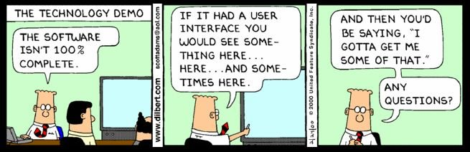
Demo Time
Wish me luck…

Slide 32

Thank You
Chris Gardner
@freestylecoder
cgardner@gmail.com
github.com/freestylecoder
DevSpace Technical Conference
@devspaceconf
info@devspaceconf.com
https://www.devspaceconf.com
Page Source: https://jaseandjax.wordpress.com/2014/05/06/no-one-expects-the-spanish-inquisition/
Image Source: https://jaseandjax.files.wordpress.com/2014/05/wpid-img_3278.jpg?w=545

