Slide 1
Introduction to Game Design

Slide 2


Who Am I?
Chris Gardner
Chairman – DevSpace Technical Conference
Sr. Software Engineer – The Tombras Group
Microsoft MVP – Development Technologies

Slide 3
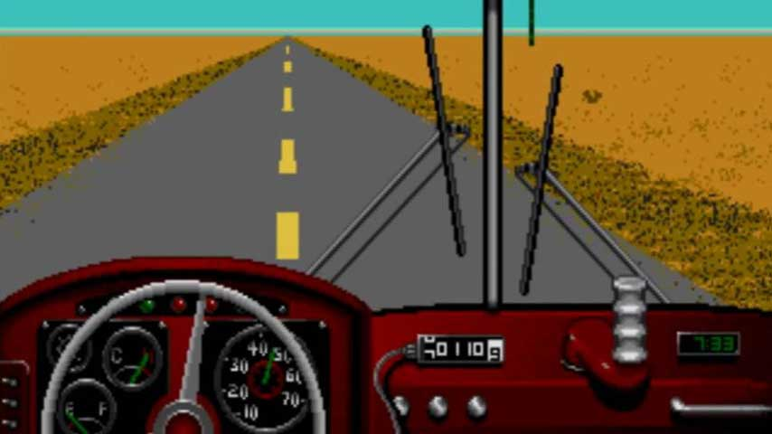
Road Map
Page Source: https://www.vg247.com/2015/11/16/desert-bus-for-hope-9-underway-watch-people-suffer-for-charity/
Image Source: http://assets.vg247.com/current//2015/11/desert_bus.jpg
Notes:
Tools
Inputs
Design Fundamentals
Components
World

Slide 4

Tools
Page Source: http://www.nintendolife.com/forums/wii-u/paper_mario_u
Image Source: http://www.the-nextlevel.com/media/gcn/paper-mario2/paper-mario211.jpg
Notes:
There is no golden hammer in game development

Slide 5




Engine Based Tools
Image attribution in notes
Notes:
All of these engines are more drag and drop with minimal coding
Scratch => https://scratch.mit.edu/
Construct 3 => https://www.scirra.com/
GameMaker Studio 2 => https://www.yoyogames.com/
Clickteam Fusion => https://www.clickteam.com/
Images:
Scratch
Page: https://en.scratch-wiki.info/wiki/Scratch_Media
Construct 3
Page: https://editor.construct.net/
GameMaker 3
Page: https://www.yoyogames.com/brand
ClickTeam Fusion
Page: https://www.clickteam.com

Slide 6



Engine Based Tools
Notes:
These give you the game engine, but require extensive programming
Unity => http://unity3d.com/
Unreal Engine => https://www.unrealengine.com/
CryEngine => http://www.cryengine.com
Unity: https://unity3d.com/public-relations/downloads
Unreal Engine: https://www.unrealengine.com/en-US/branding
CryEngine: https://press.cryengine.com/media#

Slide 7
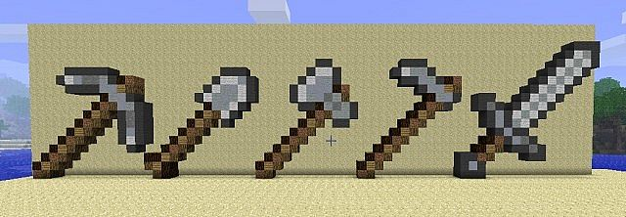
Raw Tools
Page Source: https://www.planetminecraft.com/project/tools-pixel-art/
Image Source: https://static.planetminecraft.com/files/resource_media/screenshot/1117/minecraft-tools-pixel-art_35416_screenshot.jpg
Notes:
These allow you to do whatever you want, but you have to do it all yourself.
Native => Platform specific
MonoGame (XNA) => http://www.monogame.net/
DirectX => http://msdn.microsoft.com/directx
OpenGL => https://www.opengl.org/

Slide 8
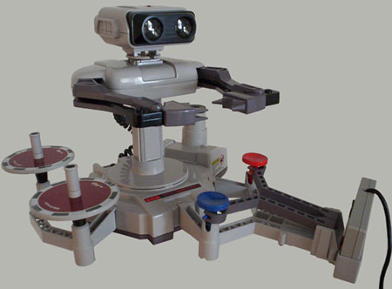
Inputs
Page Source: http://balduin.wordpress.com/2007/01/16/rob-the-nintendo-famicom-robot/
Image Source: http://www.bermuda.ch/balduin/blog/rob.jpg
Notes:
Remember to make them usable

Slide 9

Types of Inputs
Digital
Analog
Natural
Network
Page Source: https://segmentnext.com/2016/01/23/the-evolution-of-video-game-controllers-documented-in-a-video/
Image Source: http://cdn.segmentnext.com/wp-content/uploads/2016/01/Video-Games-Controllers.jpg

Slide 10
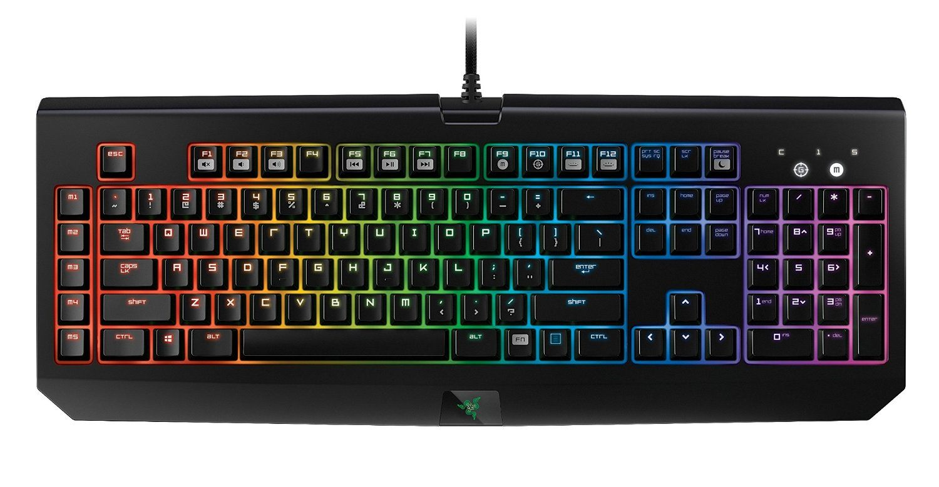
Digital
Keyboard
Mouse
Buttons
Scroll Wheel
Controllers
Buttons
D-Pad
Touch
Tap
Page Source: https://www.wiknix.com/best-gaming-keyboard-2015-gaming-keyboard-review/
Image Source: https://www.wiknix.com/wp-content/uploads/2015/03/Razer-BlackWidow-Chroma-Clicky-Mechanical-Gaming-Keyboard.jpg

Slide 11
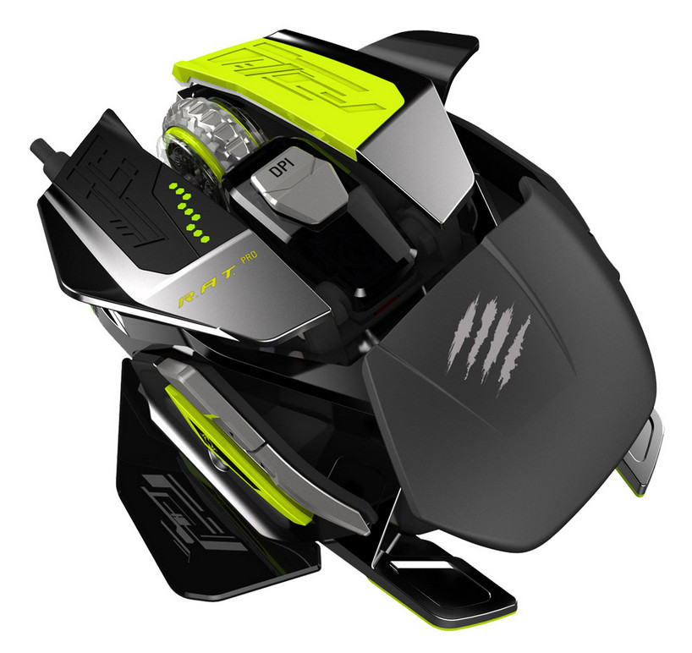
Analog
Mouse
Movement
Scroll Wheel
Controllers
Analog Sticks
Triggers
Touch
Offset from point (Think analog stick)
Page Source: https://www.techpowerup.com/216180/mad-catz-ships-the-r-a-t-prox-gaming-mouse
Image Source: http://www.techpowerup.com/img/15-09-21/Mad_Catz_R.A.T._PROX_001.jpg

Slide 12
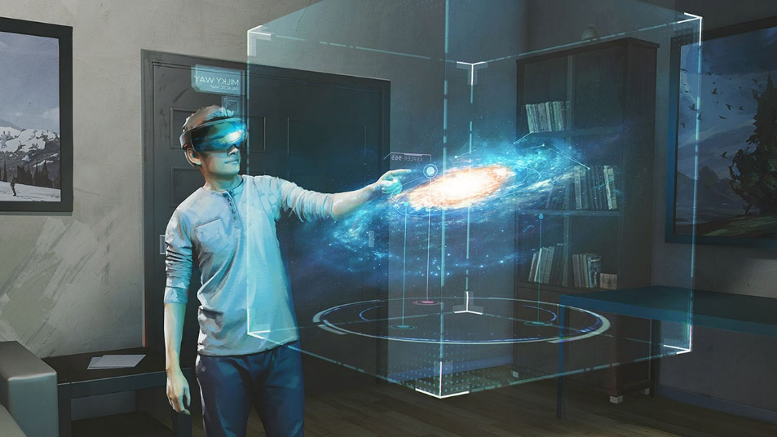
Natural
Touch
Gestures
Kinect
Leap Motion
Page Source: https://mspoweruser.com/build-2016-microsoft-studios-galaxy-explorer-app-hololens-released-windows-store/
Image Source: https://mspoweruser.com/wp-content/uploads/2016/03/Hololens-Galaxy-Explorer.jpg

Slide 13

Network
For online gaming
Notification of movement for other players
Can be
Notification of new location
Notification of Player’s inputs
Page Source: http://clipart-library.com/clipart/kiKopr9rT.htm
Image Source: http://clipart-library.com/clipart/kiKopr9rT.htm

Slide 14
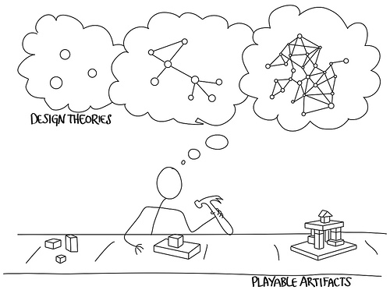
Game Design Fundamentals
Notes:
Everything you need to know before getting started

Slide 15
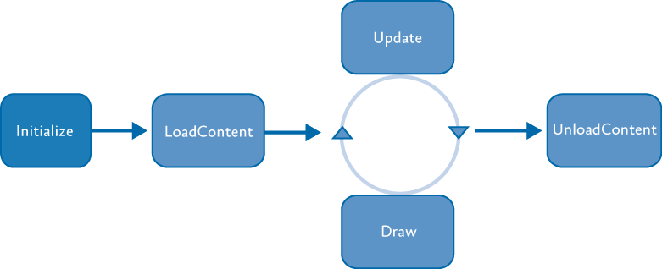
General Architecture
Notes:
Game Loop

Slide 16
Initialize
Prepare all global objects for the game
Timers
World / Level constants
Components

Slide 17
Load Content
Load and store external asset from storage
Textures
Sprites / Sprite Sheets
Audio

Slide 18
Update
Process any necessary changes to the world
Process user input
Run AI
Update necessary objects
Collision detection
State changes
Score
Lives

Slide 19
Draw
Create all screen changes
Place updates on the Back Buffer
Swap Back Buffer with current screen content

Slide 20
Unload Content
Release necessary resources

Slide 21
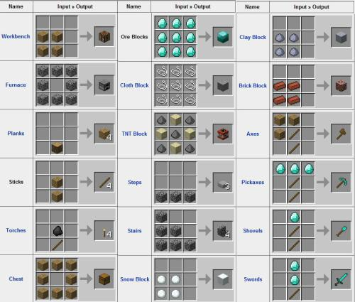
Component Design
Page Source: https://bananascoop.com/2012/07/27/minecraft-the-new-age-settler/
Image Source: https://bananascoop.files.wordpress.com/2012/07/minecrafting.jpeg?w=500&h=425

Slide 22

Game Components
Page Source: https://pixabay.com/en/minecraft-grass-brick-block-grass-1816996/
Image Source: https://cdn.pixabay.com/photo/2016/11/11/14/49/minecraft-1816996_960_720.png
Notes:
Act as independent, reusable objects that fallow the same basic form as the overall game.
Contain functions that correspond to each stage in the game loop

Slide 23

Separation of Concerns
Page Source: https://garrysmods.org/download/30985/goomba-and-koopa-troopa
Image Source: https://filecache.garrysmods.org/30985/1/390x248.jpg
Notes:
Components should only worry about their concerns
Components can, and should, view the world to make decisions
Components cannot “change” the world, only themselves.
The world should deal with interactions between components and other components or the world

Slide 24
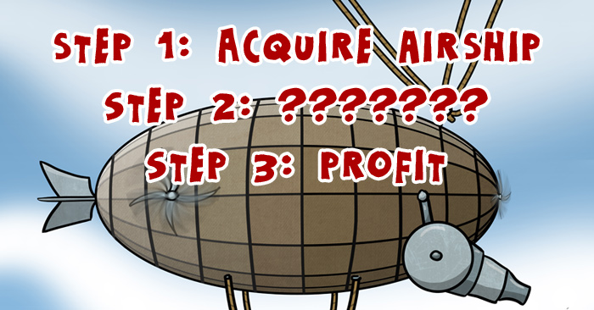
Suggested Order
Page Source: http://www.rockpapercynic.com/index.php?date=2013-10-22
Image Source: http://www.rockpapercynic.com/strips/2013-10-22-turtle-zeppelin-conquest.jpg
Notes:
Update
The world updates the world
The world tells every component to update
The world ensures consistency
Components did not break world rules
Component interactions
Component removal
Draw
World draws relevant items to screen

Slide 25
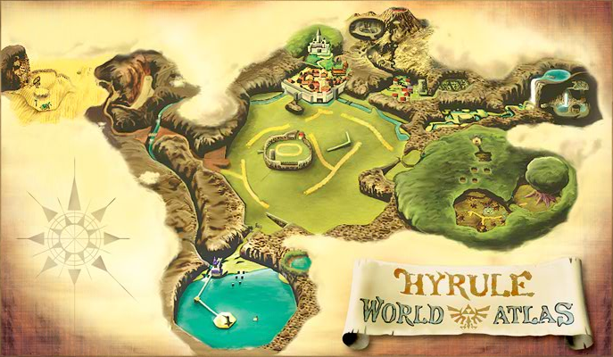
The World
Page Source: http://retrovolve.com/how-my-journey-through-hyrule-made-me-a-better-person/
Image Source: http://retrovolve.com/wp-content/uploads/2014/11/OOT3D_Map_of_Hyrule.png

Slide 26
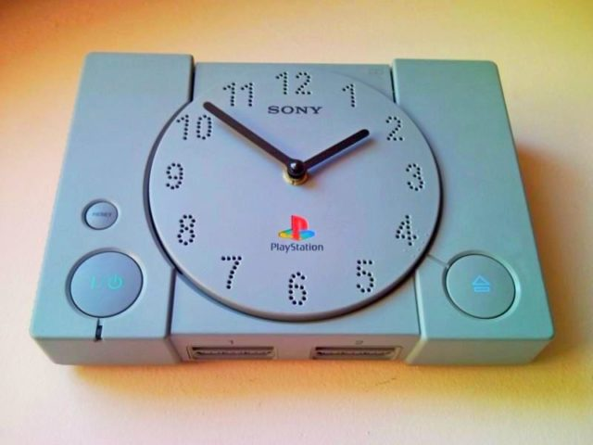
What does the World do?
Page Source: https://creativefunny.com/shop/sold/clock-sold/sony-playstation-video-game-wall-clock-2
Image Source: http://creativefunny.com/wp-content/uploads/2016/06/3-1-sony-playstation-ps1-play-station-retro-video-game-first-console-child-childhood-wall-clock-unique-handmade-gift-upcycled-recycling-art-creative-funny.jpg
Notes:
Time
Keep a running timer.
Base things off of timing offset

Slide 27
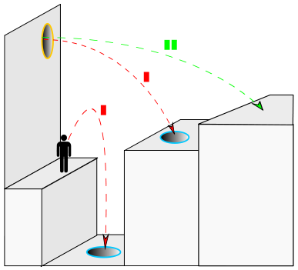
What does the World do?
Page Source: https://commons.wikimedia.org/wiki/File:Portal_physics-3.svg
Image Source: https://upload.wikimedia.org/wikipedia/commons/thumb/3/39/Portal_physics-3.svg/387px-Portal_physics-3.svg.png
Notes:
Physics
Physics engines are available
Havok: http://www.havok.com/havok-sales

Slide 28
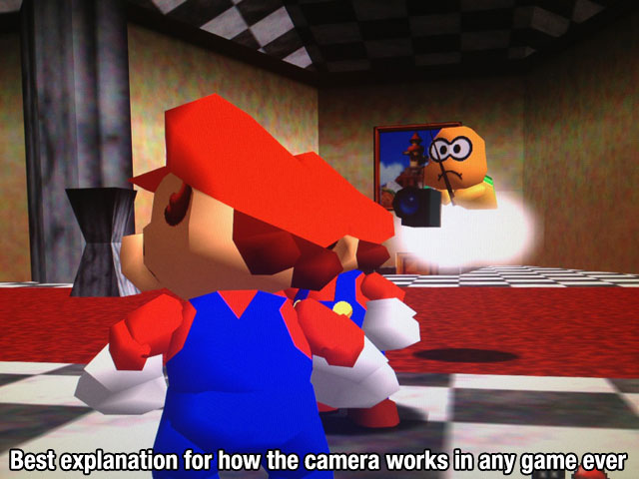
What does the World do?
Page Source: http://cavemancircus.com/2013/06/13/video-gamers-assemble-this-post-is-for-you/
Image Source: http://www.cavemancircus.com/wp-content/uploads/images/2013/june/video_games/video_games_12.jpg
Notes:
Camera
Even if the camera is a player (FPS)
The player component only knows about itself
The world can ensure only necessary object are displayed
Don’t waste processor time rendering things you can’t see
Remember, just because you can’t see it doesn’t mean it’s not there

Slide 29

What does the World do?
Page Source: https://wallpapercave.com/pac-man-wallpaper
Image Source: https://wallpapercave.com/wp/l8gP5DT.png
Notes:
State
Check inputs
Update control object: Either
Present both current and last control state
Present single object that evaluated the changes between the two

Slide 30
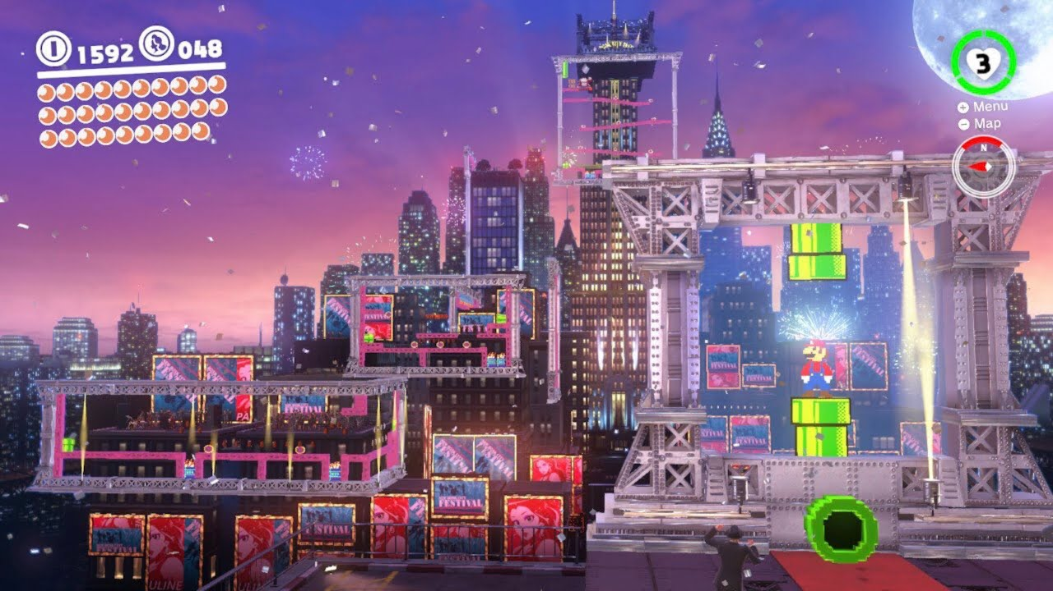
What does the World do?
Page Source: https://www.youtube.com/watch?v=6uKiGOA8hQ4
Image Source: https://i.ytimg.com/vi/6uKiGOA8hQ4/maxresdefault.jpg
Notes:
Events
Timing based
Create a new enemy every second
World based
Day / night changes
Position based
Enemies created when you pass a point

Slide 31
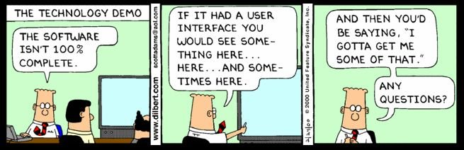
Demo Time
Wish me luck…

Slide 32

Thank You
Chris Gardner
@freestylecoder
cgardner@gmail.com
github.com/freestylecoder
DevSpace Technical Conference
@devspaceconf
info@devspaceconf.com
https://www.devspaceconf.com
Page Source: https://jaseandjax.wordpress.com/2014/05/06/no-one-expects-the-spanish-inquisition/
Image Source: https://jaseandjax.files.wordpress.com/2014/05/wpid-img_3278.jpg?w=545

