Slide 1

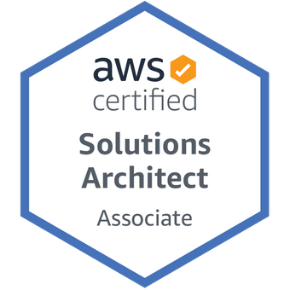
AWS Solution Architect Associate – Certification Free Hands-On Course
FR
FABRIKAM RESIDENCES
தமிழில்

Slide 2
What is this play list about
Free Tech Tamil – YouTube Channel –
இலவச ட்ரெண்டிங் டெக்னாலஜிஸ் படிப்புகள் - தமிழில்
AWS Cloud – Solution Architect Associate Certification – syllabus
Complete Hands On.
Maximum 15 minutes /per video
Completely practical oriented

Slide 3
What is Cloud?
Cloud – Nothing but infrastructure.
Server, Software, Storage, Network – Everything belongs to Cloud.
Brick Mortar Vs Cloud
All infrastructure steps applied to cloud

Slide 4
What is Cloud?
AWS, Azure, Google Cloud and other 14 Cloud
Suggest to learn AWS as first
Learning AWS is must for the future.
AWS Solution Architect Associate – syllabus covered here.

Slide 5
Study Plan
Theory Covered Daily.
Practice Daily.
Free Tier for 12 months.
After practice – Get certified within stipulated time.

Slide 6

Subscribe Now
Thanks for Visiting

