Slide 1
OCLWN Coherent Noise Generator
Team Members
Richard Klafter
Eric Swanson
Eric Roth

Slide 2
Problem Statement
Coherent noise used for a wide range of tasks including terrain generation and natural looking texture generation.
Generating coherent noise consists of many operations at thousands of points and is therefore computationally expensive.
There are several popular open source coherent noise generations targeting the CPU (http://libnoise.sourceforge.net/) but none targeting the GPU.

Slide 3
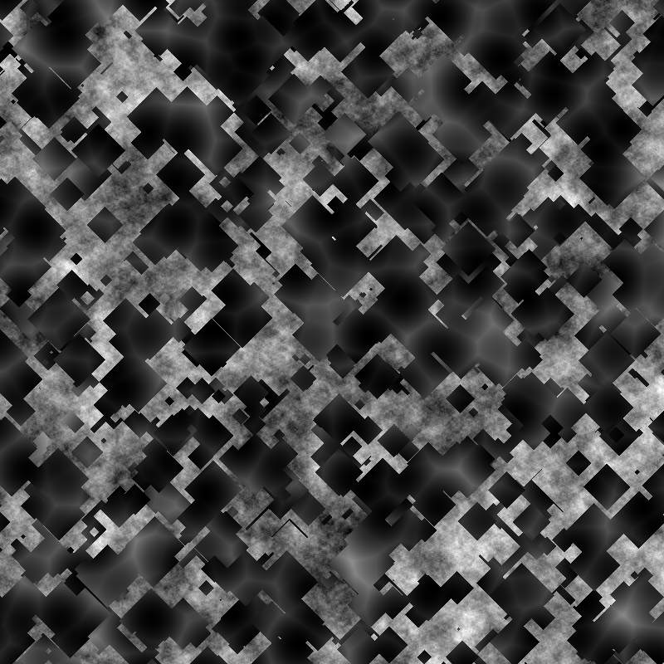

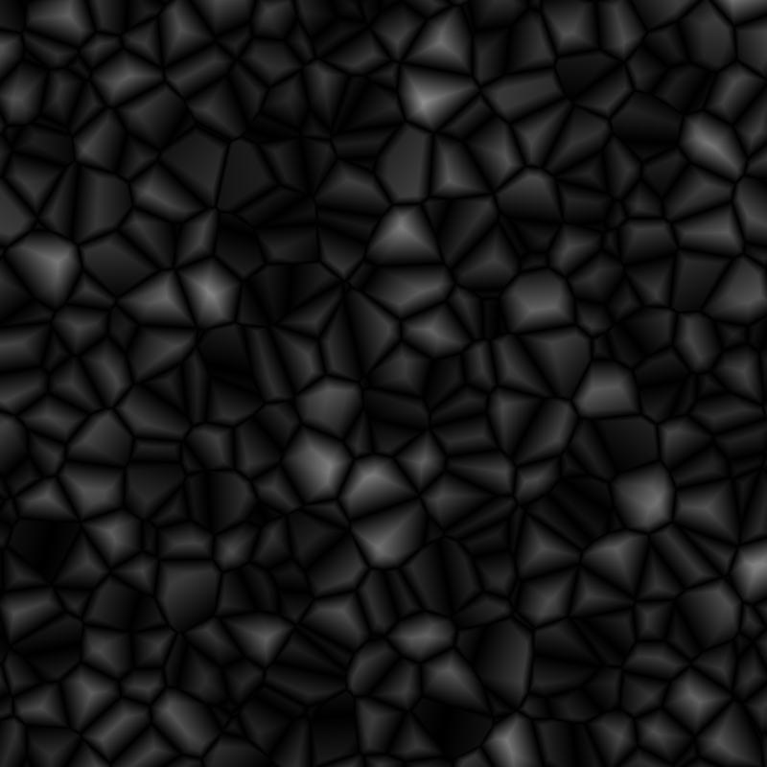
Examples of 2D Coherent Noise
Below are examples of 2D coherent noise generated using our library.

Slide 4
Approach
OpenCL: hardware availability
DAG most flexible, but hard to construct
Solution: restrict to directed trees
OpenCL code is compiled at runtime, so why not generate at runtime?
Python used to construct, compile, and run graphs.
Trees created by populating stack
Easily design noise trees without a GUI
Easy to save and load trees from file

Slide 5
Approach (Cont’d)
Chunk the input to get around memory limitations
Multiple kernel invocations
“PointColor”
Point (x, y, z, unused) – calculated by kernel
Color (r, g, b, a)
Return array of RGBA vectors (float4) from GPU

Slide 6
Example Stack
fs.push(cs)
fs.push(Worley(distance='manhattan', seed=809))
fs.push(cs)
fs.push(Worley(distance='manhattan', seed=908))
fs.push(cs)
fs.push(Worley(distance='manhattan'))
fs.push(cs)
fs.push(Perlin())
fs.push(cs)
fs.push(Worley(seed=666))
fs.push(Select())
fs.push(cs)
fs.push(Perlin(seed=897))
fs.push(Select())
fs.push(cs)
fs.push(Worley(seed=234))
fs.push(Select())

Slide 7
Results
AMD has drivers supporting OpenCL on Athlons
Best alternative implementation libnoise limited
Therefore, compare our own code running on CPU to GPU run times
Not true sequential – dual core CPU

Slide 8
20x Speedup !
Results

Slide 9
Improvements
Adjust global work size
Initially: used constant (2048)
Optimized: limited by the available memory
Return (optionally) byte4 rather than float4 from GPU

Slide 10
Improvements

Slide 11
Example of 3D Coherent Noise
Minecraft!
Log on to:
aftbit.com

Slide 12
Summary
Impressive speedup
Extremely parallel program
Algorithms chosen to avoid any global operations
http://github.com/freethenation/openclnoise
Questions?

