Slide 1
OCLWN Coherent Noise Generator
Team Members
Richard Klafter
Eric Swanson
Eric Roth

Slide 2
Problem Statement
Coherent noise used for a wide range of tasks including terrain generation and natural looking texture generation.
Generating coherent noise consists of many operations at thousands of points and is therefore computationally expensive.
There are several popular open source coherent noise generations targeting the CPU (http://libnoise.sourceforge.net/) but none targeting the GPU.

Slide 3
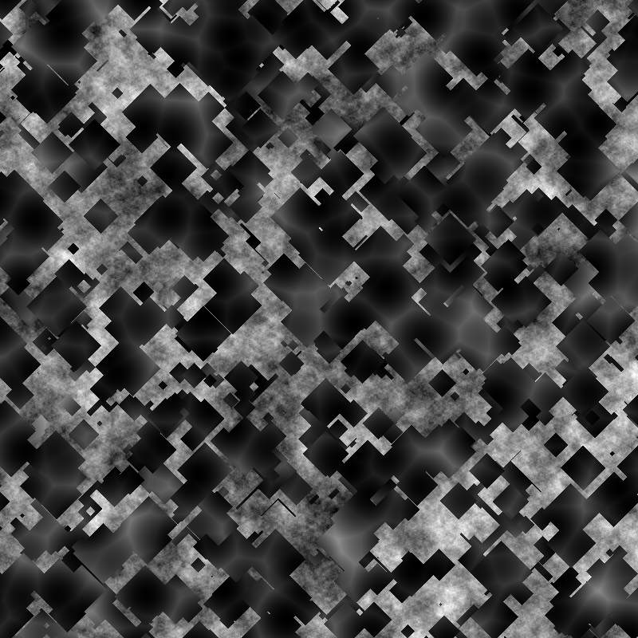
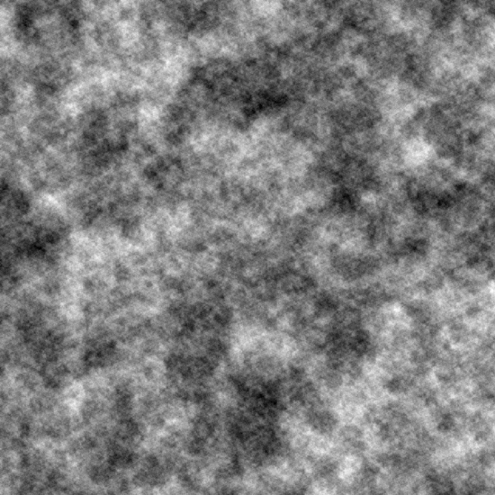
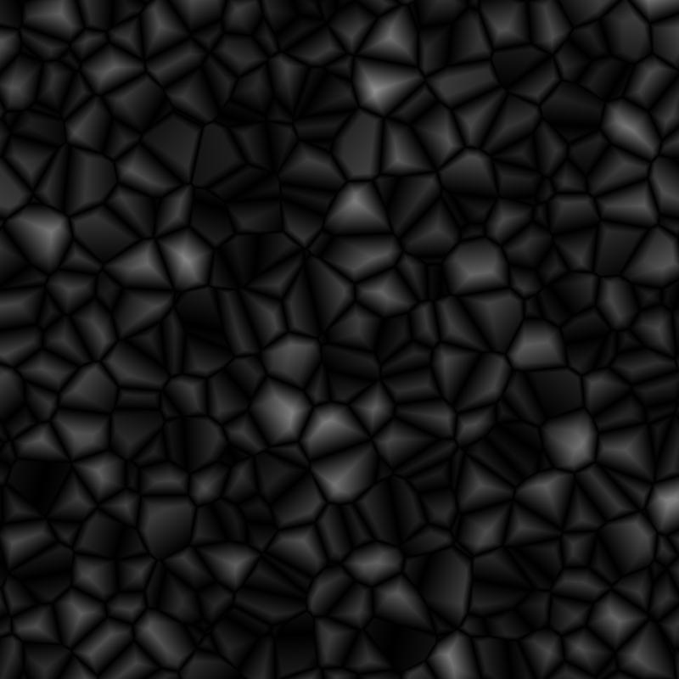
Examples of 2D Coherent Noise
Below are examples of 2D coherent noise generated using our library.

Slide 4
Approach
We decided to use OpenCL rather than CUDA because OpenCL hardware is more readily available
A directed graph with no cycles is the most flexible structure for combining different noise functions but is complex to construct and evaluate. Therefore, our library will restrict noise function graphs to directed trees.
The code which evaluates the noise functions will be written in OpenCL. OpenCL does not have support for function pointers or anything similar so in order to enable different trees to be constructed the source code for the trees will have to be generated at runtime. This should not be an issue because OpenCL allows runtime compilation. Python will be used to construct, compile, and run graphs.
In order to best utilize Python’s interactive nature and allow users to interactively design noise trees, the trees will be created by populating a stack. This will allow users to easily design noise trees without a GUI using python code. For example the noise tree

Slide 5
Results
NVIDIA has written a driver that will allow OpenCL to run on the CPU.
We verified our performance improvement by running our code on the CPU using NVIDIA’s driver and comparing the results to our code running on the GPU.

Slide 6
20x Speedup !
Results

Slide 7
Improvements
We implemented two improvements in an effort to improve performance
The first improvement was to adjust the work size to maximum allowed. Work size is limited by the available memory.
The second improvement was to optionally return byte4 rather than float4 from the GPU.

Slide 8
Improvements

Slide 9
Summary

