Slide 1
Dynamics 101
Jim Van Verth
Red Storm Entertainment
jimvv@redstorm.com

Slide 2
What is Dynamics?
Want to move objects through the game world in the most realistic manner possible
Applying velocity not enough – need ramp up, ramp down – acceleration
Same with orientation

Slide 3

Calculus Review
Have function y(t)
Function y'(t) describes how y changes as t changes (also written dy/dt, or )
y'(t) gives slope at time t
y
y(t)
y(t)
y'(t)
y'(t)
t

Slide 4

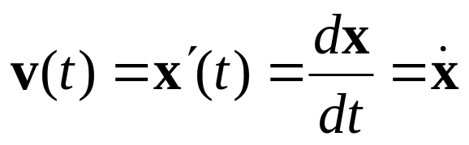
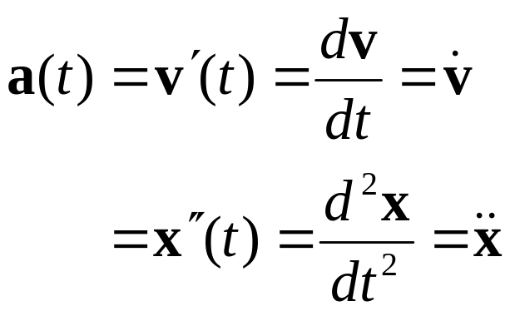
Calculus Review
Our function is position:
Derivative is velocity:
Derivative of velocity is acceleration

Slide 5
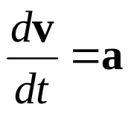
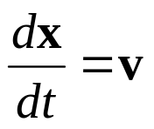
Basic Newtonian Physics
All objects affected by forces
  Gravity
  Ground (pushing up)
  Other objects pushing against it
Force determines acceleration (F = ma)
Acceleration changes velocity ( )
Velocity changes position ( )

Slide 6
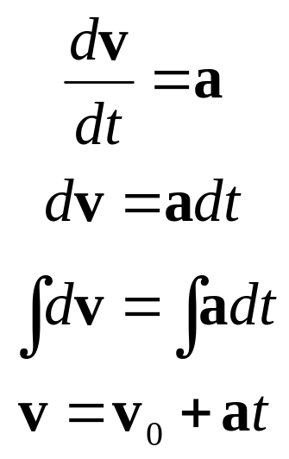
Basic Newtonian Physics
Assume acceleration constant, then

Slide 7
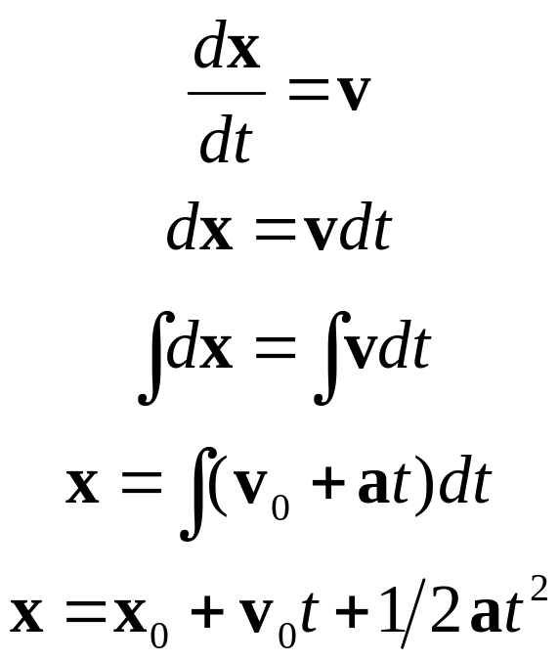
Basic Newtonian Physics
Similarly

Slide 8
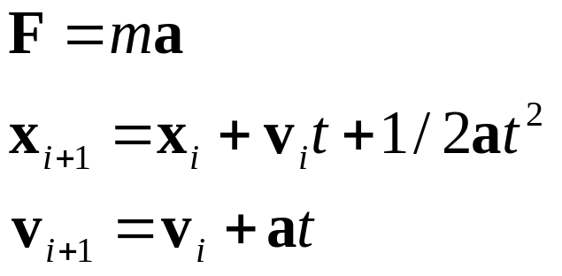
Basic Newtonian Physics
Key equations

Slide 9

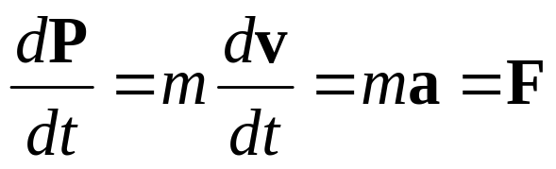
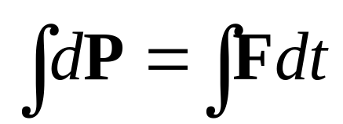
Basic Newtonian Physics
One other quantity: momentum P
Note: force is derivative of momentum P
Integrate similarly:
  Remember for later – easier for angular

Slide 10
Basic Newtonian Physics
General approach
  Compute all forces on object, add up
  Compute acceleration
    (divide total force by mass)
  Compute new position based on old position, velocity, acceleration
  Compute new velocity based on old velocity, acceleration

Slide 11
Newtonian Physics
Works fine if acceleration is constant
Not good if acceleration dependant on position or velocity – changes over time step
E.g. spring force: F_{spring} = –kx
E.g. drag force: F_{drag} = –mρv

Slide 12
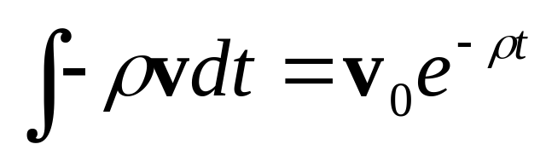
Analytic Solution
Can try and find an analytic solution
  I.e. a formula for x and v
  In case of simple drag:
  But not always a solution
  Or may want to try different simulation formulas
Better: approximate w/stepwise solution

Slide 13
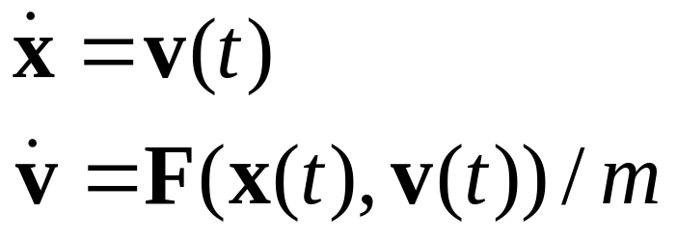
Numeric Solution
Problem: Physical simulation with force dependant on position or velocity
Start at x(0) = x₀, v(0) = v₀
Only know:
Want: x(h), v(h) for some small h
Basic solution: Euler’s method

Slide 14


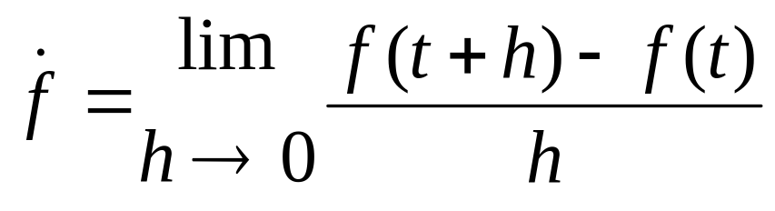
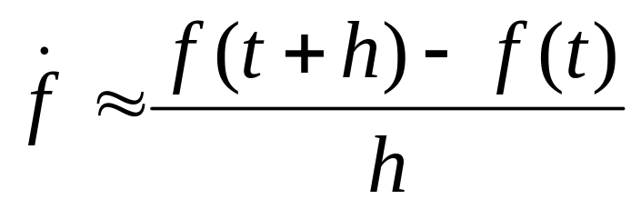
Euler’s Method
Idea: we have the slope ( or )
From calculus, know that
For sufficiently small h:

Slide 15
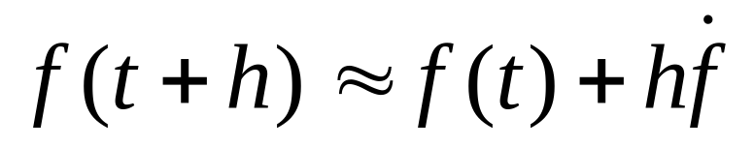
Euler’s Method
For sufficiently small h:
Can re-arrange as:
Gives us next function value in terms of current value and current derivative

Slide 16

Euler's Method
Step across vector field of functions
Not exact, but close
x
x₀
x₁
x₂
t

Slide 17
Euler’s Method
Has problems
  Expects the slope at the current point is a good estimate of the slope on the interval
  Approximation can drift off the actual function – adds energy to system!
  Gets worse the farther we get from known initial value
  Especially bad when time step gets larger

Slide 18
Euler’s Method (cont’d)
Example of drift
x
x₀
x₂
t
x₁

Slide 19
Stiffness
Running into classic problem of stiff equations
Have terms with rapidly decaying values
Faster decay = stiffer equation = need smaller h
Often seen in equations with stiff springs (hence the name)

Slide 20
Midpoint Method
Take two approximations
Approximate at half the time step
Use slope there for final approximation
x
x₀
h
x₁
h/2
x_{0.5}
t

Slide 21
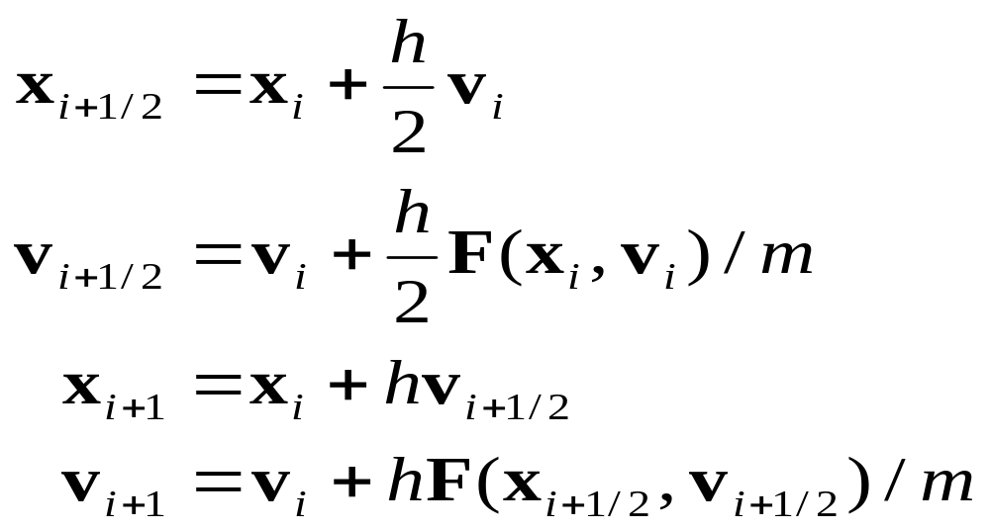
Midpoint Method
Writing it out:
Can still oscillate if h is too large

Slide 22
Runge-Kutta
Use weighted average of slopes across interval
How error-resistant indicates order
Midpoint method is order two
Usually use Runge-Kutta Order Four, or RK4

Slide 23
Runge-Kutta (cont’d)
Better fit, good for larger time steps
Expensive – requires many evaluations
If function is known and fixed (like in physical simulation) can reduce it to one big formula
But for large timesteps, still have trouble with stiff equations

Slide 24
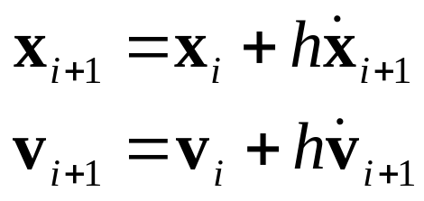
Implicit Methods
Explicit Euler methods add energy
Implicit Euler removes it
Use next velocity, not current
E.g. Backwards Euler:
Better for stiff equations

Slide 25
Implicit Methods
Result of backwards Euler
Solution converges more slowly
But it converges!
x
x₀
x₁
x₂
t

Slide 26
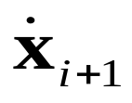
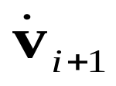
Implicit Methods
How to compute or ?
  Derive from formula (most accurate)
  Compute using explicit method and plug in value (predictor-corrector)
  Solve using linear system (slowest, but general)
  Run Euler’s in reverse: compute velocity first, then position (called symplectic Euler).

Slide 27
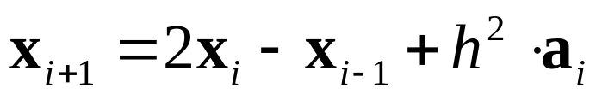
Verlet Integration
Velocity-less scheme
From molecular dynamics
Uses position from previous time step
Stable, but velocity estimated
Has error similar to symplectic Euler
Good for particle systems, not rigid body

Slide 28
Which To Use?
In practice, Midpoint or Euler’s method may be enough if time step is small
At 60 fps, that’s probably the case
In case of long frame times, can clamp simulation time step to 1/10 sec
Having trouble w/sim exploding? Try symplectic Euler or Verlet

Slide 29
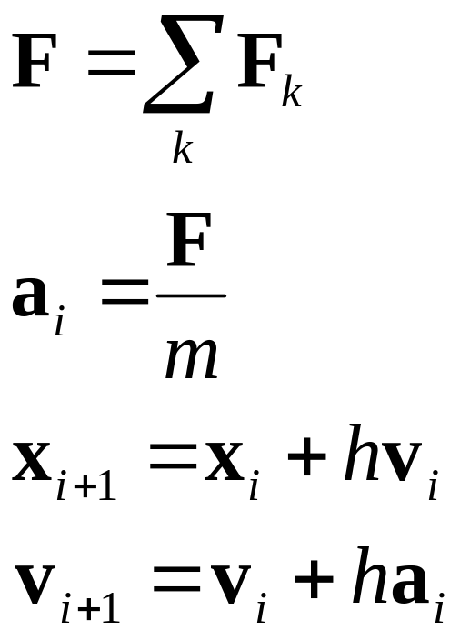
Final Formulas
Using Euler’s method with time step h

Slide 30
What About Orientation?
Previous assumption:
  Force (F) applied anywhere on body creates translation
Reality:
  Force (F) applies to center of mass of object – creates translation
  Force (F) applied anywhere else, also creates rotation

Slide 31
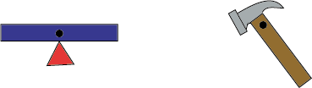
Center of Mass
Point on body where applying a force acts just like single particle
“Balance point” of object
Varies with density, shape of object
Pull/push anywhere but CoM, get torque

Slide 32

Force vs. Torque (cont’d)
To compute torque, take cross product of vector r (from CoM to point where force is applied), and force vector F
Applies torque ccw around vector
Add up torques just like forces
r
F

Slide 33
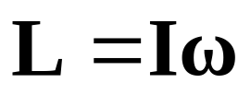
Other Angular Equivalents
Force F vs. torque τ
Velocity v vs. angular velocity ω
Position x vs. orientation R
Mass m vs. moments of inertia I
Momentum P vs. angular momentum L

Slide 34
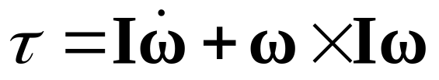
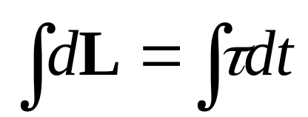
Why L?
Normally integrate to get vel from accel.
Not easy to pull angular acceleration from torque equation:
Instead, compute ang. momentum by integrating torque

Slide 35
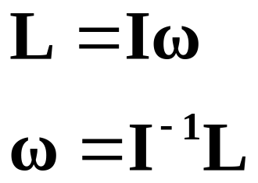
Why L?
Then compute ang. velocity from momentum
Since then

Slide 36
Moments of Inertia
Moments of inertia are 3 x 3 matrix, not single scalar factor (unlike m)
Many factors because rotation depends on shape
Describe how object rotates around various axes
Not always easy to compute
Change as object changes orientation

Slide 37
Computing I
Can use moments of inertia for closest box or cylinder
Can use sphere (one factor: 2mr²/5)
Or, can just consider rotations around one axis and fake(!) the rest
With the bottom two you end up with just one value… can simplify equations

Slide 38
Computing I
Alternatively, can compute based on geometry
Assume constant density, constant mass at each vertex
Solid integral across shape
See Mirtich,Eberly for more details

Slide 39
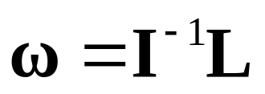
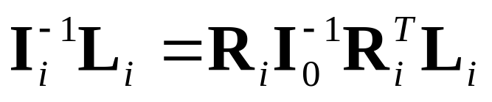

Using I in World Space
Remember,
I computed in local space, must transform to world space
If using rotation matrix R, use formula
If using quaternion, convert to matrix

Slide 40
Computing New Orientation
Have matrix R and vector ω
How to integrate?
Convert ω to give change in R
  Change to linear velocity at tips of basis vectors
  One for each basis gives 3x3 matrix
  Can use Euler's method after that

Slide 41
Computing New Orientation
Example:

Slide 42
Computing New Orientation
ω × r gives linear velocity at r
Could do this for each basis vector
Better way:
  Use symmetric skew matrix to compute cross products
  Multiply by orientation matrix

Slide 43
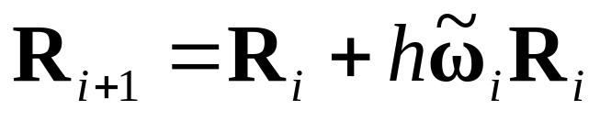
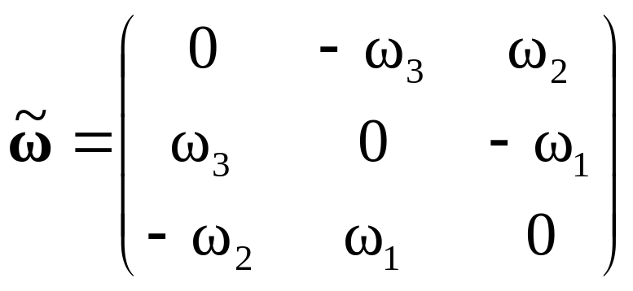
Computing New Orientation
If have matrix R, then
where

Slide 44
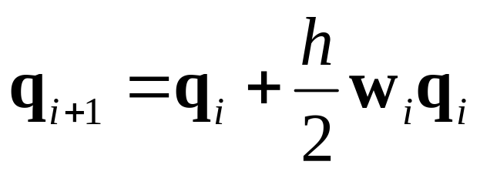
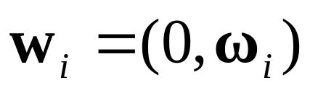
Computing New Orientation
If have quaternion q, then
See Baraff or Eberly for derivation
where

Slide 45

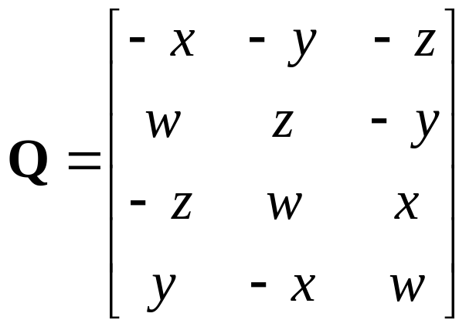
Computing New Orientation
We can represent wq as matrix multiplication where
Assumes q = (w, x, y, z)

Slide 46
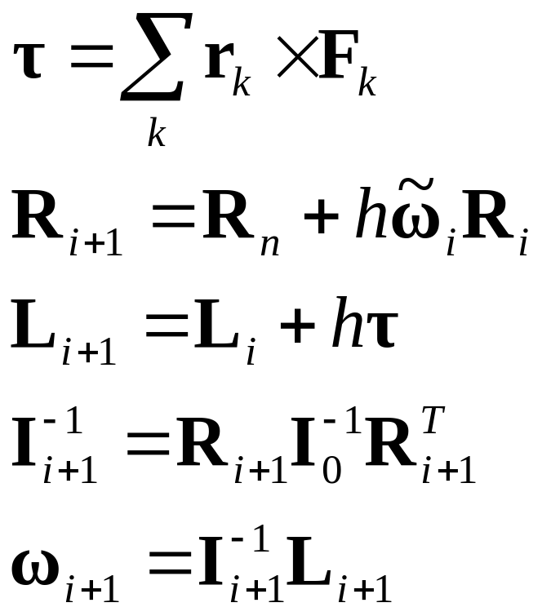
Angular Formulas

Slide 47
Summary
Basic Newtonian dynamics
  Position, velocity, force, momentum
Integration techniques
  Euler’s, RK* methods, implicit, Verlet
Linear simulation
  Force -> acceleration -> velocity -> position
Rotational simulation
  Torque -> ang. mom. -> ang. vel. -> orientation

Slide 48
What Next?
Robustness ( Christer )
Collision detection ( Squirrel, Gino )
Collision response ( Erin )
Constraints ( Erin, Marq )
Destruction ( Marq )
Inverse kinematics
Animation blending

Slide 49
References
Burden, Richard L. and J. Douglas Faires, Numerical Analysis, PWS Publishing Company, Boston, MA, 1993.
Hecker, Chris, “Behind the Screen,” Game Developer, Miller Freeman, San Francisco, Dec. 1996-Jun. 1997.
Witken, Andrew, David Baraff, Michael Kass, SIGGRAPH Course Notes, Physically Based Modelling, SIGGRAPH 2002.
Eberly, David, Game Physics, Morgan Kaufmann, 2003.

