Slide 1

Run free with the monads!
@KenScambler

Slide 2
Setup
$ git clone git@github.com:kenbot/free-yowlj.git
$ ./sbt
> test

Slide 3
Motivation
Separate concerns
Separate declaration from interpretation
Write a program as a declarative script, and interpret it later

Slide 4
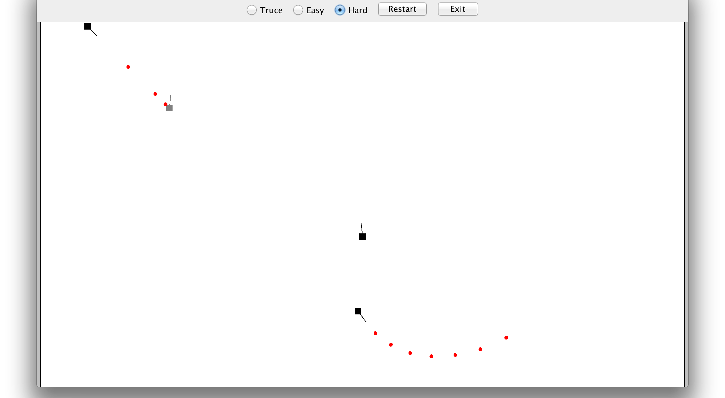
Tank game

Slide 5
Tank AI script using free monads
def regularAI() = for {
enemy <- findNearestTank
angle <- angleTo(enemy)
_ <- aimTowards(angle)
_ <- fire
} yield ()

Slide 6
The class called “Free”
Free is a data structure
Tree of computations
Free[F[_], A]

Slide 7
The class called “Free”
Free is a data structure
Tree of computations
Free[F[_], A]

Slide 8
The class called “Free”
Free[F[_], A]
Suspend(F[Free[F,A]])
Return(A)

Slide 9
The class called “Free”
Free[F[_], A]
Suspend(F[Free[F,A]])
Return(A)

Slide 10
The class called “Free”
Free[F[_], A]
Suspend(F[Free[F,A]])
Return(A)

Slide 11
Why “free monads”?
If F[_] is a functor, Free is a monad…… for free!
This buys us a whole world of existing functionality
Better abstraction
Sequential computations
Elegant imperative-style syntax

Slide 12

Remedial interlude

Slide 13
Functors
Functors are things you can map over
F[A] => (A => B) => F[B]
trait F[A] {
def map(f: A => B): F[B]
}

Slide 14
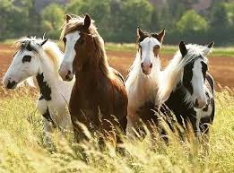
Functors
trait F[A] {
def map(f: A => B): F[B]
}

Slide 15
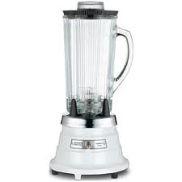
Functors
trait F[A] {
def map(f: A => B): F[B]
}

Slide 16

Functors
trait F[A] {
def map(f: A => B): F[B]
}

Slide 17
Monads
Monads have a flatMap method that allows you to chain computations together sequentially
class M[A] {
def map(f: A => B): M[B]
def flatMap(f: A => M[B]): M[B]
}

Slide 18
Monads
Nesting flatmaps allows sequential actions, ignoring the specific context!
nbaTeams.flatMap { team =>
team.players.flatMap { player =>
player.gamesPlayed.map { game =>
BasketballCard(team, player, game)
}
}
}

Slide 19
Monads
Neat comprehension syntax in Scala and Haskell
Makes it look like a regular program
for {
team <- nbaTeams
player <- team.players
game <- player.gamesPlayed
}
yield BasketballCard(team, player, game)

Slide 20
Back to our regularly scheduled program…

Slide 21
“Free objects” in maths
Important concept in maths!
Many free structures in Category Theory
Free Monoids, Free Monads, Free Categories, Free Groups, etc
It only counts as “free” if the free thing gets generated in the simplest possible way

Slide 22
Free Blargles from Fraxblatts
A Fraxblatt is said to generate a Free Blargle if:
The Blargle doesn’t contain anything not directly produced from a Fraxblatt
The Blargle doesn’t contain anything beyond what it needs to be a Blargle

Slide 23

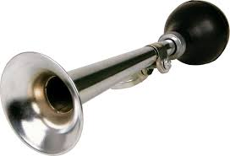
Free Blargles from Fraxblatts
A Fraxblatt is said to generate a Free Blargle if:
NO JUNK
NO NOISE

Slide 24
Exercise 1a
Implement flatMap and map for Return
case class Return[F[_], A](a: A) extends Free[F, A] {
def flatMap(f: A => Free[F, B]): Free[F, B] = ???
def map(f: A => B): Free[F, B] = ???
}

Slide 25
Exercise 1a: Answers
case class Return[F[_], A](a: A) extends Free[F, A] {
def flatMap(f: A => Free[F, B]): Free[F, B] = f(a)
def map(f: A => B): Free[F, B] = Return(f(a))
}

Slide 26
Exercise 1b
Implement flatMap and map for Suspend
case class Suspend[F[_], A](next: F[Free[F,A]])
extends Free[F, A] {
def flatMap(f: A => Free[F, B]): Free[F, B] = ???
def map(f: A => B): Free[F, B] = ???
}

Slide 27
Exercise 1b: answers
We need to map over the functor
case class Suspend[F[_], A](next: F[Free[F,A]])
extends Free[F, A] {
def flatMap(f: A => Free[F, B]): Free[F, B] =
F??? map ???
def map(f: A => B): Free[F, B] = ???
}
F[???]

Slide 28
Exercise 1b: answers
“next” is the only F we have lying around
case class Suspend[F[_], A](next: F[Free[F,A]])
extends Free[F, A] {
def flatMap(f: A => Free[F, B]): Free[F, B] =
next map {free => ???}
def map(f: A => B): Free[F, B] = ???
}
F[Free[F, ???]]

Slide 29
Exercise 1b: answers
flatMap is almost the only thing we can do to a Free
case class Suspend[F[_], A](next: F[Free[F,A]])
extends Free[F, A] {
def flatMap(f: A => Free[F, B]): Free[F, B] =
next map {free => free.flatMap(???)}
def map(f: A => B): Free[F, B] = ???
}
F[Free[F, ???]]

Slide 30
Exercise 1b: answers
Mapping function f will turn our As into Free[F, B]s
case class Suspend[F[_], A](next: F[Free[F,A]])
extends Free[F, A] {
def flatMap(f: A => Free[F, B]): Free[F, B] =
next map {free => free.flatMap(f)}
def map(f: A => B): Free[F, B] = ???
}
F[Free[F, B]]

Slide 31
Exercise 1b: answers
Wrapping in Suspend matches the type signature!
case class Suspend[F[_], A](next: F[Free[F,A]])
extends Free[F, A] {
def flatMap(f: A => Free[F, B]): Free[F, B] =
Suspend(next map {free => free.flatMap(f)})
def map(f: A => B): Free[F, B] = ???
}
Free[F, B]

Slide 32
Exercise 1b: answers
Cleaning up the syntax a bit…
case class Suspend[F[_], A](next: F[Free[F,A]])
extends Free[F, A] {
def flatMap(f: A => Free[F, B]): Free[F, B] =
Suspend(next map (_ flatMap f))
def map(f: A => B): Free[F, B] =
Suspend(next map (_ map f))
}

Slide 33
Stepping through flatMap
Let’s plug in a really simple functor and see what happens.
case class Box[A](a: A)

Slide 34

Stepping through flatMap
Let’s plug in a really simple functor and see what happens.
case class Box[A](a: A) {
def map[B](f: A => B) = Box(f(a))
}

Slide 35
banana

Slide 36
Return(banana)

Slide 37
Box(Return(banana))

Slide 38
Suspend(Box(Return(banana)))

Slide 39
that.flatMap(banana =>
Return(banana.peel))
flatMap

Slide 40
that.flatMap(banana =>
Return(banana.peel))
map

Slide 41
that.flatMap(banana =>
Return(banana.peel))
flatMap

Slide 42

that.flatMap(banana =>
Return(banana.peel))

Slide 43
Exercise 1c: liftF
Let’s automate creating the Suspend cell!
F[A] => Free[F, A]
=>

Slide 44
More flatmapping
for {
a <- liftF( Box(1) )
b <- liftF( Box(2) )
c <- liftF( Box(3) )
} yield a + b + c

Slide 45
for {
a <- liftF( Box(1) )
b <- liftF( Box(2) )
c <- liftF( Box(3) )
} yield a + b + c
1

Slide 46
for {
a <- liftF( Box(1) )
b <- liftF( Box(2) )
c <- liftF( Box(3) )
} yield a + b + c
liftF
1

Slide 47
for {
a <- liftF( Box(1) )
b <- liftF( Box(2) )
c <- liftF( Box(3) )
} yield a + b + c
flatMap
1

Slide 48
for {
a <- liftF( Box(1) )
b <- liftF( Box(2) )
c <- liftF( Box(3) )
} yield a + b + c
map
1

Slide 49
for {
a <- liftF( Box(1) )
b <- liftF( Box(2) )
c <- liftF( Box(3) )
} yield a + b + c
1
flatMap

Slide 50
for {
a <- liftF( Box(1) )
b <- liftF( Box(2) )
c <- liftF( Box(3) )
} yield a + b + c
liftF
2

Slide 51
for {
a <- liftF( Box(1) )
b <- liftF( Box(2) )
c <- liftF( Box(3) )
} yield a + b + c
flatMap
2

Slide 52
for {
a <- liftF( Box(1) )
b <- liftF( Box(2) )
c <- liftF( Box(3) )
} yield a + b + c
map
2

Slide 53
for {
a <- liftF( Box(1) )
b <- liftF( Box(2) )
c <- liftF( Box(3) )
} yield a + b + c
flatMap
2

Slide 54
for {
a <- liftF( Box(1) )
b <- liftF( Box(2) )
c <- liftF( Box(3) )
} yield a + b + c
liftF
3

Slide 55
for {
a <- liftF( Box(1) )
b <- liftF( Box(2) )
c <- liftF( Box(3) )
} yield a + b + c
flatMap
3

Slide 56
for {
a <- liftF( Box(1) )
b <- liftF( Box(2) )
c <- liftF( Box(3) )
} yield a + b + c
map
3

Slide 57
for {
a <- liftF( Box(1) )
b <- liftF( Box(2) )
c <- liftF( Box(3) )
} yield a + b + c
flatMap
3

Slide 58
for {
a <- liftF( Box(1) )
b <- liftF( Box(2) )
c <- liftF( Box(3) )
} yield a + b + c
6

Slide 59
Free[Box, A]
Chain of nothings, resulting in a single value
Not very useful!

Slide 60
Free[List, A]
for {
a <- liftF( List(1,2,3) )
b <- liftF( List(a,a*2) )
c <- liftF( Nil )
} yield a + b + c

Slide 61
for {
a <- liftF( List(1,2,3) )
b <- liftF( List(a,a*2) )
c <- liftF( Nil )
} yield a + b + c
1
2
3

Slide 62
for {
a <- liftF( List(1,2,3) )
b <- liftF( List(a,a*2) )
c <- liftF( Nil )
} yield a + b + c
1
2
3

Slide 63
for {
a <- liftF( List(1,2,3) )
b <- liftF( List(a,a*2) )
c <- liftF( Nil )
} yield a + b + c
flatMap
1
2
3

Slide 64
for {
a <- liftF( List(1,2,3) )
b <- liftF( List(a,a*2) )
c <- liftF( Nil )
} yield a + b + c
map
1
2
3

Slide 65
for {
a <- liftF( List(1,2,3) )
b <- liftF( List(a,a*2) )
c <- liftF( Nil )
} yield a + b + c
flatmap
1
2
3

Slide 66
for {
a <- liftF( List(1,2,3) )
b <- liftF( List(a,a*2) )
c <- liftF( Nil )
} yield a + b + c
3
6
2
4
1
2
liftF

Slide 67
for {
a <- liftF( List(1,2,3) )
b <- liftF( List(a,a*2) )
c <- liftF( Nil )
} yield a + b + c
3
6
2
4
1
2
flatMap

Slide 68
for {
a <- liftF( List(1,2,3) )
b <- liftF( List(a,a*2) )
c <- liftF( Nil )
} yield a + b + c
3
6
2
4
1
2
map

Slide 69
for {
a <- liftF( List(1,2,3) )
b <- liftF( List(a,a*2) )
c <- liftF( Nil )
} yield a + b + c
3
6
2
4
1
2
flatMap

Slide 70
for {
a <- liftF( List(1,2,3) )
b <- liftF( List(a,a*2) )
c <- liftF( Nil )
} yield a + b + c
liftF

Slide 71
for {
a <- liftF( List(1,2,3) )
b <- liftF( List(a,a*2) )
c <- liftF( Nil )
} yield a + b + c
flatMap

Slide 72
for {
a <- liftF( List(1,2,3) )
b <- liftF( List(a,a*2) )
c <- liftF( Nil )
} yield a + b + c
map

Slide 73
for {
a <- liftF( List(1,2,3) )
b <- liftF( List(a,a*2) )
c <- liftF( Nil )
} yield a + b + c
abort

Slide 74
Free[List,A]
Branching tree shape, with data at the leaves
Empty lists can terminate the tree, not just Return.
Again, not super useful.
The functor controls the branching factor!

Slide 75
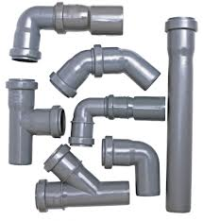
Funky functions
Functors are not just data structures that hold values
They are computations!
Free’s real power is unleashed when the Functor maps over functions!

Slide 76
Free[Function0, A]
No-arg functions, basically a lazy value
Flatmapping the free composes functions
Doesn’t actually run any code

Slide 77
Free[Function0, A]
for {
a <- liftF(() => 2 + 3)
b <- liftF(() => a * 2)
c <- liftF(() => a * b)
} yield a + b + c

Slide 78
for {
a <- liftF(() => 2 + 3)
b <- liftF(() => a * 2)
c <- liftF(() => a * b)
} yield a + b + c
=> 2 + 3

Slide 79
for {
a <- liftF(() => 2 + 3)
b <- liftF(() => a * 2)
c <- liftF(() => a * b)
} yield a + b + c
liftF
=>
2 + 3

Slide 80
for {
a <- liftF(() => 2 + 3)
b <- liftF(() => a * 2)
c <- liftF(() => a * b)
} yield a + b + c
=>
2 + 3
flatMap

Slide 81
for {
a <- liftF(() => 2 + 3)
b <- liftF(() => a * 2)
c <- liftF(() => a * b)
} yield a + b + c
map
=>
2 + 3

Slide 82
for {
a <- liftF(() => 2 + 3)
b <- liftF(() => a * 2)
c <- liftF(() => a * b)
} yield a + b + c
=>
2 + 3
=>
=>
compose

Slide 83
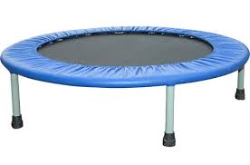
Trampolines

Slide 84
Trampolines
Believe it or not, Free[Function0,A] is incredibly useful!
Also known as Trampoline[A]
Moves tail calls onto the heap, avoiding stack overflows
The best we can get for mutual tail recursion on the JVM

Slide 85
Trampolines
Let’s take a look at some code…

Slide 86
Exercise 2: Trampolines
Write a Trampoline interpreter
Use trampolines to implement listAppend() without blowing the stack

Slide 87
Little languages
Small, imperative DSLs
Don’t directly do anything, can be interpreted many ways
Functionally pure and type-safe

Slide 88
Fantasy DSL
This is the high-level declarative code we wish we could write!
def aimToward(a: Angle): Unit
def fire(): Unit
def findNearestTank(): Entity
def angleTo(pos: Position): Angle

Slide 89
Monadized fantasy DSL
This is the high-level declarative code we CAN write!
type AI[+A] = Free[AIMove, A]
def aimToward(a: Angle): AI[Unit]
def fire(): AI[Unit]
def findNearestTank(): AI[Entity]
def angleTo(pos: Position): AI[Angle]

Slide 90
Step #1: ADT
sealed trait AIMove
case class AimToward(a: Angle)
extends AIMove
case class Fire
extends AIMove
case class FindNearestTank
extends AIMove
case class AngleTo(pos: Position)
extends AIMove

Slide 91
Step #2: Type holes
sealed trait AIMove[+Next]
case class AimToward[Next](a: Angle)
extends AIMove[Next]
case class Fire[Next]
extends AIMove[Next]
case class FindNearestTank[Next]
extends AIMove[Next]
case class AngleTo[Next](pos: Position)
extends AIMove[Next]

Slide 92
Step #3a: Continuation of statements
def aimToward(a: Angle): Unit
case class AimToward[Next]
(a: Angle, next: Next)
extends AI[Next]

Slide 93
Step #3a: Continuation of statements
def fire(): Unit
case class Fire[Next]
(next: Next) extends AI[Next]

Slide 94
Step #3b: Continuation of expressions
def findNearestTank(): Entity
case class FindNearestTank[Next]
(f: Entity => Next) extends AI[Next]

Slide 95
Step #3b: Continuation of expressions
def angleTo(pos: Position): Angle
case class AngleTo[Next]
(pos: Position, f: Angle => Next)
extends AI[Next]

Slide 96
Step #4: Make it a functor
sealed trait AIMove[+Next] {
def map[B](f: Next => B): AIMove[B] =
this match {
case AimToward(angle, next) =>
AimToward(angle, f(next))
case Fire(next) => Fire(f(next))
...
}
}

Slide 97
Step #4: Make it a functor
sealed trait AIMove[+Next] {
def map[B](f: Next => B): AIMove[B] =
this match {
case FindNearestTank(g) =>
FindNearestTank(f compose g)
case AngleTo[Next](pos, g) =>
AngleTo(pos, f compose g)
}
}

Slide 98
Step #5a: Lifting statements
import scalaz.Free.liftF
def aimToward(a: Angle): AI[Unit] =
liftF(AimToward(a, ()))
def fire(): AI[Unit] =
liftF(Fire(()))

Slide 99
Step #5b: Lifting expressions
import scalaz.Free.liftF
def findNearestTank(): AI[Entity] =
liftF(FindNearestTank(identity))
def angleTo(pos: Position):
AI[Angle] =
liftF(AngleTo(pos, identity))

Slide 100
Exercise 3: Key Value Store DSL

Slide 101
Exercise 4: Looping and if/else

