Slide 1
Lab 1: Data Lab - Manipulating Bits
Seonghak Kim and Daeyeon Kim
Architecture & Code optimization (ARC) Lab
September 14th, 2017

Slide 2
Overview
In this lab,
You will implement some simple functions
ex) byte swapping, negation, type conversion..
..by manipulating bits directly!
By finishing this lab successfully
You will become familiar with bit representations

Slide 3
Configuration
Linux environment required
ID and PW for Linux machines in software lab (302-311-1) provided
Same ID and PW can be used to access Linux server
Download and unzip datalab-handout.tar from eTL

Slide 4
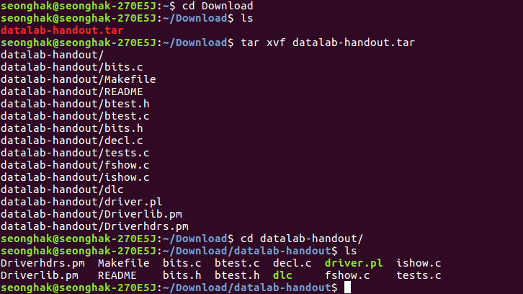
Configuration

Slide 5
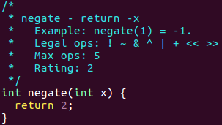
TODO
Fill in the functions of bits.c
Be careful : there are rules to follow
Kinds & Numbers of operators to use
Size of constants
Prohibition of using control structs
Problems on floating points also have own rules

Slide 6
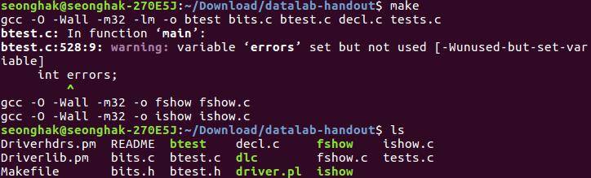
Helpers

Slide 7
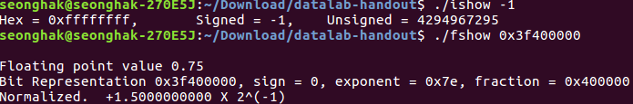
Helpers
./dlc
Check whether you followed the rules correctly
./btest
Test your functions for correctness
make btest to test your new bits.c code
./ishow & ./fshow
Given hex representation, show int/unsigned int/float value
Given int/unsigned int/float value, show hex representation

Slide 8
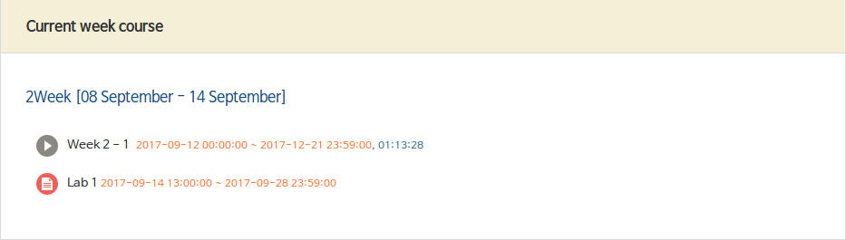
Submission
Submit bits.c on eTL
Due date: Sep 28 (Thu) 11:59 PM by eTL time stamp
Cut-off date: Oct 1 (Sun) 11:59 PM by eTL time stamp

Slide 9
Grading Policy
Different points per problem, from 1 to 4
41 points in total
Running ./btest will let you know your score
Late submission penalty
~ 24 hrs: -20% of maximum score
~ 48 hrs: -40% of maximum score
~ 72 hrs: -60% of maximum score
72 hrs ~: cut-off (no more submission)
Grace Days: no late penalties up to 3 days through this semester (applied to HW #1 through #5)
Plagiarism
0 for all assignments (worth of 35% of total grade!)
We may use a plagiarism detector program over your codes
OK to discuss ideas, but never share your codes in any form

Slide 10
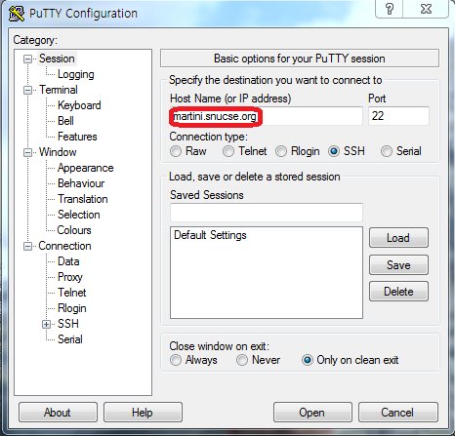
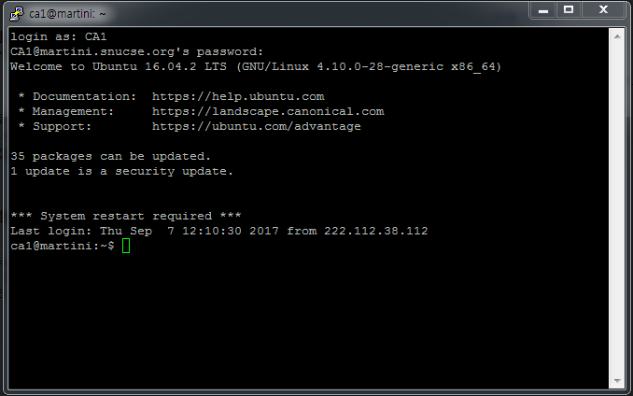
Usage of Server Accounts
Log-in computers in software lab
Register student cards and get to 302-311-1
States are saved for you
Access Linux server(Martini) remotely

Slide 11
Q&A

